Slide 1





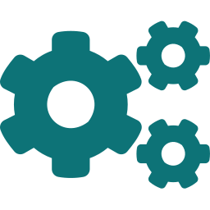

AI-POWERED CLOUD INFRASTRUCTURE
DEMO SCENARIO
IaC4 — From Intent
to Infrastructure.
“Build me a high-availability，complete 3-Tier Application Stack on Azure."
A multi-agent AI platform that turns natural language or Excel templates into production-ready Terraform code — with built-in compliance, auto-review, and one-click cloud deployment.
An engineer uploads a single Excel file defining a classic 3-tier app. Within seconds, IaC4 spins up 5 AI agents — gathering requirements, enforcing security policies, generating and reviewing a complete multi-file Terraform codebase, ready to deploy.
Multi-Agent Workflow 5 specialised AI agents collaborate — parse, validate, check, generate & review
01
02
03
AWS & Azure Dual-Cloud 21 enterprise Terraform modules covering VPC, VM, RDS, AKS, Storage and more
Converse & Generate
Validate & Harden
Deploy & Iterate
Security Shift-Left Compliance engine blocks risky configs before a single line of code is written
Chat in plain language or upload Excel. Agents extract intent, fill in missing params, and render a full Terraform codebase in seconds.
Compliance agent scans for exposed ports, missing tags, and deprecated syntax — blocking issues before any code reaches the cloud.
One-click Plan previews blast radius. Apply pushes to Azure or AWS. Switch environments, scale resources — all from the browser.
Self-Correcting Code Actor-Critic loop auto-fixes deprecated syntax and version conflicts up to 3x
One-Click Deploy Built-in Terraform executor — Plan, Apply & Destroy straight from the browser
10×
Zero
100%
Watch the Demo → See the full workflow in action
Faster Code Delivery
Debug Hell
Compliance by Default
Accenture | IaC4 Platform Demo | Confidential

