Slide 1
Email Spam Detection System
Lucas Barros & Dann Astillero

Slide 2
Introduction
- Problem: Spam emails flood inboxes
- Goal: Build a detection system using HMM, Naive Bayes, and SVM
- Language: Python

Slide 3
Hidden Markov Model (HMM)
- Sequence model with hidden states
- Learns transitions from observed words

Slide 4
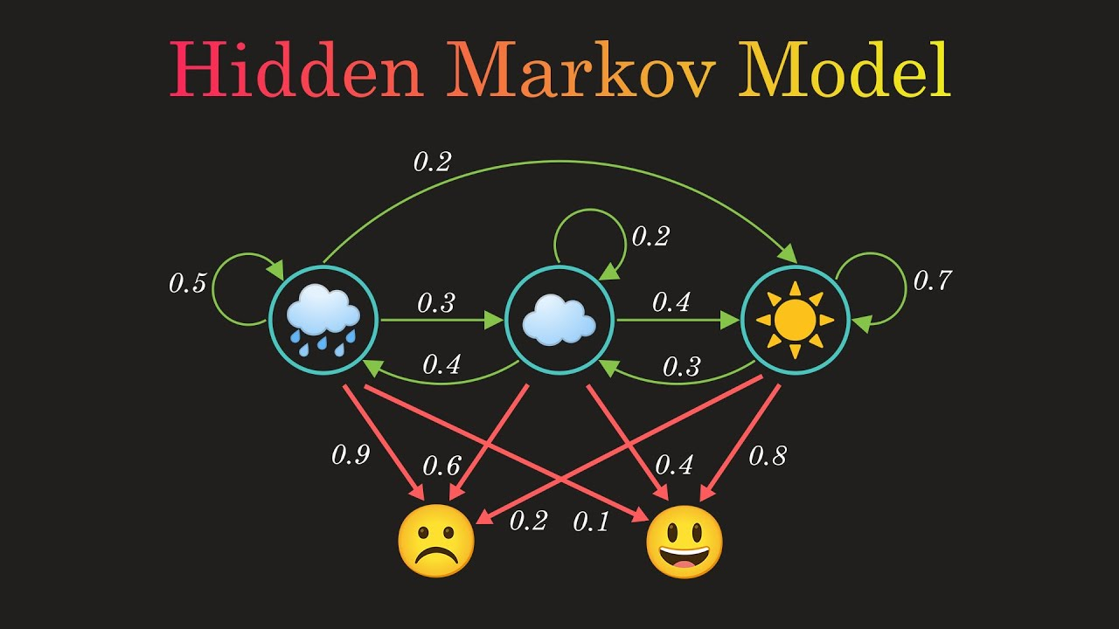

Slide 5
Naive Bayes
- Uses Bayes' Theorem
- Strong independence assumptions
- Effective for text classification

Slide 6
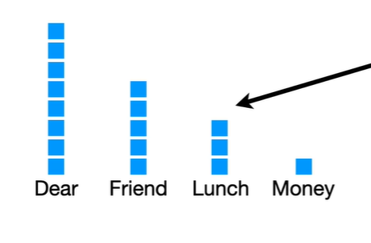

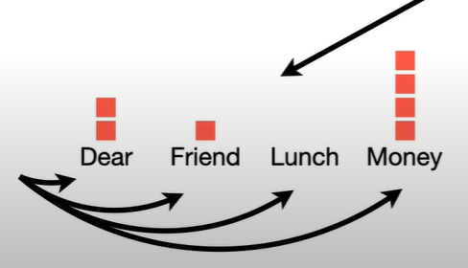

Slide 7
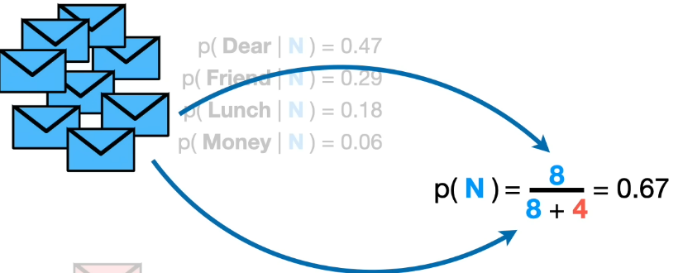
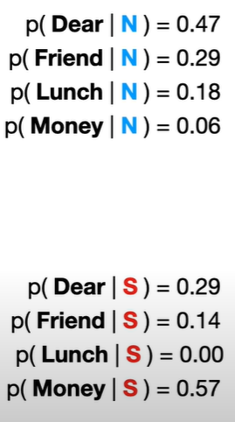
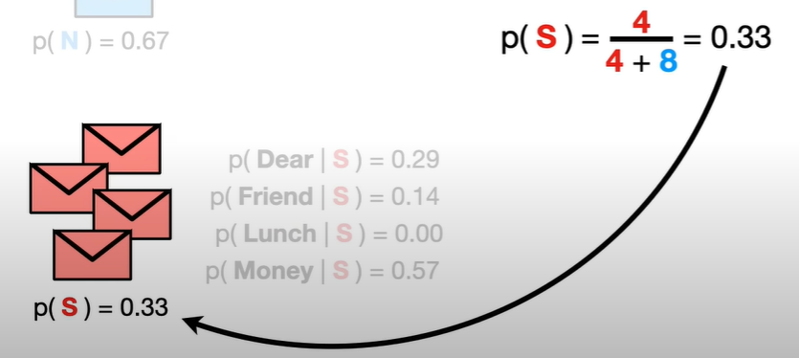

Slide 8





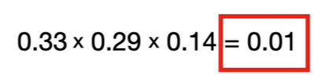
Dear Friend

Slide 9
Support Vector Machine (SVM)
- Finds optimal hyperplane
- Effective in high-dimensional space

Slide 10
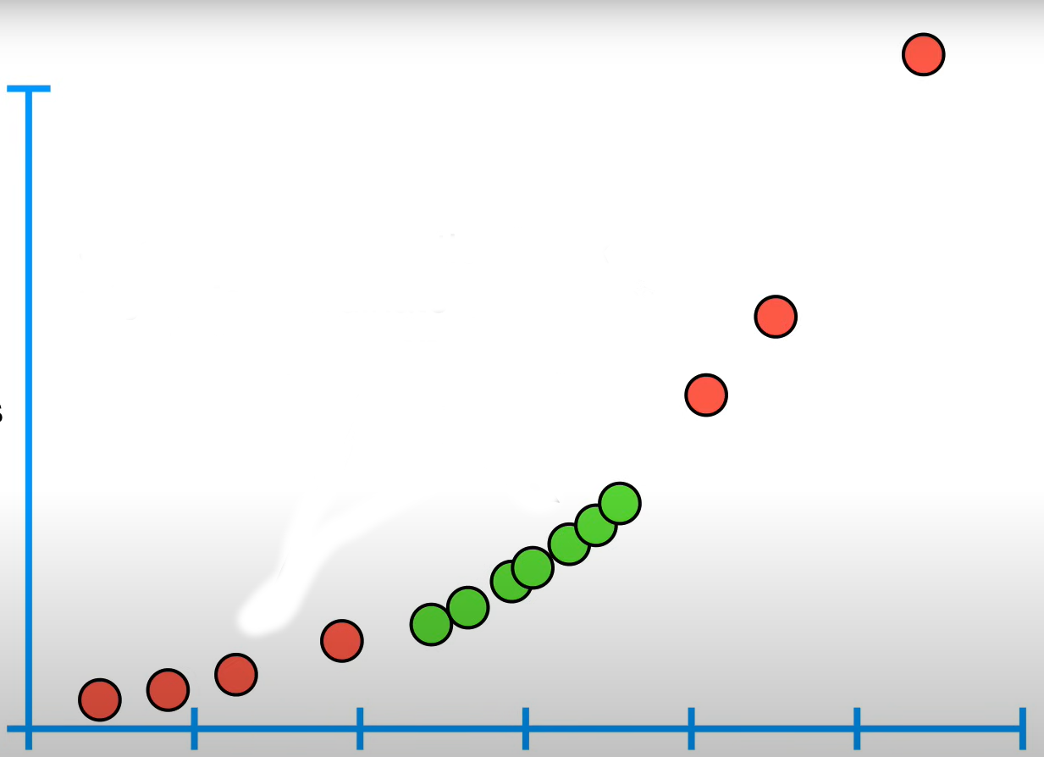
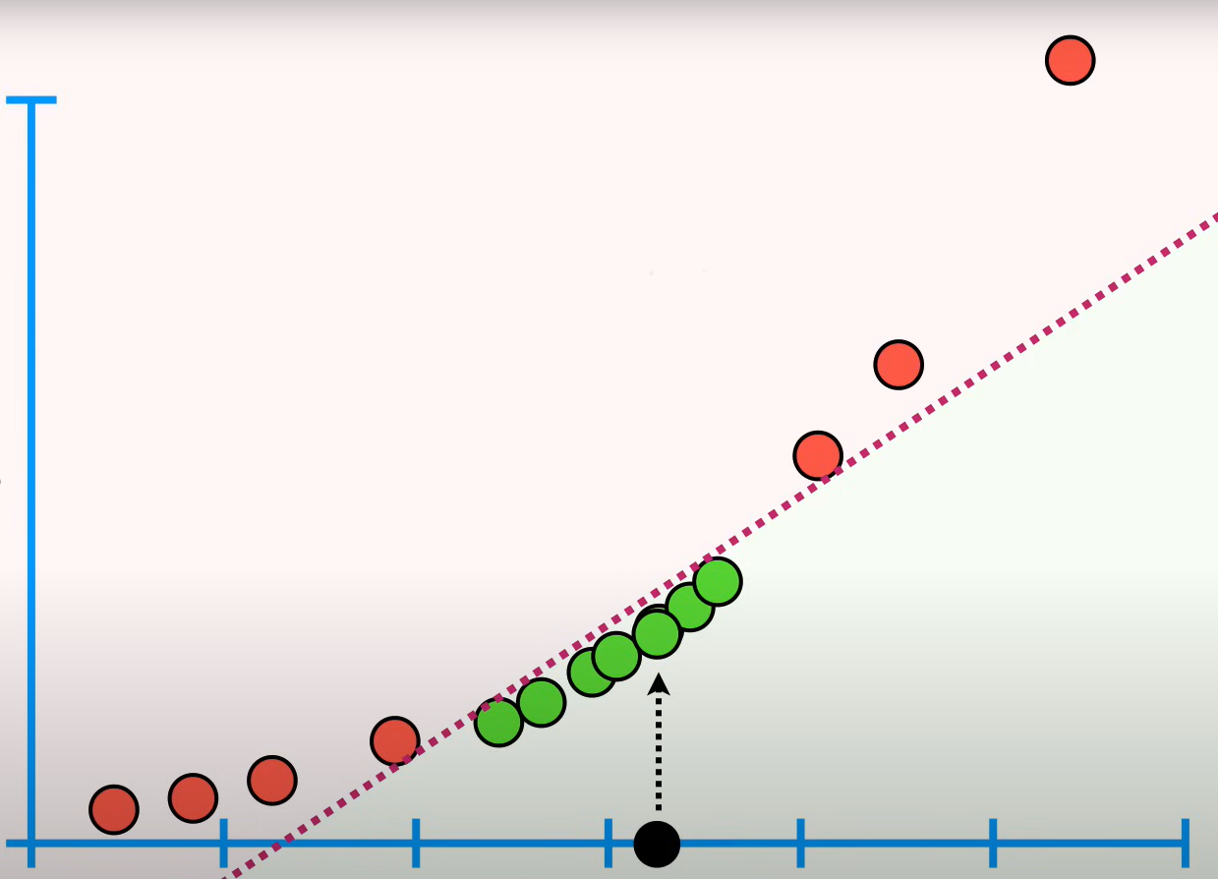
1- Dimension
2- Dimension (y = x²)
Line classifier

Slide 11
Implementation in Python (1/3)
- Preprocessing:
- Load dataset
- Clean & tokenize text
- Convert to TF-IDF

Slide 12
Implementation in Python (2/3)
- Train Models:
- HMM: Model sequences
- Naive Bayes: MultinomialNB
- SVM: LinearSVC

Slide 13
Implementation in Python (3/3)
- Evaluation:
- Train/test split
- Accuracy, Precision, Recall, F1-score

Slide 14
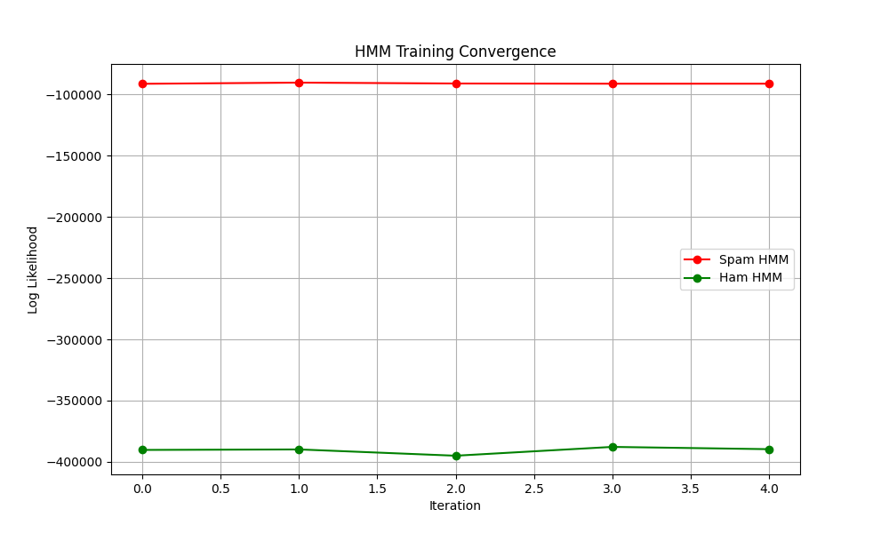

Slide 15
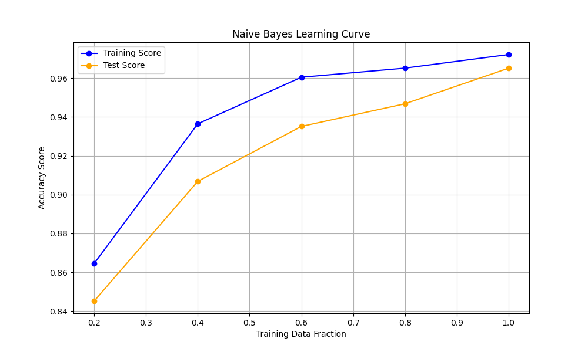

Slide 16
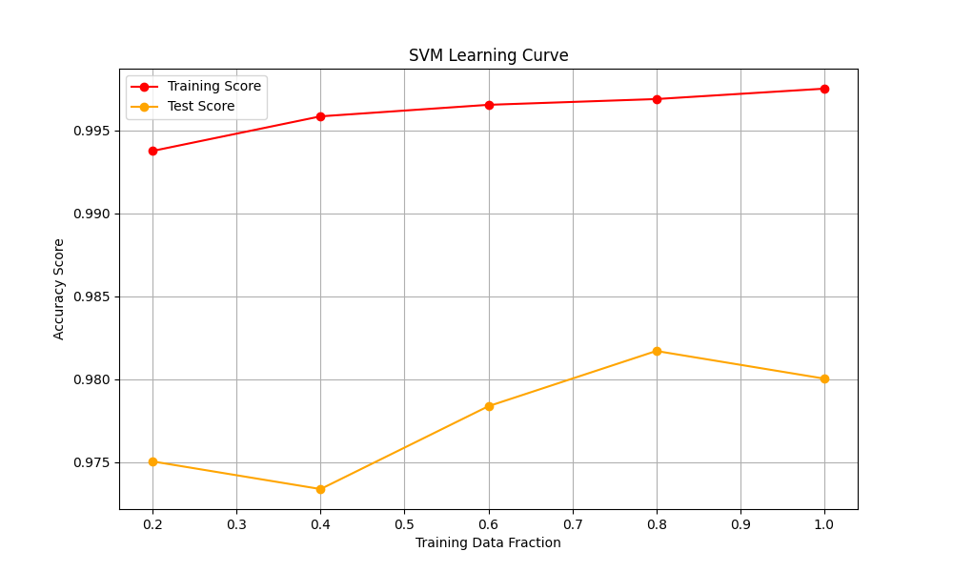

Slide 17
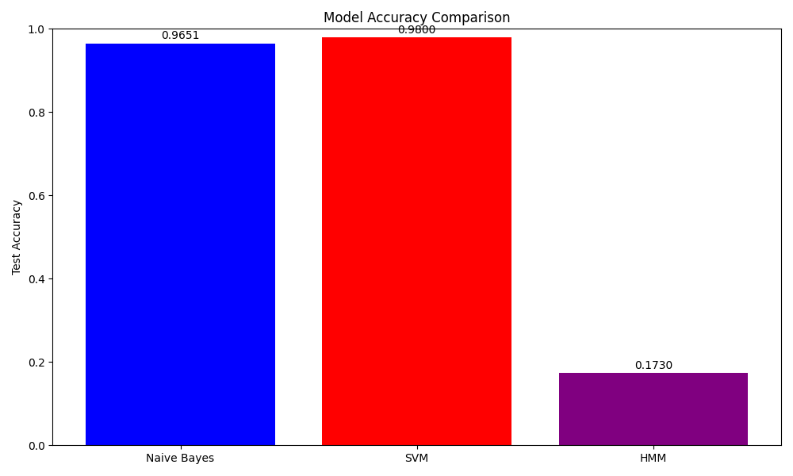

Slide 18
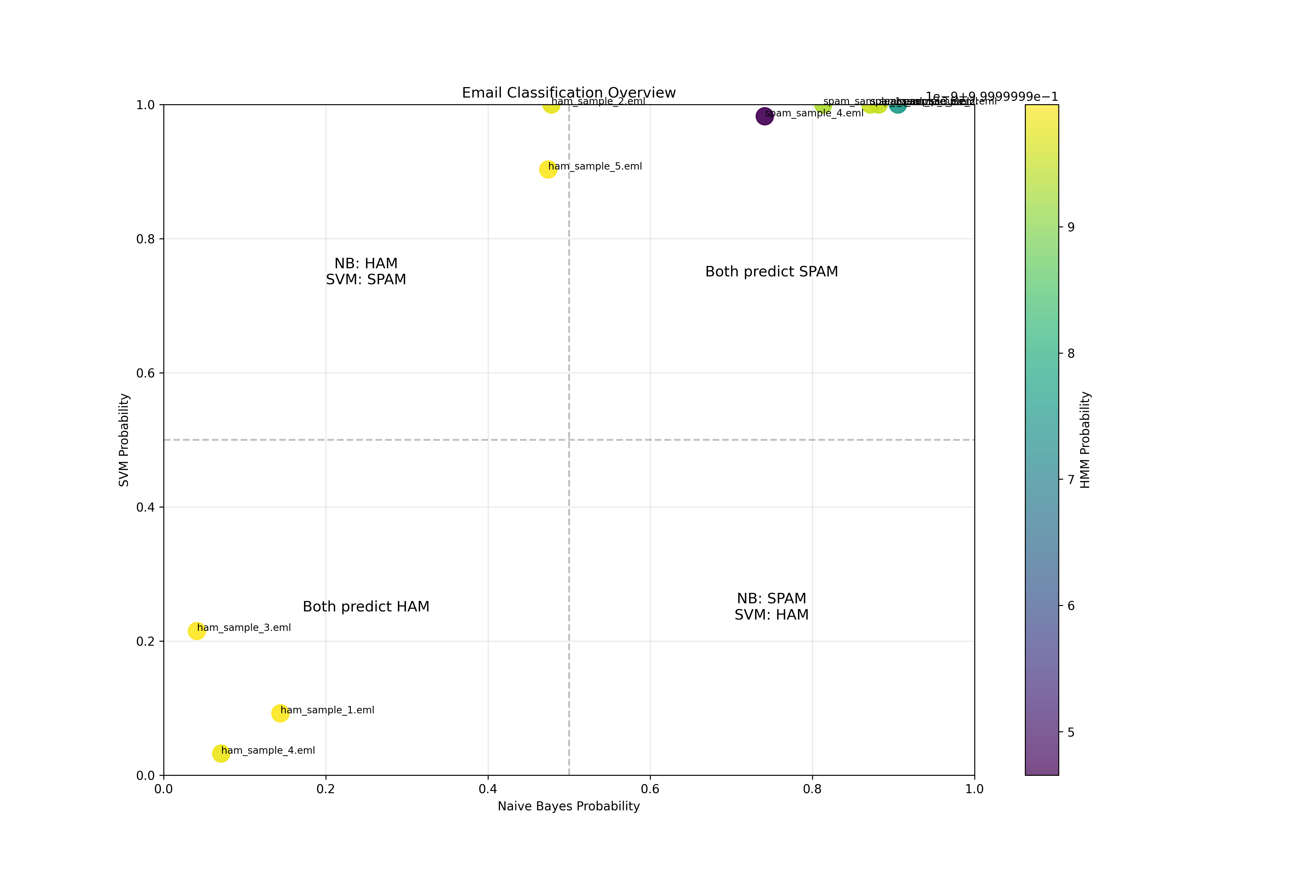

Slide 19
Demonstration: Code & Live Execution
- Walk through the code
- Train, predict, evaluate
- Discuss results

