Slide 2
Email Spam Detection System
Lucas Barros & Dann Astillero

Slide 3
Introduction
- Problem: Spam emails flood inboxes
- Goal: Build a detection system using HMM, Naive Bayes, and SVM
- Language: Python

Slide 4
Hidden Markov Model (HMM)
- Sequence model with hidden states
- Learns transitions from observed words

Slide 5
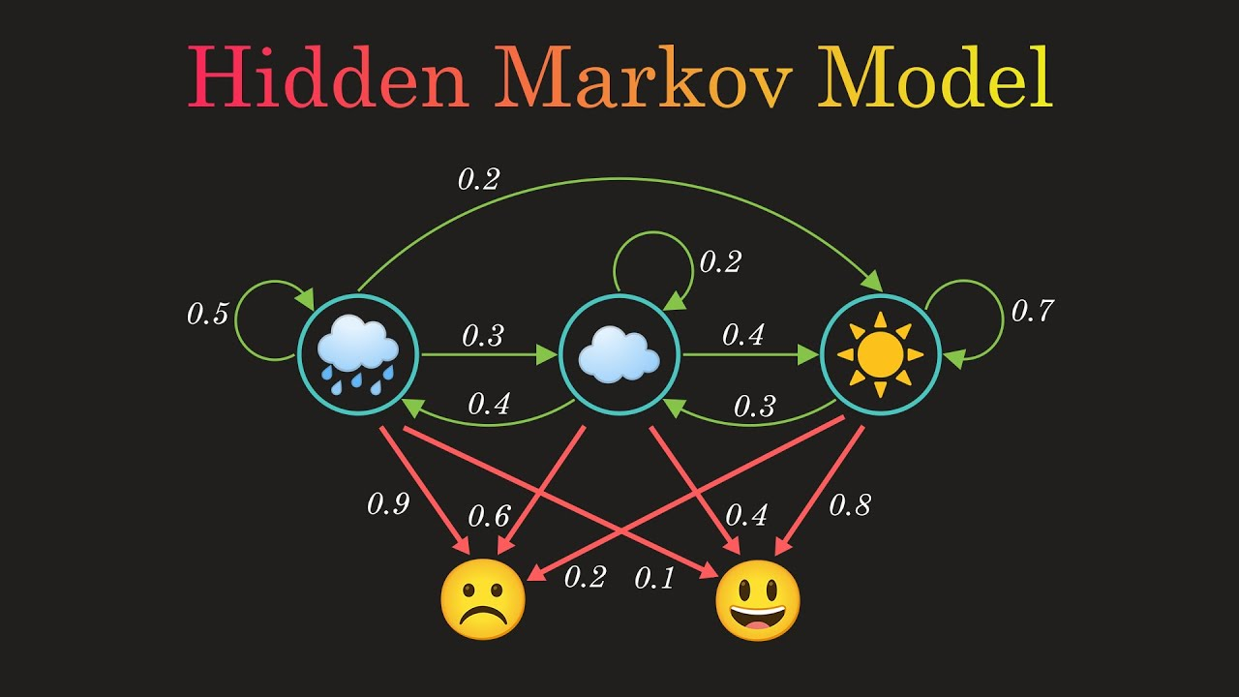

Slide 6
Naive Bayes
- Uses Bayes' Theorem
- Strong independence assumptions
- Effective for text classification

Slide 7
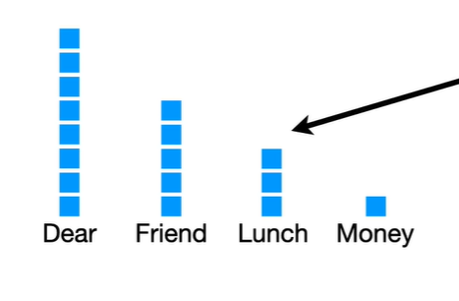

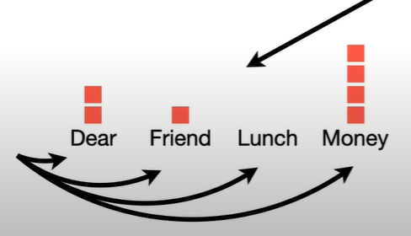

Slide 8
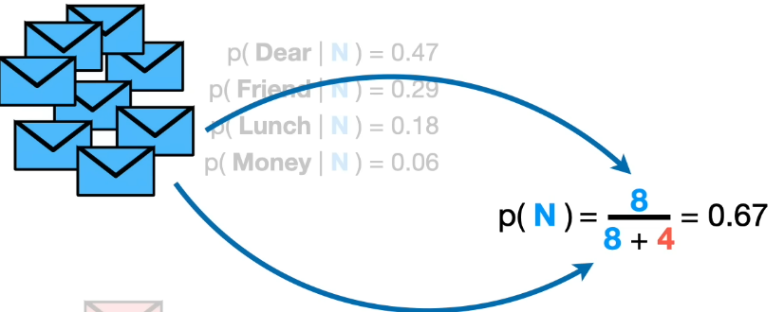
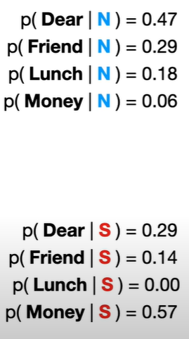
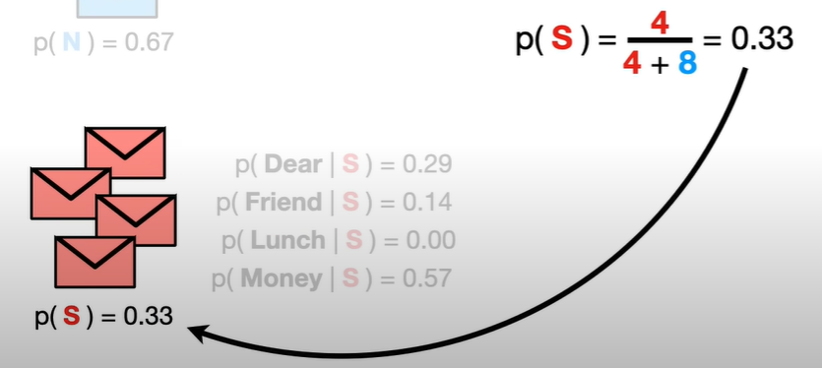

Slide 9





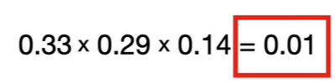
Dear Friend

Slide 10
Support Vector Machine (SVM)
- Finds optimal hyperplane
- Effective in high-dimensional space

Slide 11
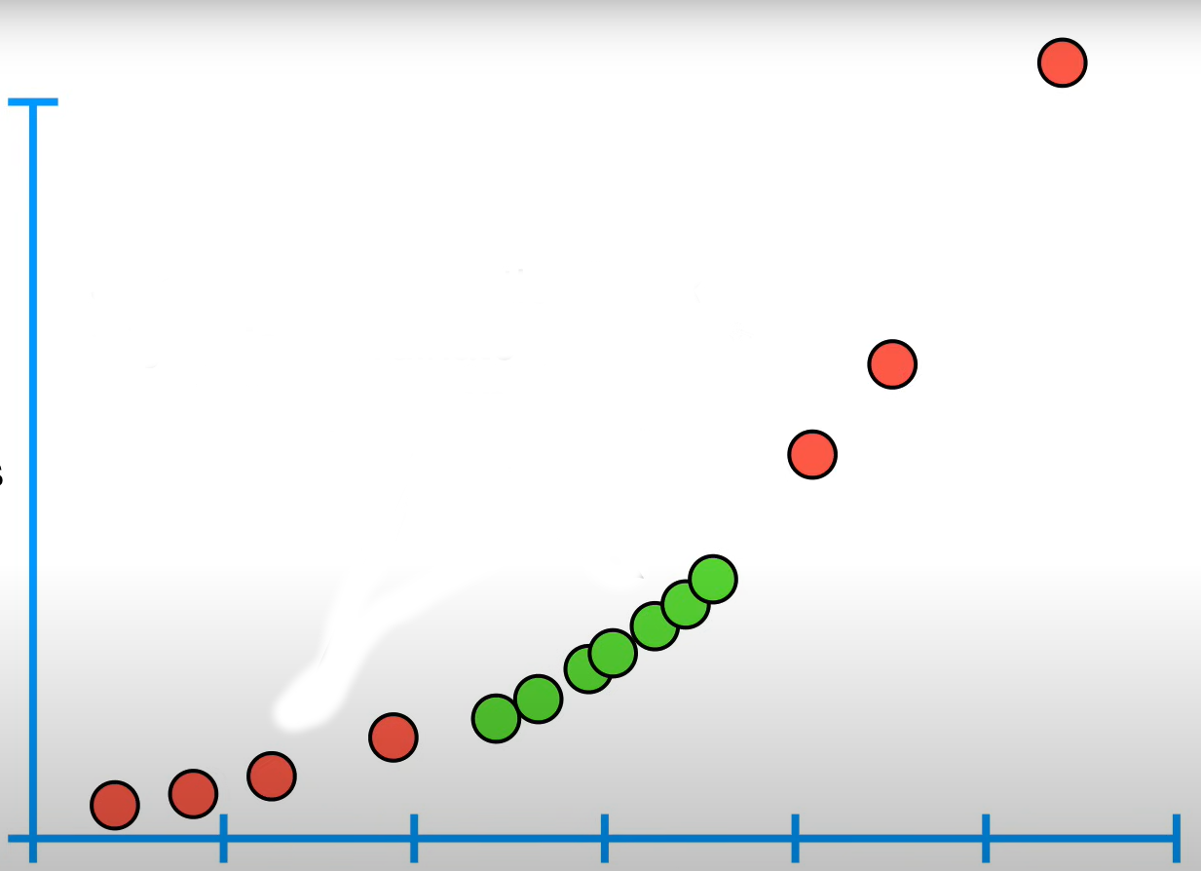
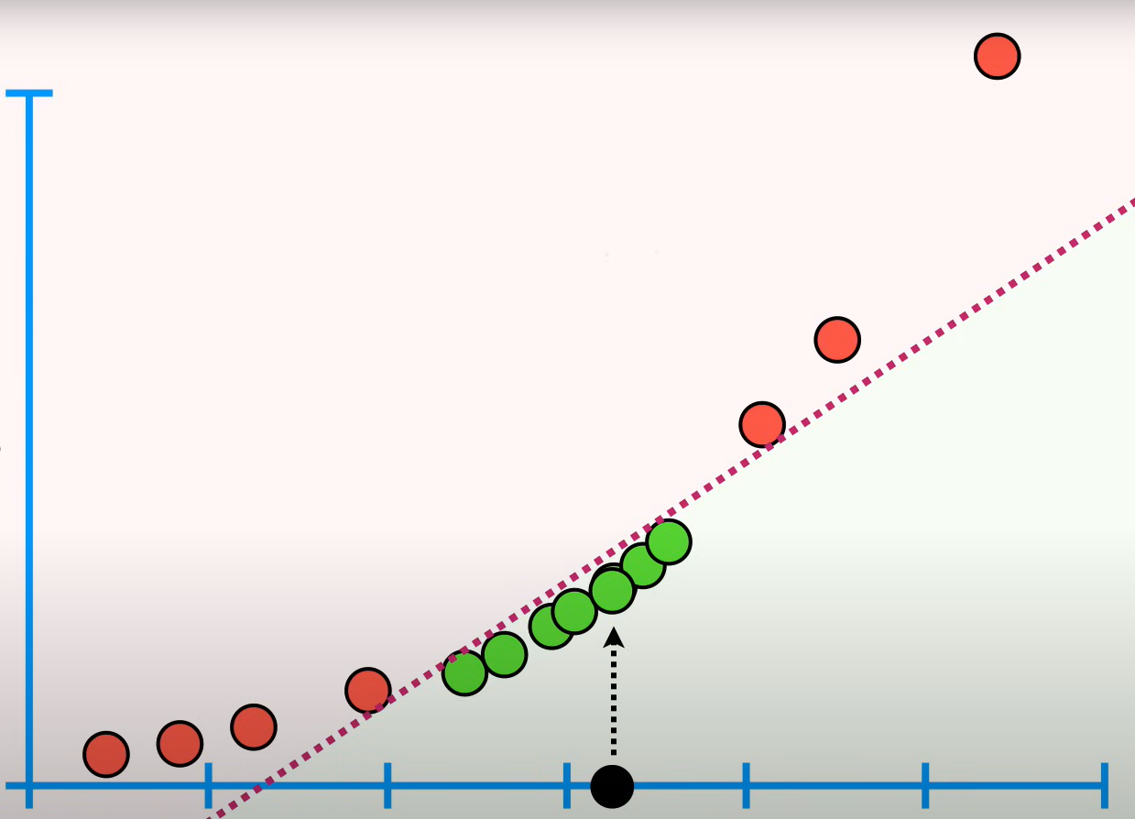
1- Dimension
2- Dimension (y = x²)
Line classifier

Slide 12
Implementation in Python (1/3)
- Preprocessing:
- Load dataset
- Clean & tokenize text
- Convert to TF-IDF

Slide 13
Implementation in Python (2/3)
- Train Models:
- HMM: Model sequences
- Naive Bayes: MultinomialNB
- SVM: LinearSVC

Slide 14
Implementation in Python (3/3)
- Evaluation:
- Train/test split
- Accuracy, Precision, Recall, F1-score

Slide 15
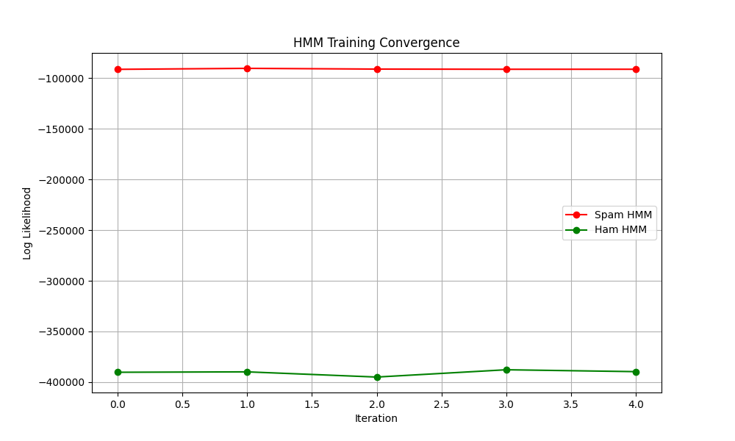
This shows the Hidden Markov Model training process tracking log-likelihood values over iterations. The two lines represent:
- Spam HMM (red): Converged around -80,000 log-likelihood
- Ham HMM (green): Converged around -390,000 log-likelihood

Slide 16
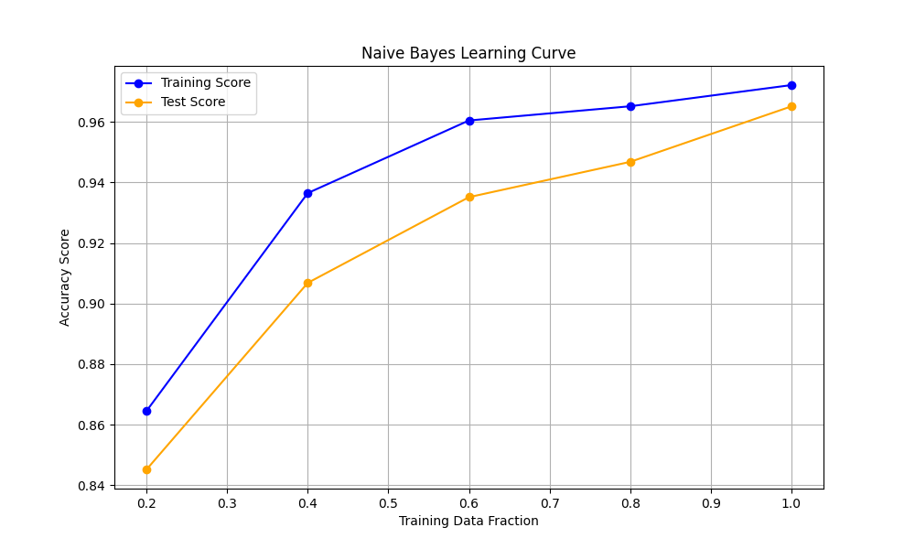
This demonstrates how Naive Bayes performance improves with more training data:
- Training Score (blue): Shows the model's accuracy on training data
- Test Score (orange): Shows accuracy on unseen test data
- Both curves rise from ~85% to ~96% accuracy as training data increases
- The gap between training and test scores narrows, indicating good generalization without overfitting

Slide 17
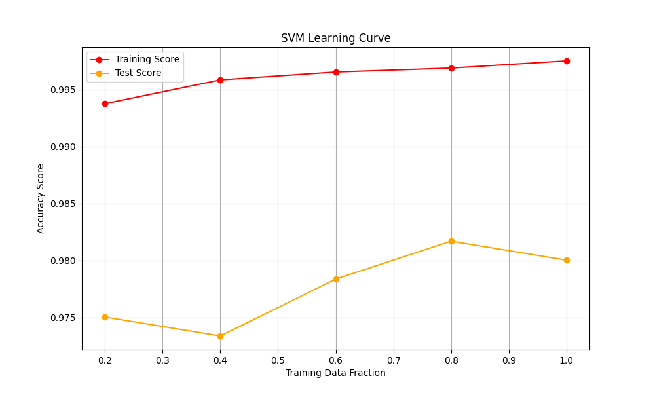
Similar to Naive Bayes, this shows SVM performance scaling:
- Training Score (red): Very high accuracy (~99.7%) across all data fractions
- Test Score (orange): Starts lower (~97.5%) but improves to ~98% with more data
- The small gap suggests SVM is performing well with minimal overfitting
- SVM achieves slightly higher accuracy than Naive Bayes

Slide 18
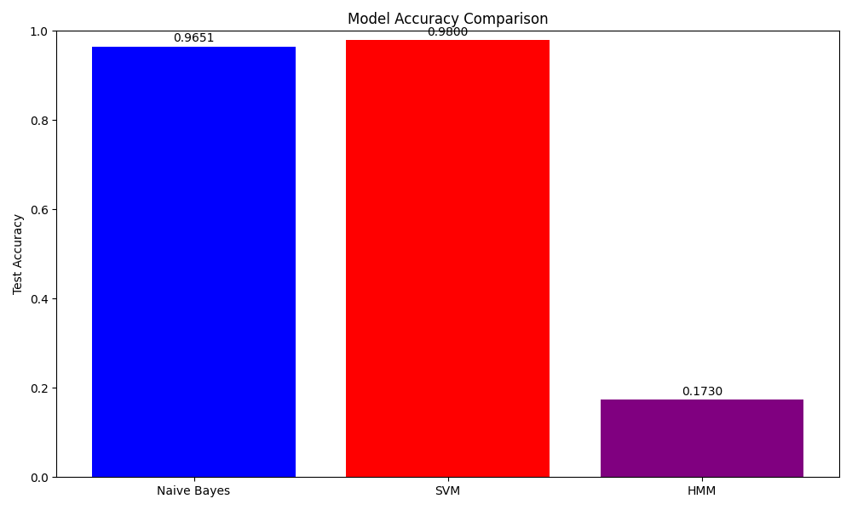
This bar chart compares final test accuracy of all three algorithms:
- Naive Bayes: 96.51% accuracy (blue)
- SVM: 98.00% accuracy (red) - best performer
- HMM: 17.30% accuracy (purple) - significantly underperforming
HMM isn't effectively discriminating between spam and ham emails, while SVM performs best overall

Slide 19
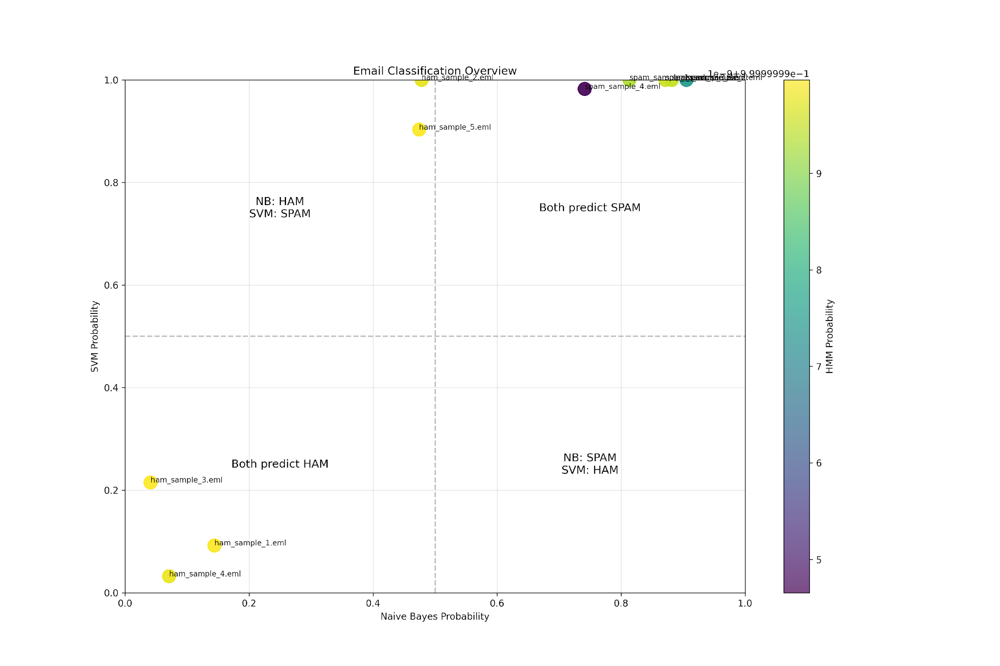
This core visualization shows how all three algorithms work together:
- X-axis: Naive Bayes probability (0 = ham, 1 = spam)
- Y-axis: SVM probability (0 = ham, 1 = spam)
- Color: HMM probability (yellow = high spam probability)
Four quadrants show agreement/disagreement:
- Bottom-left: Both NB and SVM predict HAM
- Top-right: Both NB and SVM predict SPAM
- Other quadrants: NB and SVM disagree
The plot shows HMM consistently gives high probabilities (all yellow), explaining its poor performance. Each dot represents a test email in different classification regions, directly fulfilling your requirement to visualize how all three algorithms interact.

Slide 20
Demonstration: Code & Live Execution
- Walk through the code
- Train, predict, evaluate
- Discuss results

