Slide 1



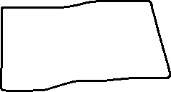
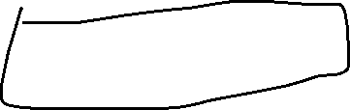

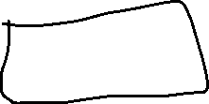

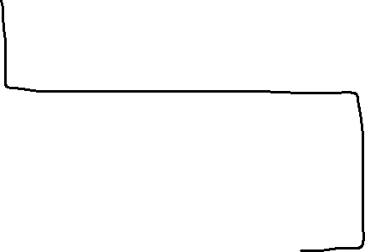
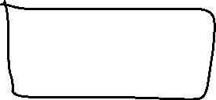
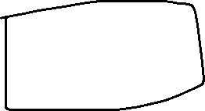


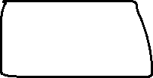




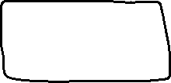

Intro
The official start of the game, has three directions.
Wolf
Player gets recaptured and is brought back to start.
Index
Click on the middle column top two rows to pull off hood and start the game.
Plaque
Bottom middle square brings player here. An excerpt of Ozymandias written in mirrored text.
Good
The shorter sinkhole, will lead to exit if player has more than one plank.
Statue
Statue points left (Bad), but as described in the poem, this is the wrong direction.
Bad
The longer of the two sinkholes, always leads to disaster.
Dead End
A dead end.

