Slide 1

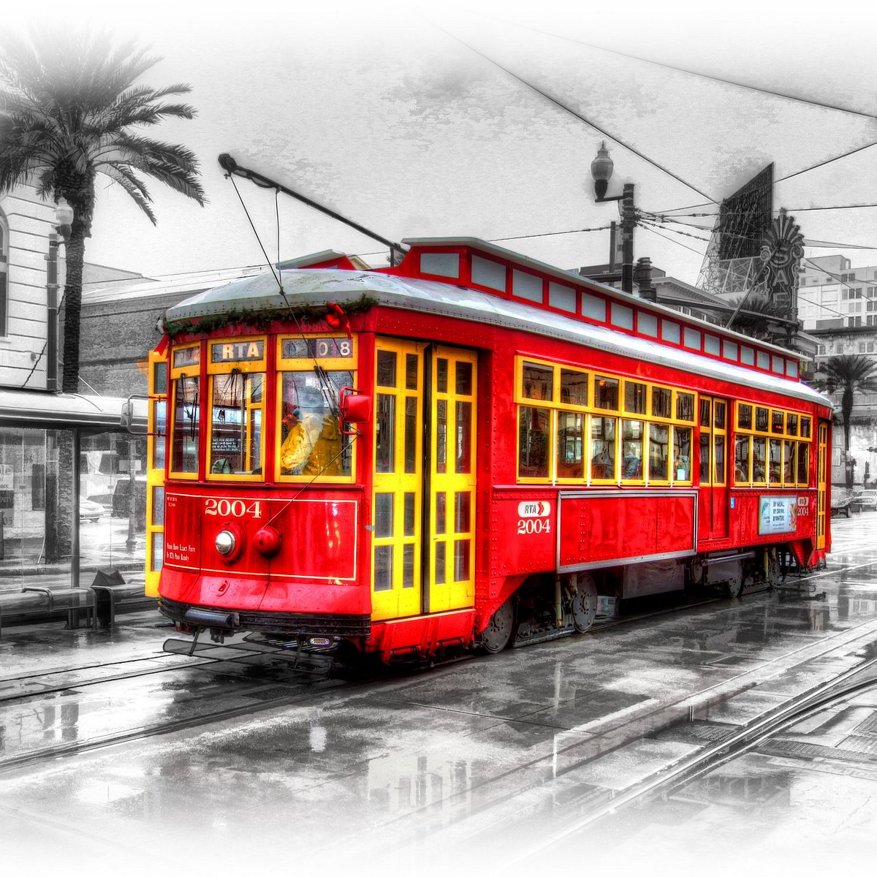
Let’s make a game about…
Named Desire.
By Daniel Nguyen (just me)

Slide 2
Why Games? 1. I like video games. 2. They’re approachable (for me) 3. Still looking for one.
I love video games!
Also, I didn’t REALLY understand any of the project suggestions.
But a couple of previously presented projects inspired me to try it with Unity.
Also, I thought text-based games (with user choices) would be simple enough to try to do for my first game.
Why a text heavy narrative game?
2. They’re approachable(for me)

Slide 3
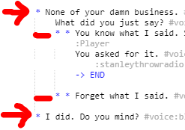

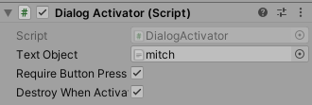
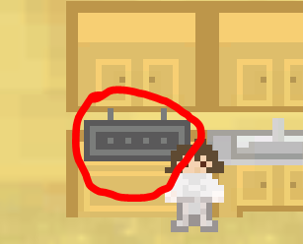

Enable Dialogue Panel and display current line and choices.
Handle tags. Includes timelines and audio.
Activate Script and Start (or Continue) reading ink file.
(Start Here)
Detect for Player input (Collider or Enter)

Slide 4
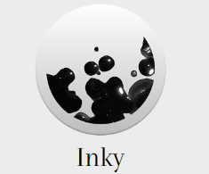
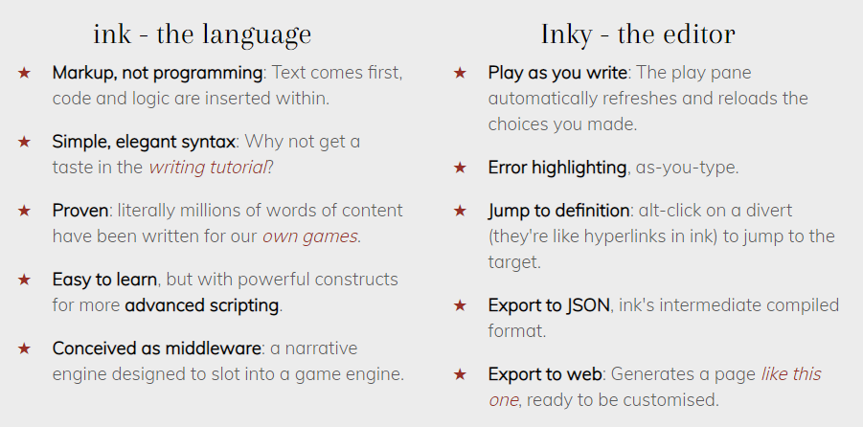





Slide 5

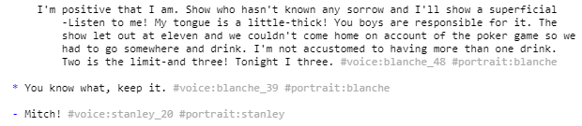
Choices and Gathers

Slide 6
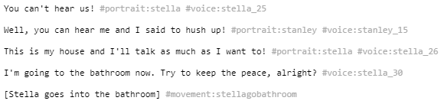
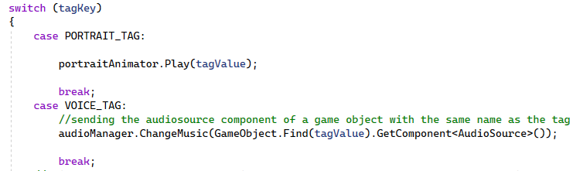
Handling Tags

Slide 7
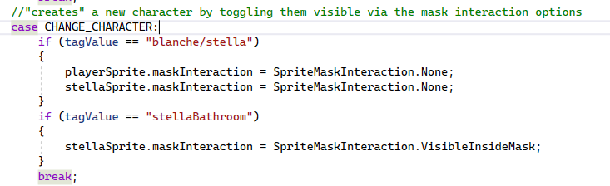
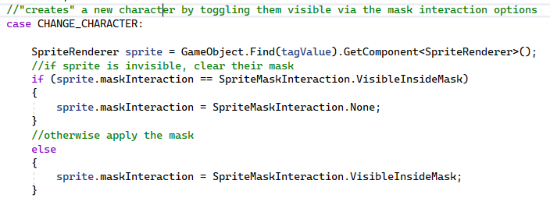
Final Thoughts

Slide 8
Anything wild this deal?
speaker:Steve voice:steve_1
portrait:steve
One-eyed jacks are wild.
speaker:Pablo voice:pablo_1
portrait:pablo
Give me two cards
speaker:Steve voice:steve_2
portrait:steve
What ‘bout you, Mitch?
speaker:Pablo voice:pablo_2
portrait:pablo
I’m out.
speaker:Mitch voice:mitch_1
portrait:mitch
One.
speaker:Pablo voice:pablo_3
portrait:pablo
Hey, does anyone want a shot?
speaker:Mitch voice:mitch_2
portrait:mitch
I gotta sick mother. She don’t go to sleep until I come home at night
speaker:Mitch voice:mitch_5
portrait:mitch
Shut up.
speaker:Stanley voice:stanley_3
portrait:stanley
I’m out again, I oughta go home pretty soon
speaker:Mitch voice:mitch_4
portrait:mitch
Kind of on your high horse, ain’t ya?
speaker:Mitch voice:mitch_3
portrait:mitch
When I'm losing you want to eat! Ante up! Ante up! Openers? Openers? Get y'r hands off the table, Mitch. Nothing belongs on a poker table but cards, chips, and whiskey.
speaker:Stanley voice:stanley_2
portrait:stanley
Why don’t somebody go to the Chinaman’s and bring back a load of chop suey?
speaker:Pablo voice:pablo_4
portrait:pablo
Yeah. Me.
speaker:Stanley voice:stanley_1
portrait:stanley
Aw, for the sake of Jesus, go home, then!
speaker:Stanley voice:stanley_4
portrait:stanley
What’ve you got?
speaker:Pablo voice:pablo_5
portrait:pablo
Spade flush
speaker:Stanley voice:stanley_5
portrait:stanley
You all are married. But I’ll be alone when she goes– I’m going to the bathroom.
speaker:Mitch voice:mitch_6
portrait:mitch
Hurry back and we’ll fix you a sugar-tit.
speaker:Stanley voice:stanley_6
portrait:stanley
This ole farmer is out th’owing corn to the chickens when all at once he hears a loud cackle and this young hen comes lickety split around the house with the rooster right behind her and gaining fast.
speaker:Steve voice:steve_3
portrait:steve
Dealing a hand
I feel so hot and frazzled. Wait till I powder before I come in. Do I look done in?
speaker:Blanche voice:blanche_2
portrait:blanche
Lovely, Blanche.
speaker:Stella voice:stella_2
portrait:stella
1.How do I look?
2.Why don’t we wait outside while the boys play their game.
3.Oh, is that poker I hear?
speaker:Blanche voice:blanche_1
portrait:blanche
blanche_6
blanche_7
The game is still going on.
speaker:Stella voice:stella_1
portrait:stella
But when the rooster catches sight of the farmer th’owing the corn he puts on the brakes and lets the hen get away and starts pecking corn. And the old farmer says, “Lord God, I hopes I never gits that hungry!”
speaker:Steve voice:steve_4
portrait:steve
Deal!
speaker:Stanley voice:stanley_7
portrait:stanley
Stop dealing hand
Stella and Blanche enter
Why no. You are as fresh as a daisy.
speaker:Stella voice:stella_3
portrait:stella
The girls wait outside for about an hour before mitch starts towards them.
(exit 2)
Oh, a feisty one. Come here and pull a seat. Steve, deal her in.
speaker: Stanley
voice:stanley_12
portrait:stanley
exit 3
poker sequence
You could not. Why don’t you women go up and sit in the back.
speaker:Stanley voice:stanley_11
portrait:stanley
(exit 1)
One that’s been picked a few days.
speaker:Blanche voice:blanche_3
portrait:blanche
Well, well, well. I see you boys are still at it!
speaker:Stella voice:stella_4
portrait:stella
Where you been?
speaker:Stanley voice:stanley_9
portrait:stanley
Blanche and I took in a show. Blanche, this is Mr. Gonzales and Mr. Hubbell.
speaker:Stella voice:stella_5
portrait:stella
How much longer is this game going to continue?
speaker:Stella voice:stella_6
portrait:stella
Till we get ready to quit.
speaker:Stanley voice:stanley_10
portrait:stanley
1.Poker is so fascinating. Could I kibitz?
2.Cut your crap. I want you out now.
speaker:Blanche blanche:blanche_4
portrait:blanche
blanche_5

Slide 9
Exit 1 (Main)
Because it is nearly two-thirty.
Couldn’t you call it quits after one more hand?
speaker:Stella voice:stella_7
portrait:stella
You could not. Why don’t you women go up and sit in the back.
speaker:Stanley voice:stanley_11
portrait:stanley
I think I will bathe.
speaker:Blanche voice:blanche_8
portrait:blanche
Again?
speaker:Stella voice:stella_8
portrait:stella
My nerves are in knots. Is the bathroom occupied?
speaker:Blanchevoice:blanche_9
portrait:blanche
I don’t know.
speaker:Stella voice:stella_9
portrait:stella
Blanche knocks
voice:knock
About the same, thanks. She appreciated your sending over that custard. –Excuse me, please.
speaker:Mitch voice:mitch_9
portrait:mitch
How is your mother now, Mitch?
speaker:Stella voice:stella_11
portrait:stella
How do you do, Miss DuBois?
speaker:Mitch voice:mitch_8
portrait:mitch
Blanche, this is Harold Mitchell. My sister, Blanche Dubois.
speaker:Stella voice:stella_10
portrait:stella
Hello.
speaker:Mitch voice:mitch_7
portrait:mitch
Oh!—good evening.
speaker:Blanchevoice:blanche_10
portrait:blanche
Mitch opens door
voice:door
1.That one seems superior to the others.
2.I thought he had a sort of sensitive look.
3.Is he married?
speaker:Blanche voice:blanche_11
portrait:blanche
voice:blanche_12
voice:blanche_13
Yes, quite so
speaker:Stella voice:stella_15
portrait:stella
Is that something much?
speaker:Blanchevoice:blanche_18
portrait:blanche
No. Stanley’s the only one of his crowd likely to get anywhere.
speaker:Stella voice:stella_19
portrait:stella
1.What makes you think Stanley will?
2.Really? ‘Cus he don’t look too sharp to me.
speaker:Blanchevoice:blanche_19
portrait:blanche
voice:blanche_20
No.
speaker:Stella voice:stella_12
portrait:stella
His mother is sick.
speaker:Stella voice:stella_14
portrait:stella
You would have to ask him about that.
speaker:Stella voice:stella_17
portrait:stella
He’s on the precision bench in the spare parts department at the plant Stanley travels for.
speaker:Stella voice:stella_18
portrait:stella
Just look at him. Will ya.
speaker:Stella voice:stella_21
portrait:stella
relation:stella_negativeone
Look at him.
speaker:Stella voice:stella_20
portrait:stella
.Is he a wolf?
speaker:Blanche voice:blanche_14
portrait:blanche
Why, Blanche!
speaker:Stella voice:stella_13
portrait:stella
.[Blanche laughs.]
speaker:Blanche voice:blanche_16
portrait:blanche
I don’t think he would be.
speaker:Stella voice:stella_16
portrait:stella
.1.What does—what does he do?
2.What’s his mother like?
speaker:Blanche voice:blanche_15
portrait:blanche
voice:blanche_17
I’ve looked at him.
speaker:Blanchevoice:blanche_21
portrait:blanche
exit 1

Slide 10
Exit 1 (Main) Page 2
Then you should know
speaker:Stella voice:stella_22
portrait:stella
I’m sorry, but I haven’t noticed the stamp of genius even on Stanley’s forehead.
speaker:Blanche voice:blanche_22
portrait:blanche
It isn’t on his forehead and it isn’t genius.
speaker:Stella voice:stella_23
portrait:stella
Oh. Well, what is it, and where? I would like to know.
speaker:Blanche voice:blanche_23
portrait:blanche
It’s a drive that he has. You’re standing in the light, Blanche!
speaker:Stella voice:stella_27
portrait:stella
Oh, am I!
speaker:Blanche voice:blanche_24
portrait:blanche
You hens cut out that conversation in there
speaker:Stanley voice:stanley_13
portrait:stanley
Why you little--.
speaker:Stanley voice:stanley_14
portrait:stanley
1.How about you stop your playing first!
2.[Stay quiet]
speaker:Blanche voice:blanche_25
portrait:blanche
voice:blanche_26
exit 2
What did you just say.
speaker:Stanley voice:stanley_17
portrait:stanley
relation:stanley_negativeone
1.None of your damn business.
2.I did. Do you mind?
3.I did. Deal with it!
speaker:Blanche voice:blanche_27
portrait:blanche
voice:blanche_28
voice:blanche_29
Who turned that on in there?
speaker:Stanley voice:stanley_16
portrait:stanley
Stella goes into the bathroom. Player regains control till they speak to Mitch in the corner.
Other poker players are busy and will not speak.
1.Blanche turns on radio
2.Blanche has not turned on radio
This is my house and I’ll talk as much as I want to!
speaker:Stella voice:stella_26
portrait:stella
Well, you can hear me and I said to hush up!
speaker:Stanley voice:stanley_15
portrait:stanley
You can’t hear us.
speaker:Stella voice:stella_25
portrait:stella
relation:stella
1.You know what I said. Suck it.
2.Forget what I said.
speaker:Blanche voice:blanche_30
portrait:blanche
voice:blanche_31
exit 1
He was looking through them drapes. Now deal the hand over again and let’s play cards or quit. Some people get ants when they win.
speaker:Stanley voice:stanley_19
portrait:stanley
What was you doing, then?
speaker:Pablo voice:pablo_8
portrait:pablo
I wasn’t listenin’.
speaker:Mitch voice:mitch_10
portrait:mitch
Turn it off!
speaker:Stanley voice:stanley_18
portrait:stanley
Aw, let the girls have their music
speaker:Steve voice:steve_5
portrait:steve
Sure, that’s good, leave it on!
speaker:Pablo voice:pablo_6
portrait:pablo
Sounds like Xavier Cugat.
speaker:Steve voice:steve_6
portrait:steve
Stanley walks over to the radio and turns it off. Then returns to the table.
I didn’t hear you name it.
speaker:Steve voice:steve_7
portrait:steve
Didn’t I name it, Mitch?
speaker:Pablo voice:pablo_7
portrait:pablo

Slide 11
Exit 1 (Main) Page 3
I’m going to the “head”. Deal me out
speaker:Mitch voice:mitch_11
portrait:mitch
Sure he’s got ants now. Seven five-dollar bills in his pants pocket folded as tight as his spitballs.
speaker:Pablo voice:pablo_9
portrait:pablo
. Tomorrow you'll see him at the cashier's window getting them changed into quarters.
speaker:Steve voice:steve_8
portrait:steve
And when he goes home he’ll deposit them one by one in a piggy bank his mother give him for Christmas.
speaker:Stanley voice:stanley_21
portrait:stanley
Mitch walks toward blanche
Hello! The Little Boys’ Room is busy right now.
speaker:Blanche voice:blanche_32
portrait:blanche
We’ve—been drinking beer.
speaker:Mitch voice:mitch_12
portrait:mitch
Oh, good. What a pretty case. Silver?
speaker:Blanche voice:blanche_37
portrait:blanche
Luckies.
speaker:Mitch voice:mitch_14
portrait:mitch
What kind are they?
speaker:Blanche voice:blanche_36
portrait:blanche
Sure.
speaker:Mitch voice:mitch_13
portrait:mitch
Oh, I don’t think so; it always makes me warmer. Have you got any cigs?
speaker:Blanch voice:blanche_35
portrait:blanche
It’s—a hot weather drink.
speaker:Stanley voice:stanley_14
portrait:stanley
1.I don’t like beer. It’s coarse and rough and irritating and it gets everywhere.
2.I hate beer.
speaker:Blanche voice:blanche_33
portrait:blanche
voice:blanche_34
What did you just say.
speaker:Stanley voice:stanley_17
portrait:stanley
relation:stanley_negativeone
Yes. Yes; read the inscription.
speaker:Mitch voice:mitch_15
portrait:mitch
1.Oh, is there an inscription? I can’t make it out.
2.You know what, keep it.
speaker:Blanche voice:blanche_38
portrait:blanche
voice:blanche_39
She must have been fond of you. Sick people have such deep, sincere attachments.
speaker:Blanche voice:blanche_45
portrait:blanche
She knew she was dying when she give me this. A very strange girl, very sweet—very!
speaker:Mitch voice:mitch:20
portrait:mitch
Oh!
speaker:Blanche voice:blanche_44
portrait:blanche
The girl’s dead now.
speaker:Mitch voice:mitch:19
portrait:mitch
Oh?
speaker:Blanche voice:blanche_43
Portrait:blanche
Exit 1
exit 1
[Mitch strikes a match]
“And if God choose, I shall but love thee better—after—death!” Why, that’s from my favorite sonnet by Mrs. Browning!
speaker:Blanche voice:blanche_40
portrait:blanche
You know it?
Speaker:Mitch voice:mitch:16
portrait:mitch
Certainly I do!
speaker:Blanche voice:blanche_41
portrait:blanche
There’s a story connected with that inscription.
speaker:Mitch voice:mitch_17
portrait:mitch
It sounds like a romance.
speaker:Blanhce voice:blanche_42
portrait:blanche
A pretty sad one.
speaker:Mitch voice:mitch_18
portrait:mitch

Slide 12
Exit 1 (Main) Page 4
I’m positive that I am. Show who hasn’t known any sorrow and I’ll show a superficial—Listen to me! My tongue is a little-thick! You boys are responsible for it. The show let out at eleven and we couldn’t come home on account of the poker game so we had to go somewhere and drink. I’m not accustomed to having more than one drink. Two is the limit—and three!
[She laughs]
Tonight I had three
speaker:Blanche voice:blanche_48
Portrait:blanche
That’s right, they certainly do.
Speaker:Mitch voice:mitch:21
portrait:mitch
Sorrow makes for sincerity, I think.
speaker:Blanche voice:blanche_46
portrait:blanche
It sure brings it out in people.
speaker:Mitch voice:mitch_22
portrait:mitch
The little there is belongs to people who have experienced some sorrow.
speaker:Blanhce voice:blanche_47
portrait:blanche
I believe you are right about that.
speaker:Mitch voice:mitch_23
portrait:mitch
Mitch!
speaker:Stanley voice:stanley_20
portrait:stanley
It’s a French name. It means woods and Blanche means white, so the two together mean white woods. Like an orchard in spring! You can remember it by that.
speaker:Blanche voice:blanche_50
portrait:blanche
Miss DuBois?
speaker:Mitch voice:mitch:25
portrait:mitch
DuBois.
speaker:Blanche voice:blanche_49
portrait:blanche
Deal me out I’m talking to Miss--.
speaker:Mitch voice:mitch:_24
portrait:mitch
You are Stella’s sister, are you not?
speaker:Mitch voice:mitch_27
portrait:mitch
We are French by extraction. Our first American ancestors were French Huguenots.
speaker:Blanche voice:blanche_51
portrait:blanche
You’re French?
speaker:Mitch voice:mitch_26
portrait:mitch
exit 1
Yes, Stella is my precious little sister. I call her little in spite of the fact she’s somewhat older than I. Just slightly. Less than a year. Will you do something for me?
speaker:Blanche voice:blanche_52
portrait:blanche
Sure. What?
speaker:Mitch voice:mitch_28
portrait:mitch
I bought this adorable little colored paper lantern at a Chinese shop on Bourbon. Put it over the light bulb! Will you, please?
speaker:Blanche voice:blanche_53
portrait:blanche
Be glad to.
speaker:Mitch voice:mitch_29
portrait:mitch
I can’t stand a naked light bulb, any more than I can a rude remark or a vulgar action.
speaker:Blanhce voice:blanche_54
portrait:blanche
I guess we strike you as being a pretty rough bunch.
speaker:Mitch voice:mitch_30
portrait:mitch
I’m very adaptable—to circumstances.
speaker:Blanche voice:blanche_55
portrait:blanche
Married? No, no. I’m an old maid schoolteacher!
speaker:Blanche voice:blanche_57
portrait:blanche
You’re not--?
speaker:Mitch voice:mitch:32
portrait:mitch
Stella hasn’t been so well lately, and I came down to help her for a while. She’s very run down.
speaker:Blanche voice:blanche_56
portrait:blanche
Well, that’s a good thing to be. You are visiting Stanley and Stella?
speaker:Mitch voice:mitch:_31
portrait:mitch
So you are in the teaching profession?
speaker:Mitch voice:mitch_34
portrait:mitch
Thank you, sir! I appreciate your gallantry!
speaker:Blanche voice:blanche_58
portrait:blanche
You may teach school but you’re certainly not an old maid.
speaker:Mitch voice:mitch_33
portrait:mitch
exit 1
Yes. Ah, yes…
speaker:Blanche voice:blanche_59
portrait:blanche
Grade school or high school or--
speaker:Mitch voice:mitch_35
portrait:mitch
Mitch!
speaker:Stanley voice:stanley_21
portrait:stanley
Coming!
speaker:Mitch voice:mitch_36
portrait:mitch
Gracious, what lung-power!... I teach high school. In Laurel.
speaker:Blanhce voice:blanche_60
portrait:blanche
What do you teach? What subject?.
speaker:Mitch voice:mitch_37
portrait:mitch
Exit 1

Slide 13
Exit 1 (Main) Page 5
How very right you are! Their literary heritage is not what most of them treasure above all else! But they’re sweet things! And in the spring, it’s touching to notice them making their first discovery of love! As if nobody had ever known it before!
[The bathroom door opens and Stella comes out.]
Oh! Have you finished? Wait—I’ll turn on the radio.
speaker:Blanche voice:blanche_63
Portrait:blanche
[She turns the knobs on the radio and it begins to play "Wien, Wien, nur du allein." Blanche waltzes to the music with romantic gestures. Mitch is delighted and moves in awkward imitation]
[Stanley stalks fiercely through the portieres into the bedroom. He crosses to the small white
radio and snatches it off the table. With a shouted oath, he tosses the instrument out the window.]
Never arithmetic, sir, never arithmetic!.
[with a laugh]
I don’t even know my mutiplication tables! No, I have the misfortune of being an English instructor. I attempt to instill a bunch of bobby-soxers and drug-store Romeos with reverence for Hawthorne and Whitman and Poe!
speaker:Blanhce voice:blanche_62
portrait:blanche
Guess!.
speaker:Blanche voice:blanche_61
portrait:blanche
I bet you teach art or music?
[Blanche laughs delicately]
Of course I could be wrong. You might teach arithmetic.
speaker:Mitch voice:mitch_38
portrait:mitch
I guess that some of them are more interested in other things.
speaker:Mitch voice:mitch_39
portrait:mitch
You lay your hands on me and I’ll--[She backs out of sight to bathroom. Stanley follows. There is the sound of a blow. Stella cries out and Blanche screams and runs into the kitchen. The men rush forward]
speaker:Stella voice:stella_28
portrait:stella
[Stanley charges after Stella]
Take it easy, Stanley. Easy, fellow,--Let’s all--
speaker:Steve voice:steve_9
portrait:steve
Stella, watch, he’s--
speaker:Blanche voice:blanche_64
portrait:blanche
Drunk—drunk—animal thing, you!
[She rushes through to the poker table]
All of you—please go home! If any of you have one spark of decency in you—
speaker:Stella voice:stella:_31
portrait:stella
Get him in here, men.
[Stanley is forced into the bedroom]
speaker:Mitch voice:mitch_41
portrait:mitch
Lunacy, absolute lunacy!
speaker:Blanche voice:blanche_65
portrait:blanche
This is terrible.
speaker:Mitch voice:mitch_40
portrait:mitch
exit 1
I want to go away, I want to go away!
speaker:Stella voice:stella_29
Portrait:stella
Poker shouldn’t be played in a house with women.
speaker:Mitch voice:mitch_42
portrait:mitch
I want my sister’s clothes! We’ll go to that woman’s upstairs!
speaker:Blanche voice:blanche_66
portrait:blanche
They’re in the chest.
speaker:Mitch voice:mitch_43
portrait:mitch
Stella, Stella, precious! Dear, dear little sister, don’t be afraid!
[Blanches guides Stella to the front door]
speaker:Blanhce voice:blanche_67
portrait:blanche
What’s the matter; what’s happened?
speaker:Stanley voice:stanley_22
portrait:stanley
You just blew your top, Stan.
speaker:Mitch voice:mitch_44
portrait:mitch
I think some coffee would do him a world of good, now.
speaker:Pablo voice:pablo_10
portrait:pablo
Put him on the bed and get a wet towel.
speaker:Mitch voice:mitch:45
portrait:mitch
Sure, my boy’s okay!
speaker:Steve voice:steve_10
portrait:steve
He’s okay, now.
speaker:Pablo voice:pablo:_10
portrait:pablo
[water turns on]
Let go of me, you dogs!
speaker:Stanley voice:stanley_23
portrait:stanley
Put him under the shower!
[the boys go into bathroom with stanley]
speaker:Mitch voice:mitch_46
portrait:mitch
[thickly]
I want water.
speaker:Stanley voice:stanley_23
portrait:stanley
exit 1
Let’s get quick out of here!
[Steve and Pablo run out of the house while Mitch stands in corner]
speaker:Steve voice:steve_11
portrait:steve
Poker should not be played in a house with women.
speaker:Mitch voice:mitch_47
portrait:mitch
Exit 1

Slide 14
Demo Time! Hopefully coming to a Unity server near you! (once I’m done)

