Slide 1

Hackathon
with BASIS VECTORS
Basis Vectors
2025

Slide 2

Basis Vectors
2025
Interview AI: Automating Interview Scheduling
A Python-based Intelligent Scheduling Bot
Group Code : N
Group Number : 14
Team Members:
Jas Makhija – 12106971
Anuvind-12112273

Slide 3
Technologies Used
Basis Vectors
2025
Category | Tool/Framework | Purpose
Language | Python | Core programming language
Standard Libraries | datetime, re | Date/time handling, regex parsing
Third-Party Libs | dateutil, google-auth-oauthlib, googleapiclient, smtplib, email.mime.text, pytz, spacy | Parsing, authentication, API calls, email, timezones, NLP
API | Google Calendar API (v3) | Calendar operations, Google Meet links
AI/NLP Model | spaCy "en_core_web_sm" | Natural language parsing of input
Framework | OAuth 2.0 | Secure API authentication
Tools | Google Cloud Console, SMTP (Gmail) | API setup, email notifications
Config Files | credentials.json | OAuth 2.0 credentials

Slide 4
Key Functionality
Basis Vectors
DATE
Natural Language Parsing
Converts "Monday 2pm" to UTC datetime.
Availability Checking
Queries recruiter’s calendar for free slots (9 AM–4 PM IST).
Event Creation
Schedules Google Calendar events with Meet links and reminders with confirmation emails.
Time Zone Handling
IST → UTC conversion for API compatibility.

Slide 5
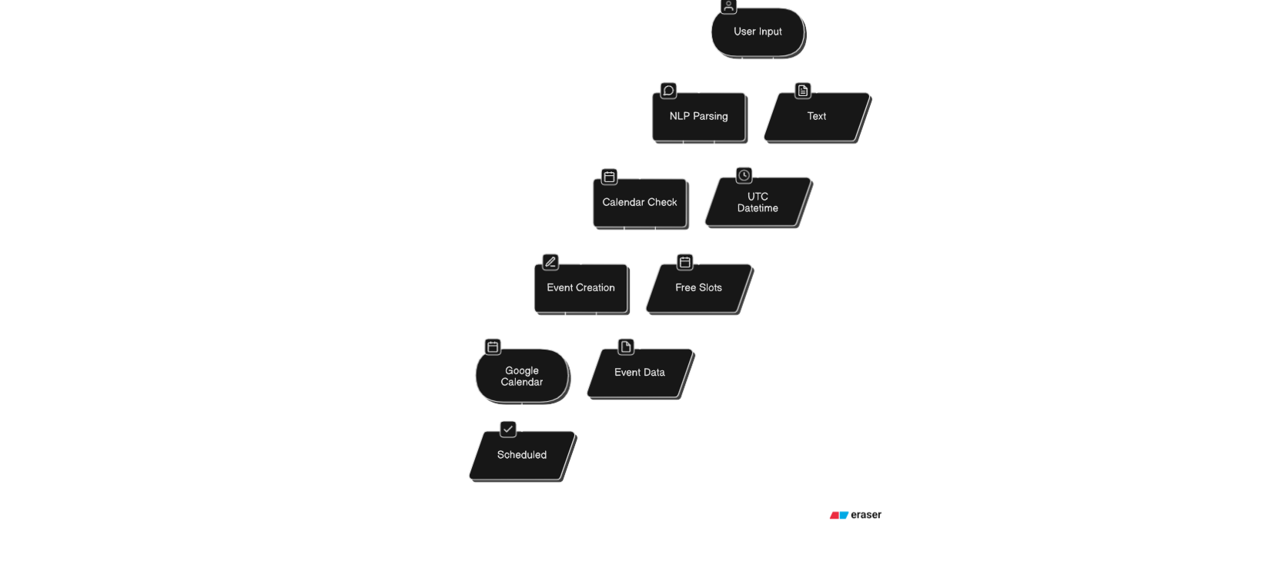
High level architecture
Basis Vectors
2025

Slide 6
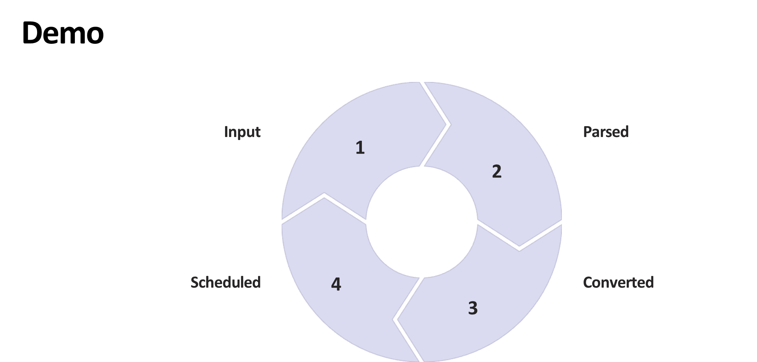
Basis Vectors
2025
" Monday 2pm"
2025-03-24 14:00 IST
Event with Meet link.
2025-03-24 08:30 UTC.

Slide 7

Basis Vectors
2025
Questions?

