Slide 1

Hackathon
with BASIS VECTORS
Basis Vectors
2025

Slide 2
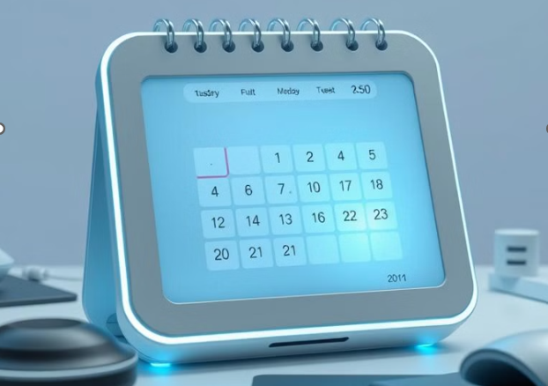
Basis Vectors
2025
Interview AI: Automating Interview Scheduling
A Python-based Intelligent Scheduling Bot
Group Code : N
Group Number : 14
Team Members:
Jas Makhija – 12106971
Anuvind-12112273

Slide 3
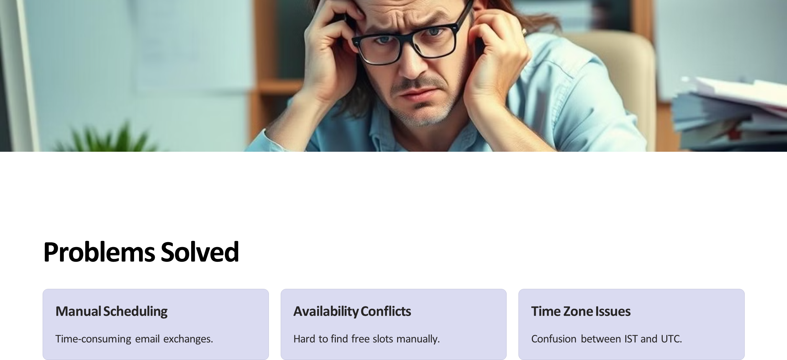
Basis Vectors
2025

Slide 4
Key Functionality
Basis Vectors
DATE
Natural Language Parsing:
Converts "next Monday 2pm" to UTC datetime.
Availability Checking:
Queries recruiter’s calendar for free slots (9 AM–4 PM IST).
Event Creation:
Schedules Google Calendar events with Meet links and reminders with confirmation emails.
Time Zone Handling:
IST → UTC conversion for API compatibility.
Error Handling:
Graceful fallback (e.g., defaults to 9 AM if time missing).

Slide 5
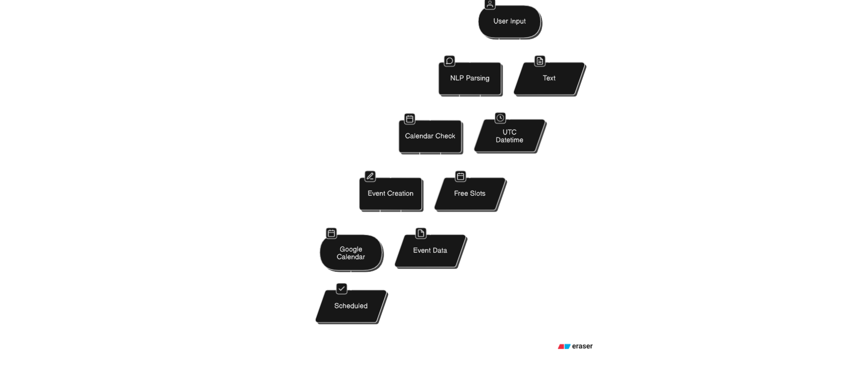
High level architecture
Basis Vectors
2025

Slide 6
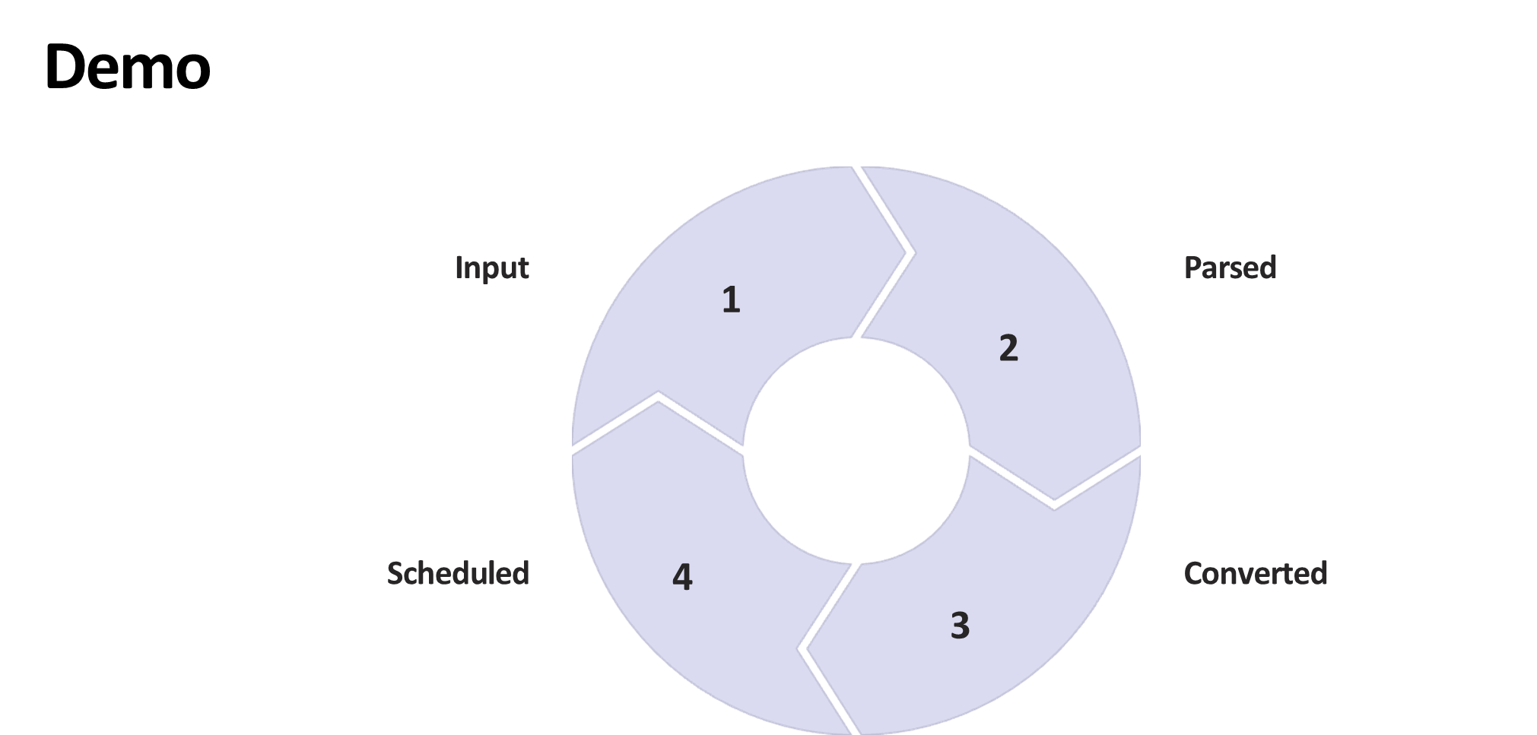
Basis Vectors
2025

Slide 7

Basis Vectors
2025
Questions?

