Slide 1

DOG BREED CLASSIFICATION USING
CNN ALGORITHM
PRESENTED BY:
DEEPAK SHARMA(PUR076BCT029)
DIPESH ADHIKARI(PUR076BCT031)
KRITARTHA BIKRAM SHAH(PUR076BCT041)
LIJESH SUBEDI(PUR076BCT043)

Slide 2
Overview
Introduction
Objective
Literature Review
Block Diagram
Methodology
Output

Slide 3
Introduction
Developing a dog breed classification system using Convolutional Neural Networks (CNNs) to identify the breed of a dog from an input image.
CNNs are promising for accurately classifying dog breeds from images without requiring manual feature selection such as nose shape, ear shape, coat texture, or eye color.
The project aims to develop a user-friendly dog breed classification system that accurately predicts the breed of a dog from an input image, achieved by training a CNN model on a large dataset of dog images to learn breed-specific features.

Slide 4
Objective
To accurately classify dog breeds
To create a user-friendly interface

Slide 5
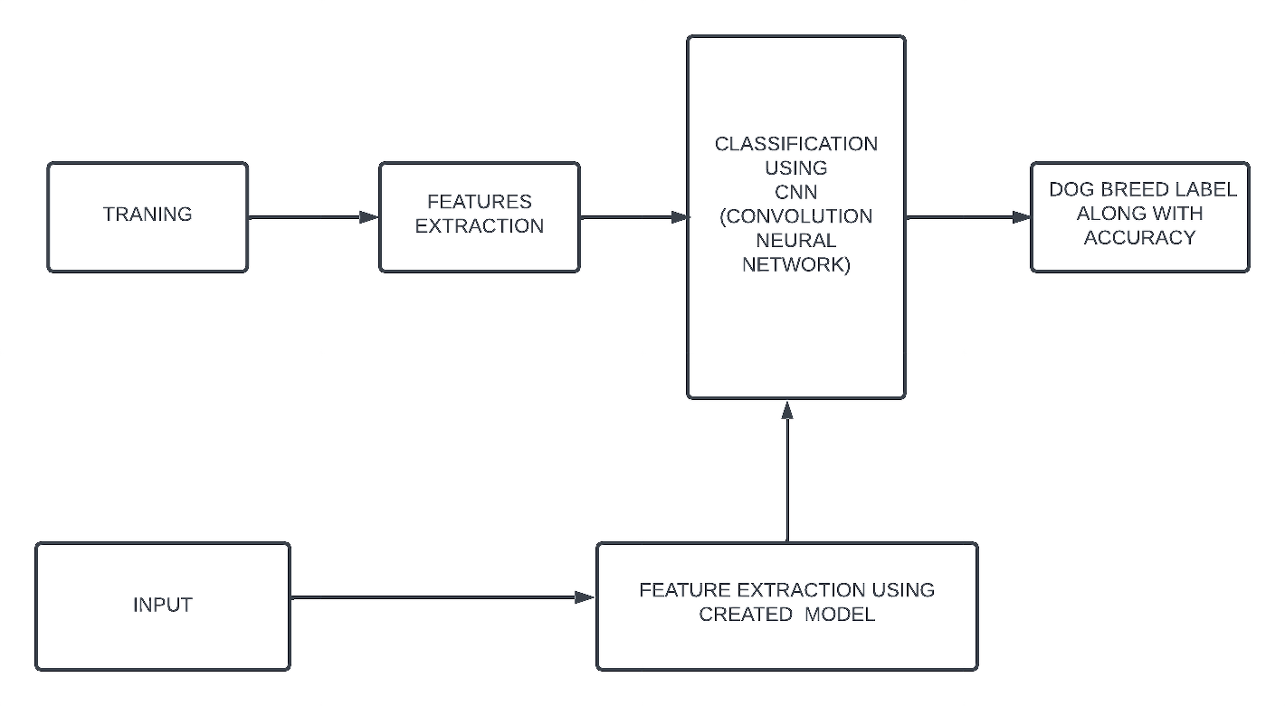
Methodology
Software Development Approach
Waterfall model
Requirements are properly defined and understood.
Fig: Block diagram of the system

Slide 6
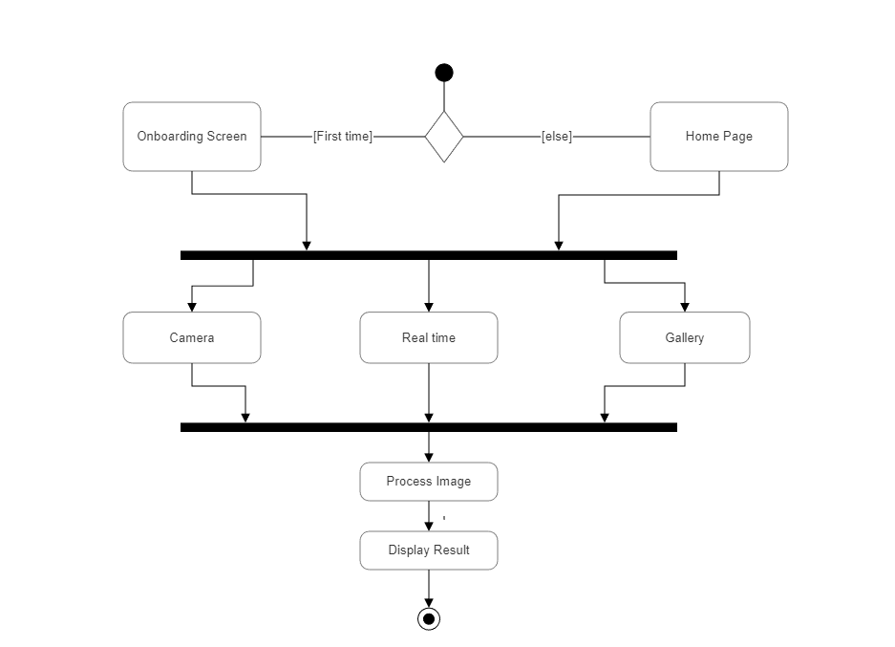
Activity Diagram

Slide 7
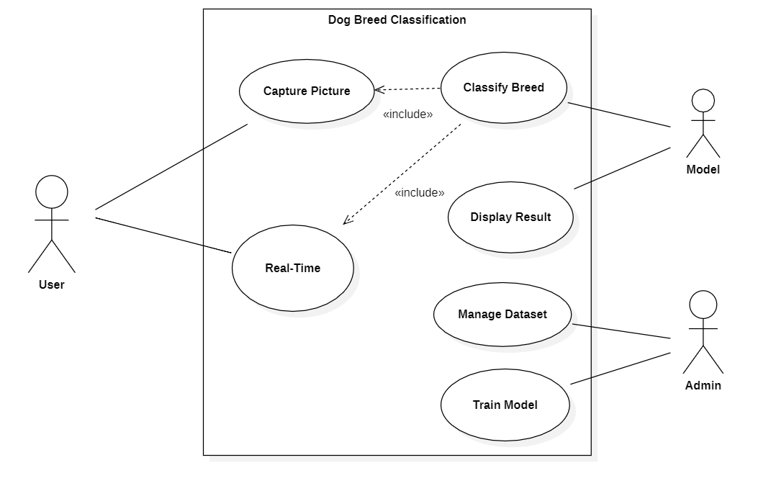
Use-case Diagram

Slide 8
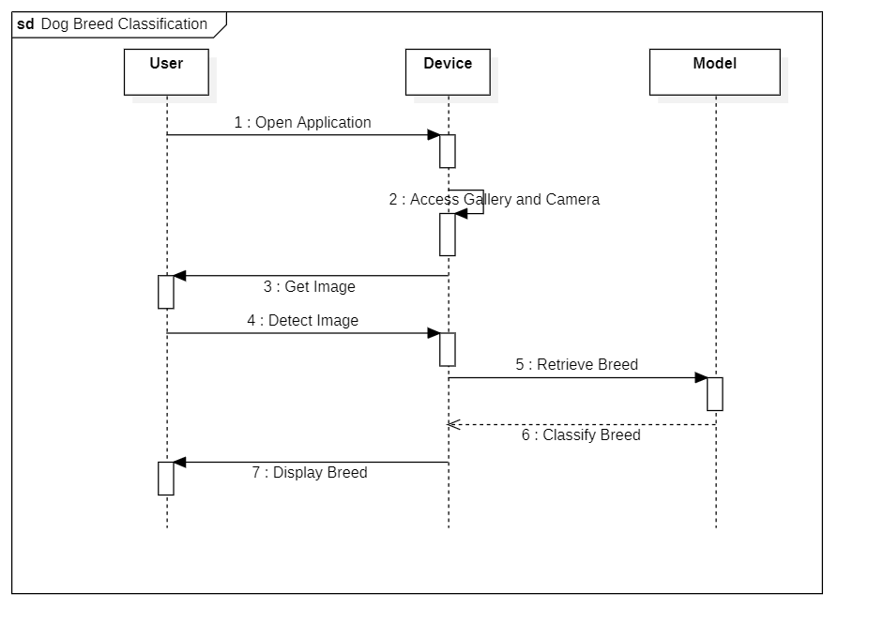
Sequence Diagram

Slide 9
Dataset
Dataset obtained from Kaggle, Adobe Images, Google Images and Pinterest.
Total number of images 14,179 belonging to 74 classes.

Slide 10
Why CNN?
CNNs are specifically designed to interpret and process visual information, making them highly suitable for tasks such as dog breed identification.
CNNs excel at automatically learning and extracting relevant features from images.
Parallel processing enables fast and accurate breed predictions.

Slide 11

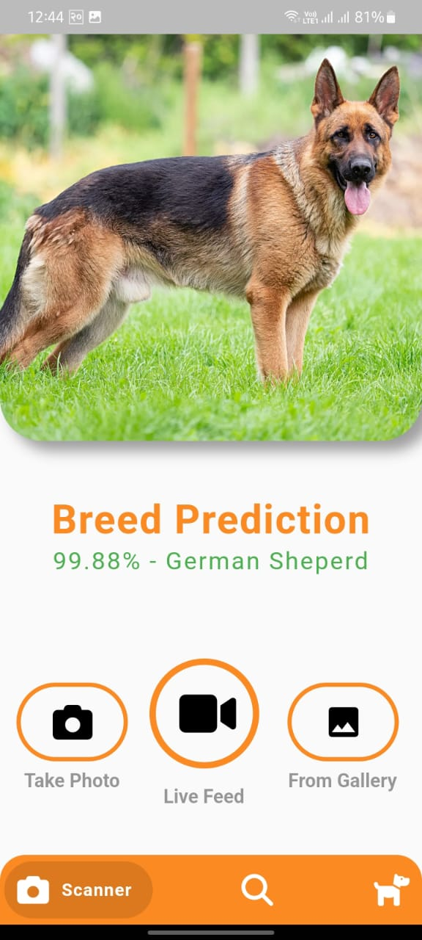

Output:
1.Screenshots:

Slide 12
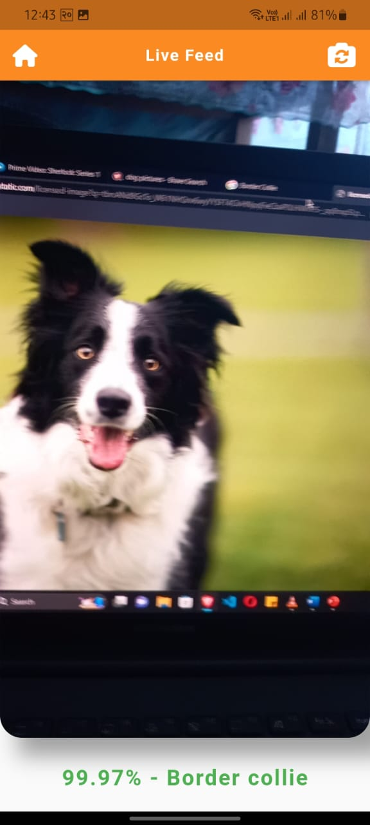
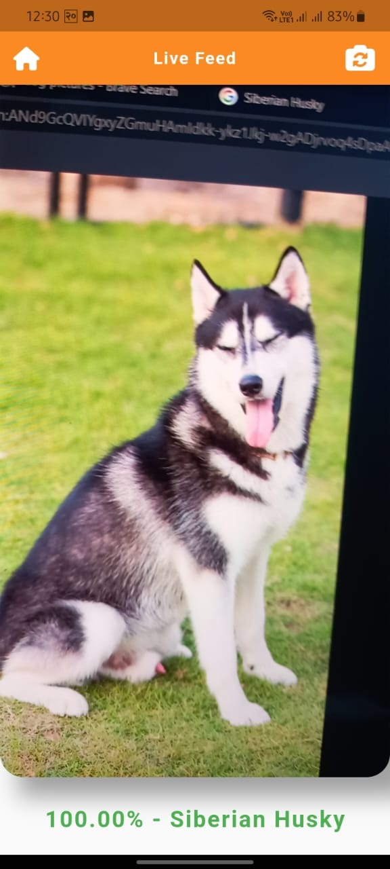
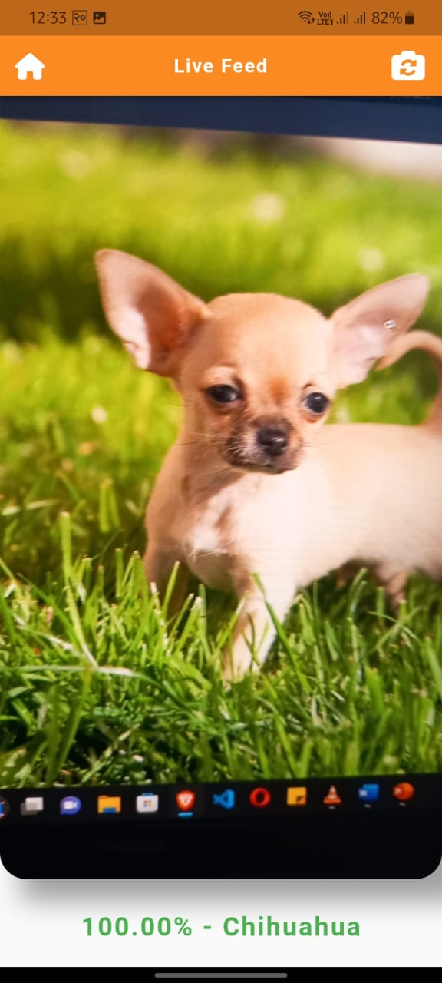
2. Live feed:

Slide 13
Limitations:
Distinguishing between visually similar breeds can be challenging for model.
It is sensitive to image quality factors such as lighting conditions, resolution, noise, etc. that may hinder accurate classification.
If dog images are presented from a different angle or viewpoint than what the model has seen during training, it may struggle to correctly classify the image.

Slide 14
DEMO

Slide 15
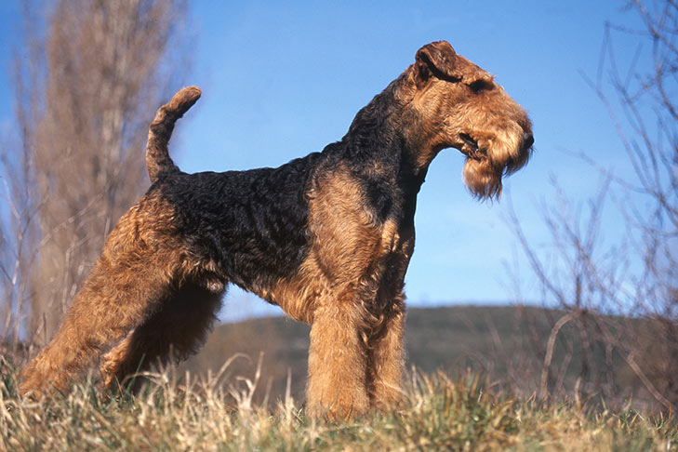

Slide 16
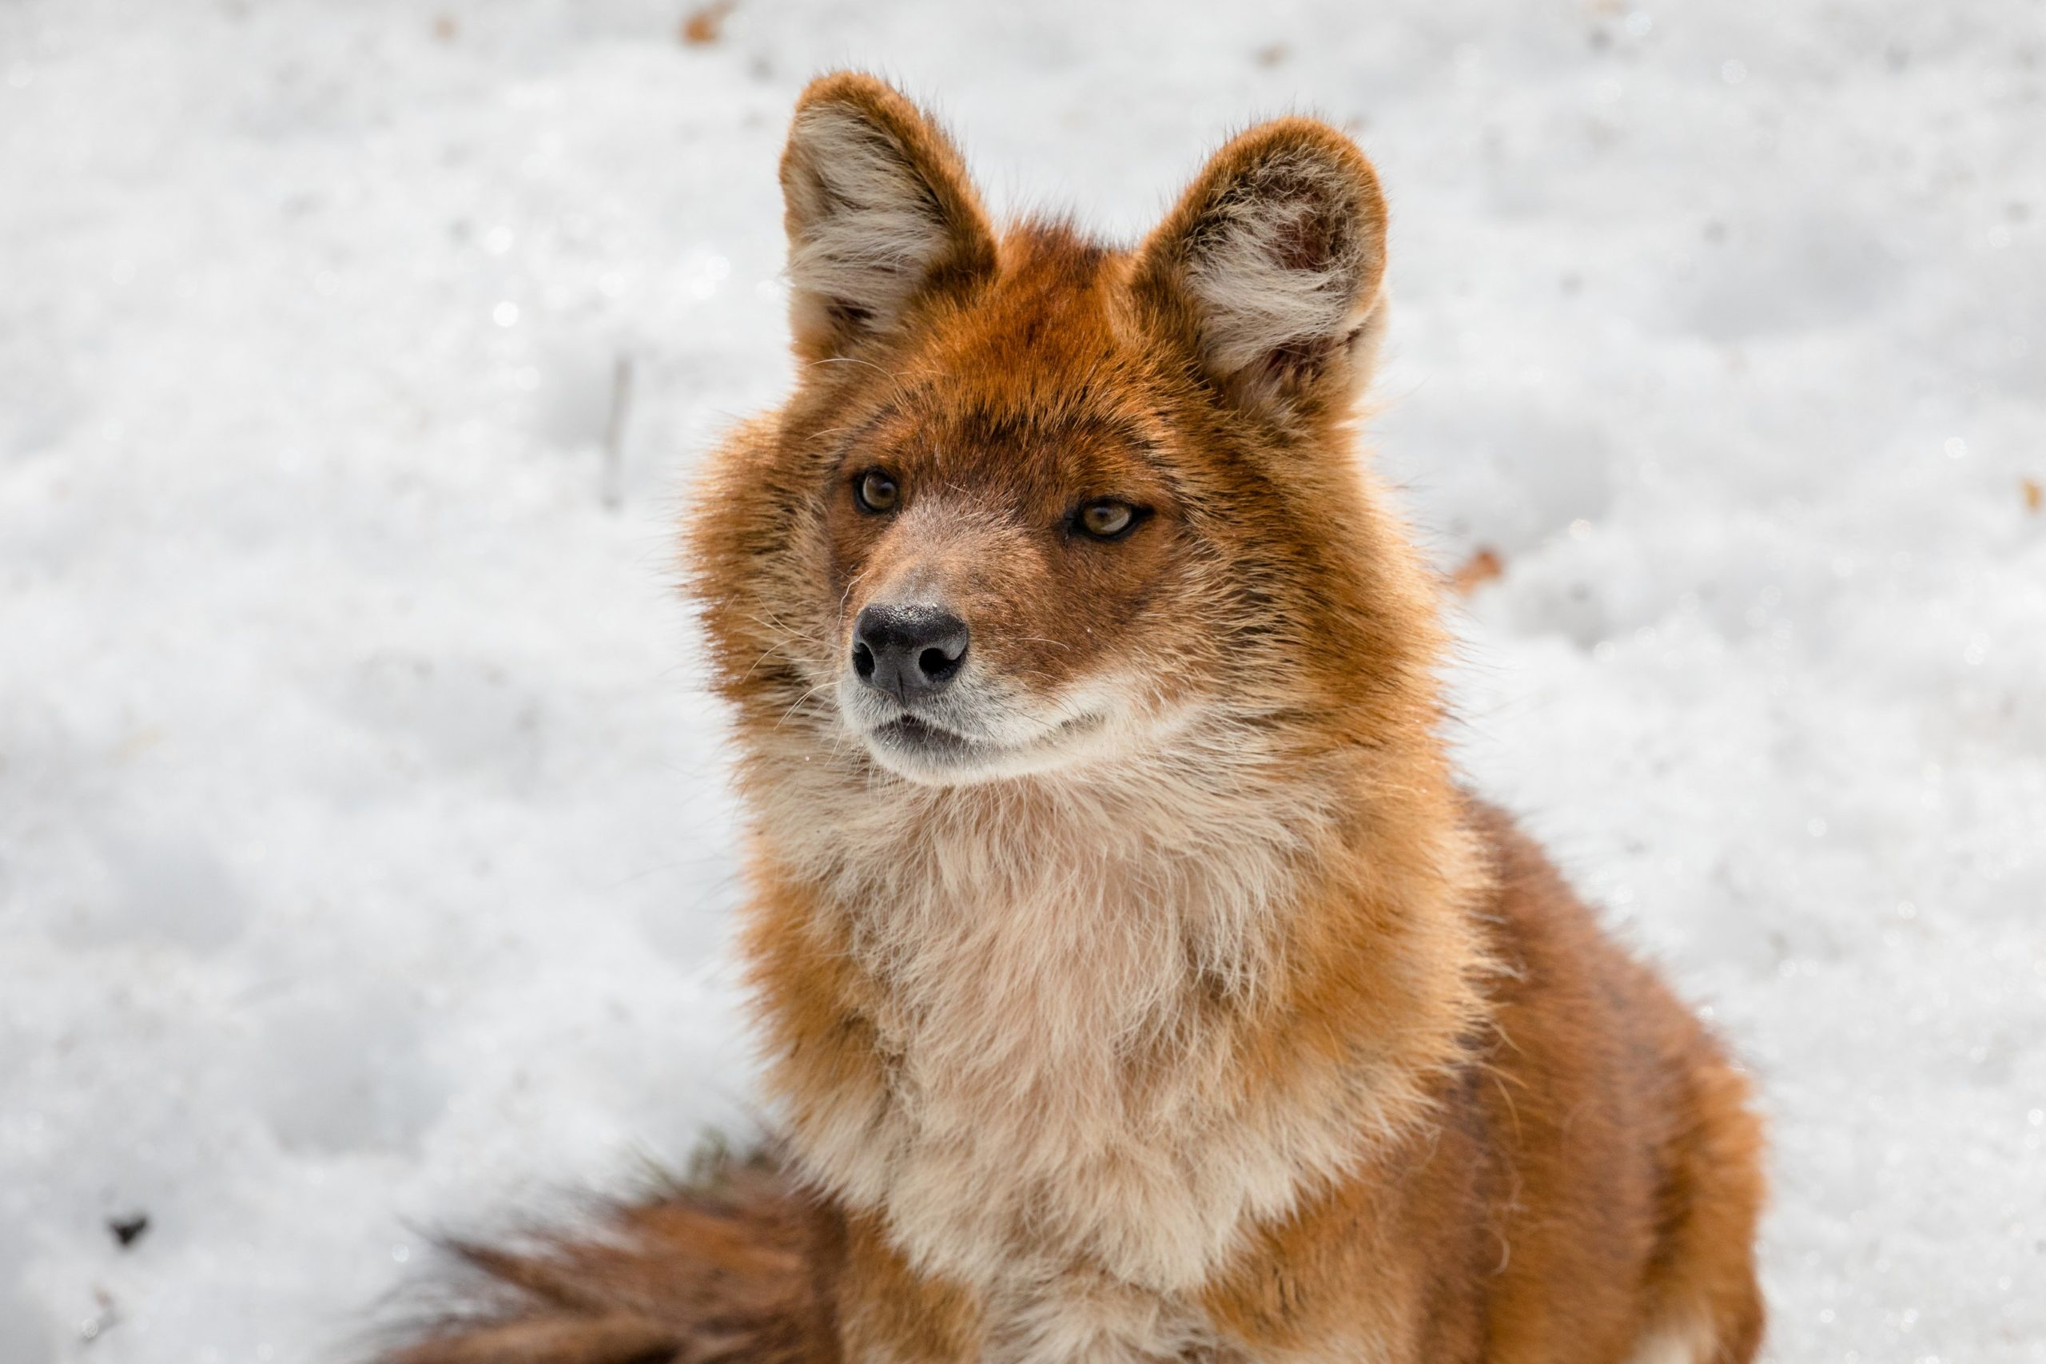

Slide 17
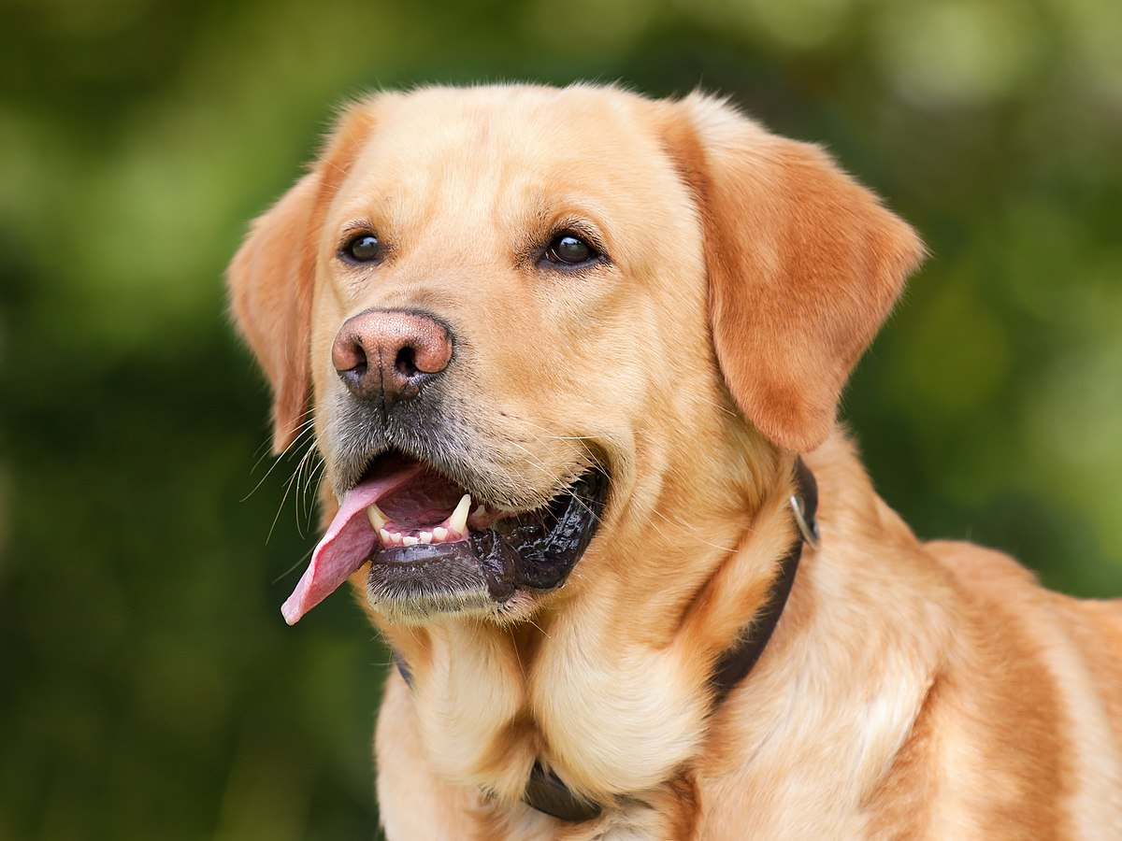

Slide 18
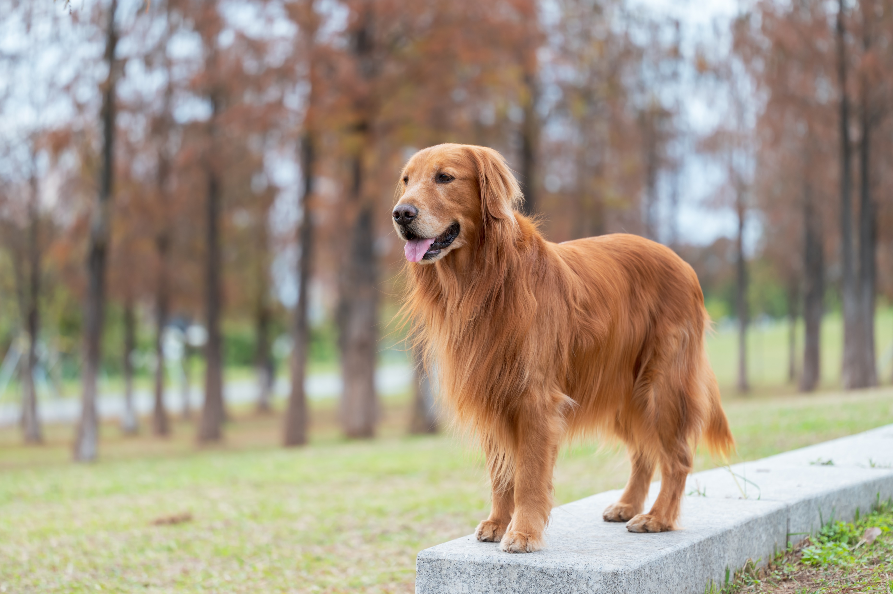

Slide 19
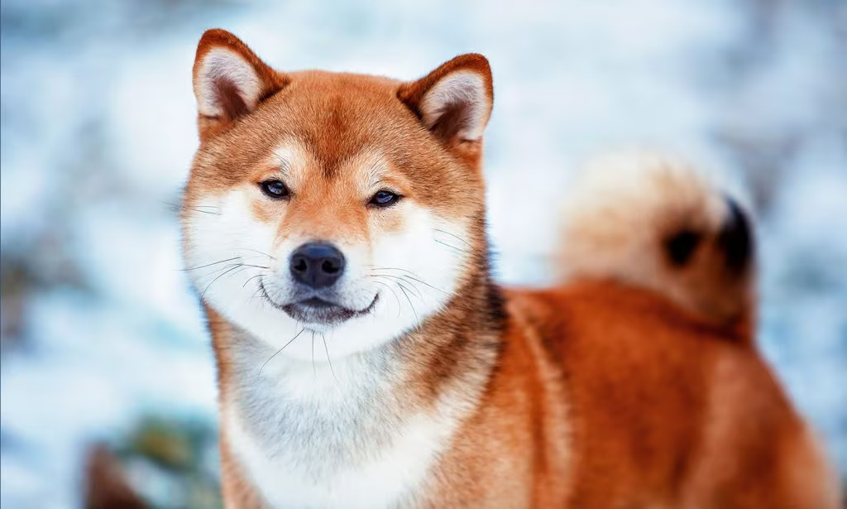

Slide 20
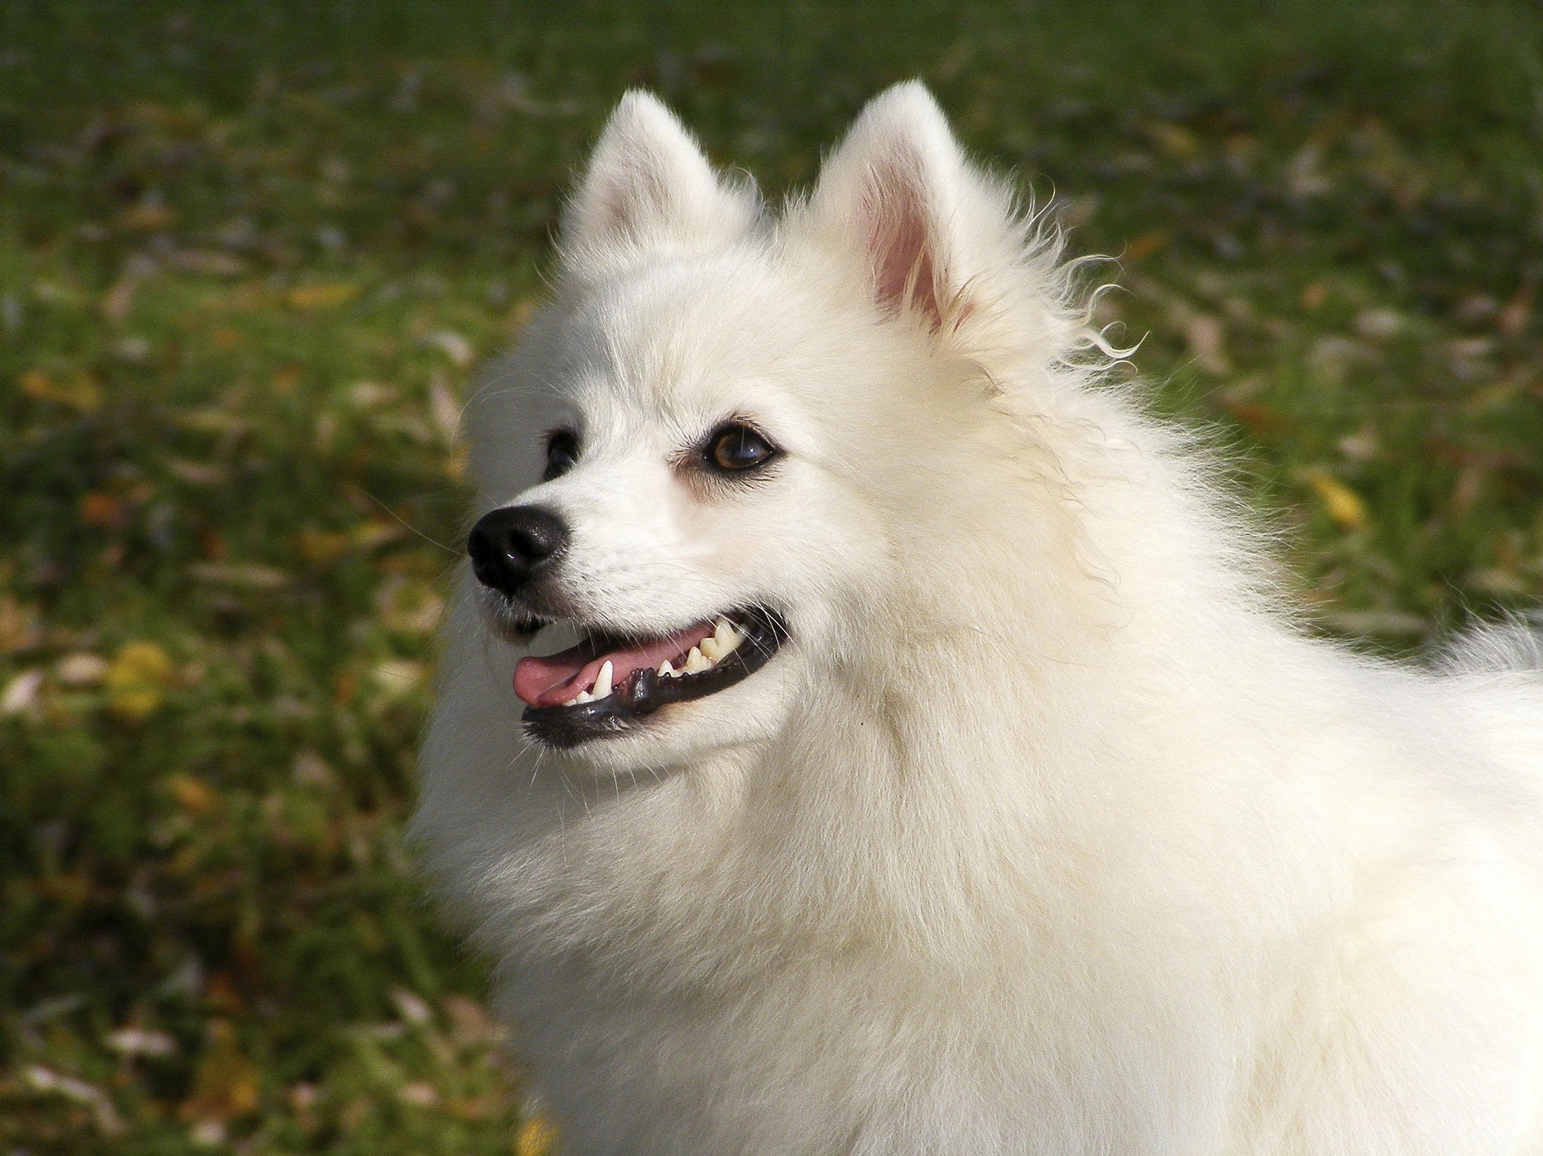

Slide 21
References
​ Simonyan, K. and Zisserman, A. (2015) Very deep convolutional networks for large-scale image recognition, arXiv.org.
Ghosh, S.(Aug 27, 2021) Dog Breed Classification with Deep Learning, Medium. Retrieved from: https://medium.com/msackiit/tensorflow-flutter-22061fff6761
Levy, A. (2021) Dog breed classification using Convolutional Neural Networks, Medium. Retrieved from: https://ariehlevyp.medium.com/dog-breed-classification-using-convolutional-neural-networks-cef89891d609
Jamil, D. (2020) Deep learning for dog breed classification, Medium. Retrieved from: https://pub.towardsai.net/deep-learning-for-dog-breed-classification-77ef182a2509

Slide 22


