Slide 1
CityTrack
AI-Powered Smart City Issue Reporting & Management System

Slide 2
Table of contents
Introduction
Literature Review
Problem Statement
Objectives
Proposed Solution
System Architecture Overview
AI-Based Complaint Classification
Severity Prediction Logic
Duplicate Detection Mechanism
User Module Workflow
11. Admin & Department Module
12. Field Worker Module
13. City Hotspot Dashboard
14. Flow Graph Explanation
15. Technology Stack
16. Development Workflow
17. Industry Relevance
18. Results & Observations
19. Conclusion
20. Future Scope
2

Slide 3
Introduction
Rapid urbanization has increased city infrastructure issues such as potholes, garbage overflow, and streetlight failures.
Traditional complaint systems are mostly: Manual, Slow to respond, Poorly categorized, Lack transparency
Citizens often face: Delayed resolutions, No real-time tracking, Repeated duplicate complaints
Municipal departments struggle with: Issue prioritization, Resource allocation, Workload management
SAMPLE FOOTER TEXT
3

Slide 4
Key Motivation
Increasing number of unresolved urban complaints
Lack of real-time tracking and accountability
No automated prioritization mechanism
Need for smart governance solutions
Project Vision
To create a centralized, intelligent, and transparent platform that bridges the gap between citizens and city authorities using Artificial Intelligence and data-driven decision making.
Why This Project Is Industry-Ready
Uses scalable AI models
Supports real-time data processing
Modular system architecture
Cloud deployment compatibility
Mobile and web platform support
Industry Alignment
The project follows practices used by:
Municipal E-Governance Systems
Smart Infrastructure Management Platforms
AI-based Decision Support Systems
Real-World Applications
CityTrack can be deployed in:
Municipal Corporations
Smart City Mission Projects
University Campus Management
Township Management Systems
Corporate Facility Maintenance

Slide 5
Literature Review
1. Kumar et al. (2021)
Title: Machine Learning Based Smart Complaint Management System Journal: IEEE Smart Cities Conference Contribution: Automated complaint classification Limitation: No image analysis Relevance: CityTrack uses multimodal AI (text + image)
2. Zhang et al. (2020)
Title: Deep Learning Framework for Urban Road Damage Detection Journal: Elsevier – Future Generation Computer Systems Contribution: CNN-based pothole and garbage detection Limitation: Text complaints ignored Relevance: CityTrack integrates visual + textual inputs
3. Li et al. (2022)
Title: Multimodal Learning for Intelligent Urban Monitoring Journal: IEEE Transactions on Intelligent Transportation Systems Contribution: Improved classification using multimodal fusion Limitation: High computational complexity Relevance: CityTrack uses lightweight models for real-time use
4. Fernandez et al. (2021)
Title: AI-Based Severity Estimation for Road Infrastructure Damage Journal: Springer Smart Infrastructure Contribution: Severity scoring of road damages Limitation: Limited to road category Relevance: CityTrack supports multi-domain severity prediction

Slide 6
5. Sharma et al. (2020)
Title: Duplicate Detection in Location-Based Complaint Systems Journal: ACM SIGSPATIAL Contribution: GPS-based duplicate detection Limitation: High false positives Relevance: CityTrack adds semantic + image similarity
7. Brown et al. (2022)
Title: Continuous Learning Framework for Smart Applications Journal: IEEE Access Contribution: Automated retraining pipelines Limitation: Infrastructure complexity Relevance: CityTrack uses scheduled lightweight retraining
6. Patel & Mehta (2021)
Title: Citizen-Centric Digital Governance Platforms Journal: International Journal of E-Governance Contribution: Improved citizen engagement systems Limitation: Manual processing Relevance: CityTrack automates workflow using AI
8. Singh et al. (2021)
Title: GIS-Based Urban Infrastructure Monitoring System Journal: Elsevier Sustainable Cities and Society Contribution: GIS-based urban issue mapping Limitation: No AI intelligence Relevance: CityTrack integrates GIS with AI decision making

Slide 7
9. Ahmed et al. (2020)
Title: Mobile-Based Smart City Issue Reporting Platform Journal: IEEE Internet of Things Journal Contribution: Mobile civic reporting system Limitation: No severity prioritization Relevance: CityTrack adds AI-based priority scoring
10. Rao et al. (2022)
Title: Data-Driven Optimization of Urban Services Journal: Springer Urban Computing Contribution: Analytics-driven service optimization Limitation: No citizen feedback integration Relevance: CityTrack combines citizen input with analytics
Research Gap
No complete end-to-end AI civic management system
Limited multimodal complaint processing
Lack of automated severity prioritization
Weak duplicate handling mechanisms
Minimal continuous learning integration
CityTrack Contribution
Multimodal AI-based complaint classification
Automated severity scoring and prioritization
Duplicate detection using semantic similarity
Real-time tracking platform
Continuous retraining pipeline

Slide 8
Problem Statement
Current urban complaint systems suffer from:
Manual categorization of issues
Inconsistent severity assessment
High response delays
Duplicate complaint flooding
Municipal departments lack automated prioritization tools.
Citizens do not receive real-time updates or transparency.
To design and develop a scalable, AI-powered smart city platform that automatically classifies urban complaints, predicts severity, detects duplicates, and enables real-time issue tracking between citizens and municipal departments.
8

Slide 9
Project Objectives
Primary Objectives
To develop an AI-based complaint classification system
To automatically predict severity and prioritize issues
To reduce duplicate complaints using similarity detection
To provide real-time issue tracking for citizens
To improve departmental response efficiency
Secondary Objectives
To design a user-friendly mobile and web interface
To implement role-based dashboards for admins and workers
To generate actionable analytics and hotspot maps
To enable continuous learning through retraining
Learning Outcomes
Practical implementation of machine learning models
Experience with full-stack system integration
Exposure to smart city application development

Slide 10
Existing System Overview
Citizen → Submit Complaint → Manual Review → Department Assignment → Resolution
Complaints are currently handled through:
Call centres
Email-based portals
Basic mobile apps
Issue classification is done manually by staff.
Severity is often based on human judgment.
Limited integration of:
Real-time tracking
Smart analytics dashboards
10

Slide 11
Proposed solution
CityTrack proposes an AI-powered centralized urban issue management platform that connects citizens, municipal departments, and field workers through a single digital ecosystem.
Key Features
Multimodal AI-based complaint classification
Automated severity prediction and prioritization
Duplicate complaint detection
Real-time status tracking
Role-based dashboards
City-level analytics and hotspot mapping
Working Principle
Citizens submit issues with text, image, and GPS location
AI engine analyses and classifies complaints
System assigns severity and department
Issue is forwarded to relevant authorities
Field workers resolve the issue
Updates are reflected in real-time
Benefits
Faster complaint resolution
Reduced manual workload
Improved transparency
Data-driven urban management

Slide 12
WORKFLOW
1. User submits complaint (Text + Image + GPS Location)
2. Backend validates input data
3. Text passed to NLP classification model
4. Image passed to Vision classification model
5. Multimodal AI engine combines predictions
6. Severity prediction module calculates priority
7. Duplicate detection module checks existing issues
8. Issue stored in database
9. Assigned to respective department
10. Real-time status updates sent to user
SAMPLE FOOTER TEXT
12

Slide 13
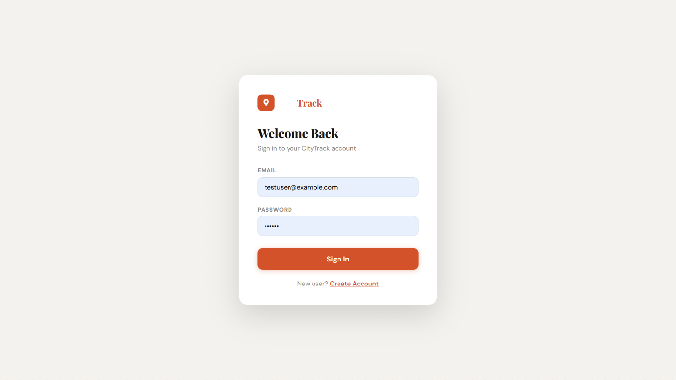
USER LOGIN
This page enables logged in users to access the system. The user must provide their registered email address and password to log in.
Steps:
1. Open the application
2. Enter your email address
3. Enter your password
4. Click on “Sign In” button
13

Slide 14
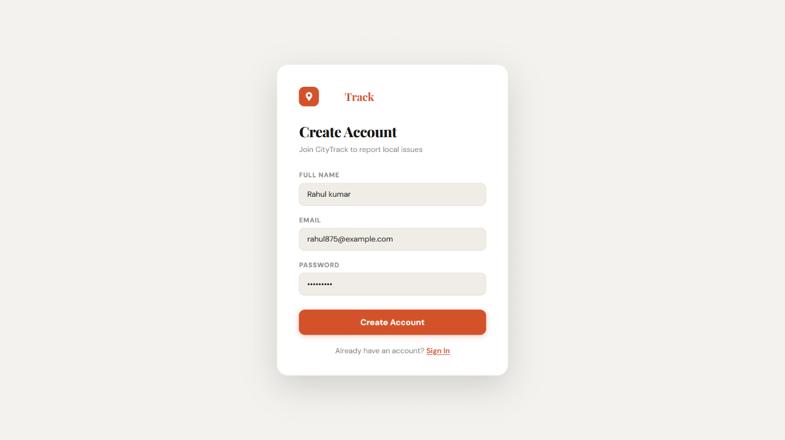
USER REGISTRATION
For users who have not registered, a new account must first be created before access to the system can be granted. Users are required to complete a registration form to provide basic details.
Steps:
1. Enter full name
2. Enter email address
3. Create a password
4. Click on “Create Account”
14

Slide 15
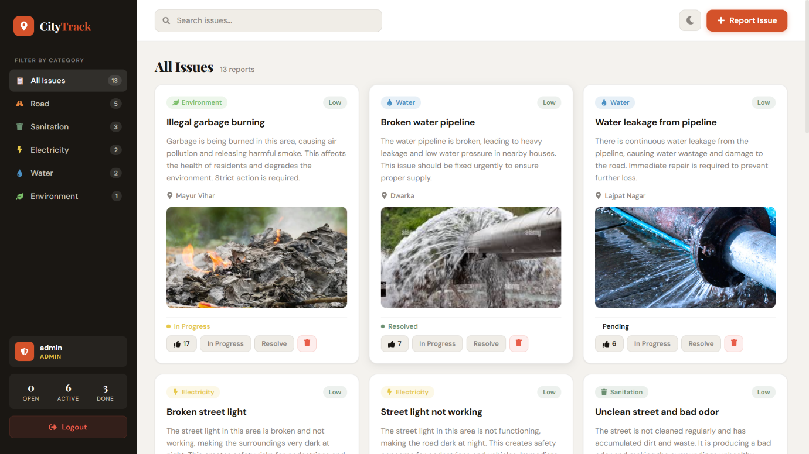
USER INTERFACE
The Issues dashboard is where you can see all the issues reported by other users. The issues are sorted by categories, described in words and also featured with pictures, and the issue status is shown.
Features:
View all issues
Filter by category (Road, Water, Electricity, etc.)
See issue status (Pending, In Progress, Resolved)
Search issues
Report a new issue
15

Slide 16
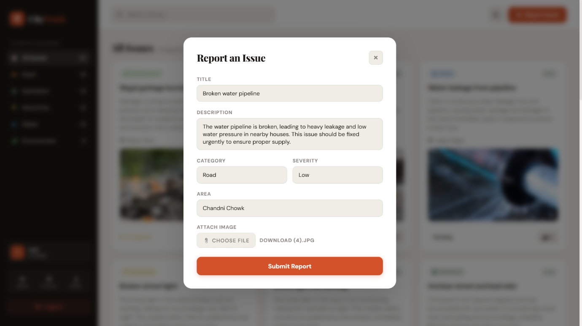
REPORT AN ISSUE
You can use this function to submit a new complaint. Simply fill out the details required and upload an image as needed.
Steps:
1. Click on “Report Issue”
2. Enter title of issue
3. Write description
4. Select category
5. Select severity
6. Enter area/location
7. Upload image
8. Click “Submit Report”
Complaints will be automatically analyzed using advanced artificial intelligence technology.
16

Slide 17

ADMIN INTERFACE
The admin interface is where the authorities that run an organization using Trustable use it to manage complaints reported through the app. It’s also where they’ll see all the information about the status of every complaint that’s been submitted.
Features:
View all complaints
Change ticket status (Pending to In Progress to Resolved)
Delete complaints
Prioritize issues based on severity
This helps in efficient management and faster resolution.
17

Slide 18
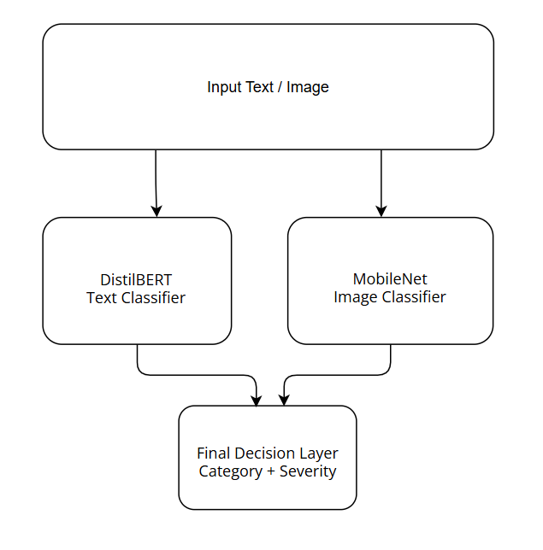
AI-BASED COMPLAINT CLASSIFICATION SYSTEM
Multimodal Classification Approach
CityTrack uses a multimodal AI framework that combines:
Text-based complaint description
Image-based visual evidence
Historical complaint patterns
Text Classification Module
Model Used: Fine-tuned DistilBERT
Input: User complaint text
Output: Probability score for each category
Example Output:
Roads: 0.82
Sanitation: 0.05
Electricity: 0.03
Water: 0.10
The category with the highest probability is selected.
Image Classification Module
Model Used: MobileNetV3 Input: Uploaded image
Output: Visual category prediction
Example Output:
Pothole: 0.76
Garbage: 0.12
Broken Light: 0.08
Water Leakage: 0.04

Slide 19
SEVERITY PREDICTION LOGIC
Importance of Severity Prediction
Severity prediction helps municipal departments to:
Prioritize critical issues
Optimize resource allocation
Reduce public safety risks
Parameters Used
Severity is calculated based on:
Keywords in complaint text
Image-based damage assessment
Traffic importance of location
Citizen upvotes
Severity Formula
Severity Score = 0.7 × AI Severity Output + 0.3 × Traffic Importance Score
Severity Classification
0.00 – 0.33 → Low
0.34 – 0.66 → Medium
0.67 – 1.00 → High
Example
Large pothole on highway:
Text Severity: 0.72
Image Severity: 0.80
Traffic Score: 0.85
Final Severity: 0.77 (High Priority)

Slide 20
DUPLICATE ISSUE DETECTION MECHANISM
Why Duplicate Detection Is Important
Multiple users often report the same issue, which causes:
Database overload
Repeated work assignments
Inefficient resource utilization
CityTrack Duplicate Detection Approach
CityTrack uses a three-level similarity checking system:
1. Location Similarity
Radius-based matching (within 30 meters)
GPS coordinate comparison
2. Text Similarity
Model Used: Sentence-BERT embeddings
Semantic similarity comparison
Captures meaning instead of just keywords
3. Image Similarity
Feature vector extraction
Visual similarity comparison
Decision Threshold
If combined similarity score > 0.85:
System displays:
“A similar issue already exists nearby. Would you like to upvote it?”
Benefit
Reduces redundant complaints
Improves data quality
Encourages community participation

Slide 21
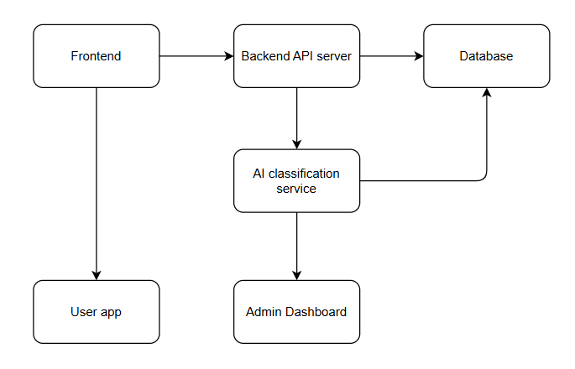
SYSTEM ARCHITECTURE OVERVIEW
1. User Interface Layer
Web Application
Citizen Dashboard
ReactJS
2. Application Server Layer
API Gateway
Authentication Service
Business Logic Engine
NodeJS+Express, REST APIs
3. AI Processing Layer
Text Classification Module (DistilBERT)
Image Classification Module (MobileNet)
Multimodal Fusion Engine
Severity Prediction Engine
Duplicate Detection Engine(Sentence-BERT)

Slide 22
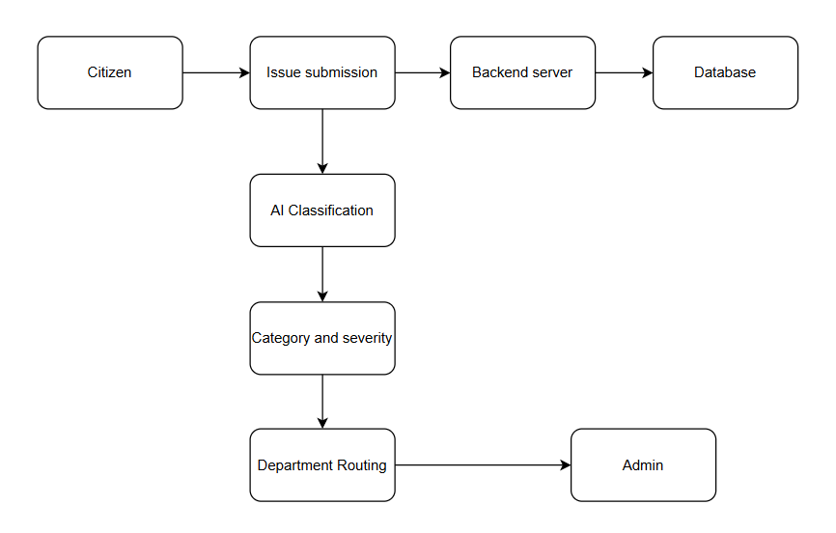
4. Data Layer
Complaint Database
User Database
Image Storage
Model Training Dataset
5. Admin & Analytics Layer
Department Dashboards
Heatmap Generator
Performance Analytics

Slide 23
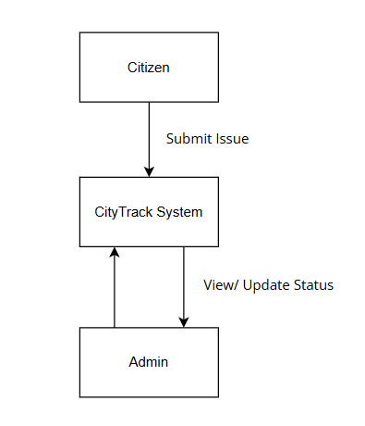
USER & ADMIN WORKFLOW OVERVIEW
User Workflow
User opens CityTrack application
Browses city feed
Submits complaint (Text + Image + GPS)
AI processes complaint
User receives submission confirmation
Tracks issue status in real time
Admin Workflow
Department receives assigned complaint
Admin verifies issue details
Assigns task to field worker
Monitors progress
Marks issue as resolved
Real-Time Synchronization
All updates reflect instantly on user dashboard
Notifications sent at each stage

Slide 24
Conclusion
The project improves:
Transparency between citizens and authorities
Response efficiency of municipal departments
Overall quality of urban service delivery
Industry Readiness Factors
CityTrack follows industry practices such as:
REST API architecture
Modular AI microservices
Role-based access control
Cloud compatibility
Data security practices
Performance Observations (Sample Results)
Complaint classification accuracy: ~90%
Image classification accuracy: ~88%
Duplicate detection precision improvement: ~30% reduction in redundant entries
Average complaint routing time reduced significantly
Key Achievements
Designed a complete end-to-end complaint management system
Implemented multimodal AI for accurate classification
Developed automated severity prioritization logic
Integrated duplicate detection for data efficiency
Built real-time tracking and role-based dashboards
Practical Impact
Faster service delivery
Improved citizen satisfaction
Reduced manual workload for departments
Better data-driven decision making

