Slide 1
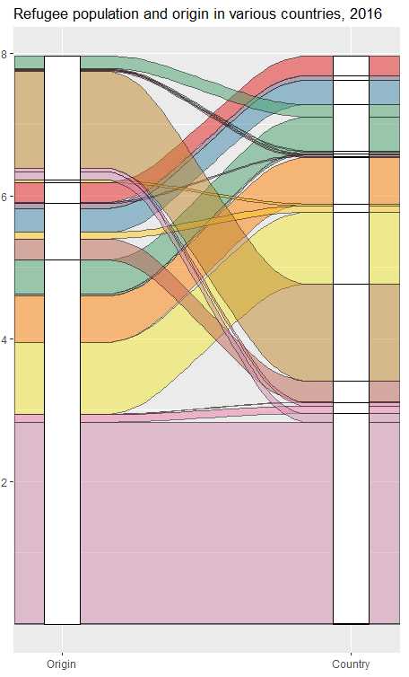
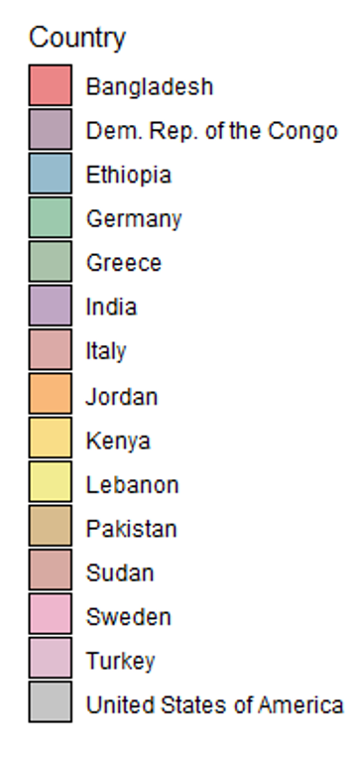
Afghanistan
Dem. Rep.
of the Congo
Germany
Jordan
Myanmar
South
Sudan
Lebanon
Population in 2016 (millions)
Pakistan
Syrian
Arab Rep.
Turkey

Slide 2
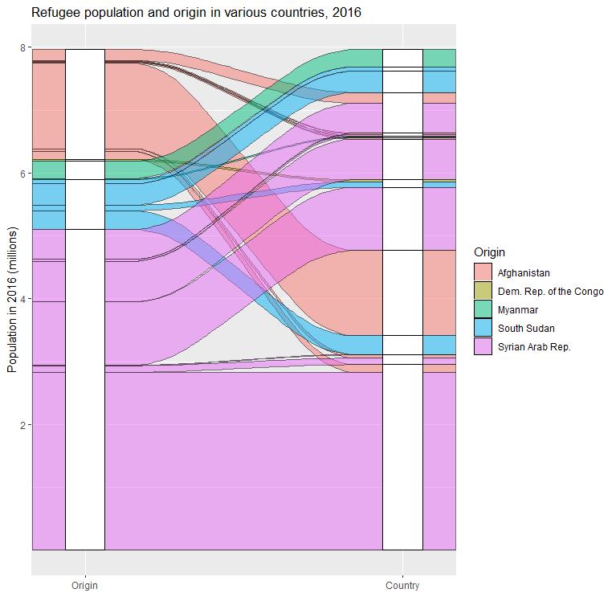
Bangladesh
Afghanistan
Ethiopia
Dem. Rep.
of the Congo
Germany
Jordan
Myanmar
South
Sudan
Lebanon
Pakistan
Syrian
Arab Rep.
Sudan
Turkey

