Slide 2
Objectives
Data Binding:
Data provider & Data consumer
BindingContext & CurrencyManager classes
Types of Binding
BindingSource Component
Sorting & Filtering

Slide 3
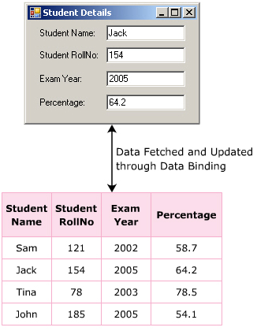
DataBinding
Is the technique used to fetch and update records through controls.
Allows to create a link between the controls of the form and the tables in database:
The records from tables are fetched in the DataSet or DataTable, and controls are generally bound to these components.
Is useful to view, insert, update, and delete records in the table.

Slide 4
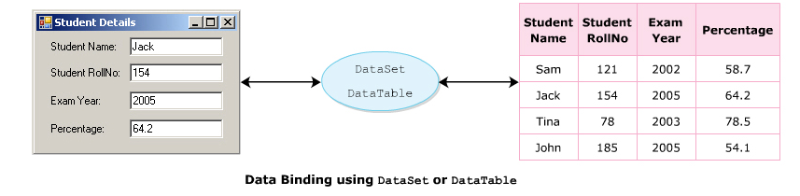
DataBinding
Advantages:
Binds data with minimum lines of code → enhances performance.
Developer has the flexibility to modify the auto-generated code on data binding to meet the requirements.
Disadvantages:
Difficult to debug as the existing of the extra binding layer.
Does not provide 100% flexibility to include customized functionalities.

Slide 5
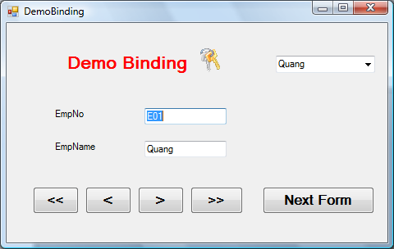
Data Provider - Data Consumer
Data Provider:
Is an object or component, which makes the data made available to consumer.
Some of data providers : array, DataSet, DataTable, DataView
Data Consumer:
Is an object, which uses the data made avaiable by the provider.
Is to display the data for viewing, modifying, navigating …
Some of data consumers: textbox, label, grid controls
Database
Data Source
Consumer

Slide 6
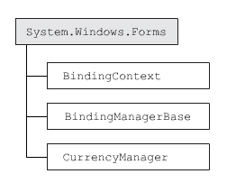
BindingContext class
Helps in binding to multiple data sources.
Manages a collection of the BindingManagerBase objects:
Each Windows Form contains at least one BindingContext object.
txtEmpNo.DataBindings.Add("Text" , ds.Tables["Employee"] , "EmpNo")
Property | Item, IsReadOnly
Method | Add, Contains, Remove, UpdateBinding

Slide 7
CurrencyManager class
All data sources, which are bound to a Windows Forms controls, will be linked with a currency manager.
CurrencyManager is used to point to an item in data source and navigate through records.
Property | Binding, Count, Current, List, Position
Method | CheckEmpty, OnPositionChanged, OnItemChanged, AddNew, Refresh, RemoveAt, ResumeBinding
Event | ItemChanged, PositionChanged, ListChanged
CurrencyManager bmOrders=(CurrencyManager)this.BindingContext[ds.Tables[0]];
bmOrders.Position+=1;

Slide 8
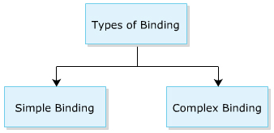
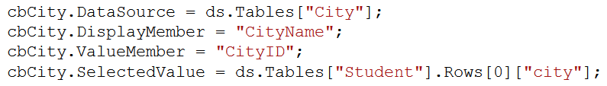
Types of Binding
Simple data binding :
Is the ability to bind a control to a single value in a data source.
Controls support simple binding: TextBox, Label …
Complex Binding :
Allows to bind the control to multiple data elements
By using complex data binding, DataGridView can be bound to the entire DataSet.
Controls support complex binding: ComboBox, ListBox, DataGrid …

Slide 9
Binding class
Helps to bind the property value of an object to the property value of a control:
Eg, bind the Name field of Employee table to Text property of Textbox control
Properties | Methods | Events
BindAbleComponent | ReadValue | BindingComplete
BindingManagerBase | WriteValue
Control
Datasource

Slide 10
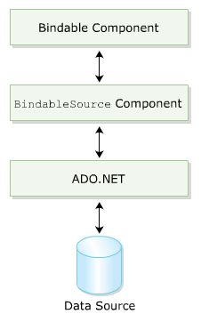
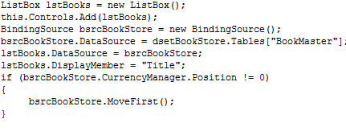
BindingSource component
Is used to optimize the process of data binding.
Acts as a strongly typed data source
Binding the controls and data indirectly.
Support data navigation , manipulation, sorting or filtering data

Slide 11
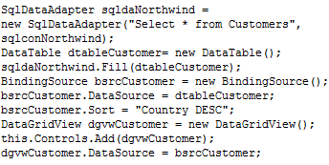
BindingSource Sort and Filter Property
Property | Count, CurrencyManager, Current, DataMember, DataSource, Item, List, Position, Sort, Filter
Method | Add, AddNew, Clear, Insert,MoveFirst, MoveLast, MoveNext, MovePrevious, RemoveAt
Event | BindingComplete, CurrentChanged, DataMemberChanged, DataSourceChanged, ListChanged

Slide 12
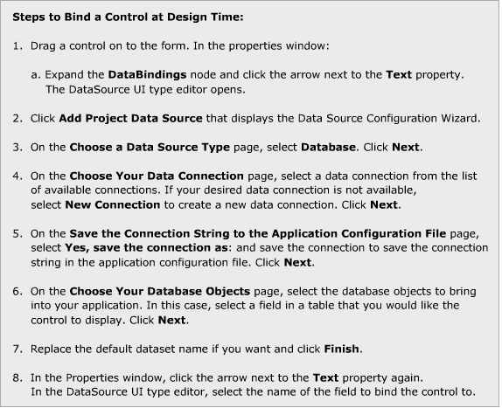
Binding a control

Slide 13
Summary
Databinding is used to link a control to the table in the DB:
BindingContext, CurrencyManager classes are used to manage binding objects
Two types of binding: simple and complex data binding.
Simple : bind a control to a single value in a data source
Complex: bind a control to multiple data elements in a data source.
BindingSource component is used to optimize the data management implemeted through databinding:
Sort property: allow to specify the order for sorting data.
Filter property : filter records base on the filter expression

