Slide 1

Introduction
BARBERIA
Team members:
Lê Minh(leader)
Hoàng Thiên Ân
Nguyễn Minh Thoại
Lương Vinh Hiển
19-August-2021

Slide 2
Content
Introduction
Short introduction
Technologies
Actual requirements
Requirements of the project
Deployment diagram
Test result
Conclusion and development
Task list

Slide 3
Introduction - Actual requirements
SHORT INTRODUCTION
This project is will help customer can make an appointment for hair cut and other services.
Customer can easily choose the time which is available for salon owner and hair stylist.
Salon manager can manage all the booking and can store payment record in the system.
The project is design base on spring boot MVC model.

Slide 4
Test Result [1-n]
TECHNOLOGIES
Language: Java
Spring boot
Spring boot Thymeleaf
JasperReport
Bootstrap
Jquery
IDE: Intellij
Database: MySQL (Workbench)

Slide 5
Introduction - Requirements of the project
Actual requirements
Functional
Manager can manage all bookings easily
Booking system: customer can chose time and make appointment, it is also filter all the full hour so other customers can not pick at the same time.
Walk-in check in: salon can check-in for walk-in customer.
Non-functional
QR code
Email Sender
Payment Report
Notes:
Non-functional (how the system works)
Functional (what the system should do)

Slide 6
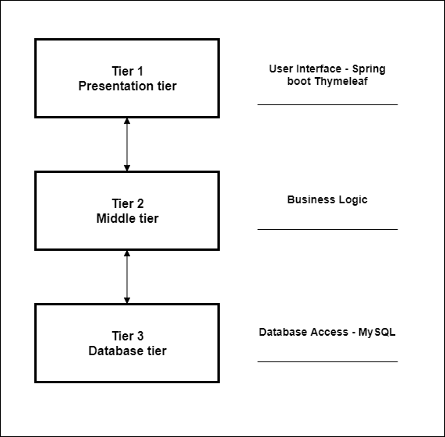
Introduction - Deployment diagram
DEPLOYMENT DIAGRAM

Slide 7
Test Result [2-n]

Slide 8

Thank You

