Slide 1
AVD Anywhere: Azure Virtual Desktop on Azure, Azure Local, and AVD Hybrid Platforms
Kristopher Turner · NIC 2026 · Wed 14 Oct, 13:20

Slide 2


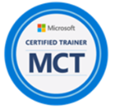
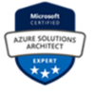



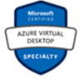

Kristopher Turner
Microsoft MVP
Microsoft Certified Trainer
Solutions Architect Expert · Security Engineer · Administrator · Hybrid Administrator · AVD Specialty · Stack Hub Operator
X
@CountryCloudBoy
www
kristopherjturner.me
in
kristopherjturner
GH
kristopherjturner
Product Technology Architect
TierPoint
kris@hybridsolutions.cloud
▶
@CountryCloudBoy

Slide 3
Users refuse to live in one place. One promise covers them all
Three kinds of users, three right places, and the precise promise so the session can be held to it.
Azure
Elastic, pooled, Entra-joined
Azure Local
Your site: data, latency, regulation
AVD Hybrid
Your hypervisor, Arc-enabled VMs
Entra ID + Arc
One workspace exposes three entitled desktops
The same user and the same profile pattern work in each
Monitoring is shared; patching, power and recovery differ
Azure
Azure Local
Hybrid
3

Slide 4
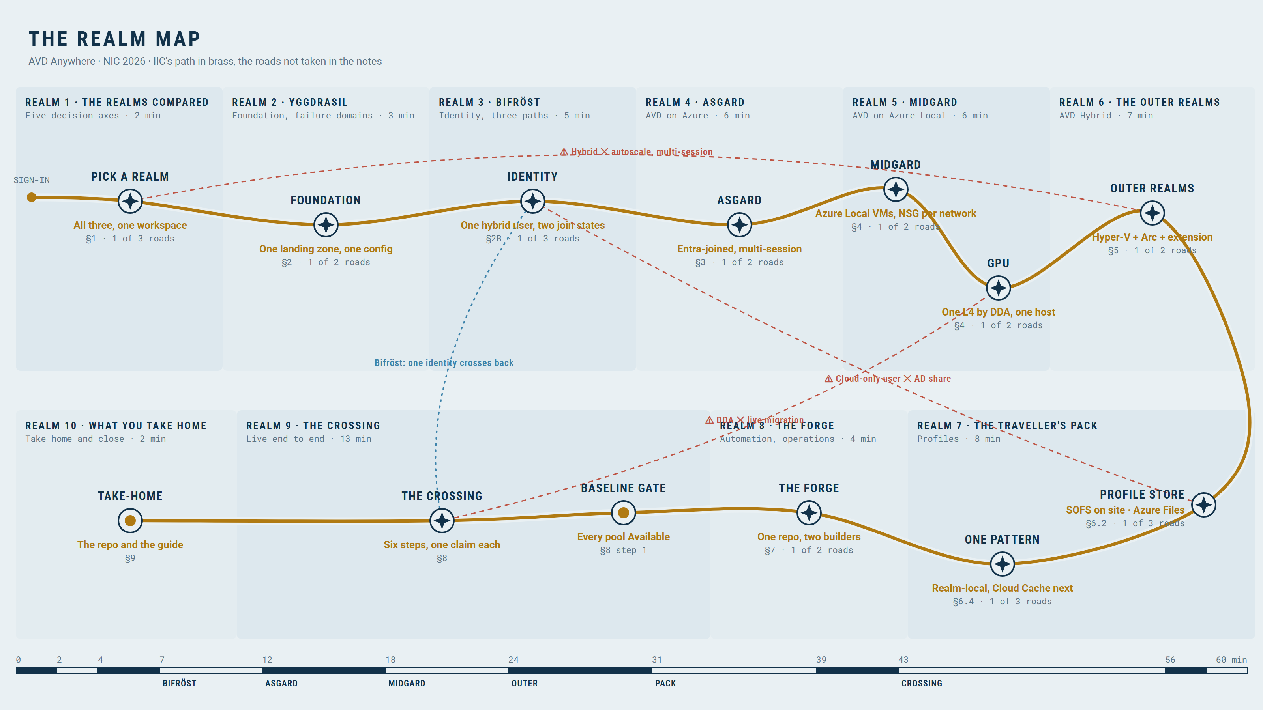
The Realm Map: the whole session on one map
Azure
Azure Local
Hybrid
4

Slide 5
The end state first, and where the repo lives
LIVE DEMO
One workspace, three host pools, all Available; everything is in the repo with a follow-along page per demo.
github.com/<org>/nic2026_avd (repo)
Demo guide
follow along in your own tenant
Azure
Azure Local
Hybrid
5

Slide 6
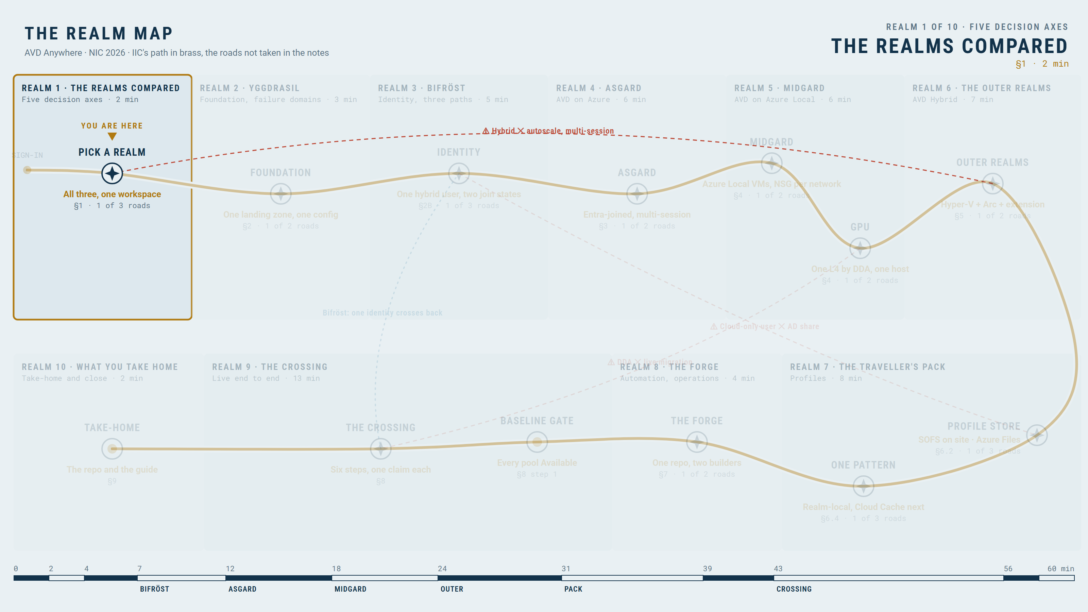
Three realms, five decision axes, no prophecy required
THE REALMS COMPARED — FIVE DECISION AXES · SECTION 1
Locality, lifecycle owner, identity and OS, operations, support: and a one-line rule per realm.
Axis | AVD on Azure | AVD on Azure Local | AVD Hybrid
Locality | Azure | Your cluster | Your hypervisor
Lifecycle owner | Azure | Azure through Arc | You, with hypervisor tools
Identity and OS | Entra, AD or hybrid; Win11 single or multi-session, Windows Server | Win11 multi-session; AD DS join (+ hybrid join for SSO) | Win11/10 Enterprise single-session; Entra, AD or hybrid join (Server: AD); no multi-session
Operations | Autoscale, Start VM on Connect | To verify | None: you scale and power-manage
Support and licensing | Azure compute plus user licence | Cluster, AVD on Azure Local fee, user licence | Your infrastructure plus user licence
YOU ARE HERE · THE REALMS COMPARED — FIVE DECISION AXES
Azure
Azure Local
Hybrid
6

Slide 7
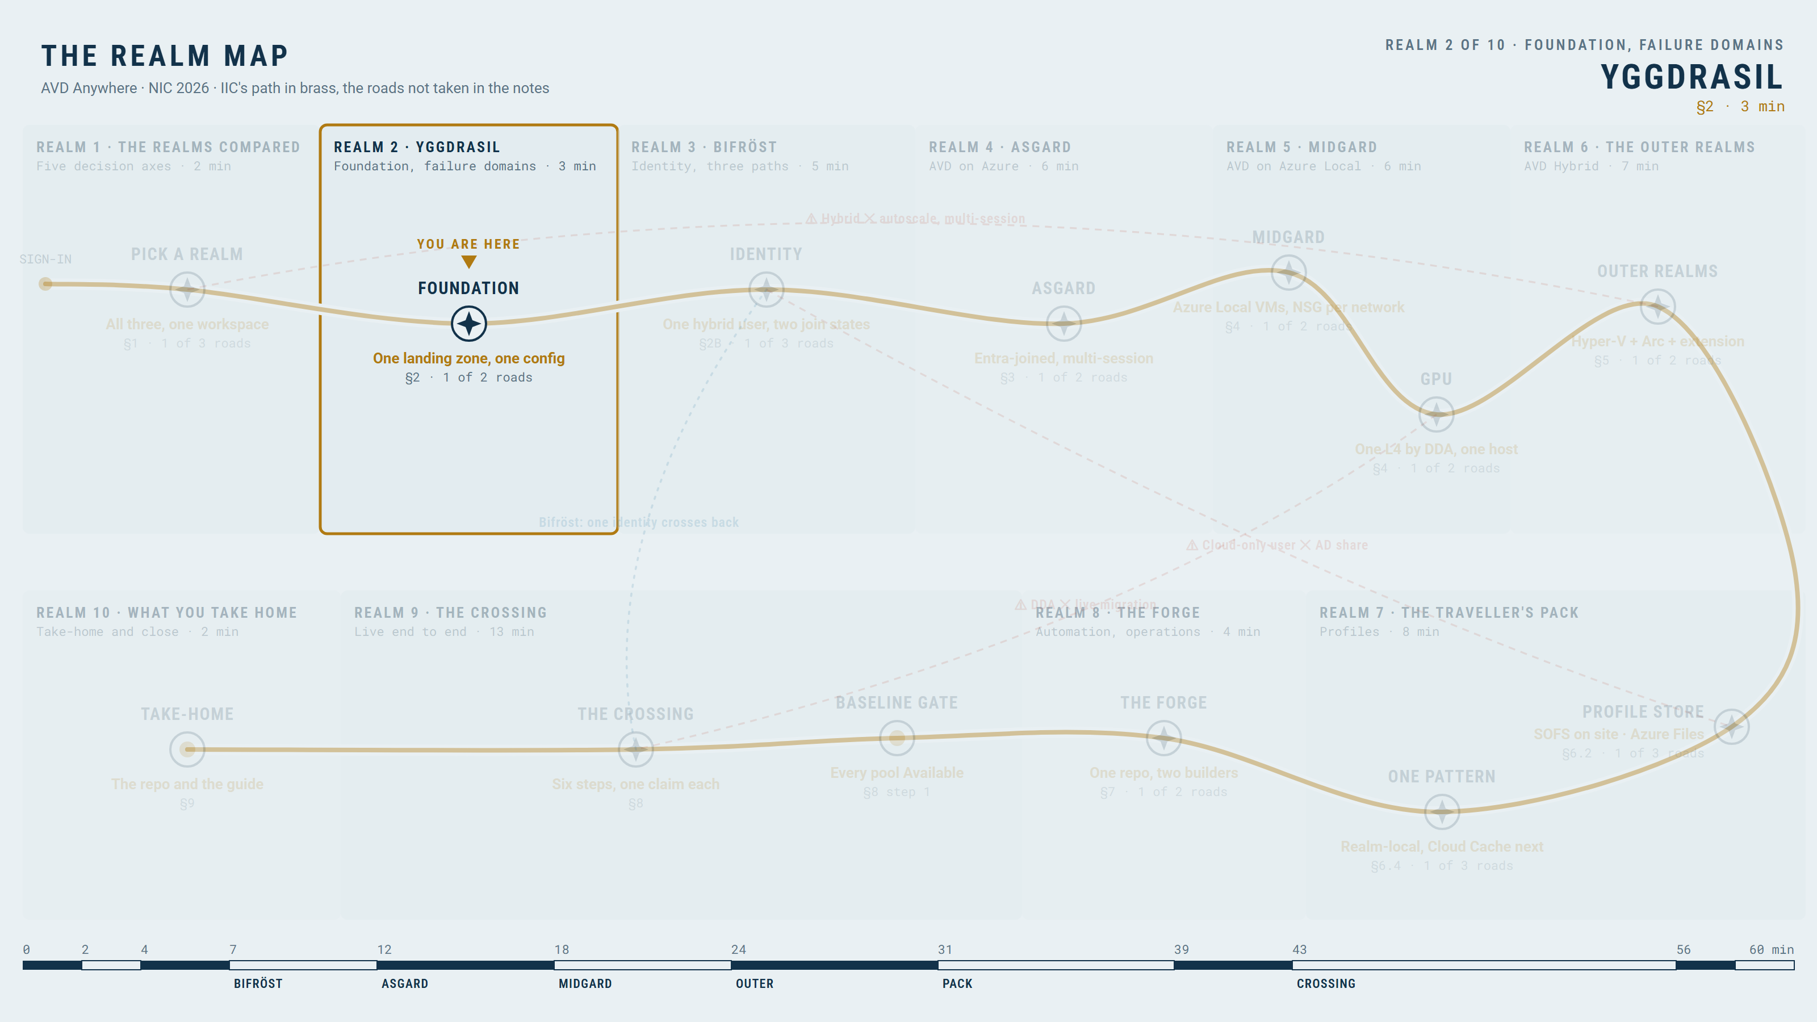
Yggdrasil: one foundation, one config file, three realms
YGGDRASIL · SECTION 2
LIVE DEMO
One landing zone built from one config; each realm section shows only its delta.
Control plane, hosts, images, storage, network, monitoring, Arc: seven resource groups by lifecycle
Profile share on its public endpoint, direct egress
Registration tokens are never stored
YOU ARE HERE · YGGDRASIL
Azure
Azure Local
Hybrid
7

Slide 8
Failure domains: what the lab proves, and politely does not
Both local realms share one cluster and one internet line.
Proves hosting-model differences and profile reuse
Does not prove independent-site resilience
Compute locality is not data locality
Control plane: Entra, broker, gateway, Azure Monitor
Profile share and Key Vault
Network links: site to Azure
Azure Local VMs and Hybrid VMs
Nodes and hypervisor hosts: one lab, one site
Azure
Azure Local
Hybrid
8

Slide 9
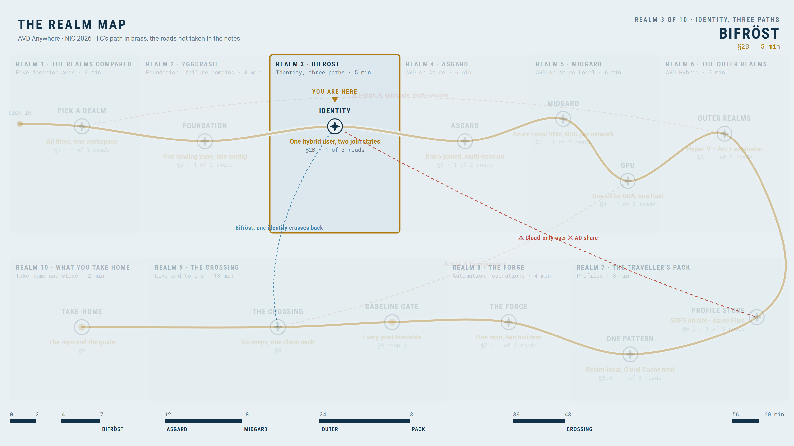
Support status by realm: GA, preview and to-verify
BIFRÖST · SECTION 2B
Before the identity path: what each realm supports today, and what this lab has not yet proven.
Realm | Host OS | Join and SSO | Profile auth | Power features | Status
Azure | Windows 11 multi-session | Entra join, SSO | Entra Kerberos to Azure Files: hybrid and cloud-only GA | Autoscale, Start VM on Connect | GA
Azure Local | Windows 11 multi-session (GA) | AD DS join; hybrid join (for SSO) pending in the lab | AD Kerberos to an SMB service (here the SOFS), not a CSV | Autoscale and Start VM on Connect: verify | GA with items to verify
AVD Hybrid | Windows 11 Enterprise single-session, or Windows Server | Arc-enabled; Entra, AD or hybrid join (Server: AD); lab: AD join | AD Kerberos to on-site SMB (here the SOFS), or Azure Files | None: no autoscale, power management or Start VM on Connect | Verify product status
YOU ARE HERE · BIFRÖST
Azure
Azure Local
Hybrid
9

Slide 10
Bifrost, the settings: one user, two join states, and why AD is back
One hybrid user everywhere.
Hybrid users: created in AD, synchronized to Entra (password hash sync)
Entra Connect Sync on its own member server, never on a domain controller
Azure realm: Entra-joined Windows 11, Entra Kerberos to Azure Files
Azure Local and Hybrid realms: AD-joined, AD Kerberos to the SOFS; hybrid join pending, so the AD password at the host for now
Entra SSO on Entra-joined or hybrid-joined hosts; two Conditional Access policies
Azure
Azure Local
Hybrid
10

Slide 11
Bifrost, the map: three identity paths, one diagram, no secret fourth
User to service, user to host, host-as-user to the profile share: Azure Files in Azure, the SOFS on site.
User to AVD
Entra sign-in, MFA, Conditional Access, broker, feed
1
User to the session host
SSO, Virtual Machine User Login role
2
Host, as the user, to the profile share
Azure: Entra Kerberos to Azure Files · Azure Local and Hybrid: AD Kerberos to the SOFS (hybrid user)
3
Azure
Azure Local
Hybrid
11

Slide 12
Bifrost's toll: the ticket, and the ACL has the final word
LIVE DEMO
Entra Kerberos to Azure Files is GA for hybrid and cloud-only users; AD Kerberos is the only key to an on-site share.
Entra user
Kerberos ticket (cifs)
SMB share
ACL result
Entra Kerberos to Azure Files: GA, hybrid and cloud-only users
The storage app is excluded from MFA Conditional Access because the ticket request is silent
Current Windows 11 build; cloud security groups; admin consent
AD Kerberos to the SOFS: hybrid users, a domain controller in line of sight
Azure
Azure Local
Hybrid
12

Slide 13
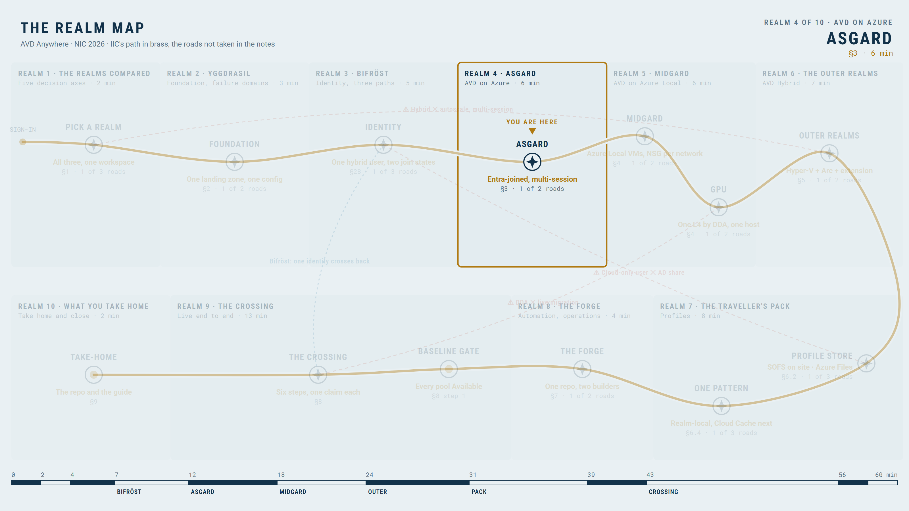
Asgard: AVD on Azure, the reference realm
ASGARD · SECTION 3
LIVE DEMO
Pooled multi-session, Entra-joined hosts, SSO, Shortpath.
Pooled, breadth-first, multi-session Windows 11
Entra-joined, SSO, RDP Shortpath
Scaling plan and Start VM on Connect
YOU ARE HERE · ASGARD
Azure
Azure Local
Hybrid
13

Slide 14
The forge: one image definition, target-specific outputs
LIVE DEMO
Image Builder to Compute Gallery to host pool.
Pinned source image
Shared customisation scripts
Gallery version
Replicate and roll back
Pinned source version (Image Builder also accepts latest)
Shared customisation scripts; no identity baked in
Gallery version, replication, rollback
Azure
Azure Local
Hybrid
14

Slide 15
Heimdall's bill: the DCR decides the cost, the workbook shows it
LIVE DEMOS · 2
One causal chain: what the DCR selects, what is collected, what Insights shows, what it costs.
DCR selection
Collected signal
Insights evidence
Ingestion and cost
Insights default counters and events only
Measured in this lab: roughly 3 to 5 GB per host per month
It depends on DCR contents, sampling and collection hours
DCRs do not control every ingestion source
Preview: Azure Copilot Observability Agent investigates alerts on this workspace; billed per use
Azure
Azure Local
Hybrid
15

Slide 16
Asgard's perks: autoscale and Start VM on Connect
The features only this realm gets in full.
Ramp-up, peak, ramp-down, off-peak
Start VM on Connect
Azure
Azure Local
Hybrid
16

Slide 17
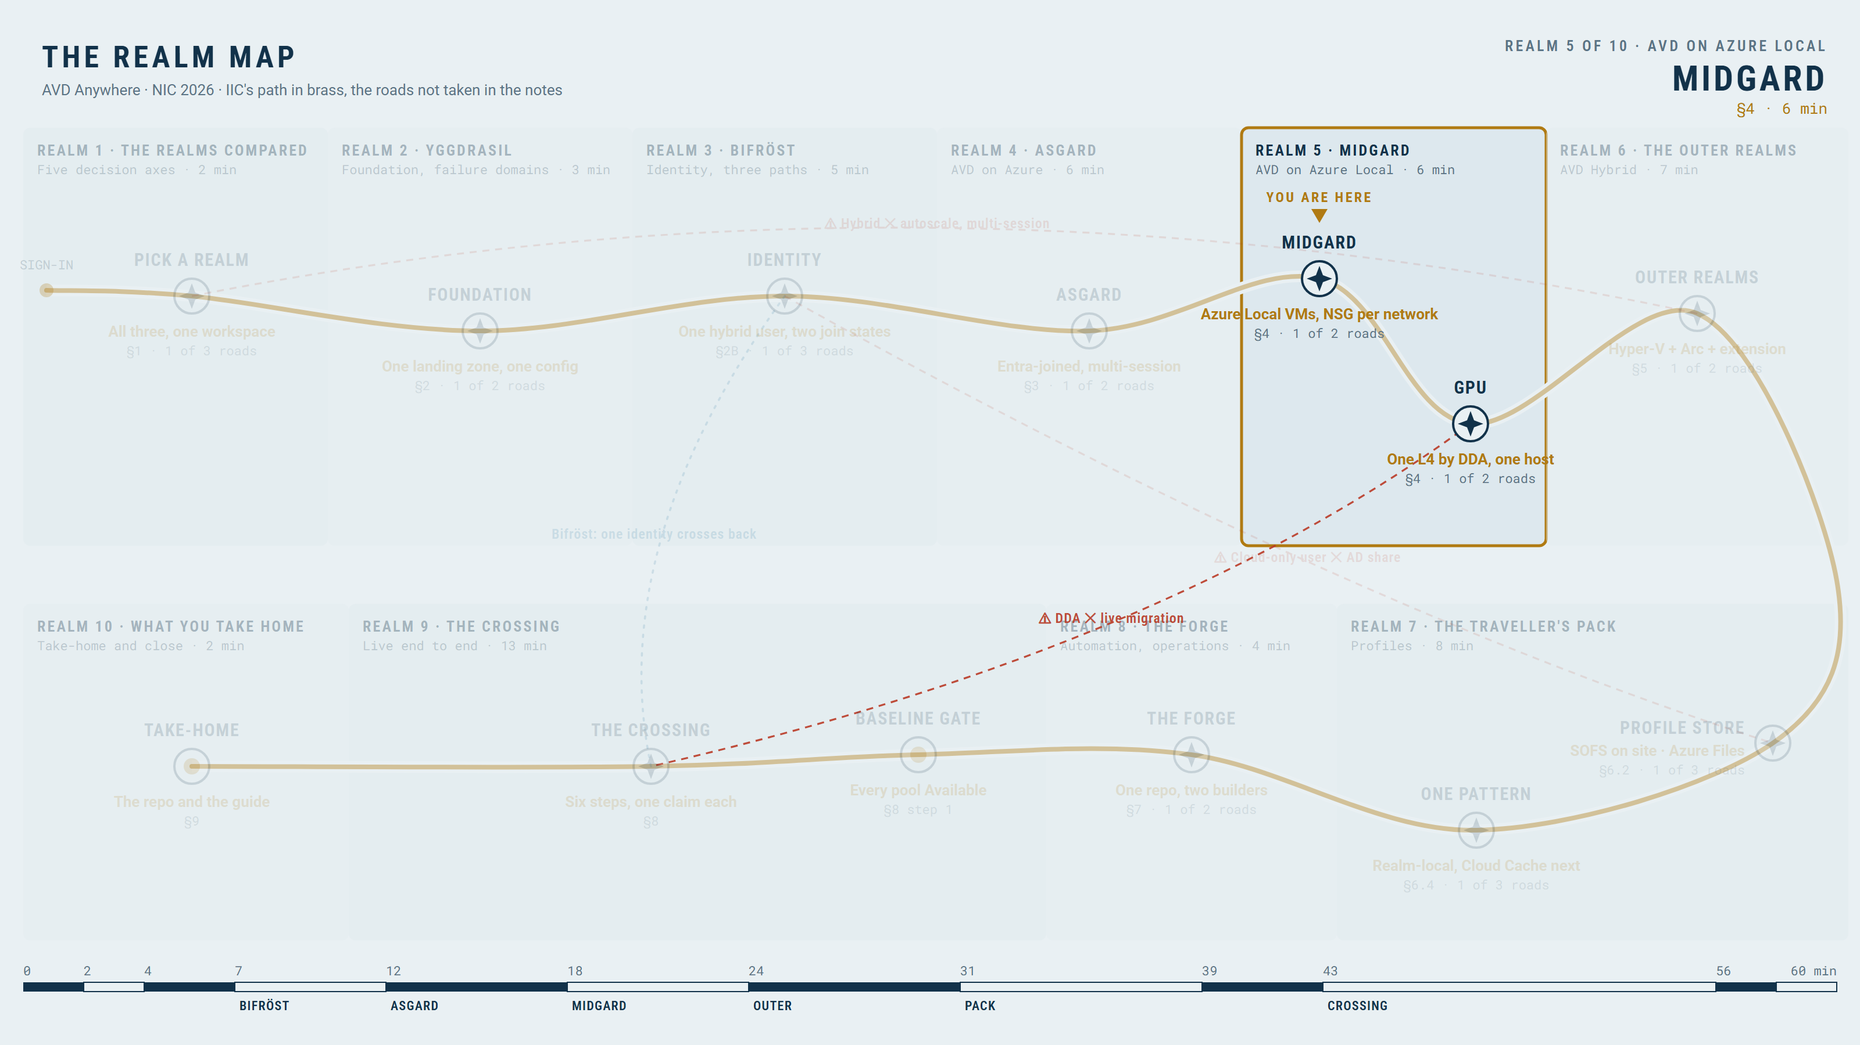
Midgard: AVD on Azure Local, compute at your site
MIDGARD · SECTION 4
Hosts are Azure Local VMs in a different landing zone.
Hosts in the Azure Local landing zone
Created from Azure through the Resource Bridge and custom location
On lnet-iic-nic26-avd-vlan2215-eus; its NSG admits RDP Shortpath from P2S only
Three hosts: al01, al02 and the GPU host al03; AD-joined by the domain-join extension, hybrid users
What breaks when the Resource Bridge is unhealthy
YOU ARE HERE · MIDGARD
Azure
Azure Local
Hybrid
17

Slide 18
Images for Azure Local, and the host pool you can touch
LIVE DEMO
There is no direct Image Builder target for Azure Local.
AIB to gallery or VHD
Import as an Azure Local image
Or marketplace images downloaded to the cluster
Azure
Azure Local
Hybrid
18

Slide 19
SMB, not CSV, sized bottom-up: and one GPU host by DDA
LIVE DEMOS · 2
A CSV is not an SMB share; draw the serving layer and its failure boundary.
CSV is storage; FSLogix needs an SMB path
File server VM or SOFS on the cluster, or Azure Files
This realm: a two-VM SOFS guest cluster on the same cluster; Azure keeps Azure Files
Sizing, bottom-up: 20 users × 30 GB + 20 % = 720 GB → 2 SOFS VMs on 2 × 1.5 TiB CSVs → 6 TiB raw; restarts on one node
azurelocal.cloud/azurelocal-avd · azurelocal.cloud/azurelocal-sofs-fslogix/architecture/capacity-planning
One L4 per node by DDA to the GPU host al03: whole device, no vGPU licence, no live migration
Azure
Azure Local
Hybrid
19

Slide 20
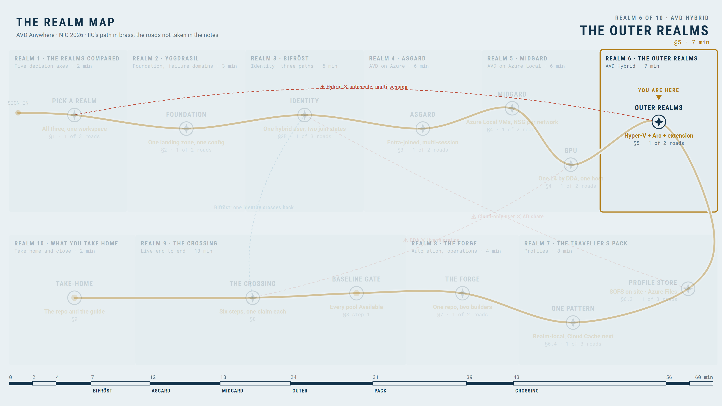
The outer realms: AVD Hybrid in four steps, Arc is the bridge
THE OUTER REALMS · SECTION 5
The service stays in Azure; hosts run on your hypervisor; Arc is the bridge.
1. Create a Windows VM with your tools
2. Install the Arc agent in the guest
3. Add the AVD Hybrid extension with a registration token
4. Host Available (documented expectation: up to 15 minutes; set a timeout)
No hypervisor integration; everything happens inside the guest
AVD never powers, scales, replaces or patches this VM: you own the lifecycle
YOU ARE HERE · THE OUTER REALMS
Azure
Azure Local
Hybrid
20

Slide 21
Terms of residence: requirements, limits, plain Hyper-V VMs
LIVE DEMO
What Hybrid requires of the Arc machine and does not offer.
Win11 Enterprise single-session or Windows Server; no multi-session
Win11: Entra, AD or hybrid join; Server: AD or hybrid. This lab: AD join in the build, like Azure Local (one SOFS); hv01 and hv02, one per node
Standard pool; its managed identity has Reader on the Arc machines' resource group (here: inside the AVD landing zone)
Arc onboarding by service principal, secret in memory, rotated; outbound 443 to AVD and Arc endpoints; RDP Shortpath
No autoscale, power management, Start VM on Connect, Session Host Configuration
Azure
Azure Local
Hybrid
21

Slide 22
Same intent, different plumbing: the extension and the hypervisors
LIVE DEMO
One extension, one token, one host.
Arc-enabled VM
CloudDeviceExtension + token
Host Available
You own power and recovery
Hyper-V: tested in the repo
vSphere and AHV: reference templates, labelled as such
Arc-enabled VMware is not required
Azure
Azure Local
Hybrid
22

Slide 23
The forge without Image Builder: Packer, identity, network, GPU
Packer plus platform-native tools, running the same customisation scripts AIB runs; the domain join and the FSLogix profile...
hyperv-iso (tested), vsphere-iso and Nutanix plugin (reference): one build, the AIB customisation scripts reused
Domain join (AD) and the FSLogix settings profile in the build; SSO back to Entra
Outbound only through the firewall allow-list; RDP Shortpath; GPU per hypervisor, AVD neither adds nor blocks
Windows 11 patching: Intune or Windows Update for Business; Azure Update Manager does not cover Windows 11
Arc here: AMA + DCR, AVD Insights, inventory. Update Manager, Policy, Defender, Arc licensing: Room 5, 14:40
Azure
Azure Local
Hybrid
23

Slide 24
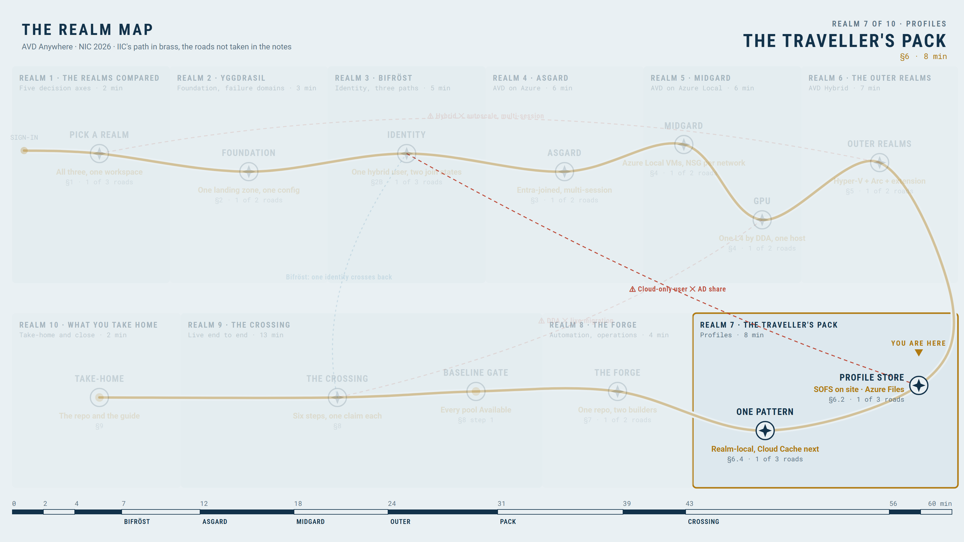
The traveller's pack: where it can live, and who can open it
THE TRAVELLER'S PACK · SECTION 6
The profile store and the session-host identity are one decision: FSLogix mounts the container as the signed-in user over SMB, so...
Profile store | Auth on the share | Entra host, cloud-only user | Entra host, hybrid user | AD/hybrid host, hybrid user
Azure Files | Entra Kerberos | Yes (GA) | Yes | Yes
Azure Files | AD DS | No | Yes, DC in sight | Yes
Azure NetApp Files | AD DS | No | Yes, DC in sight | Yes
SOFS on Azure Local | AD DS | No | Yes, DC in sight | Yes, native
File server VM / NAS / vSAN FS / Nutanix Files | AD DS | No | Yes | Yes (a single VM: no transparent failover)
Entra Domain Services + Azure Files | Entra DS | No | Entra DS-joined hosts only | —
YOU ARE HERE · THE TRAVELLER'S PACK
Azure
Azure Local
Hybrid
24

Slide 25
Three realms, three packing lists: the options and the lab's choice
Per realm: how hosts join, where the profile can live, how the host reaches it, and what this lab chose (D-050).
Realm | Host join | Profile options | Path to the profile | Lab choice
AVD on Azure | Entra join; hybrid join; AD join | Azure Files (Entra Kerberos or AD DS), Azure NetApp Files, file server VM | In region; public or private endpoint | Entra-joined, Azure Files + Entra Kerberos
AVD on Azure Local | AD DS join (+ hybrid join for SSO) | SOFS on the cluster, Azure Files over the WAN, file server VM, NAS | SOFS: VLAN 2215 → 2216 on the same cluster, SMB 3 CA; Azure Files: outbound 445 | AD join (hybrid join pending), SOFS (two VMs, one per node)
AVD Hybrid | Entra, AD or hybrid join | Same as Azure Local, or Azure Files | On-site SOFS, or Azure Files outbound 445 | AD join, SOFS (same site, same users)
Azure
Azure Local
Hybrid
25

Slide 26
Splitting the pack: Profile, ODFC and the settings that matter
LIVE DEMO
Two containers, different size, tier and retention.
Profile: the profile
ODFC: Outlook OST, Teams, OneDrive cache, search
VHDLocations, ODFC VHDLocations
FlipFlopProfileDirectoryName, PreventLoginWithFailure
redirections.xml keeps caches out
Azure
Azure Local
Hybrid
26

Slide 27
One pattern, three realms, no teleportation clause
Multiple providers, local reads: resilience, not conflict resolution.
A: one Azure Files share, Entra Kerberos, from all three realms: simplest; on-site realms pay WAN latency
B (the target, not built yet, D-053): Cloud Cache, CCDLocations = SOFS + Azure Files: LAN speed on site, the profile follows the user to Azure
C (the lab today): realm-local containers: the SOFS for Azure Local and Hybrid, Azure Files for Azure
Same hybrid user (UPN, SID) and one FSLogix configuration profile
Cloud Cache costs: a local cache disk and logoff flush time; the host must authenticate to every provider
Azure
Azure Local
Hybrid
27

Slide 28
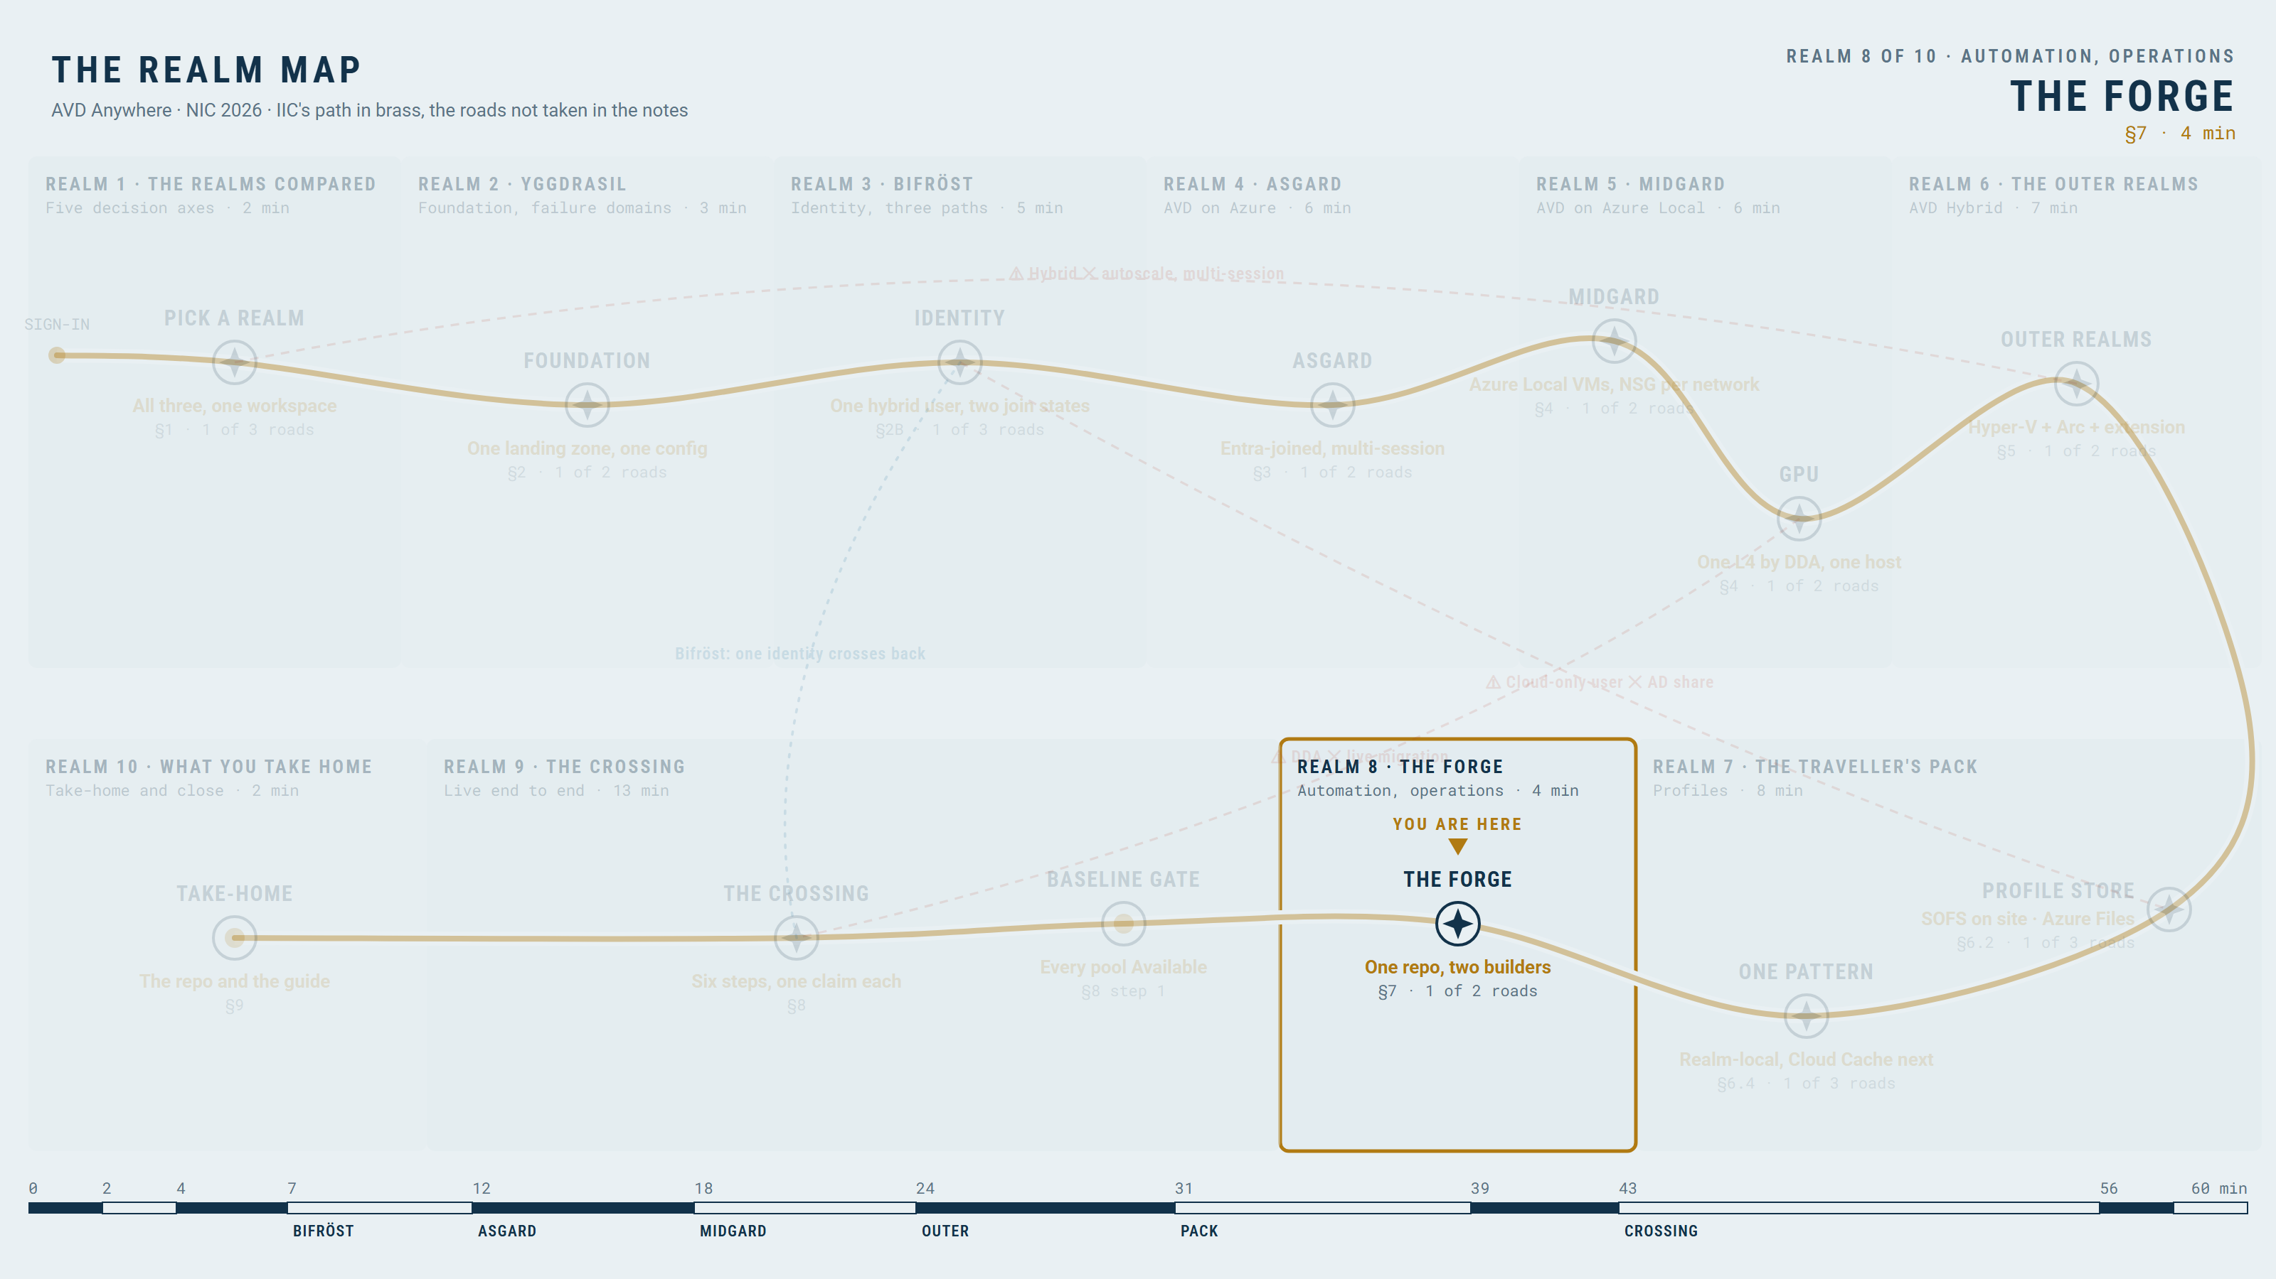
The forge, one repo: reuse the intent, declare the differences
THE FORGE · SECTION 7
LIVE DEMO
One commit, one image version, builder-specific steps.
Shared intent, platform-specific implementation
No template works unchanged everywhere
YOU ARE HERE · THE FORGE
Azure
Azure Local
Hybrid
28

Slide 29
The operating model: ownership is not an optional parameter
Monitoring is common; patching, power and recovery are not.
Task | Azure | Azure Local | AVD Hybrid
Guest patching | Image replacement; Intune or WUfB for Windows 11 | Same; Update Manager covers servers, not Windows 11 | Same; Intune or WUfB
Host or hypervisor patching | Microsoft | Lifecycle Manager: you schedule, Azure orchestrates | You, with your hypervisor tooling
Power and scaling | Scaling plan, Start VM on Connect | Verify; otherwise you | You: none from AVD
Monitoring | Insights and Log Analytics | Same workspace, via Arc | Same workspace, via Arc
Failed VM recovery | Redeploy from the image | Cluster and operator | The hypervisor, not AVD
Azure
Azure Local
Hybrid
29

Slide 30
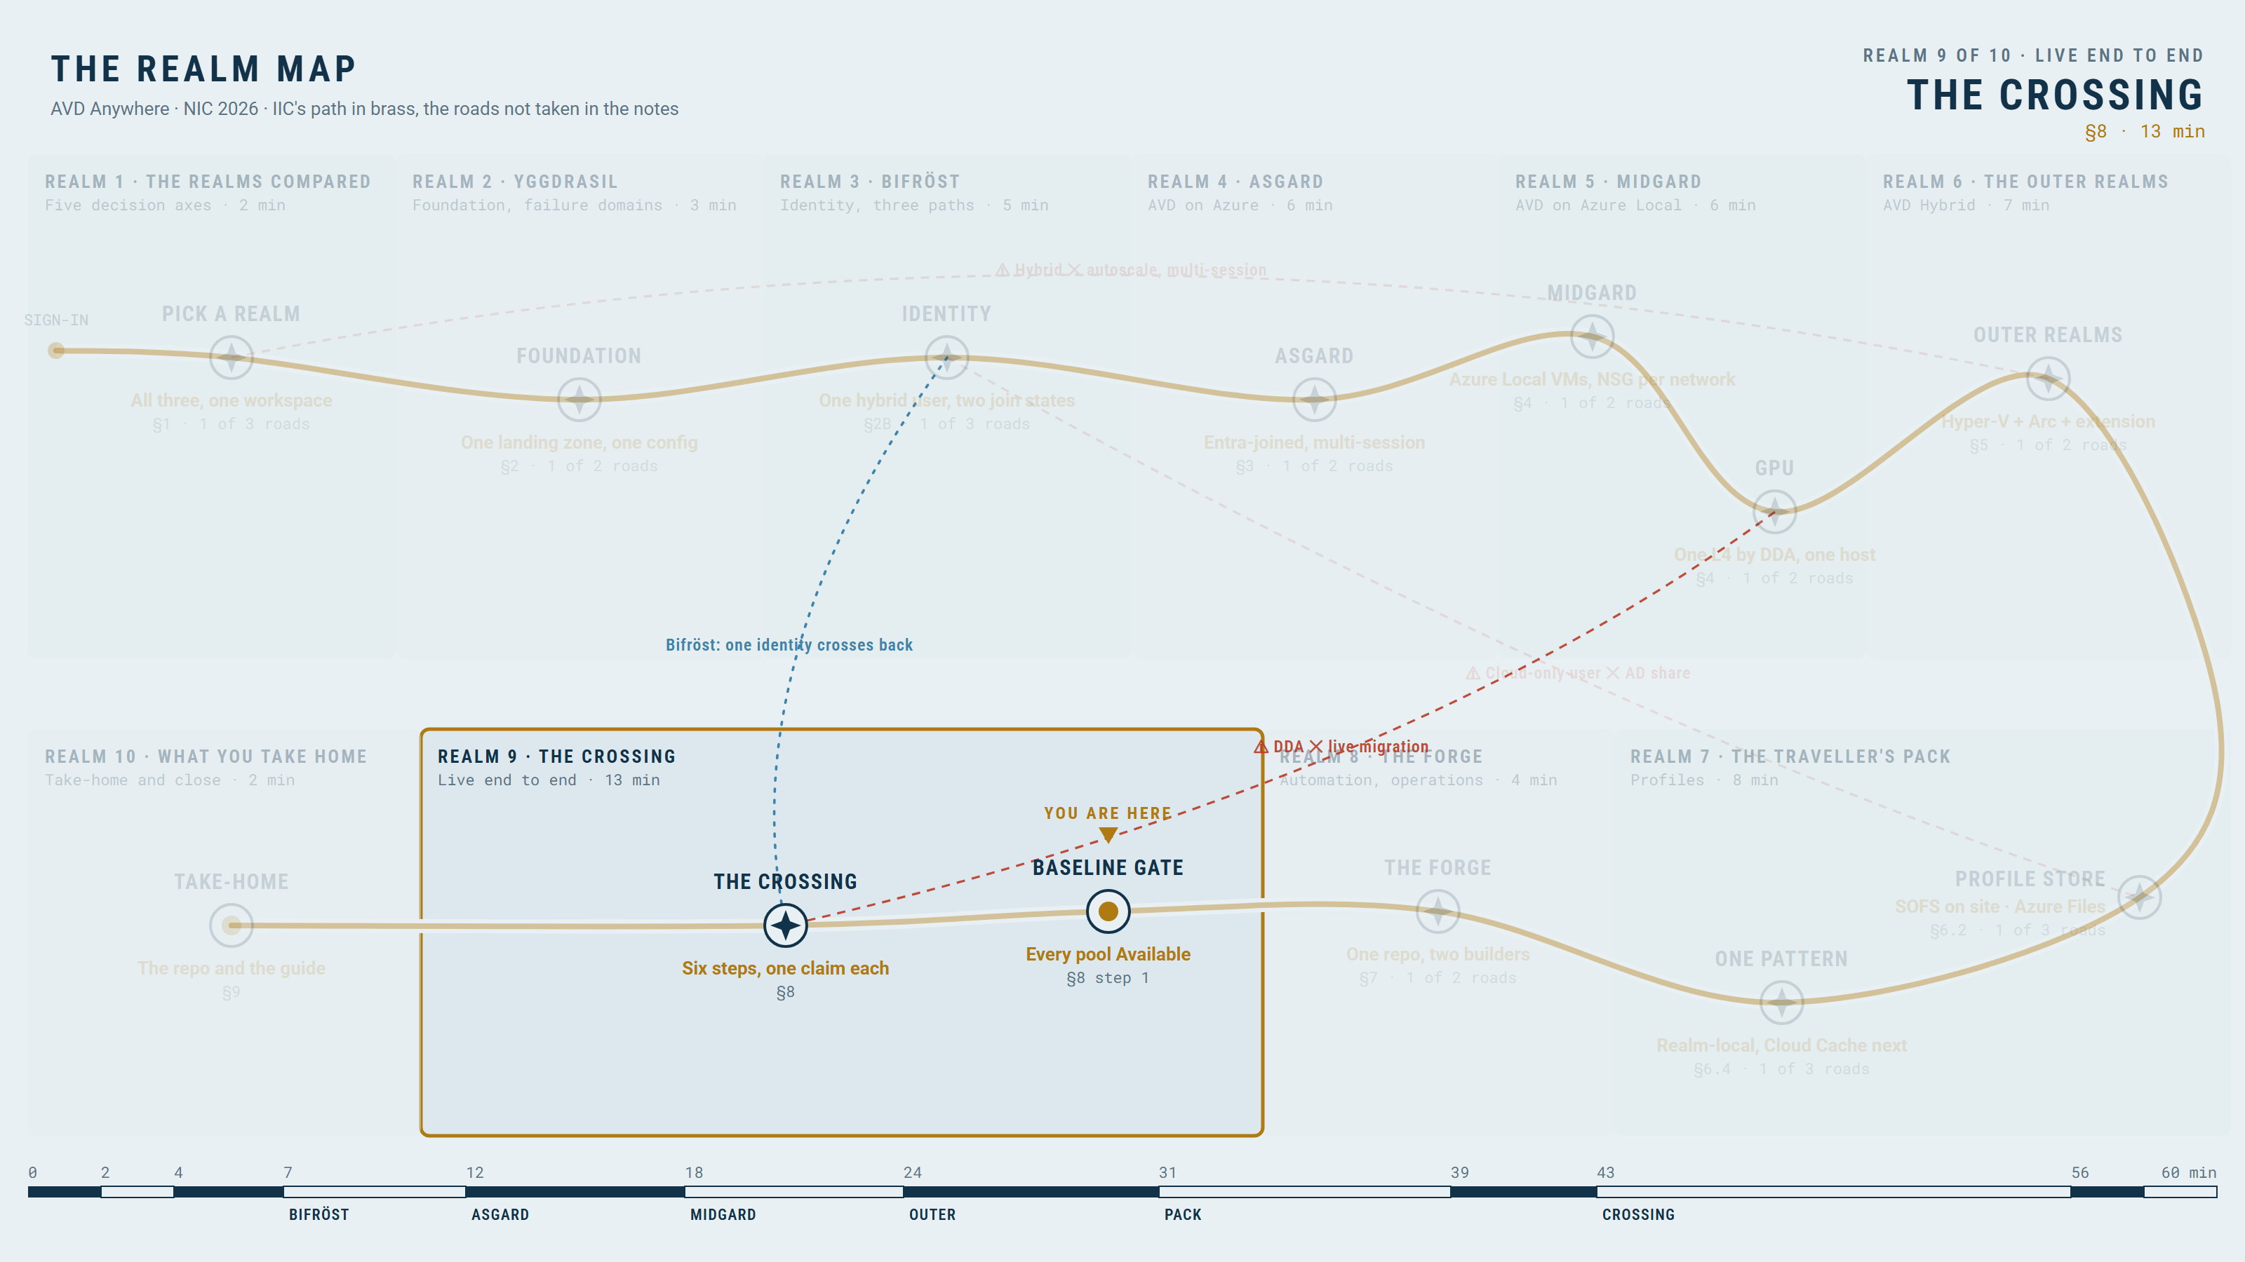
The crossing: six steps, one claim each, Heimdall watching
HEIMDALL WATCHES · SECTION 8
LIVE DEMOS · 6
One continuous test: six checkpointed steps, each with a clip and a prepared recovery state behind it.
Step | Action | Observable proof | Pass condition
1 State | Show the three pools and the user | Three desktops, hosts Available | Entitlement is not routing
2 Entitle | Change the user's group, refresh the feed | Different desktops appear | Feed matches the group
3 Portable | Sign in on each realm | Known file on Azure Local and Hybrid (same SOFS container); Azure has its own until pattern B | Same SID, container attached
4 Fail | Hard power-off a Hybrid host | Host Unavailable; new session on host 2 | Saved work present, unsaved lost
5 Watch | Query the one workspace | All three realms in one view | Persistence is not recovery
6 Explain | Investigate the host alert (agent, preview) | Findings, ruled-out causes, next steps | It reasons from Azure-side signals only
YOU ARE HERE · HEIMDALL WATCHES
Azure
Azure Local
Hybrid
30

Slide 31
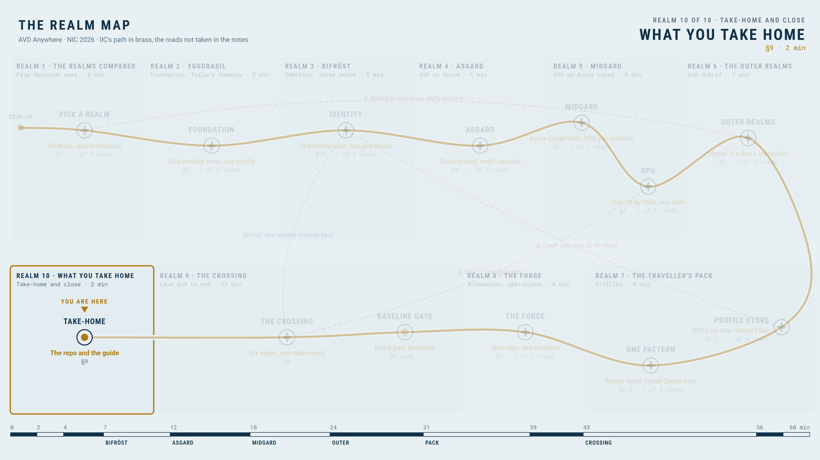
What to decide, validate and run next: the take-home
TAKE-HOME, TOMORROW'S SESSION, OTHER SESSIONS, CLOSE · SECTION 9
The five axes are the decision; the support table lists what to verify; the repo is what you run.
Decide: which realm for which workload (the five axes)
Validate: every 'verify' cell in the support table, in your tenant
Run: the repo, one config file and the follow-along guide
Questions in the hallway; the repo is yours
YOU ARE HERE · TAKE-HOME, TOMORROW'S SESSION, OTHER SESSIONS, CLOSE
Azure
Azure Local
Hybrid
31

Slide 32
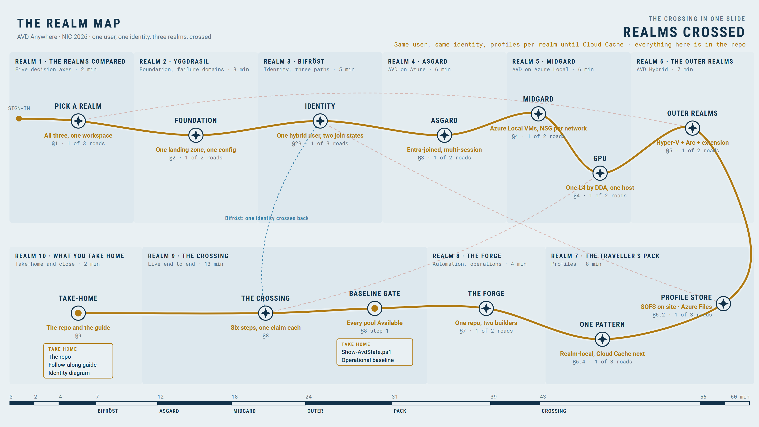
The crossing in one slide: every realm crossed, and what you take home
Azure
Azure Local
Hybrid
32

Slide 33
Tomorrow: Azure Local, from discovery to Day 2
The cluster under all this, how it was planned, deployed and operated.
We just saw AVD land on an Azure Local cluster. Tomorrow: how that cluster was planned for these desktops, built and run.
Thu 15 Oct, 09:50, Room 5: plan and discover; deploy and Day-2 ready; operate
Same cluster, same repo, live
Azure
Azure Local
Hybrid
33

Slide 34
Next door at 14:40, and you may also like
The first card is a hand-off, not a recommendation: the Arc side of AVD Hybrid continues in Room 5 twenty minutes from now.
Hand-off: Breaking the Platform Barrier: AVD Hybrid on Any Hypervisor (Gregor Reimling & Marcel Meurer, L300, Wed 2:40 pm, Room 5). We built the hosts, the identity and the profile; they take Arc design before onboarding, how the Arc and AVD agents work together, and day-2 with Update Manager, Policy, Defender and licensing
Combining identity and network controls in Azure (Kristoffer Hatland, L400, Thu 1:00 pm, Room 3)
10 security settings you must configure in Windows 11 (Nicklas Ahlberg, L300, Thu 11:10 am, Room 5)
Times are Oslo time. Rooms can change: check the NIC agenda.
Azure
Azure Local
Hybrid
34

