Slide 1
Hybrid Cloud: Plan, Deploy, and Operate Azure Local from Discovery to Day 2
Kristopher Turner · NIC 2026 · Thu 15 Oct, 09:50

Slide 2
IIC wants Azure Local: the ship, and the versions on board
The job, a two-node validated system reached remotely, and the exact release it runs: a lab smaller than the real thing, with...
Fictional customer: IIC
2 x AX-760 nodes, switch pair, firewall pair, console server; reached remotely over a VPN
Azure Local 12.2609.1003.7 (OS 26100.33438): the latest at build time
Abstract: sizing against 2604. On stage: sizing against whatever is current when you deploy
Preview on stage: simplified machine provisioning (a feature, not the release)
Repo tag and last validation date
Chart
Build
Seaworthy
Cargo
Storm
Harbour
2

Slide 3
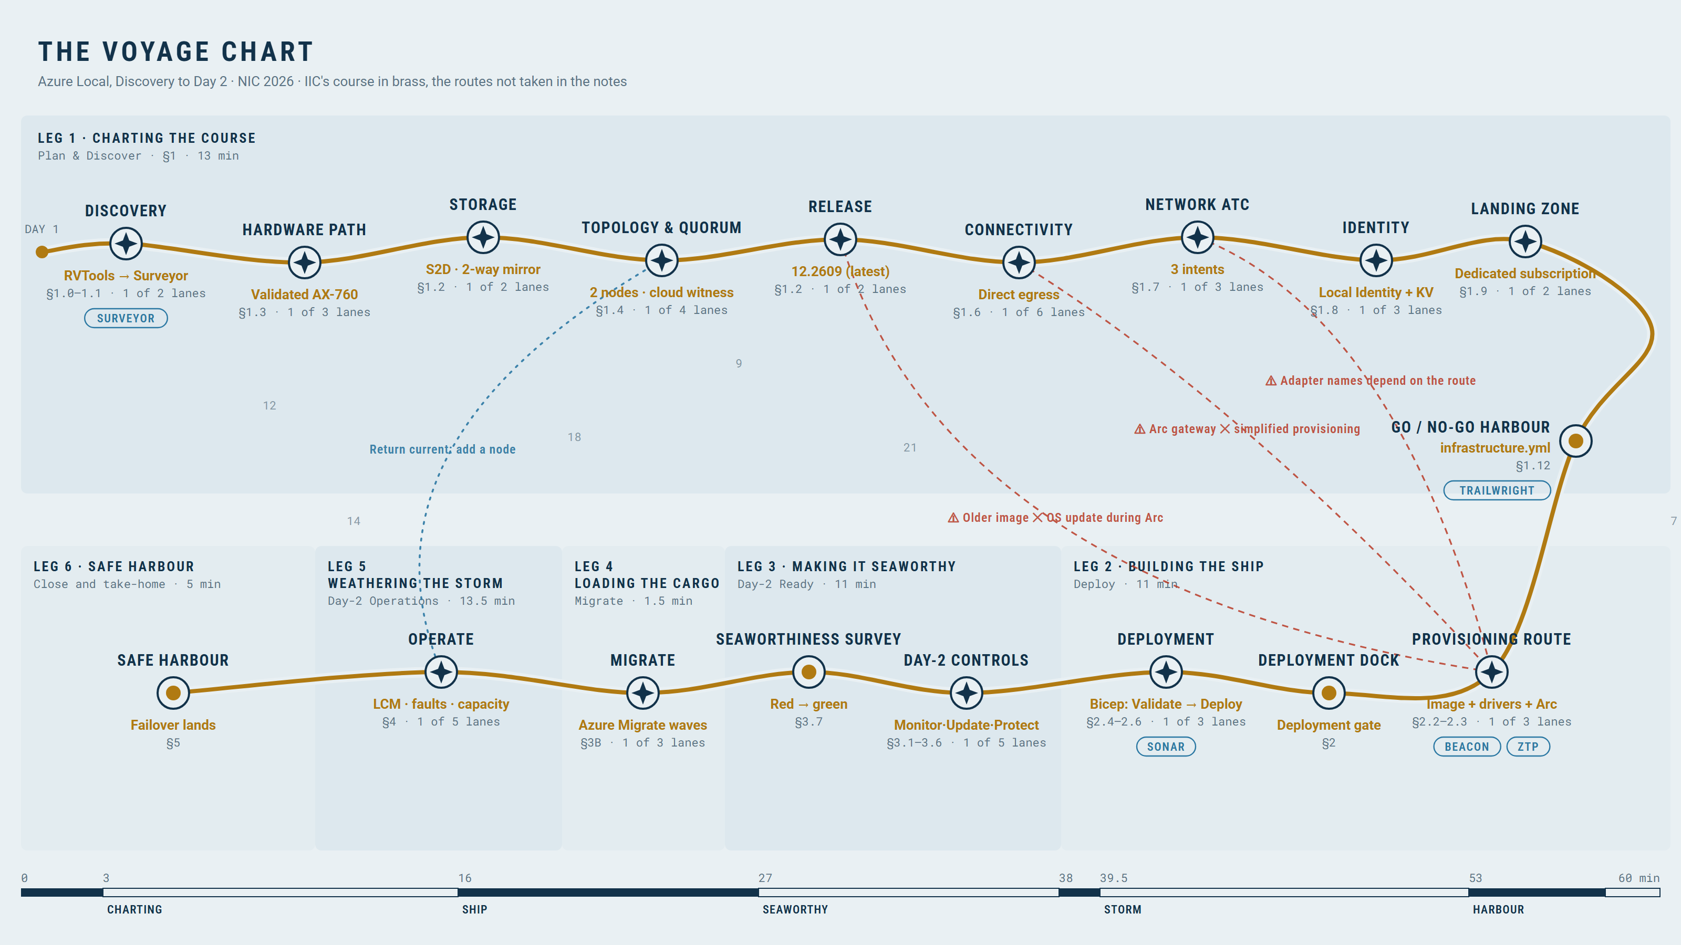
The Voyage Chart: the whole session on one map
Chart
Build
Seaworthy
Cargo
Storm
Harbour
3

Slide 4
Five tools along the course: assess, design, check, provision, listen
The owner's tool family, each at its step on the chart, and which beats are live, recorded or yours to follow along.
Tool | Step | What it does | On stage
Surveyor | 1.1–1.2 | Assess the estate and size the cluster | Live, follow-along
Trailwright | 1.12 | Design record, validation, infrastructure.yml export | Live, follow-along
Beacon | 2.2 | Pre-deployment check from virtual media, before any OS | Recorded, 30 s
ZTP | 2.3 | Provision the machines (simplified provisioning, preview) | Recorded, 30 s
Sonar | 2.4 | Watch Validate and Deploy, step by step, with the logs | Live replay of the recorded deployment
Chart
Build
Seaworthy
Cargo
Storm
Harbour
4

Slide 5
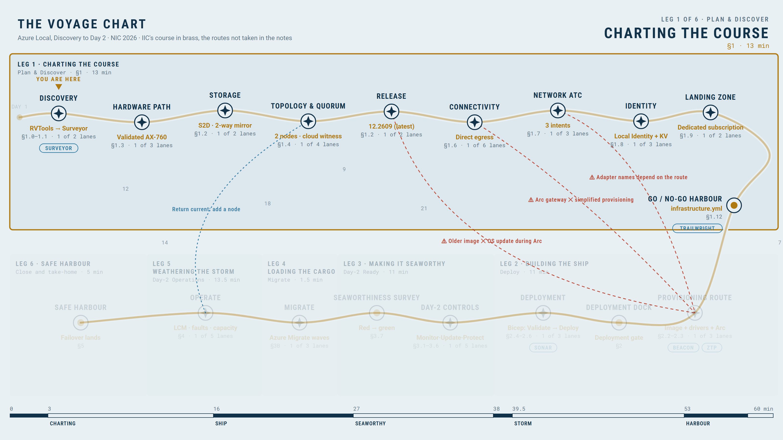
Charting the course: kick-off, assessment and what it cannot see
CHARTING THE COURSE · SECTION 1
LIVE DEMOS · 2
Two routes to the same evidence: what each finds, what each misses, and which output enters the design package.
Tenant, identity, access, landing zone, automation, network, hardware, naming, workloads, continuity
RVTools from the VMware team, or Azure Migrate discovery
Both feed Azure Local Surveyor
The workload: the IIC estate plus AVD on Azure Local (session hosts, SOFS profile shares)
Record missing evidence; do not invent it
YOU ARE HERE · CHARTING THE COURSE
Chart
Build
Seaworthy
Cargo
Storm
Harbour
5

Slide 6
Sizing: usable capacity, minus wishful thinking
LIVE DEMO
Demand (the IIC estate plus the AVD session hosts and SOFS nodes), resiliency, node-loss reserve, growth, usable.
Workload demand
Growth headroom
Resiliency copies
Rebuild reserve
Usable capacity
Demand: IIC estate + AVD session hosts + SOFS nodes
Two-way mirror on two nodes
N-1 maintenance reserve
Release decision: latest supported at build time
Chart
Build
Seaworthy
Cargo
Storm
Harbour
6

Slide 7
Hardware paths, topology and quorum: count votes, not hopes
Existing hardware or new purchase: discover the whole site, verify support and map observed server/fabric evidence into the...
Decision: validated integrated system (two AX-760)
Two-way mirror: one fault from zero redundancy
Inventory: servers, NIC ports/MACs, drives/controllers, boot media; ToR/OOB switches, firewall, uplinks
Outputs: provenance, supported hardware/firmware review, approved JSON-to-YAML mapping
Rack Aware: not chosen here, and not proven by this demo
One node plus the witness lost: quorum lost, cluster offline
Chart
Build
Seaworthy
Cargo
Storm
Harbour
7

Slide 8
One GPU per node: DDA for one AVD host, and what it does to Day 2
Partitioning or passthrough is decided per workload.
 | DDA (passthrough) | GPU partitioning
What the VM gets | The whole GPU | A slice of the GPU
Licence | None for DDA and the data center driver | NVIDIA vGPU software (vApps, vPC or vWS)
Live migration | No: restarts on a node with a free GPU, or stays off | Supported with conditions
IIC choice | Yes: one L4 per node, one GPU session host (D-051) | No licence, not used
Chart
Build
Seaworthy
Cargo
Storm
Harbour
8

Slide 9
Site and connectivity: a failed prerequisite has a price
A failed prerequisite and its deployment consequence.
Management, compute, storage and OOB paths; gateways, DNS/NTP, routing, egress and return path
Full sanitized ToR/OOB/firewall exports; VLANs, ports, trunks, MTU, ACLs and NAT
Recommendation: Arc gateway (new deployments on 2506 or later; it cannot be enabled afterwards) or proxy plus Arc gateway
Preview constraint: the provisioning preview used here does not support the gateway
Lab: direct egress with the full allow-list (D-024)
Chart
Build
Seaworthy
Cargo
Storm
Harbour
9

Slide 10
Demo: Network ATC intent design, preferably intentional
LIVE DEMO
VLAN isolation and physical convergence are separate decisions; reviewed site evidence maps to approved Network ATC intents.
Three intents
management, compute, storage
Management/compute
same VLAN, separate VLANs on shared adapters, or dedicated adapters
Read back the approved choice; map ports/MACs, tagging, MTU and storage/RDMA requirements
Workload VLANs follow the workloads
2204 compute, 2215 AVD, 2216 SOFS, 2217 app, 2218 data, 2219 isolated
Chart
Build
Seaworthy
Cargo
Storm
Harbour
10

Slide 11
Identity, landing zone and naming: future you has to read this
Local Identity with Key Vault, and who may do what.
Local Identity with Key Vault: no domain join, no OU
Workloads decide their own identity: the SOFS needs AD, so its VMs and the AVD hosts join AD; hybrid users synced by Microsoft Entra Cloud Sync, agent on its own member server
Dedicated subscription under the landing-zones management group
Supported with this model: Azure portal, PowerShell, Azure Monitor. Not Windows Admin Center
Naming: nic26 site token
Groups, Azure RBAC, PIM eligibility
Chart
Build
Seaworthy
Cargo
Storm
Harbour
11

Slide 12
Continuity, then the go/no-go: Trailwright turns the design into infrastructure.yml
LIVE DEMO
RPO/RTO per tier and the operating requirements decided now.
Azure Backup for all tiers; Site Recovery for tier 1 with a quarterly test
Monitoring scope and cost ceiling; maintenance windows; update ownership
Trailwright
the design record, validated, one bad value caught
Export
infrastructure.yml and a Bicep starting point; a handoff, not the deployment
Chart
Build
Seaworthy
Cargo
Storm
Harbour
12

Slide 13
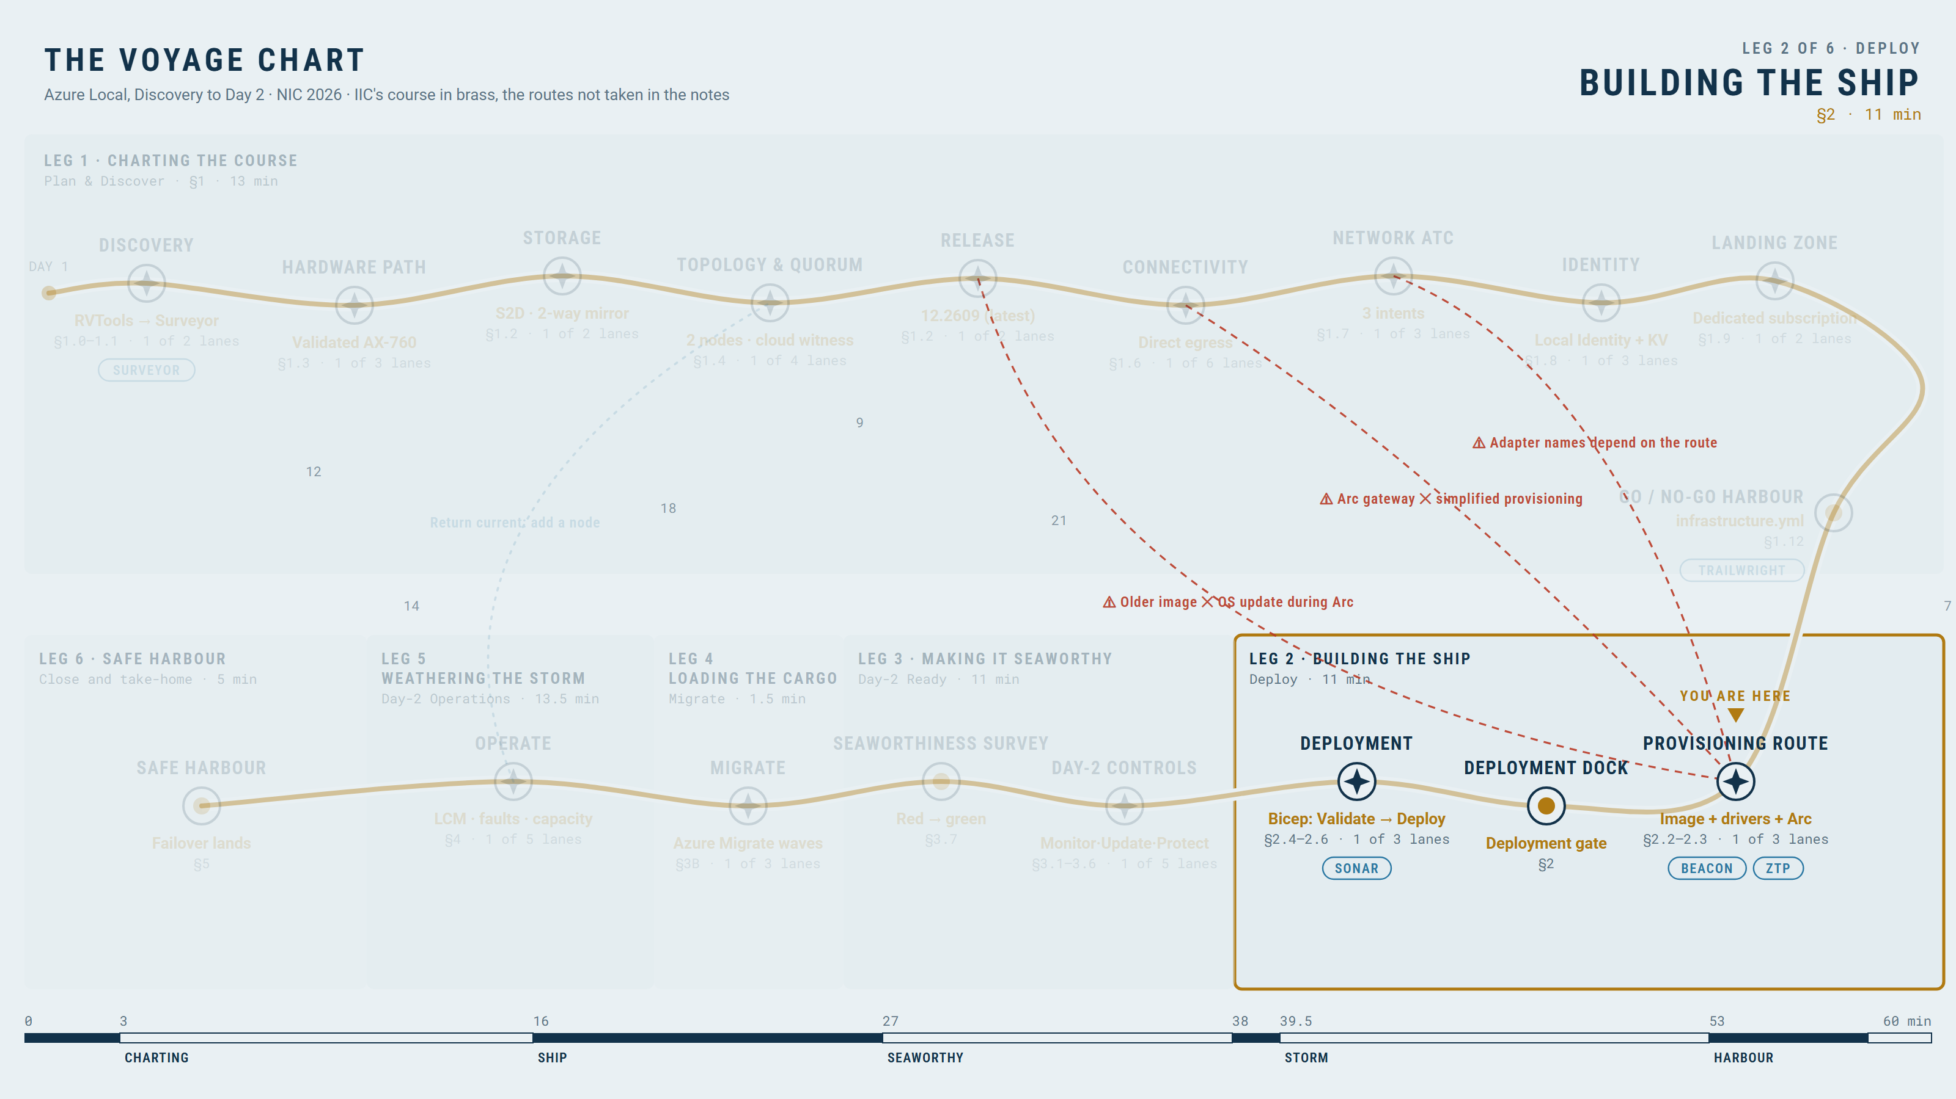
Building the ship: Beacon sounds the harbour, two routes to an Arc-registered machine
BUILDING THE SHIP · SECTION 2
LIVE DEMOS · 2
Foundation and site checks first, Beacon before any OS; then the machines get an OS and Arc by one of two routes, and the preview...
Foundation: resource groups, providers, workspace, Key Vault, witness, spoke, tags, budgets
Beacon before any OS: target disk, network, DNS, Azure endpoints (Environment Checker)
Route A, simplified machine provisioning (preview): Ready to cluster, then Deploy stopped on device-ID Arc names
Route B, image + drivers + Arc registration (GA): the event cluster; Arc names = host names
YOU ARE HERE · BUILDING THE SHIP
Chart
Build
Seaworthy
Cargo
Storm
Harbour
13

Slide 14
One setting, every layer, and the what-if before the what-have-we-done
LIVE DEMO
The layers the setting passes through, then a read-only preview of the deployment package.
infrastructure.yml
Bicep parameter
Portal field
Deployment result
Validation
What the what-if cannot validate
Chart
Build
Seaworthy
Cargo
Storm
Harbour
14

Slide 15
The deployment time-lapsed, Sonar listening beside it, and the intents running for real
LIVE DEMOS · 2
Honest durations, and the real run's steps and logs beside them: the Resource Bridge step alone is 40 to 45 minutes.
Validate about 10 minutes; Deploy 2.5 to 3 hours
Sonar
every step, its status and duration, and the seed-node logs
Local Identity bootstrap
node in WORKGROUP, secrets in the vault
Chart
Build
Seaworthy
Cargo
Storm
Harbour
15

Slide 16
Post-deployment validation, then a little red
LIVE DEMO
A healthy deployment is not a Day-2-ready platform.
Validate
Deliberate red
Fix
Green
Chart
Build
Seaworthy
Cargo
Storm
Harbour
16

Slide 17
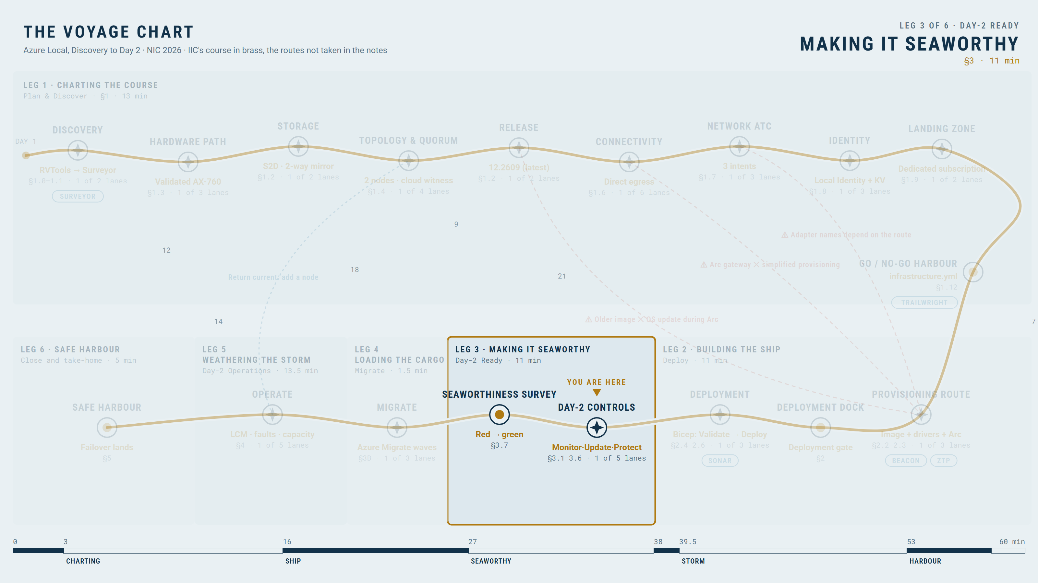
Making it seaworthy: Monitor, Heimdall and the bill
MAKING IT SEAWORTHY · SECTION 3
LIVE DEMO
The DCR is the cost decision.
Lab workspace law-iic-nic26-eus-01: 30 days, 2 GB/day cap; security data in its own Sentinel workspace
Health, storage, intents, cluster: not the firehose
DCRs do not control every ingestion source
Preview: Azure Copilot Observability Agent investigates alerts on the same data; billed per use
YOU ARE HERE · MAKING IT SEAWORTHY
Chart
Build
Seaworthy
Cargo
Storm
Harbour
17

Slide 18
Who updates what, and who told Windows 11
LIVE DEMO
Two update planes, two owners; Windows 11 is a third.
Cluster: Lifecycle Manager
Guests: Azure Update Manager
Windows 11 clients (the AVD session hosts): Intune or Windows Update for Business
Maintenance window: Sunday 02:00 US Eastern, first run 18 Oct (after the event); dynamic scope by tag
No patch run is shown
Chart
Build
Seaworthy
Cargo
Storm
Harbour
18

Slide 19
Backup versus DR: hope has no RPO
LIVE DEMO
Backup is recovery in hours; Site Recovery is continuity in minutes.
Azure Backup as the worked example; any backup solution applies
Restore tests land on the isolated network, never next to production
As built: vault and policies in place; Site Recovery replication waits (node preparation needs approval; Trusted launch VMs are not supported)
Chart
Build
Seaworthy
Cargo
Storm
Harbour
19

Slide 20
Eligible, not standing: access with an audit trail
LIVE DEMO
Operators hold eligible roles, activate with justification and MFA, and every activation leaves an audit entry.
PIM
eligible, not standing; activation with justification and MFA
Azure Local administrator, VM contributor and VM reader roles scoped to the landing zone
The audit entry is the evidence, not the activation
Chart
Build
Seaworthy
Cargo
Storm
Harbour
20

Slide 21
One policy set, Defender for Cloud on everything: the security baseline as production
LIVE DEMO
Policy audits and inherits tags at subscription scope; Defender for Cloud covers the cluster and every Arc-enabled VM on it.
Policy at subscription scope on both landing zones: audit, not block; tags inherited; activity log and security events to the Sentinel workspace
Defender CSPM, Defender for Servers P2, Storage, Key Vault, Resource Manager
Azure Local machines exempt from per-machine agent policy: the agent is a cluster extension
Compliance evaluation is not instant: show the existing result
Chart
Build
Seaworthy
Cargo
Storm
Harbour
21

Slide 22
Microsoft Sentinel: the security log gets its own workspace
Sentinel on a dedicated workspace with the Defender for Cloud, Azure Activity, Entra ID and Windows Security Events connectors...
Dedicated workspace, 90 days, its own daily cap and alerts
Connectors
Defender for Cloud, Azure Activity, Microsoft Entra ID, Windows Security Events (AMA)
Analytics
starter rules plus Fusion and Defender incident creation
One incident, from alert to the entity, in one glance
Chart
Build
Seaworthy
Cargo
Storm
Harbour
22

Slide 23
The workload platform: six logical networks, a rule book each
LIVE DEMO
SDN enabled by Arc puts an NSG on every logical network, managed from Azure like the VMs.
Logical network | VLAN | Workload | NSG admits
lnet-iic-nic26-compute-vlan2204-eus | 2204 | General VMs, demo and ASR source VMs | Admin (RDP, WinRM, SSH, ICMP), internal web
lnet-iic-nic26-avd-vlan2215-eus | 2215 | AVD session hosts | RDP Shortpath from P2S, break-glass RDP; never the data tier
lnet-iic-nic26-sofs-vlan2216-eus | 2216 | SOFS for FSLogix | SMB and SMB Witness from the AVD network only
lnet-iic-nic26-app-vlan2217-eus | 2217 | IIC app tier | Web 80/443 from internal and P2S; admin
lnet-iic-nic26-data-vlan2218-eus | 2218 | IIC data tier | 1433 from the app tier (and jump hosts); never initiates to desktops
lnet-iic-nic26-isolated-vlan2219-eus | 2219 | Restore and migration tests | DNS and itself only
Chart
Build
Seaworthy
Cargo
Storm
Harbour
23

Slide 24
Storage for the cargo: fixed volumes, a repair reserve and a two-VM SOFS
Four fixed two-way mirror volumes sized for every VM both sessions use; one drive per node never allocated; the SOFS as two VMs,...
Volume or service | Size | Holds | Storage path or check
vmstore-01 / vmstore-02 | 2.5 TiB each, fixed | AVD session hosts, IIC VMs, demo and ASR VMs, images | One per volume, plus one for images
sofs-01 / sofs-02 | 1.5 TiB each, fixed | One SOFS VM each: OS + 4 × 256 GB data disks | One per volume
SOFS as built | nic26-sofs-cl, two VMs | Guest two-way mirror FSLogixData 720 GiB; share \\nic26-sofs.azurelocal.mgmt\Profiles, continuously available | 44 of 44 read-back checks passed
Repair reserve | One capacity drive per node | Never allocated: the drive fault repairs into it | —
Chart
Build
Seaworthy
Cargo
Storm
Harbour
24

Slide 25
The readiness gate: evidence, not hope
LIVE DEMO
Operational acceptance is verified controls, not configured ones.
Configured · Pending evidence · Verified · Failed · Not applicable
Platform validation and operational acceptance are separate gates
Chart
Build
Seaworthy
Cargo
Storm
Harbour
25

Slide 26
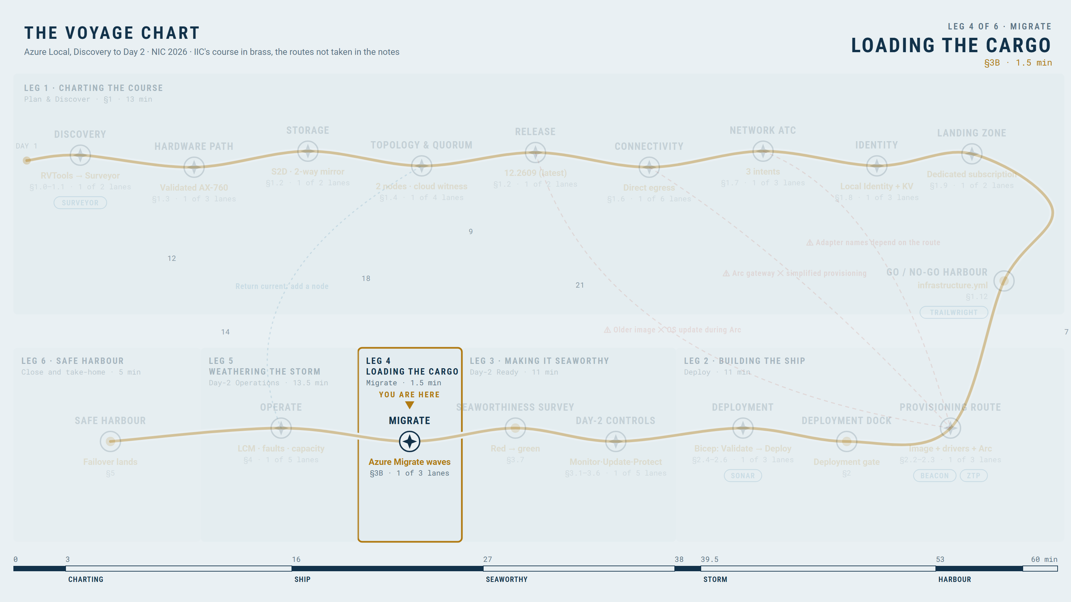
Loading the cargo with Azure Migrate
LOADING THE CARGO · SECTION 3B
LIVE DEMO
Assessed, migrated, operated: one inventory through the lifecycle.
Assess
Replicate
Test migrate
Cutover
Operate
Prepare, discover, target appliance on the cluster, replicate, migrate, verify, complete
YOU ARE HERE · LOADING THE CARGO
Chart
Build
Seaworthy
Cargo
Storm
Harbour
26

Slide 27
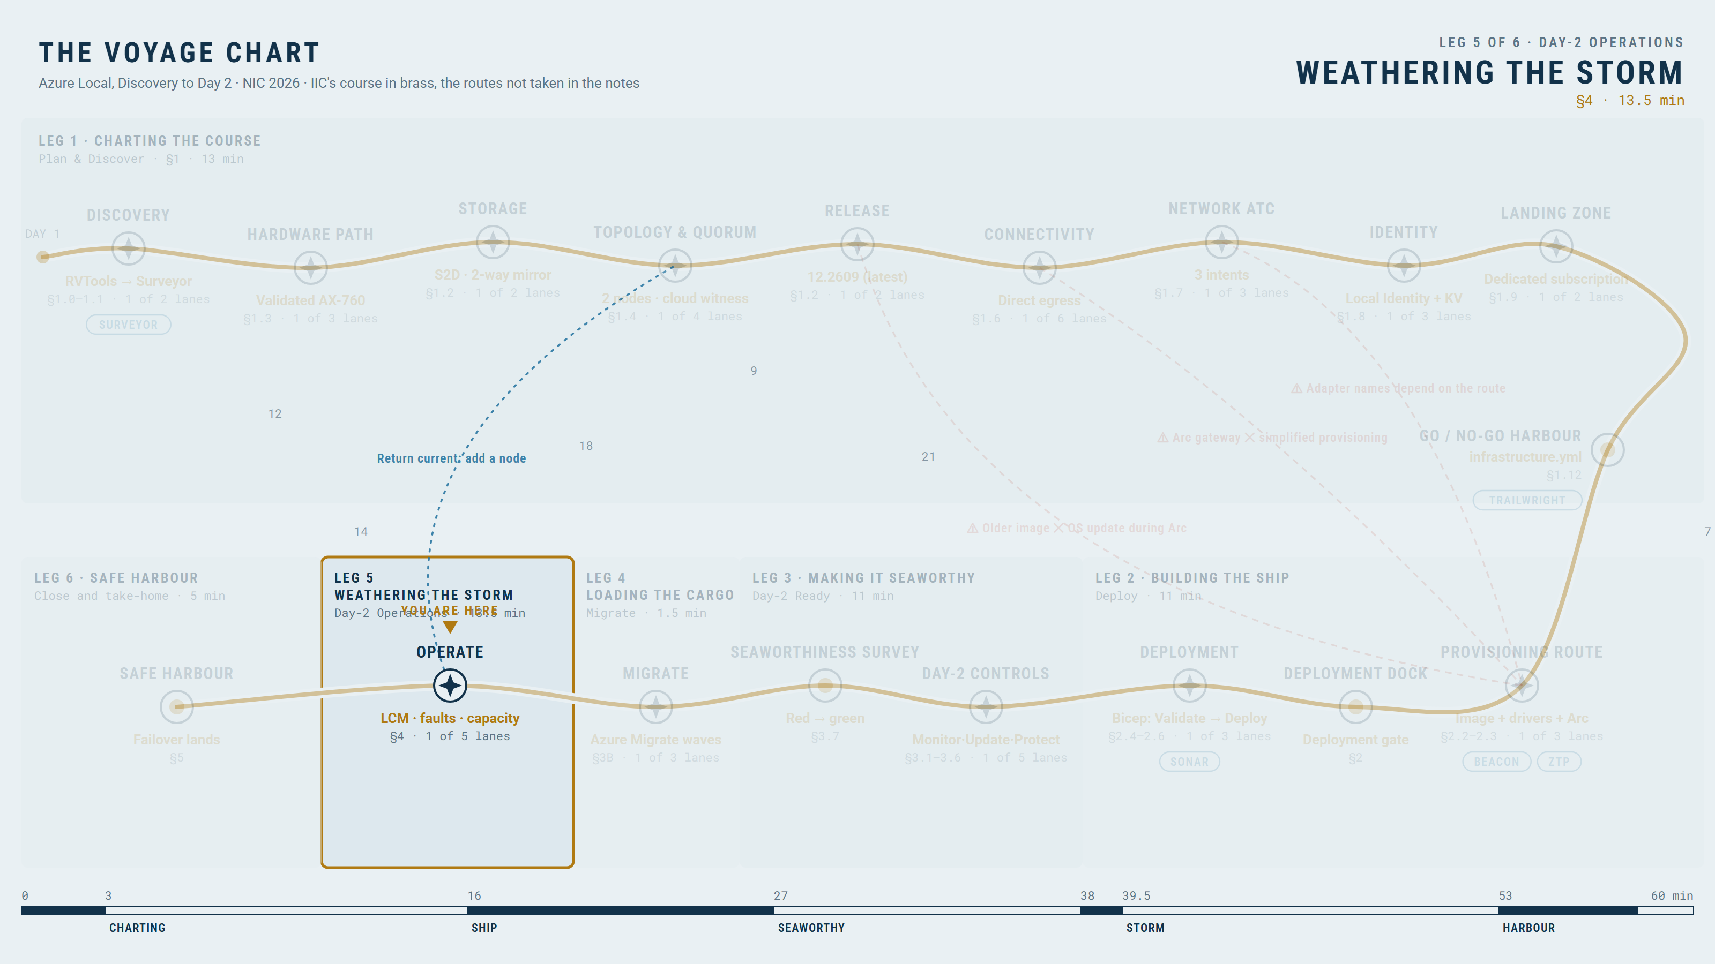
Weathering the storm: Lifecycle Manager, one update train
WEATHERING THE STORM · SECTION 4
LIVE DEMO
Entry conditions for the operating loop, then one update train with readiness checks before and after.
Discover
Download
Health check
Update node by node
Validate
A precheck that blocks progress; the decision to proceed or stop; post-update evidence
Under the storm: the AVD session hosts, the SOFS profile shares and the IIC tiers
YOU ARE HERE · WEATHERING THE STORM
Chart
Build
Seaworthy
Cargo
Storm
Harbour
27

Slide 28
Fault diagnosis: the shape, and a drive retired by software
LIVE DEMO
Symptom, signal, differential diagnosis, action, recovery evidence.
Symptom
Signal
Diagnosis
Action
Recovery evidence
Recovery is the repair finished and redundancy restored, not a cleared alert
Software-induced: an administrative retire, not a physical failure
Does not test: physical failure signals
Chart
Build
Seaworthy
Cargo
Storm
Harbour
28

Slide 29
The agent proposes, the engineer decides: an investigation from the rehearsal run
LIVE DEMO
The Observability Agent (preview) takes the signal and the diagnosis steps; recovery evidence is still the repair finished.
Preview
Azure Copilot Observability Agent
Alert from the rehearsal run of the same fault, labelled with its date
Plan shown, not confirmed
a confirmed deep investigation is billed
Saved investigation
affected components, ruled-out hypotheses, next steps
Chart
Build
Seaworthy
Cargo
Storm
Harbour
29

Slide 30
Intent drift remediated, and a node lost with quorum intact
LIVE DEMOS · 2
Two incidents, two failure domains: symptom, diagnostic evidence, response, outcome.
Not live
no redundancy to spare, and the BMC path may share the VPN
The GPU host al03 restarts rather than moves: DDA does not live-migrate
Chart
Build
Seaworthy
Cargo
Storm
Harbour
30

Slide 31
Capacity is a decision; the VM lifecycle runs through Arc
LIVE DEMOS · 2
Constraint, admission decision, VM action, resulting capacity state.
Capacity constraint
Admission decision
VM action
Resulting headroom
Adding a third node changes resiliency and intents
Chart
Build
Seaworthy
Cargo
Storm
Harbour
31

Slide 32
Planned Site Recovery failover: a small Ragnarok
LIVE DEMO
Source, replication path, Azure target; the job starts now and may not land in time.
Source cluster
Replication path
Azure target
Failover job
Completion is not guaranteed during the talk
Azure Local integration with Site Recovery: confirm its status on the day (Learn lists it as preview)
Chart
Build
Seaworthy
Cargo
Storm
Harbour
32

Slide 33
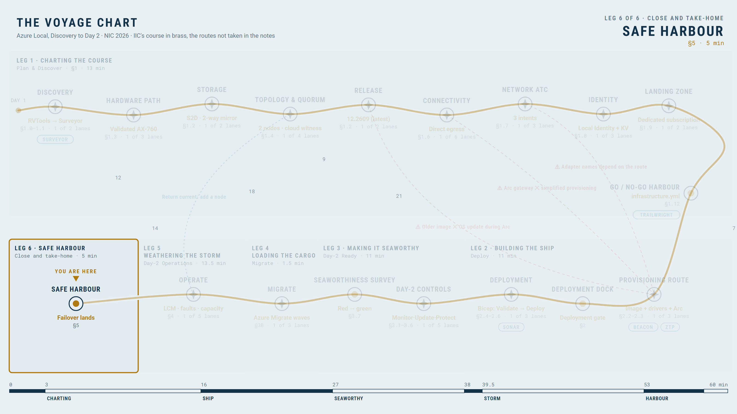
Safe harbour: the failover result, not just relief
SAFE HARBOUR · SECTION 5
Inspect the landed job, or play the labelled recording.
YOU ARE HERE · SAFE HARBOUR
If it did not land: labelled recorded completed failover
Chart
Build
Seaworthy
Cargo
Storm
Harbour
33

Slide 34
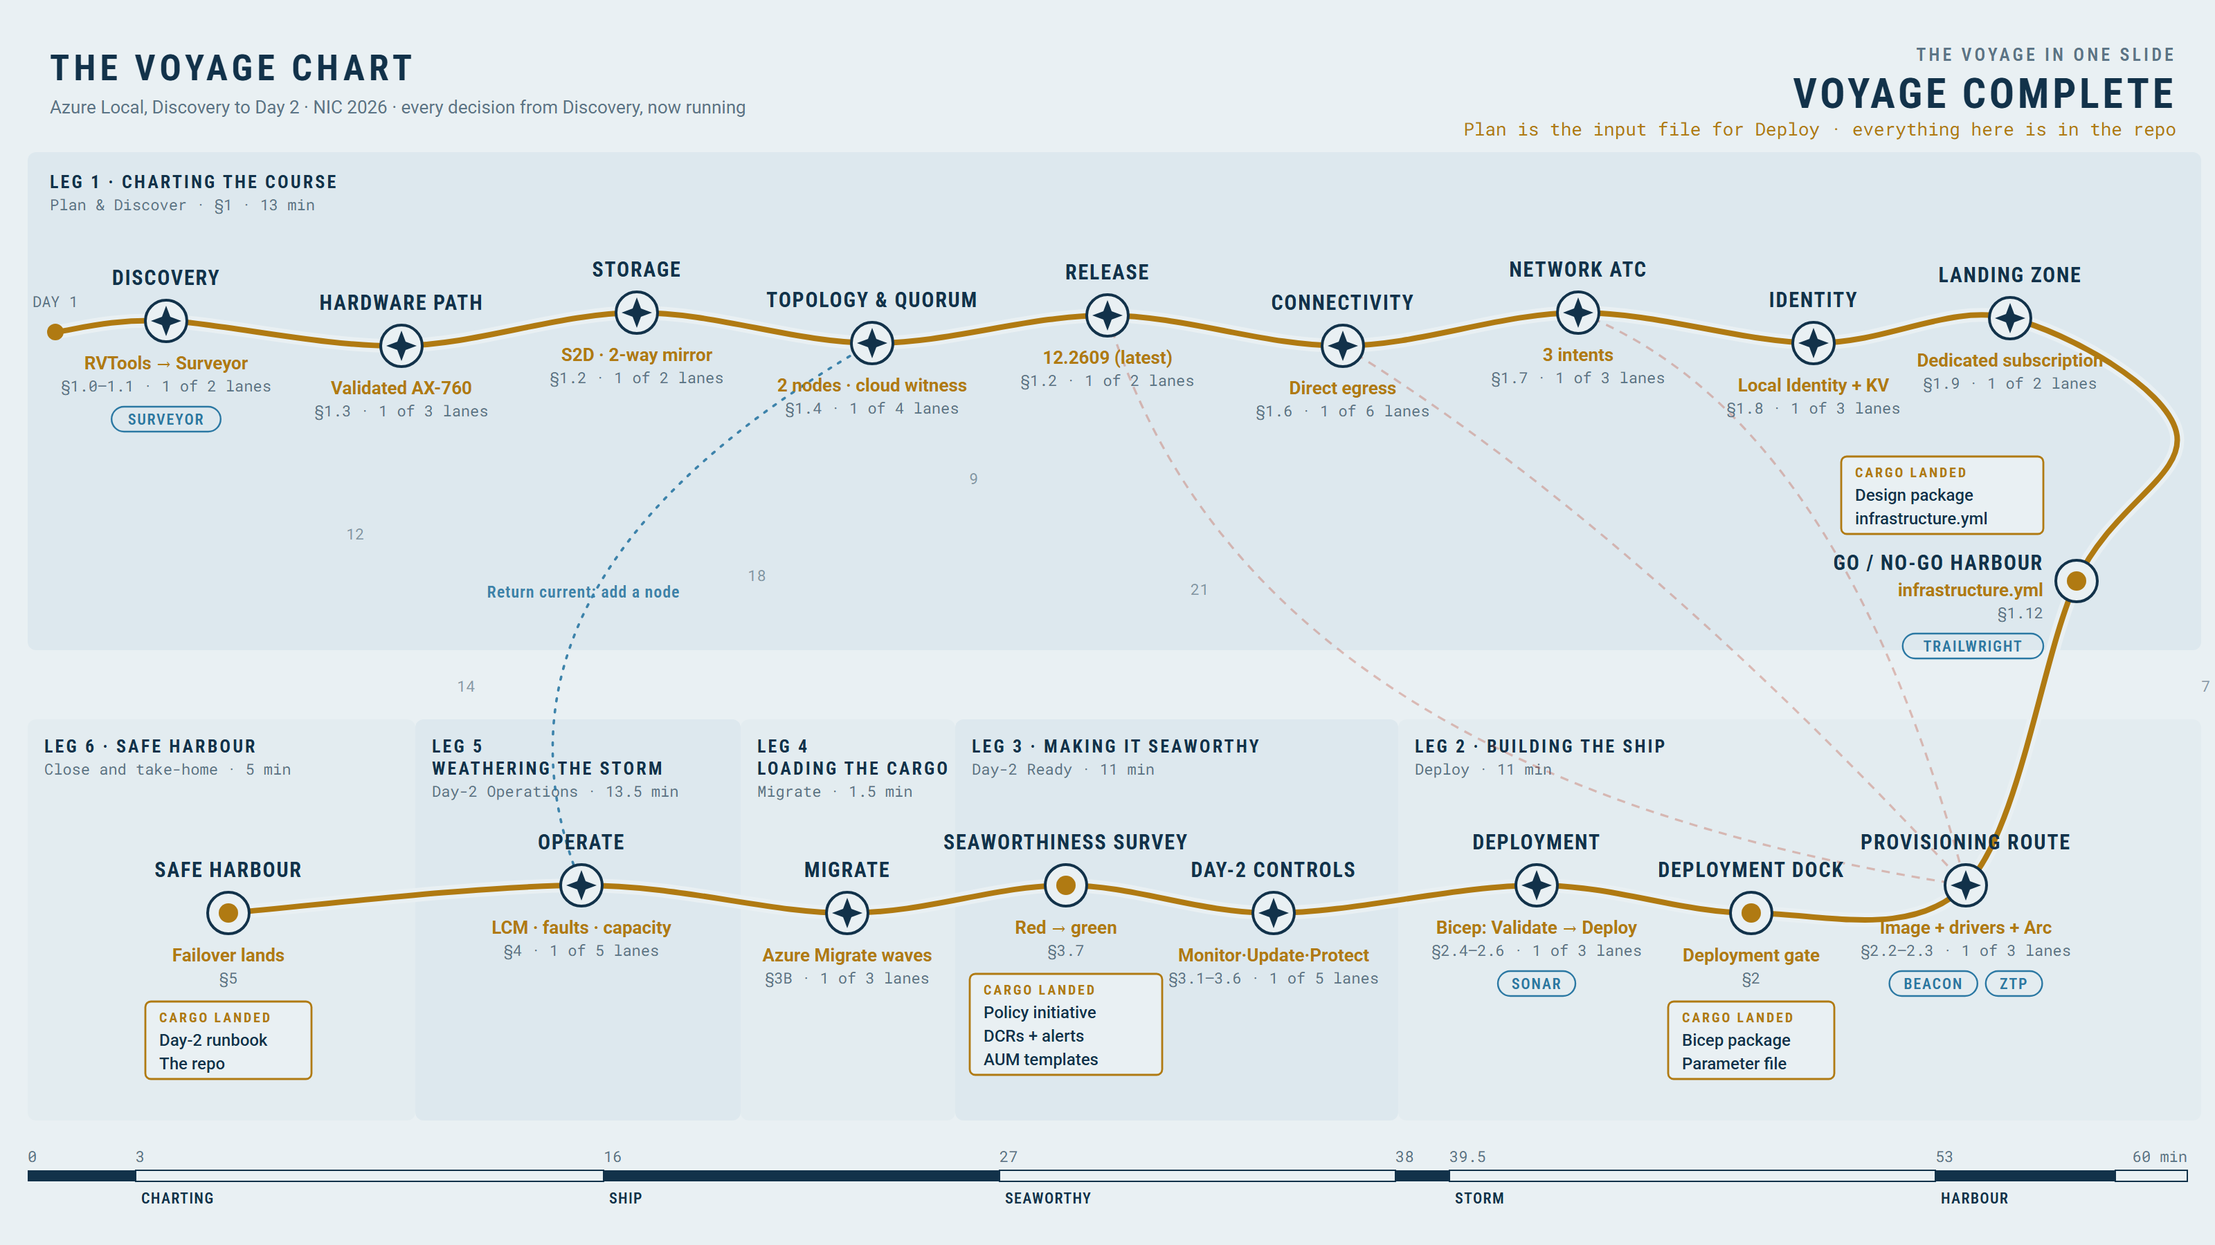
The voyage in one slide: every decision now running, and the cargo you take home
Chart
Build
Seaworthy
Cargo
Storm
Harbour
34

Slide 35
You may also like: more sagas worth your time
Three other NIC 2026 sessions that complement this one.
Behind the Patch
A Deep Dive into Azure Update Manager (Wim Matthyssen, L400, Thu 11:10 am, Room 2)
Migrating from VMWare to Azure Local with Azure Migrate (Jan-Tore Pedersen, L300, Thu 1:00 pm, Room 2)
Who Broke Production? Ask the Agent (Marius Sandbu, L400, Thu 3:40 pm, Room 3)
Times are Oslo time. Rooms can change
check the NIC agenda.
Chart
Build
Seaworthy
Cargo
Storm
Harbour
35

Slide 36
Voyage complete. Day 2 never ends
Questions in the hallway; the repo is yours.
Repo and demo guide
Chart
Build
Seaworthy
Cargo
Storm
Harbour
36

