Slide 1
Congressional Language
Niall Murphy
10.10.16

Slide 2
Goal: Topic Modeling of Congressional Bills
Potential ‘pre-work’ for Future Research re: what topics does Congress actually spend its time on, issue-related voting records vs stated opinions, etc
Inspired by classic misrepresentation of presidential role in domestic policy; actual ‘day job’ heavily foreign-oriented yet people vote overwhelmingly on domestic issues
Note: Not a “true” classification problem because there is no true test data to train against

Slide 3
Process
Bill Text Publicly Available on Congress.gov
Methods: Truncated SVD, Randomized SVD, NMF, LDA
Best Results with NMF
20 topics (arbitrary)

Slide 4
Results
Look at the pretty visualization. (nmf_display.html)

Slide 5
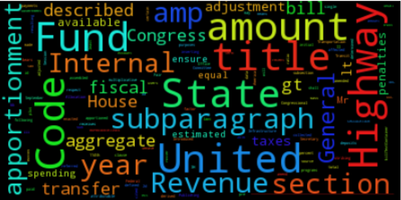
Later
Expand current page to include topic-breakdown by document and associated wordcloud, with wordcloud coloring being topic-related

Slide 6
Thanks!
Contact:
niallpatrickmurphy@gmail.com
https://github.com/thisisniall

