Slide 1
Developing Shiny Apps:
Tip, Tricks, and Best Practices
Notes:
OK, so earlier I spoke about a Shiny app that I’ve worked on, and now I want to continue the Shiny theme and talk about some of the best practices and general ideas I learned on the way, so I thought what better way to do it than take some massively out of date memes and make them about Shiny.

Slide 2
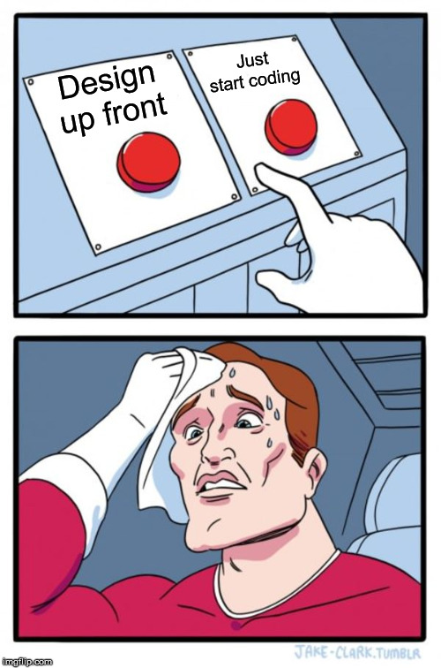
Design up front
Notes:
So the first lesson learned for me was about design, like, it’s really easy with Shiny to just want to get some code out there and knock up a prototype in half an hour because Shiny makes it possible to do that.
But I find the problem there is that I tend to get hung up on the first idea that comes into my head, which isn’t necessarily the best possible idea. And if you just start coding you can end up going down one path.
Design layout up front in order to prevent nasties with huge complex bits of code, add funny gif of something monstrous here.
Also mention Balsamiq?
And even designing behaviour, e.g. “when I click X, then Y happens”.
UI – wireframes
Behaviour
Code

Slide 3
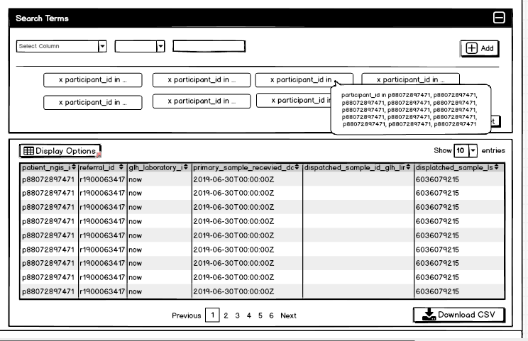
Wireframes: Balsamiq

Slide 4
Behaviour: Given-When-Then
Pre-requisite
Action
Result
Given it’s Friday night
When I go to the pub
Then I drink too much vodka
Given the user has successfully done a search
When the user clicks the reset button
Then their search terms will be cleared

Slide 5
Code
One script or lots of files?
App within package? Package within app?
App with lots of subpackages?

Slide 6
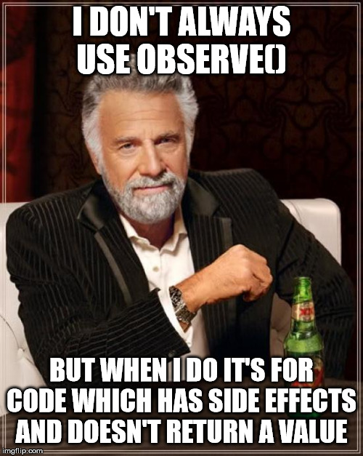
Mastering reactivity
Notes:
Learn the difference between reactive() and observe() and print it out if you need to!
Learn the difference between reactive and eventReactive, versus observe and observeEvent!

Slide 7
Reactivity
Imperative (telling Shiny what to do) vs. reactive (Shiny does the hard work)
observe() and observeEvent() are for side effects; reactive() and eventReactive() are for calculating values. reactiveValues() is for storing values that can’t be inferred from the state of other things (e.g. how many times a button has been clicked)
RStudio Conference Intermediate Shiny workshop is an amazing resource for this
Make code snippets and gists to play around with things and see what happens, create your own personal library of examples

Slide 8
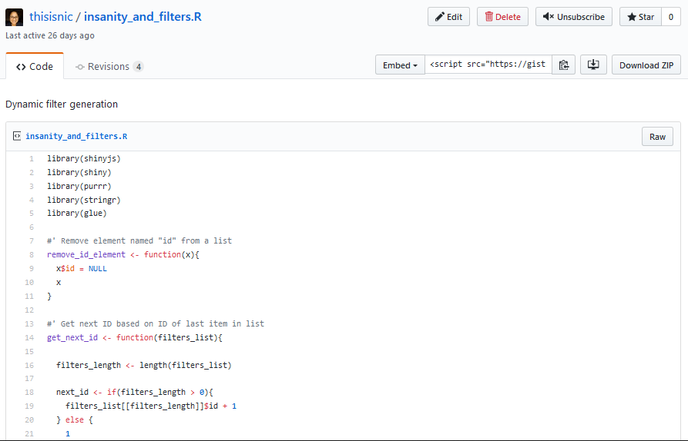
gists

Slide 9
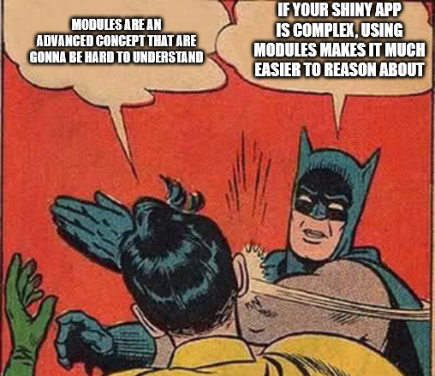
Learn modules early
Notes:
Learn modules to prevent spaghetti code, maybe have a theme here?
Modules make your life easier and although they can be tough to initially get your head around, will actually make things simpler. They are not just a) for reusable things – sometimes it’s nice to spearat code out into enclosed chunks, like functions you only call once.

Slide 10
Modules
Modules are just functions that do special things to deal with reactivity.
Not just for repeated bits of code – same as with functions.
RStudio Conference Intermediate Shiny workshop is an amazing resource for this too!
Lots of little black boxes with inputs and outputs, rather than loads of things tied together.

Slide 11
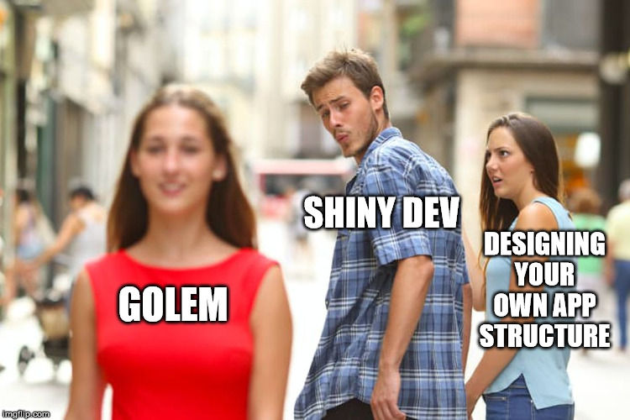
Consider using golem
Notes:
Quick overview of what golem does, what the benefits of it are, I have stickers etc

Slide 12

Golem
golem by ThinkR
Provides a framework for building Shiny apps
Includes templates for creating new modules
Contains functions for doing things like logging things to the console when the app’s running locally that then gets switched off when in production environment
Also has helper functions for deployment with Docker, Shiny Proxy and other technologies

Slide 13
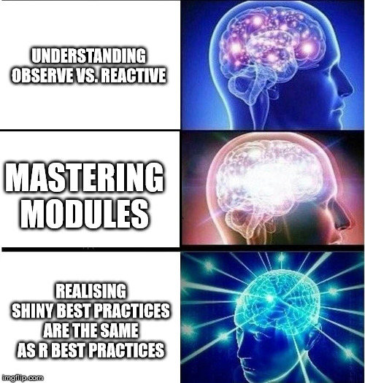
Best Practices
Notes:
Similar to R best practices, e.g. make judicious use of functions, a function should do 1 thing well, functions should have unit tests
Write everything as R functions as much as possible. And write unit tests for them.
Make sure someone knows how to get this thing into prod – where will it be deployed, how, how many people
Mini prototypes and gists are your friend! Instead of changing everything and seeing what happens like I sometimes do. Learn how to make a reprex!

Slide 14
Thank You!
Nic Crane
nic.crane@elucidata.co.uk
Twitter: @nic_crane
elucidata.co.uk

