Slide 1

Module EGE321 Wireless Communication & Networking Chapter 2.3 Digital Modulation Techniques
2.3 Digital Modulation Techniques

Slide 2
Contents
2. Wireless Communications System
2.1 Communication System Architecture
2.2 Radio Propagation and Link Budget Analysis
2.3 Digital Modulation Technique (Part II)

Slide 3
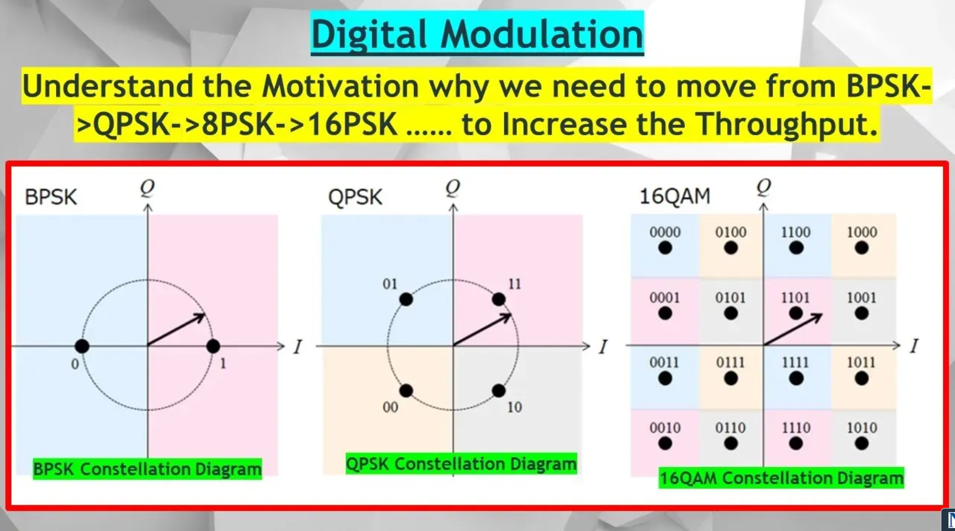


Pls see this Youtube video to understand more.
Digital Mod Part 6. Why we Need to Have so Many Different Levels, BPSK, QPSK of Digital Modulation.
https://youtu.be/dWNj1NCEEeo

Slide 4
Digital Modulation Scheme – QPSK
QPSK Constellation Diagram
Q
Q
I
I
Carrier phases {0, π/2, π, 3π/2}
{0, 90, 180, 270 degree}
Carrier phases {π/4, 3π/4, 5π/4, 7π/4}
{45, 135, 225, 315 degree}
Quadrature Phase Shift Keying has twice the bandwidth efficiency of BPSK since 2 bits are transmitted in a single modulation symbol
2.3 Digital Modulation Techniques
Page 23 of 41

Slide 5
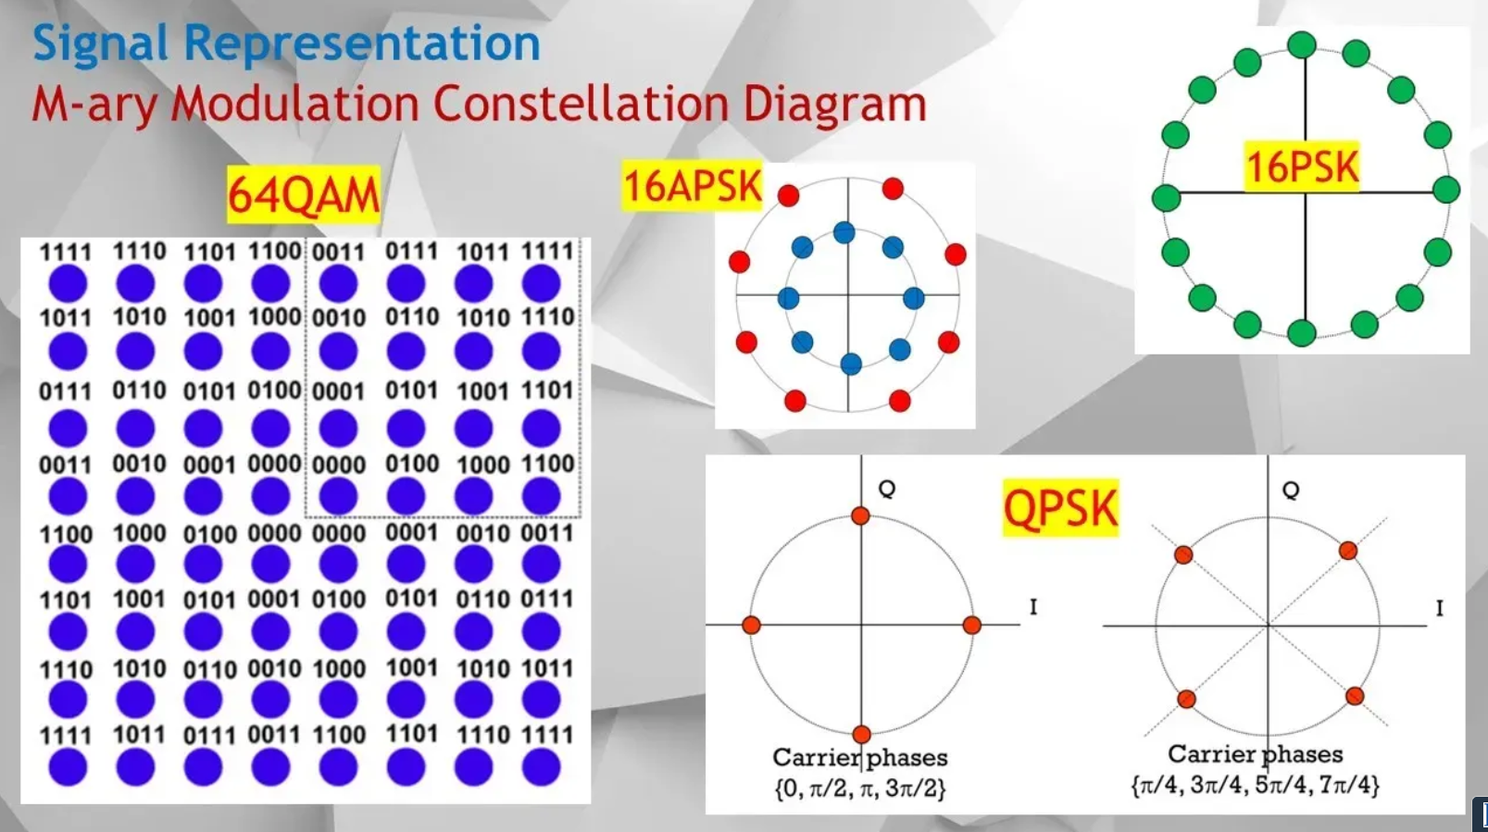
Pls see this Youtube video to understand more.
Digital Mod Part 5. How Signal Representation by Constellation Diagram: 8PSK, 16PSK, 16QAM & 64QAM.
https://youtu.be/mFgGLqjU9Fc

Slide 6
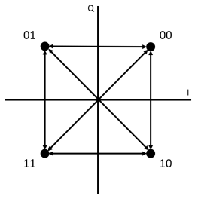
Digital Modulation Scheme – QPSK
QPSK Constellation Diagram
2.3 Digital Modulation Techniques
Page 24 of 41

Slide 7
Digital Modulation Scheme – M-ary Modulation
M-ary Modulation with Noise & Distortion
Perfect channel
White noise
Phase jitter
2.3 Digital Modulation Techniques
Page 25 of 41

Slide 8
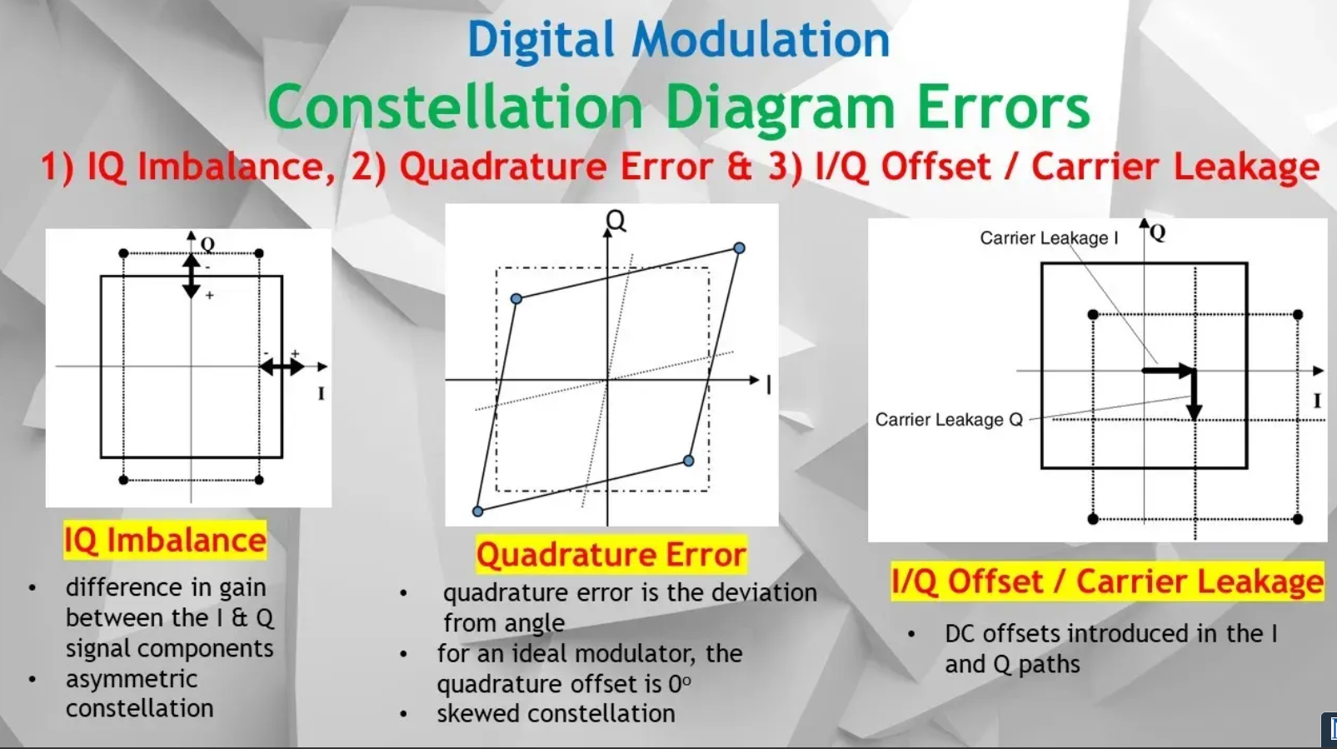
Pls see this Youtube video to understand more.
Digital Mod Part 7. Constellation Diagram Error: IQ Imbalance, Quadrature & Offset Carrier Leakage.
https://youtu.be/5T0RE2_2GzM

Slide 9
Digital Modulation Scheme – QPSK
QPSK Constellation Diagram
Q
Q
Q
I
I
I
Conventional QPSK
Offset QPSK
π/4 QPSK
Conventional QPSK has transitions through zero (i.e. 180⁰ phase transition).
In Offset QPSK, the phase transitions are limited to 90⁰, the transitions on the I and Q channels are staggered.
In π/4 QPSK the set of constellation points are toggled to each symbol, so transitions through zero cannot occur. This scheme produces the lowest envelope variations.
2.3 Digital Modulation Techniques
Page 26 of 41

Slide 10
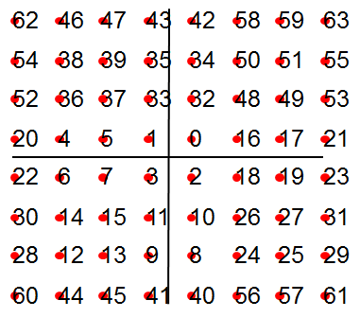
Digital Modulation Scheme
M-ary Modulation Constellation Diagram
16 QAM
16 PSK
16 APSK
Amplitude and phase shift keying can be combined to transmit several bits per symbol. They are more bandwidth-efficient, but more susceptible to noise.
64 QAM
2.3 Digital Modulation Techniques
Page 27 of 41

Slide 11
Digital Modulation Scheme – QAM
Quadrature Amplitude Modulation(QAM) Constellation (1)
62
46
47
43
42
58
59
63
13
9
8
12
54
38
39
35
34
50
51
55
52
36
37
33
32
48
49
53
5
1
0
4
20
4
5
1
0
16
17
21
22
6
7
3
2
18
19
23
7
3
2
6
30
14
15
11
10
26
27
31
15
11
10
14
28
12
13
9
8
24
25
29
16-QAM
60
44
45
41
40
56
57
61
64-QAM
16QAM: 1 symbol => 4 bits
Symbol rate = 1/4 bit rate
64QAM: 1 symbol => 6 bits
Symbol rate = 1/6 bit rate
2.3 Digital Modulation Techniques
Page 28 of 41

Slide 12
Digital Modulation Schemes
What is Digital Modulation?
Question 5
State a figure of merit commonly used to characterize the overall performance of a digital communication system.
ANS
Bit Error Rate
Question 6
Name a method of analyzing digital modulated signals.
ANS
Vector diagram or Constellation Diagram
2.3 Digital Modulation Techniques
Page 29 of 41

Slide 13
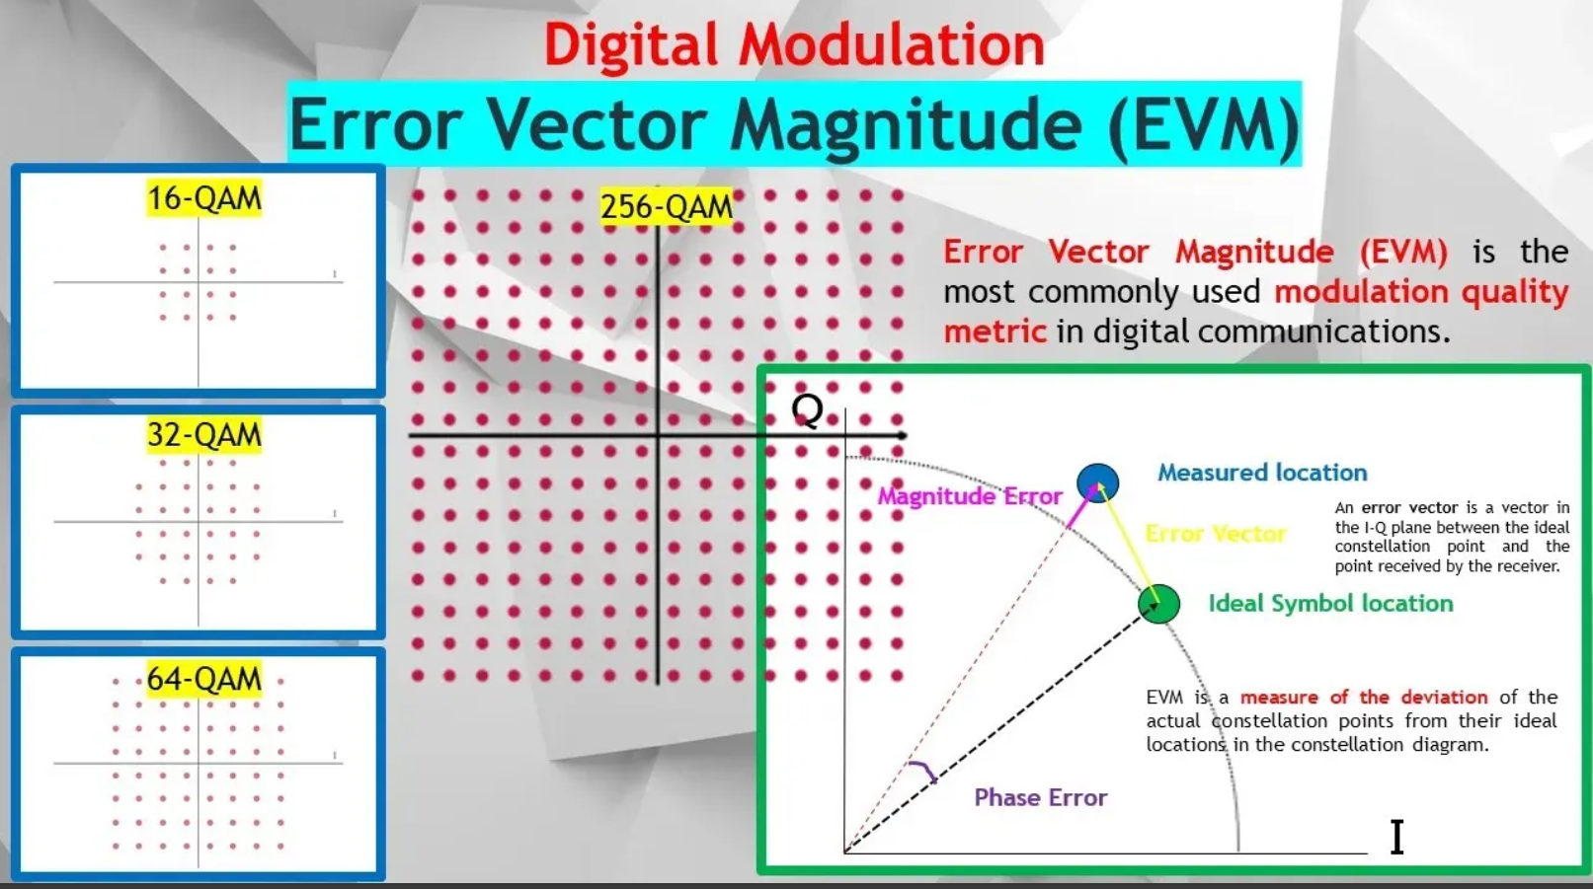
Pls see this Youtube video to understand more.
Digital Mod Part 8. How Error Vector Magnitude, EVM can be used as Modulation Quality Metric.
https://youtu.be/BVbGugzt-FY

Slide 14
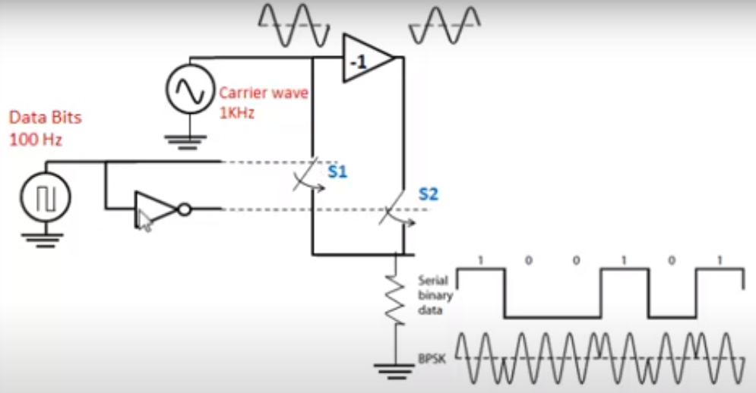
Digital Modulation Scheme – BPSK
BPSK Modulator
2.3 Digital Modulation Techniques
Page 30 of 41

Slide 15
Digital Modulation Scheme – BPSK
BPSK Modulator
There are two switches, S1 and S2 in the diagram. Whether the switches are on or off are depend on the data bits (100 Hz). For example, when the data is 1, switch S1 will be on and switch S2 will be off.
The carrier wave being higher frequency (1KHz) has two signals. One signal is in phase and another one is 180 degree out of phase. Which carrier signal (in phase or out of phase) appears on the output depends on which switch is on,
When the data is one, switch 1 will be on and switch 2 will be off. When switch 1 is on, the carrier signal, in phase will appear at the output.
When the data is zero, switch 2 will be on and switch 1 will be off. When switch 2 is on, the carrier signal, out of phase will appear at the output
2.3 Digital Modulation Techniques
Page 31 of 41

Slide 16
Digital Modulation Scheme – M-ary QPSK
QPSK Modulator
LPF
Balanced modulator
In-phase data stream
Symbol rate = Rb/2
I
BPF
Q
carrier
QPSK out
Data in
Bit rate = Rb
Data
Splitter
90°
I
Quadrature data stream
Symbol rate = Rb/2
Q
LPF
Balanced modulator
2.3 Digital Modulation Techniques
Page 32 of 41

Slide 17
Digital Modulation Scheme – M-ary QPSK
QPSK Modulator
In the QPSK modulator, the incoming bit-stream is divided into two parallel streams to be fed simultaneously to the I and Q balanced modulators to construct the 2 bit symbols. The carrier output from the modulator is controlled by the digital bit stream and by adding together the I and Q outputs, the phase state diagram is generated.
The LPF is a baseband filter (Raised Cosine filter) used to shape the spectrum of the incoming pulses. The filter at the output of the modulator confines the power spectrum of the QPSK signal within the allocated band. This prevents spill-over of signal energy into adjacent channels and also removes out-of-band spurious signals generated during the modulation process.
2.3 Digital Modulation Techniques
Page 33 of 41

Slide 18
Assignment
Search from the internet for information of BPSK and QPSK demodulator. Submission via email with a diagram of BPSK and QPSK demodulator and simple explanation how it works.
2.3 Digital Modulation Techniques
Page 34 of 41

Slide 19
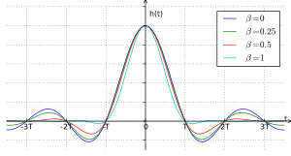
Digital Modulation Scheme
Raise Cosine
Raised-cosine filter used for pulse-shaping in digital modulation.
The purpose is to minimise intersymbol interference (ISI).
ISI interferes with subsequent symbols and has similar effect as noise.
The spreading of the pulse is beyond its allotted time interval and hence it causes to interfere with neighbouring pulses.
2.3 Digital Modulation Techniques
Page 35 of 41

Slide 20
Digital Modulation Scheme
Raise Cosine (Example)
An unfiltered 2Mbps digital data stream is modulated onto a 900 MHz carrier using BPSK modulation.
Sketch the RF spectrum of the unfiltered BPSK signal.
(ii) Calculate the RF mainlobe bandwidth.
(iii) Suppose the RF transmission bandwidth allowed is 2.6MHz. Suggest how a Raised Cosine filter can be used to meet this requirement. Draw the RF spectrum with the raised cosine filter.
(iv) The effect of the roll-off factor on the RF bandwidth and the Inter-symbol Interference (ISI).
2.3 Digital Modulation Techniques
Page 36 of 41

Slide 21
Digital Modulation Scheme
Raise Cosine (Example)
i)
ii) RF mainlobe bandwidth =2 x Symbol rate = 4MHz
iii) To constraint the bandwidth to 2.6MHz, we need to use a raised cosine filter of α=0.3,
this will result in RF bandwidth = (1+ α)x 2M= 2.6MHz.
898 900 902
f(MHz)
2.3 Digital Modulation Techniques
Page 37 of 41

Slide 22
Digital Modulation Scheme
Raise Cosine (Example)
fc - Rs (1 + α)/2
=900MHz-2.6MHz/2
=898.7MHz
fc=900MHz
fc + Rs (1 + α)/2
=900MHz +2.6MHz/2
=901.3MHz
When α increases, bandwidth increases and ISI reduces.
When α decrease, bandwidth reduces and ISI increases.
2.3 Digital Modulation Techniques
Page 38 of 41

Slide 23
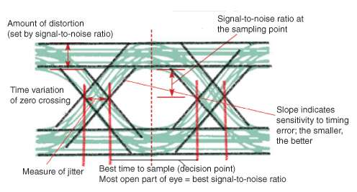
Digital Modulation Scheme
Eye diagram
An eye diagram is a indicator of the quality of signals in high-speed digital transmissions.
An eye diagram can be presented in an oscilloscope and indicate the best point for sampling, divulge the SNR at the sampling point, and indicate the amount of jitter and distortion
2.3 Digital Modulation Techniques
Page 39 of 41

Slide 24
Digital Modulation Applications
Factors Affecting Choice of Modulation
1) Signal-to-noise ratio (SNR)
2) Probability of error or Bit Error Rate (BER)
3) Power Efficiency
Power efficiency is a measure of how much received power is needed to achieve a specified BER (inversely proportional to BER)
As BER increases, power efficiency decreases since transmitted power is “wasted” on more bad data
4) Bandwidth Efficiency (or Spectral Efficiency)
Defined as the ratio of the bit rate to the channel bandwidth
The capacity of a digital system is directly related to bandwidth efficiency
2.3 Digital Modulation Techniques
Page 40 of 41

Slide 25
Digital Modulation Applications
Applications of Different Modulation Schemes
MSK, GMSK GSM, CDPD
BPSK Deep space telemetry, cable modems
QPSK, Satellite, CDMA, NADC, TETRA, PHS, PDC, LMDS, DVB-S, cable (return
π/4 DQPSK path), cable modems, TFTS
OQPSK CDMA, satellite
FSK, GFSK DECT, paging, RAM mobile data, AMPS, CT2, ERMES, land mobile, public safety
8, 16 VSB North American digital TV (ATV), broadcast, cable
8PSK Satellite, aircraft, telemetry pilots for monitoring broadband video systems
16 QAM Microwave digital radio, modems, DVB-C, DVB-T
32 QAM Terrestrial microwave, DVB-T
64 QAM DVB-C, modems, broadband set top boxes, MMDS
256 QAM Modems, DVB-C (Europe), Digital Video (US)
2.3 Digital Modulation Techniques
Page 41 of 41

Slide 26
Thank you

