Slide 1


EGE321 Wireless Communication & Networking Introduction
1 System Design Considerations

Slide 2
Module EGE321 Wireless Communication & Networking Chapter 1. System Design Considerations
1 System Design Considerations

Slide 3
Contents
1. System Design Considerations
1.1 Wireless Technology Overview
1.2 Wireless System Design Considerations
1.3 Challenges in Wireless Communication System
1 System Design Considerations

Slide 4
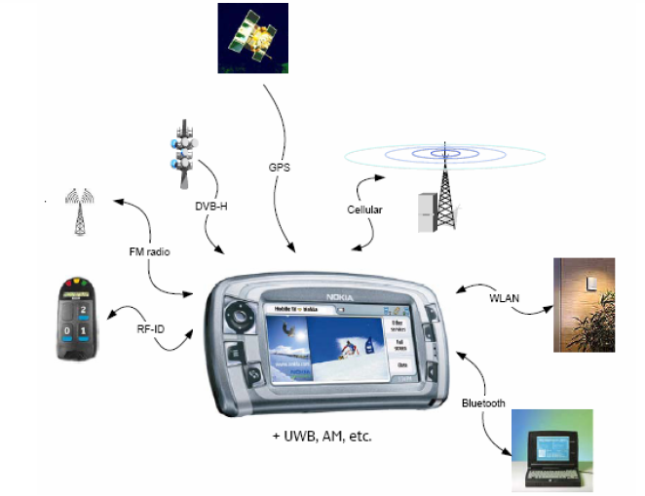
Wireless Technology Overview
Q: What is communication?
Ans : Communication means transfer of information from source to recipient.
Q: What is wireless communication?
ANS: Any transfer of information between points that do not have a physical connection, like wire or cable connection, would be WIRELESS COMMUNICATION.
1 System Design Considerations

Slide 5
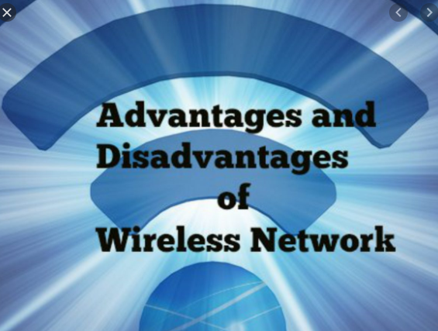
Wireless Technology Overview
Advantages and Disadvantages of Wireless Communication
ADVANTAGES
Flexibility
Easy Installation
Accessible
Mobility
DISADVANTAGES
Security vulnerabilities
Planning
Interference
1 System Design Considerations

Slide 6
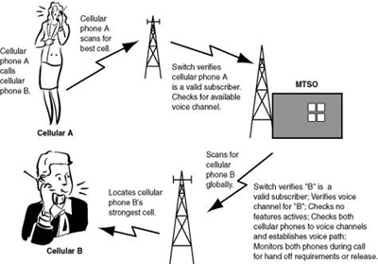
Wireless Technology Overview
Radio System Fundamentals
Transmitting or receiving voice and data using electromagnetic waves in open space.
The information from the sender to receiver is carried over a well defined channel.
Each channel has a fixed frequency bandwidth and capacity.
Different channels can be used to transmit information in parallel and independently.
1 System Design Considerations

Slide 7

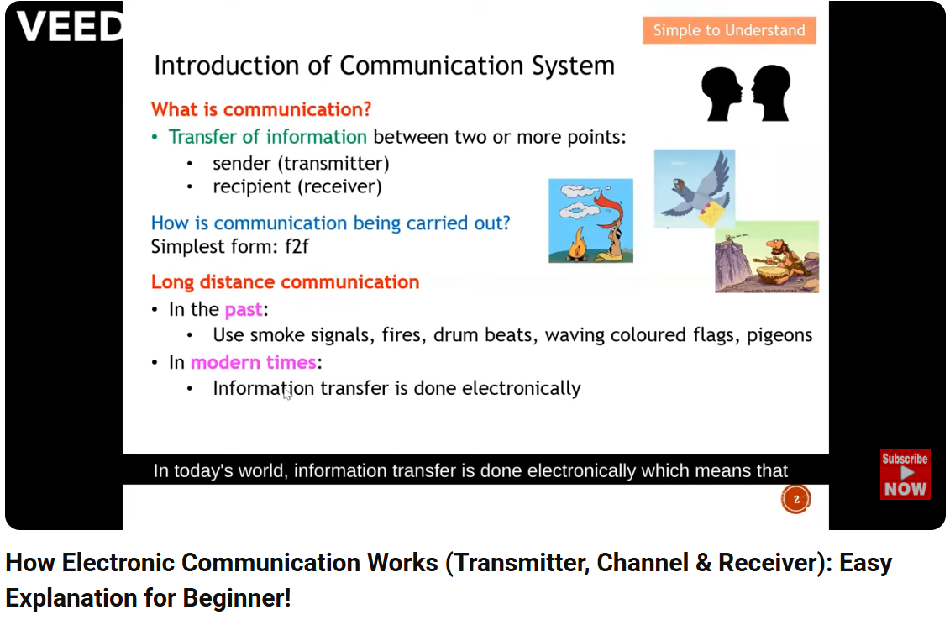
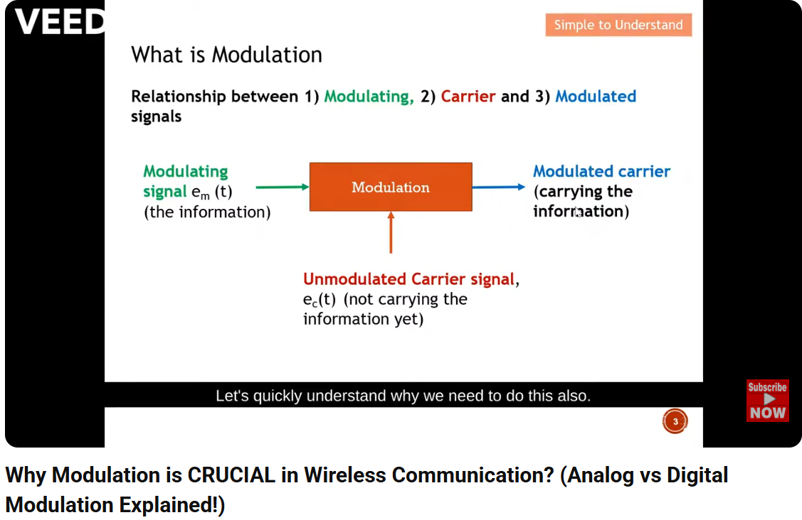
How Electronic Communication Works (Transmitter, Channel & Receiver): Easy Explanation for Beginner!
Why Modulation is CRUCIAL in Wireless Communication? (Analog vs Digital Modulation Explained!)

Slide 8
Wireless System Design Considerations
Types of Radio In Wireless Communications
Classification of mobile radio transmission system
Simplex: Communication in one direction only and cannot be reversed.
Half-Duplex: Communication can be in both direction but the transmission does not occur at the same time.
Full-Duplex: Allows simultaneous exchange in both directions at the same time.
1 System Design Considerations

Slide 9
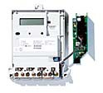

Wireless System Design Considerations
Simplex Radio System
A radio technology that allows only one-way communication from a transmitter to a receiver.
Examples: FM radio, Pagers, TV.
TX TX
RX
TX
RX
TRX
TX
TX
1 System Design Considerations

Slide 10

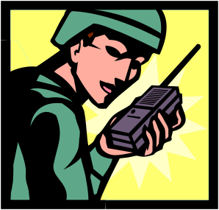
Wireless System Design Considerations
Half Duplex Radio System
Two direction communication using the same frequency.
Each station can either transmit or receive but not at the same time (not simultaneously).
Examples: Walkie-talkie, wireless keyboard mouse.
1 System Design Considerations

Slide 11
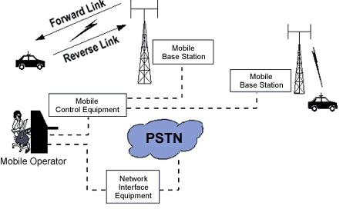
Wireless System Design Considerations
Full Duplex Radio System
Radio systems in which each end can transmit and receive simultaneously.
Typically two frequencies are used to set up the communication channel; one for transmit and the other for receive.
Example: CT2 Cordless Phone, Cellular Phone (3G,4G, LTE, etc.)
1 System Design Considerations

Slide 12
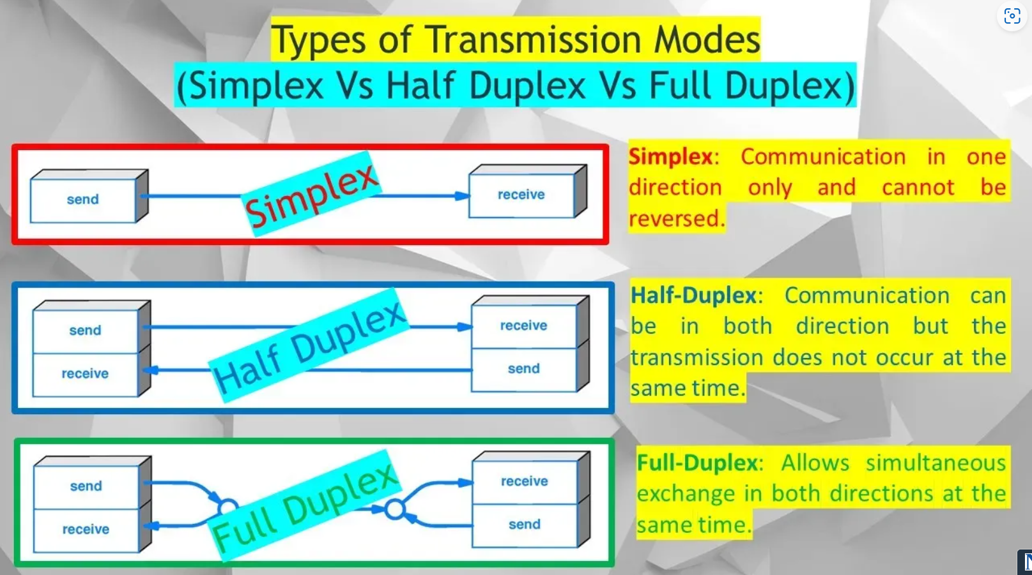

Pls see this Youtube video to understand more.
What is Simplex, Half Duplex & Full Duplex, Different Types of Telecommunication Transmission Modes.
https://youtu.be/07pFHyOrN_k

Slide 13
Thank you
1 System Design Considerations

