Slide 1

Wireless System Design Considerations
Multiple Access Techniques
There are five common multiple access techniques as following:
1) Frequency Division Multiple Access (FDMA),
2) Time Division Multiple Access (TDMA),
3) Code Division Multiple Access (CDMA),
4) Orthogonal Frequency Division Multiple Access (OFDMA), and
5) Spatial Division Multiple Access (SDMA).
1 System Design Considerations

Slide 2
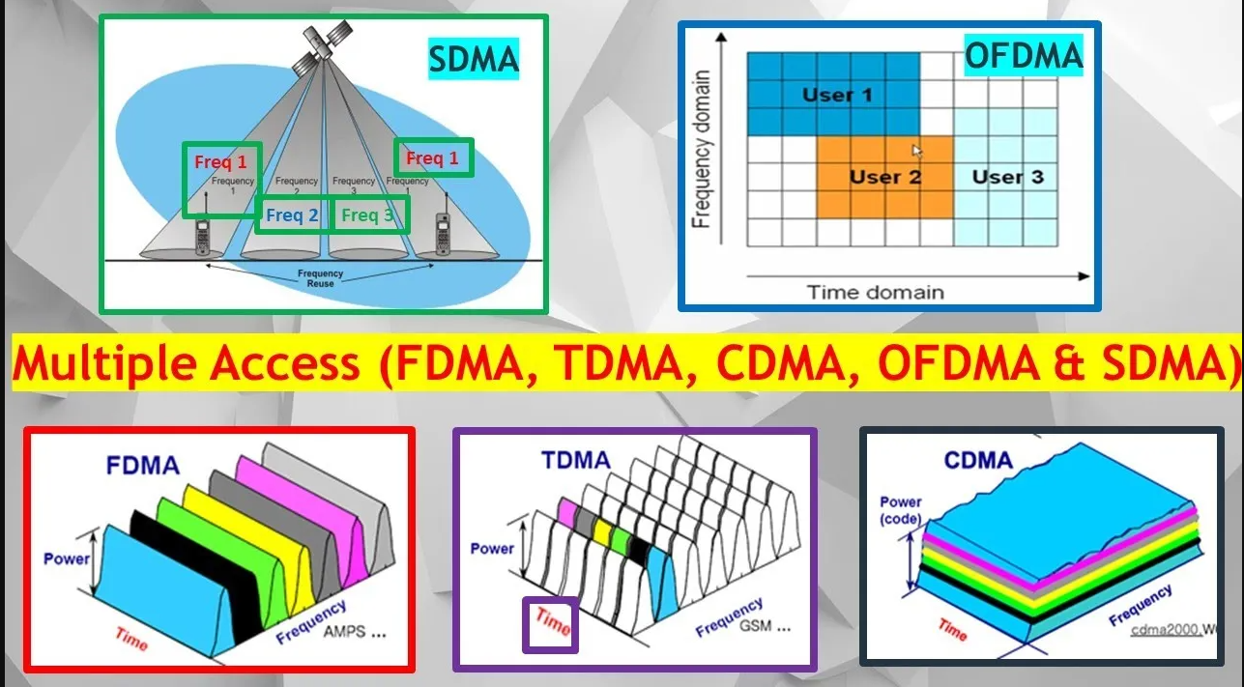


Pls see this Youtube video to understand more.
5 Most Commonly Used Multiple Access, FDMA, TDMA, CDMA, OFDMA & SDMA to Support Multiple Users.
https://youtu.be/-Nux72R5W24

Slide 3
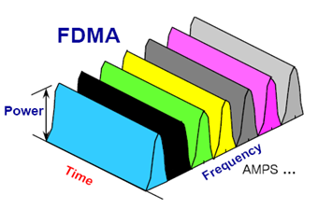
Wireless System Design Considerations
Multiple Access Techniques (FDMA)
Frequency Division Multiple Access (FDMA)
Each user is assigned one unique frequency for communication between the transmitter and receiver.
If there are multiple transmitters and one receiver, different transmitter will transmit by different frequency to the receiver.
1 System Design Considerations

Slide 4
Wireless System Design Considerations
Multiple Access Techniques (FDMA)
Frequency Division Multiple Access (FDMA)
Freq.
f₃
User 3
f₃
f₂
f₂
User 2
f₁
Frequency
f₁
User 1
Time
Time
f₃
f₁
f₂
1 System Design Considerations

Slide 5
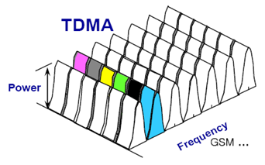
Wireless System Design Considerations
Multiple Access Techniques (TDMA)
Time Division Multiple Access (TDMA)
Each user is assigned unique time but same frequency for communication between the transmitter and receiver.
If there are multiple transmitters and one receiver, different transmitter will transmit at different time to the receiver.
Time
1 System Design Considerations

Slide 6
Wireless System Design Considerations
Multiple Access Techniques (TDMA)
Time Division Multiple Access (TDMA)
Freq.
f₁
Frequency
f₁
User 1
User 2
User 3
User 1
Time
Timeslot 1
Timeslot 2
Timeslot 3
Time
f₁
f₁
f₁
1 System Design Considerations

Slide 7
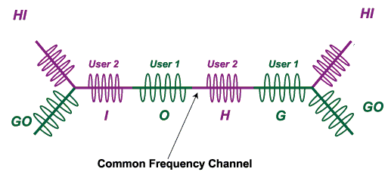
Wireless System Design Considerations
Multiple Access Techniques (TDMA)
Time Division Multiple Access (TDMA)
Time-division multiple access (TDMA) allows several users to share the same frequency channel by dividing the signal into different time slots.
1 System Design Considerations

Slide 8
Wireless System Design Considerations
Combination of TDMA and FDMA
Freq.
User 7
User 8
User 9
User 7
User 4
User 5
User 6
User 4
Frequency
f
1
User 1
User 2
User 3
User 1
Time
Timeslot 1
Timeslot 2
Timeslot 3
Time
1 System Design Considerations

Slide 9
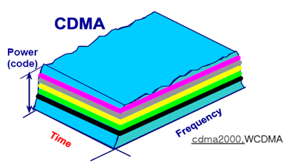
Wireless System Design Considerations
Multiple Access Techniques (CDMA)
Code Division Multiple Access (CDMA)
User is assigned one unique code for communication, occupying over a wide bandwidth.
CDMA is where several transmitters can send information simultaneously over a single communication channel. This allows several users to share a band of frequencies (where each transmitter is assigned a unique code).
1 System Design Considerations

Slide 10
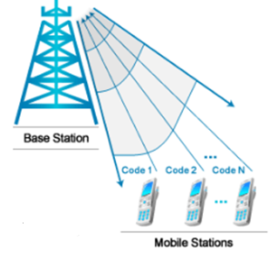
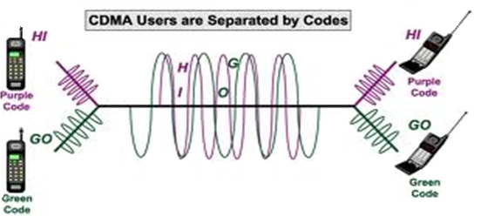
Wireless System Design Considerations
Multiple Access Techniques (CDMA)
Code Division Multiple Access (CDMA)
CDMA is a digital technology and transmits over the entire frequency range. It does not assign a specific frequency to each user but assign a unique code to each user on the communications network as illustrate in the diagram.
1 System Design Considerations

Slide 11
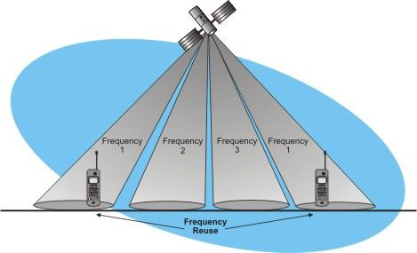
Wireless System Design Considerations
Multiple Access Techniques (SDMA)
Spatial Division Multiple Access (SDMA)
SDMA - focusing signal beams using advanced antenna technology which is also called phased array techniques.
“Know the direction to transmit” energy efficiency
Use in satellite and cellular communication by reuse the frequency, focusing on different areas.
SDMA
1 System Design Considerations

Slide 12
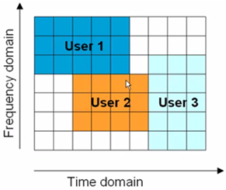
Wireless System Design Considerations
Multiple Access Techniques (OFDMA)
Orthogonal Frequency Division Multiple Access (OFDMA)
Orthogonal frequency division multiplexing (OFDMA) is used in 4G or Long Term Evolution (LTE) cellular systems.
OFDM is a modulation method that divides a channel into multiple narrow orthogonal bands that are spaced so they don’t interfere with one another.
OFDMA
1 System Design Considerations

Slide 13

Challenges in Wireless Communication System
The demand and traffic patterns, user locations, and the network conditions are constantly changing and the wireless communication system must adapt to the user needs.
The main issues facing wireless communication are:
the complexity of communication protocols that support full user mobility,
the power consumption in the mobile or portable terminal, and
the spectrum scarcity.
1 System Design Considerations

Slide 14
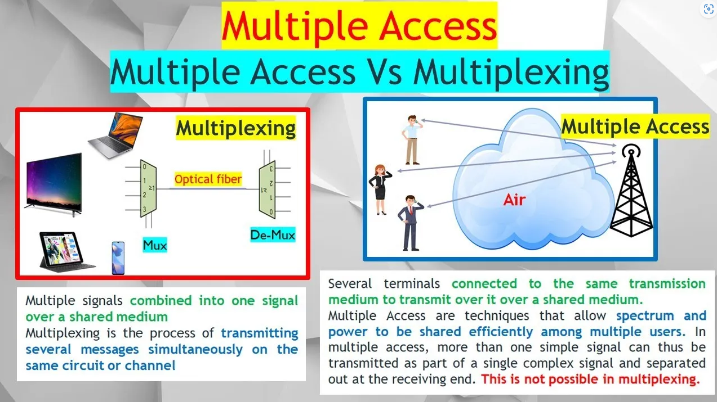
Pls see this Youtube video to understand more.
Multiple Access Vs Multiplexing. Distinguish the Different Between Multiple Access and Multiplexing.
https://youtu.be/8sxlqLX_dBY

Slide 15
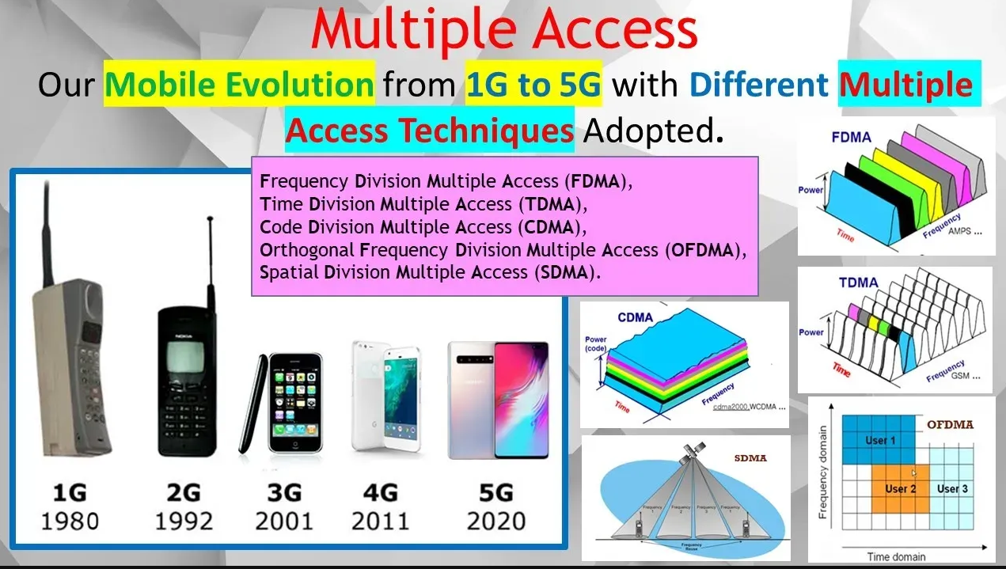
Pls see this Youtube video to understand more.
How our Phone Evolve from 1G to 5G with Different Multiple Access (FDMA. TDMA, CDMA, OFDMA & SDMA).
https://youtu.be/Vz7H6J6RmFU

Slide 16
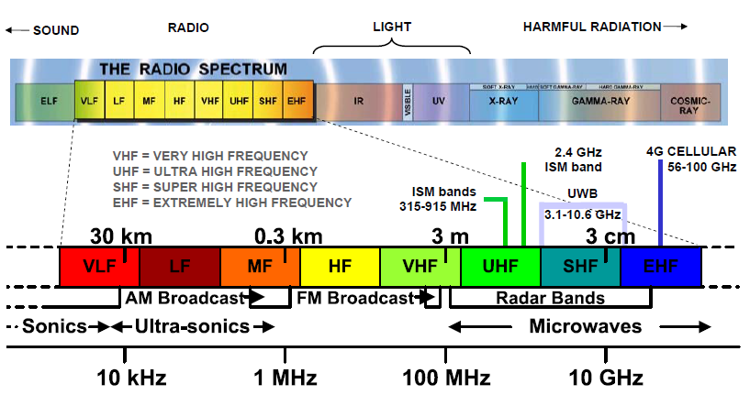
Challenges in Wireless Communication System
Managing the scarce RF spectrum resources
1 System Design Considerations

Slide 17
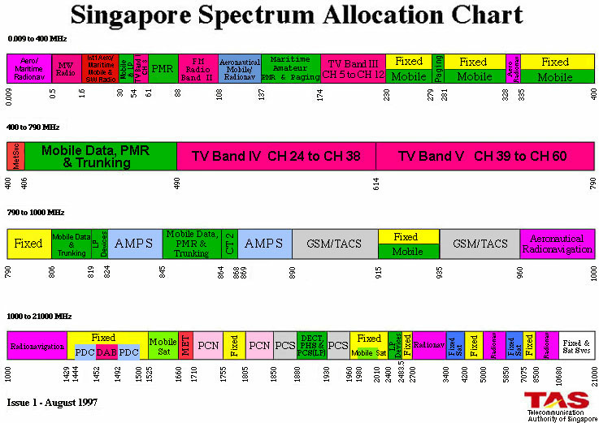
How to put more users in the limited resource like spectrum? To solve the RF bandwidth scarcity problem, more efficient modulation techniques like QAM and OFDM will have to be used to carry more payload. Users will also need to share the frequency bandwidth using multiple access techniques like FDMA, TDMA and CDMA. Frequency will also need to be reused (SDMA) if possible, for example use case in cellular system.
Challenges in Wireless Communication System
Managing the scarce RF spectrum resources
1 System Design Considerations

Slide 18
Challenges in Wireless Communication System
Quality of Service (QoS)
QoS - Latency, Reliability, Security
Latency – 1) time for the packets to take between sender and receiver 2) interaction between the sender & receiver or even various parties along the way.
Four key causes of latency are 1) propagation delay
2) serialization
3) data protocols and routing
4) switching, queuing and buffing
1 System Design Considerations

Slide 19
Challenges in Wireless Communication System
Quality of Service (QoS)
QoS - Latency, Reliability, Security
Definition of Reliability : is the ability of the communication network guarantee that the data is always delivered from the transmitter to the receiver but time taken for communication to take placed is not concerned.
For example, in a communication network, reliability can be improved by:
Improve the reliability of individual components
Increase the number of paths between the source and destination
Decrease the number of intermediate links
1 System Design Considerations

Slide 20
Challenges in Wireless Communication System
Quality of Service (QoS)
QoS - Latency, Reliability, Security
“How secure is your communication?”
How to ensure that only the intended receiver receive your message especially for wireless communication.
Increased risk of eavesdropping with wireless connectivity
With device / user mobility (only wireless can fulfil), there will be security issues related to authentication and privacy.
Security can be enhanced with encryption using combination of public and private keys cryptography.
1 System Design Considerations

Slide 21
Challenges in Wireless Communication System
Other Design Consideration
Other considerations will include:
The physical environment.
Presence of peripheral devices that can impact the wireless system.
Proximity to human or metallic structure.
Availability of stable power source.
Cost.
Manufacturing reliability.
Repeatability of performance.
Land
Maritime
Aeronautical
Satellite
Distance
Zone
Open-area
Semi-open
Close
Gain
Efficiency
Bandwidth
Pattern
System
Propagation
Fading
Interference
Integrated
Structure
Downsizing
Wireless Transceiver
Diversity
Proximity Effect
Body Effect
Multipath
Fading
Delay
Environment
Human Interface
Human Hazard
1 System Design Considerations

Slide 22
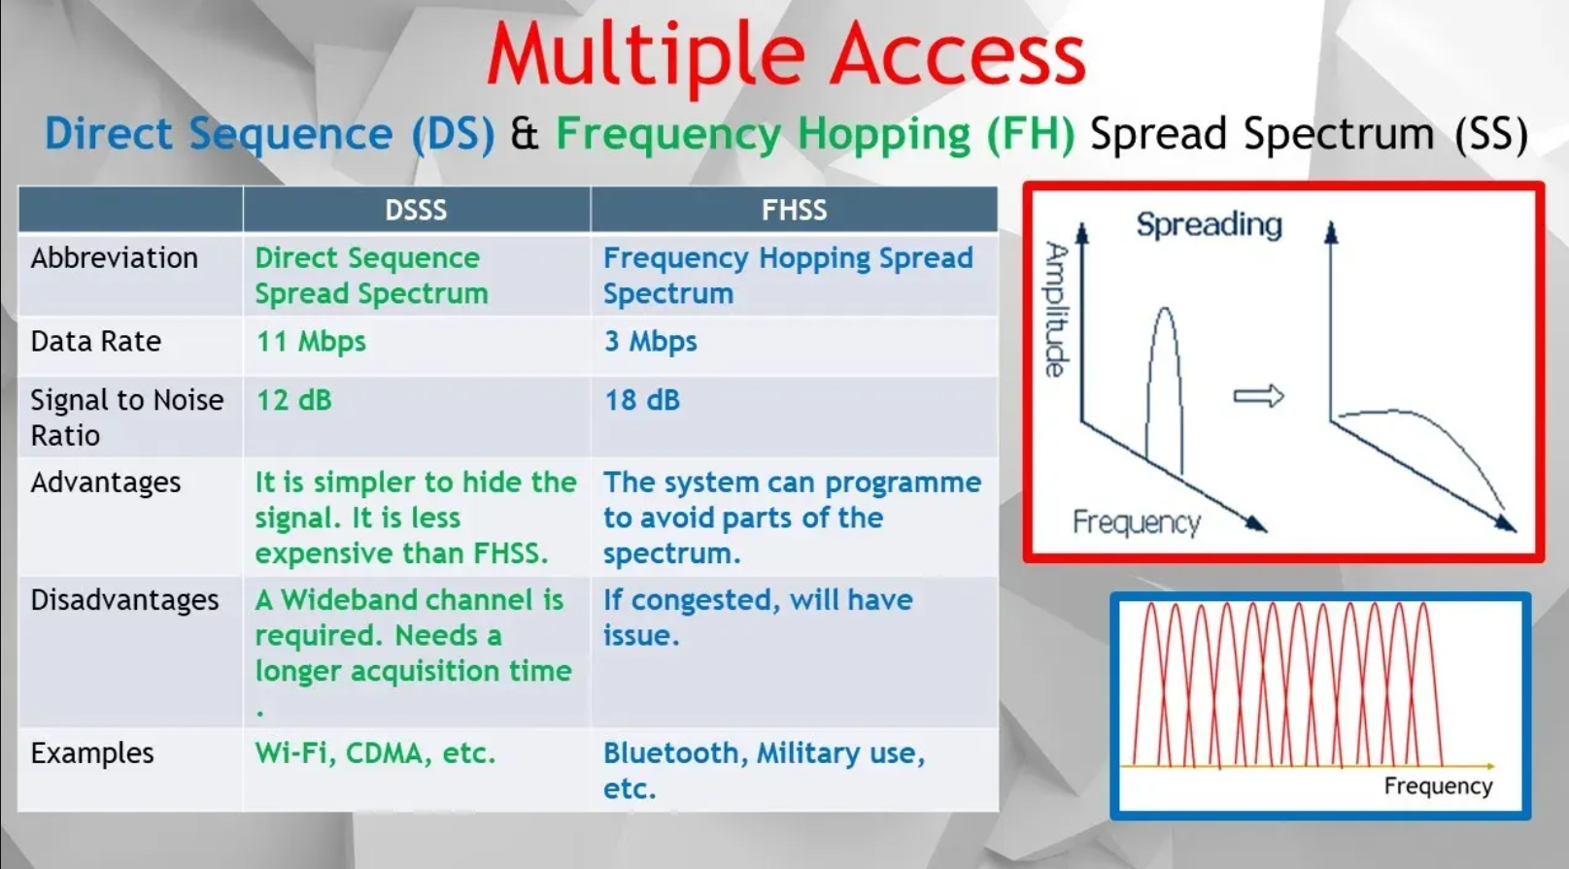
Pls see this Youtube video to understand more.
Frequency Hopping Spread Spectrum, FHSS: How Multiple Users Share Resources Without Interference.
https://youtu.be/xV3fZThMYlI

Slide 23
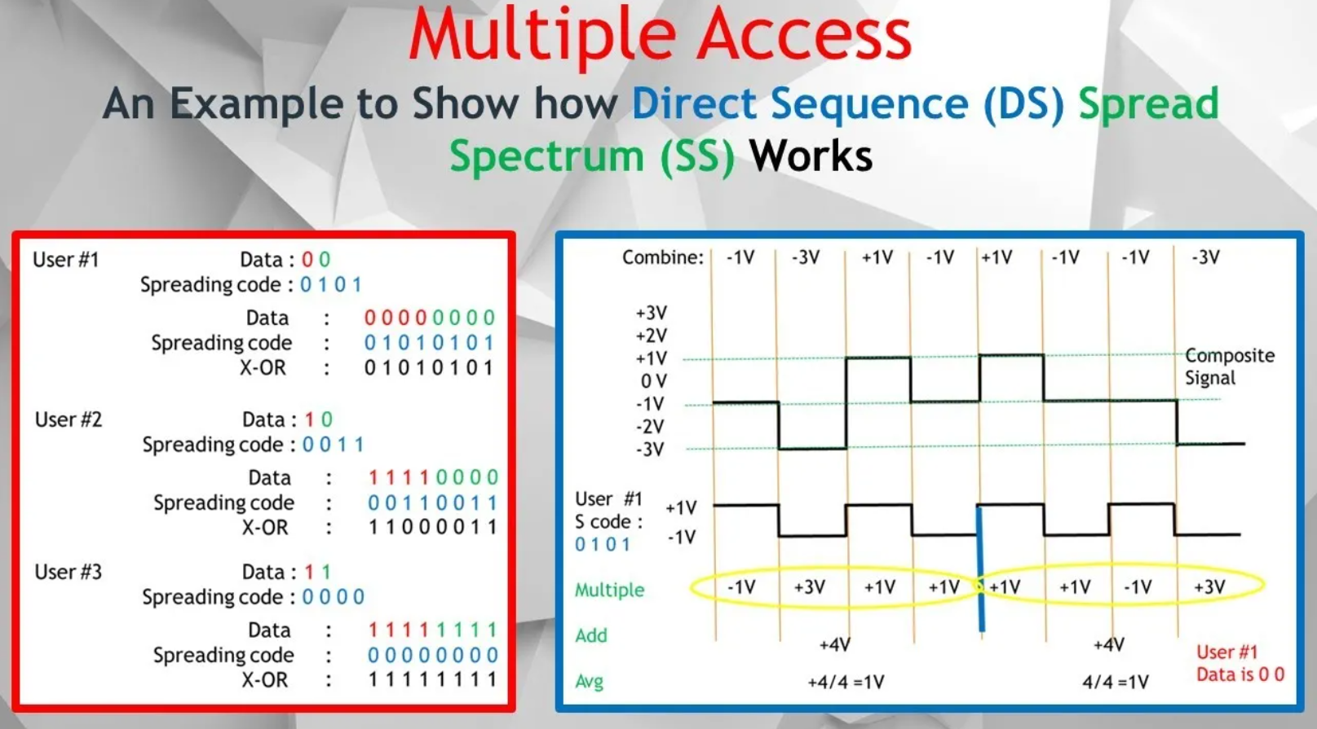
Pls see this Youtube video to understand more.
How Code Division Multiple Access, CDMA & Direct Sequence Spread Spectrum, DSSS Works.
https://youtu.be/Zahw-f-_KVs

Slide 24
Thank you
1 System Design Considerations

