Slide 1

Module EGE321 Wireless Communication & Networking Chapter 2 Wireless Communications System

Slide 2
Contents
2. Wireless Communications System
2.1 Communication System Architecture
2.2 Radio Propagation and Link Budget Analysis
2.3 Digital Modulation Technique

Slide 3
Fundamentals - Analog & Digital Signals
Amplitude
Amplitude
...
Analogue
An analogue signal is defined as a physical time-varying quantity and is usually smooth and continuous.
Digital
A digital signal, on the other hand, is made up of discrete symbols selected from a finite set.
...
t
t
Analogue Signal
Analogue Signal
Amplitude
Amplitude
...
...
t
t
Digital Signal
Digital Signal

Slide 4
Digital Transceiver Architecture
Digital input
Source bits
Channel bits
From other sources
Input signal
Format
Source
Channel
Multiplex
Modulate
Spread
Multiple
Encoder
Encoder
Access
Tx
Performance
Bits or Symbol
Measure
Waveforms
Rx
Source
Channel
Demodulate
Multiple
Format
Decoder
Decoder
Demultiplex
& Detect
Despread
Access
Digital output
Source bits
Channel
bits
To other
Carrier & symbol
destinations
synchronization

Slide 5
Digital Transceiver Building Block – ADC
Operation of the Analog to Digital Converter
Process of converting Analog signal to Digital format
Analog Input Signal
Digital Signal
amplitude
PCM Codes
Encoder
011 110 100 010...
t
ADC
Sampling Function
Generator
Quantized
Level
PCM Codes
7
111
T_{S}
110
5
101
T_{S} = sampling interval (s)
f_{S}= 1/T_{S} = sampling frequency (Hz)
V_{FS}
100
3
011
Sampling pulses
q
010
1
001
0
000
1
2
3
4

Slide 6
Fundamentals - Information Transfer Rate (Bit Rate)
Digital signal represent by ‘0’ or ‘1’
0 or 1 that represents information to be transmitted through the communication system.
What is bit rate?
Bit rate is the number of bits that are conveyed or processed per unit of time.
Information transfer rate or Bit rate: the speed at which binary information (bits) can be transferred from source to destination.
Example: if 10 bits of information are sent every second, then
Information transfer rate = 10 bits / 1s = 10 bps (in 1 sec, 10 bits can tx)
Unit of information transfer rate : bits / second or bps

Slide 7
Fundamentals - Symbol Rate
What is symbol rate?
Symbol rate (baud rate or modulation rate) is the number of symbol changes, waveform changes, or signalling events, across the transmission medium per time unit using a digitally modulated signal or a line code.
Example:
If 1 bit = 1 symbol, then the symbol rate would be the same as the bit rate.
If 2 bits = 1 symbol then the symbol rate would be half of the bit rate.
Symbol rate = bit rate / the number of bits to represent a symbol.
Unit of symbol rate: Symbol / second or sps

Slide 8
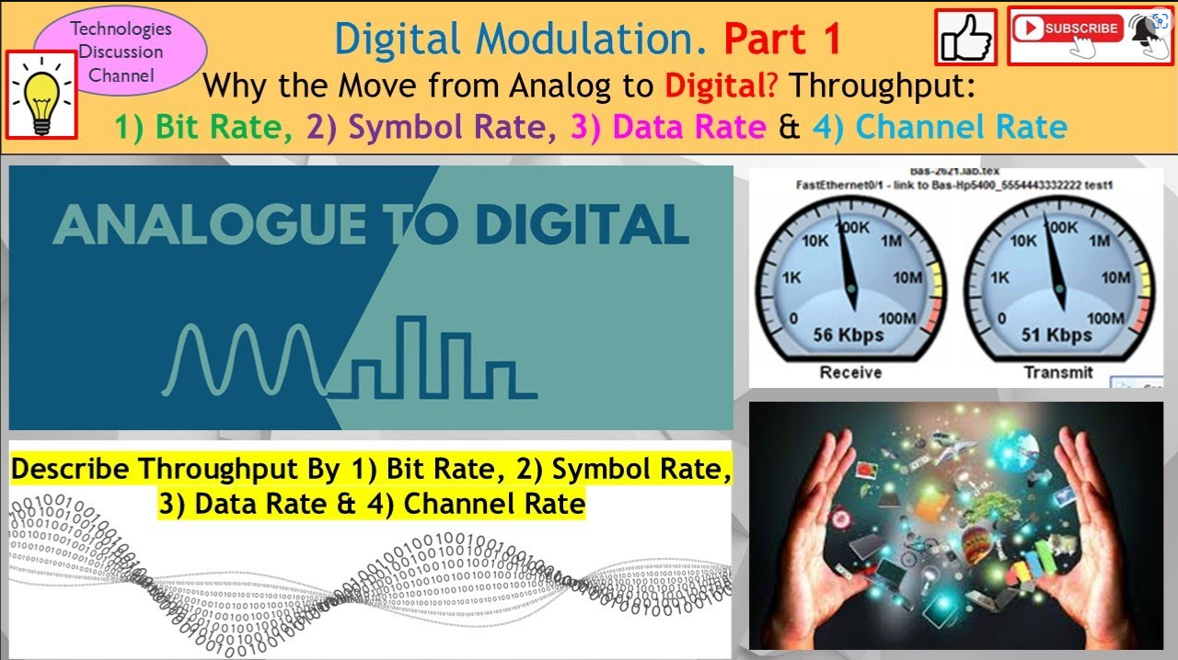


Pls see this Youtube video to understand more.
Digital Modulation Part 1. How Data Speed Works: Throughput, Bits, Baud & Channel Rate Demystified!
https://youtu.be/LkG0iXV4d2E

Slide 9


Fundamentals – Binary Signaling
Every 1 second, 1 bit of data is send which is 1 bps
10 second, this is the data “1 1 0 1 1 0 0 1 0 0”
Open
Bit 1
1 1 0 1 1 0 0 1 0 0
Close
Bit rate = 1 bps
1 Symbol = 1 bit, then the symbol rate is 1 sps
Bit 0

Slide 10



Fundamentals – M-ary Signaling
0 0 → Paul
Every 1 second → 1 bit of data is 1 bps
Every 10 second, I can send “1 1 0 1 1 0 0 1 0 0”
Received data
0 1 → Andy
Start from here
1 1 0 1 1 0 0 1 0 0
1 0 → Jenny
1st
Symbol
2nd
Symbol
3rd
Symbol
4th
Symbol
5th
Symbol
No one
1 1 → No one
Bit rate = 1 bps
1 Symbol = 2 bit, then the symbol rate is 0.5 sps

Slide 11
Fundamentals – Binary Signaling
In Binary Signaling: One Symbol is used to represent One bit
K = number of bit make into a symbol
M = number of possible state = 2^{k}
For this case
K =1
And therefore M=2
S₁(t)
S₂(t)
Binary
Modulator
1 0 1
S₁(t)
S₂(t)
S₁(t)
ASK, BPSK, FSK
2 possible states
“1” or “0”
For Binary Signaling:
Symbol Rate = Bit Rate

Slide 12
Fundamentals – M-ary Signaling
For M-ary Signaling, one symbol is represented by more than 1 bit.
Group of k bits represented by One Symbol from 2^{k}-symbol set
K = number of bit make into a symbol
M = number of possible state = 2^{k}
For this case
K =4
And therefore M= 2⁴ = 16
S₁(t)
S₂(t)
.
.
.
S_{M}(t)
M-ary
Modulator
01...100…00...10
Group of k bits
MPSK, MFSK
M-QAM
For M-ary Signalling:
M=2^{k} symbols
Symbol Rate = Bit Rate / k = Bit Rate / log₂M
To represent group of k bits, M=2^{k} symbols are required.

Slide 13
Example (1)
A mobile radio can support a symbol rate of 8kbps within a bandwidth of 20 kHz by encoding 2 bits in each symbol.
Compute the following:
The data/bit rate.
ANS
Data/Bit rate = Symbol rate x k (Given, k is 2)
= 2 x 8kbps = 16kbps
The bandwidth efficiency of the radio link.
ANS
BW efficiency = data rate / bandwidth =16k/20k = 0.8 bps/Hz

Slide 14
Shannon Capacity Theorem
Fundamentals – Capacity Theorem
The Shannon-Hartley capacity limit for error-free communication is given by:
Channel Capacity, C = BW log₂ (1 + S/N ) bps
Shannon–Hartley theorem tells the maximum rate at which information can be transmitted over a communications channel of a specified bandwidth in the presence of noise.

Slide 15
Shannon Capacity Theorem
Fundamentals – Capacity Theorem
Example:
A telephone line has a bandwidth of 0 to 4 kHz, and the maximum signal to noise ratio (S/N) on the line is 20 dB. What is the channel capacity for error free transmission?
BW = Highest freq – lowest freq = 4kHz
C = BW log₂(1+S/N)
Therefore C = (4000-0) log₂(1+10^{20/10})
= 4000 log₂(101)
= 26.63kbps

Slide 16
Digital Transceiver Architecture
Digital input
Source bits
Channel bits
From other sources
Input signal
Format
Source
Channel
Multiplex
Modulate
Spread
Multiple
Encoder
Encoder
Access
Tx
Performance
Bits or Symbol
Measure
Waveforms
Rx
Source
Channel
Demodulate
Multiple
Format
Decoder
Decoder
Demultiplex
& Detect
Despread
Access
Digital output
Source bits
Channel
bits
To other
Carrier & symbol
destinations
synchronization

Slide 17
Digital Transceiver Building Block
Input signal
The source of information can be analog / digital, e.g. analog: audio or video signal, digital: like teletype signal. In digital communication the signal produced by this source is converted into digital signal consists of 1′s & 0′s.
Source Encoder
In digital communication we convert signal from source into digital signal as mentioned above. The point to remember is we should like to use as few binary digits as possible to represent the signal. In such a way this efficient representation of the source output results in little or no redundancy. This sequence of binary digits is called information sequence.
Source Encoding or Data Compression: the process of efficiently converting the output of wither analog or digital source into a sequence of binary digits.

Slide 18
Digital Transceiver Building Block
Channel Encoder
The purpose of the channel encoder is to introduce some redundancy in the binary information sequence that can be used at the receiver to overcome the effects of noise and interference encountered in the transmission on the signal through the channel.
Digital Modulator
The binary sequence is passed to digital modulator which in turns convert the sequence into electric signals so that it can transmit on channel. The digital modulator maps the binary sequences into signal wave forms, for example if we represent 1 by sin x and 0 by cos x then we will transmit sin x for 1 and cos x for 0.

Slide 19
Digital Transceiver Building Blocks
Communication Channel
The communication channel is the physical medium that is used for transmitting signals from transmitter to receiver. In wireless system, this channel consists of atmosphere, for traditional telephony, this channel is wired, there are optical channels, under water acoustic channels etc.
Digital Demodulator
The digital demodulator processes the channel corrupted transmitted waveform and reduces the waveform to the sequence of numbers that represents estimates of the transmitted data symbols.

Slide 20
Digital Transceiver Building Blocks
Channel Decoder
This sequence of numbers then passed through the channel decoder which attempts to reconstruct the original information sequence from the knowledge of the code used by the channel encoder and the redundancy contained in the received data
Source Decoder
At the end, if an analog signal is desired then source decoder tries to decode the sequence from the knowledge of the encoding algorithm. And which results in the approximate replica of the input at the transmitter end.
Output Transducer
Finally we get the desired signal in desired format analog or digital.

Slide 21
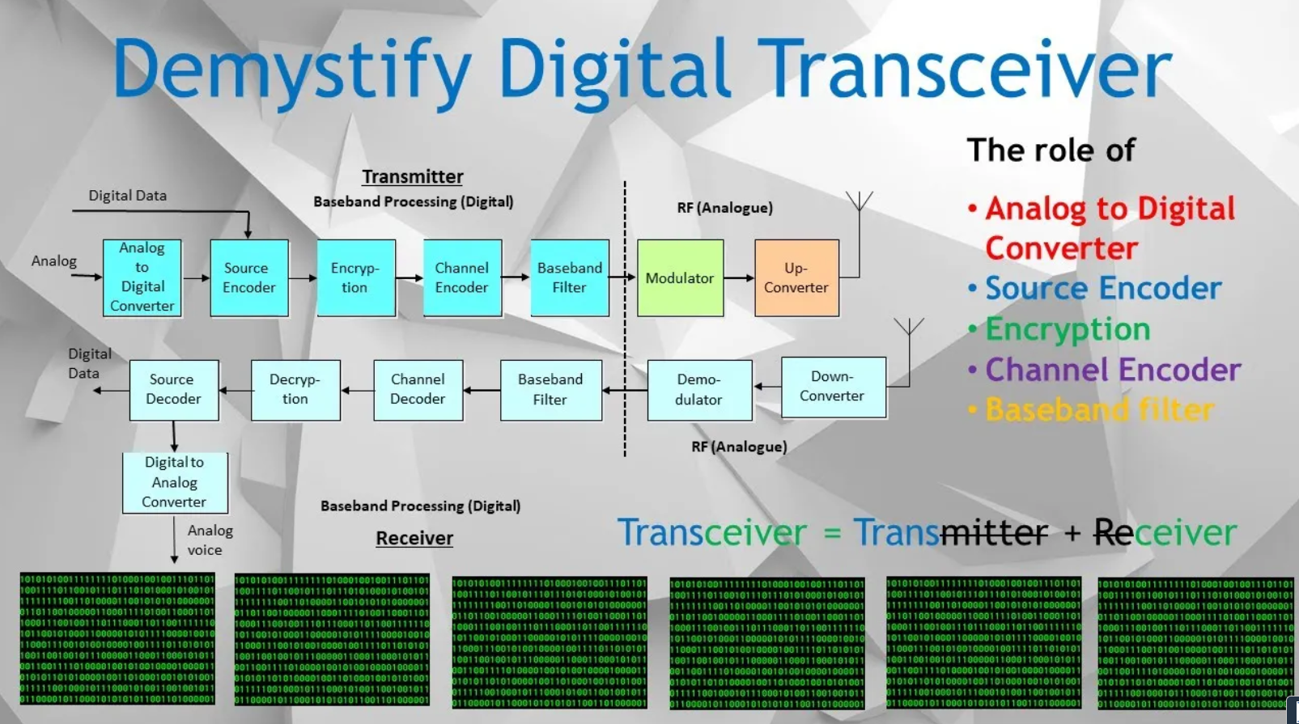
Pls see this Youtube video to understand more.
The Roles of Source Encoder, Channel Encoder & Encryption of a Transmitter of Digital Transceiver.
https://youtu.be/ymF3ZMlp4f8

Slide 22
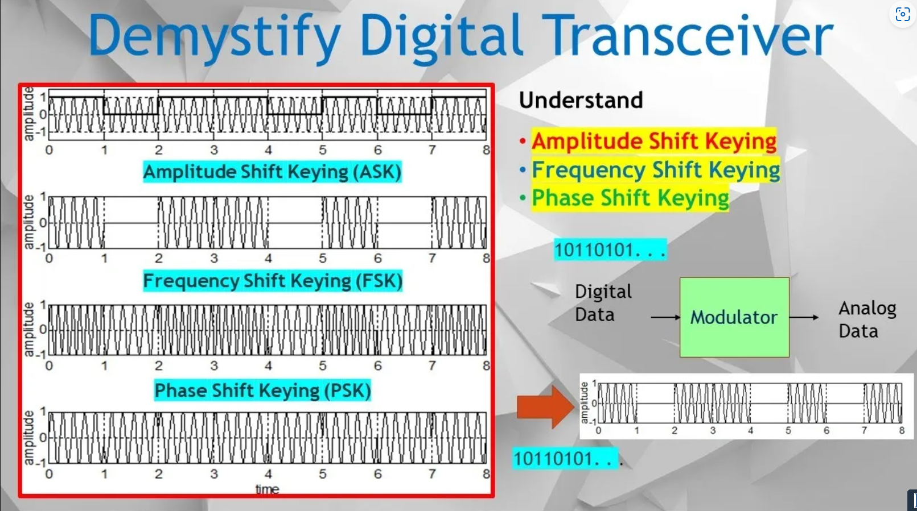
Pls see this Youtube video to understand more.
Digital Transceiver: Roles of Modulator (ASK, FSK & PSK). Draw the Time Diagram of ASK, FSK & PSK.
https://youtu.be/EzkrhXHouNg

Slide 23
Digital Transceiver Building Block
Example1:
What is function of the source coding in a digital transmitter?
ANS
The function of the source coding is to perform data compression of the input source to achieve a minimal representation of the input waveform.
Example2:
What is the function of the channel encoder in a digital transmitter?
ANS
Channel encoder is to combat channel impairments by adding redundancy bits for error detection and correction.

Slide 24
Digital Transceiver Building Block
Information source and input transducer
Source encoder
Encryption
Channel encoder
Digital modulator
& Upconverter
Transmitter
removes redundancy, e.g. speech compression
security of information
adds redundancy (e.g. linear block codes, cyclic codes & convolutional codes) to combat channel impairment
baseband filtering, data formatting based on modulation scheme (BPSK, QPSK), upconversion, power amplification, etc
e.g. speech source & A-to-D conversion of speech
propagation loss, shadowing, multipath, etc
Propagation
Media
Digital demodulator
& Downconverter
Output Transducer
Source decoder
Decryption
Channel decoder
Receiver
Basic elements of a digital communication system

Slide 25
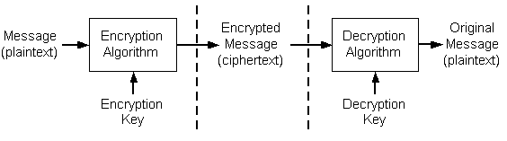
Digital Transceiver Building Block
Encryption & Decryption
Encryption is the process of translating plain text data (plaintext) into something that appears to be random and meaningless (ciphertext).
Decryption is the process of converting ciphertext back to plaintext. To encrypt more than a small amount of data, symmetric encryption is used.

Slide 26
Digital Transceiver Building Block – Channel Coding
Types of errors
1. Random errors : occur randomly in the received sequence.
mainly due to thermal noise, also called Gaussian noise.
codes designed to correct random errors are called random-error-correcting codes, e.g. Block Codes & Convolutional Codes
2. Burst errors : occurs in clusters of message in the received sequence.
mainly caused by multipath fading.
burst errors can be corrected using a combination of random-error correcting codes & time interleaving
3. Diffuse Errors : combination of burst & random errors
Can be corrected using concatenated codes, example: random-error-correcting codes + Reed-Solomon Codes.

Slide 27
Thank you

