Slide 1

Module EGE321 Wireless Communication & Networking Chapter 2.2 Radio Propagation and Link Budget
2.2 Radio Propagation and Link Budget

Slide 2
Contents
2.2 Radio Propagation and Link Budget
2.2.1 Electromagnetic Wave Propagation
2.2.2 Propagation Path Loss Model
2.2.3 Link Performance Analysis
2.2 Radio Propagation and Link Budget

Slide 3
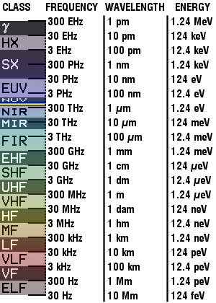
Electromagnetic Wave Propagation
Electromagnetic(EM) Spectrum (1)
GHz = Gigahertz (10⁹) (billion)
THz = Terahertz (10¹²) (Trillion)
PHz = Petahertz (10¹⁵) (Quadrillion)
EHz = Exahertz (10¹⁸) (Quintillion)
The entire range of frequencies that is occupied by the electromagnetic waves is referred as electromagnetic spectrum
Allocation of frequencies is made by world-wide agreements under the control of the International Telecommunications Union (ITU)
Representatives from different countries meet at regular ITU conference to decide what services should be allowed to use which frequencies
These are necessary so as not to cause interference to each other’s transmission
Legend:
γ = Gamma rays
HX = Hard X-rays
SX = Soft X-Rays
EUV = Extreme ultraviolet
NUV = Near ultraviolet
Visible light
NIR = Near infrared
MIR = Moderate infrared
FIR = Far infrared
Radio waves:
EHF = Extremely high frequency (Microwaves)
SHF = Super high frequency (Microwaves)
UHF = Ultrahigh frequency
VHF = Very high frequency
HF = High frequency
MF = Medium frequency
LF = Low frequency
VLF = Very low frequency
VF = Voice frequency
ELF = Extremely low frequency
2.2 Radio Propagation and Link Budget

Slide 4
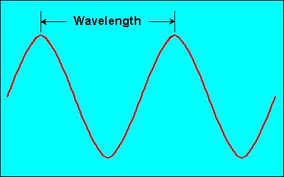
Electromagnetic Wave Propagation
Electromagnetic(EM) Spectrum (2)
Information to be transmitted must be converted into signals that is compatible with the transmitting medium
The information is converted into an electrical signal which consists of both Electric (E) and Magnetic (M) fields. This is called a Electromagnetic (EM) wave. Radio Frequency (RF) wave is part of the EM wave
The wavelength (λ) of an electromagnetic wave is defined as:
A wavelength is the distance travelled by the EM wave in the time of one period. The frequency of the EM wave is inversely proportional to the wavelength
EM waves can travel through long distances, through guided medium such as transmission wires or unguided medium such as the free space or vacuum
= velocity of EM wave through transmission medium
c = velocity of EM wave through free space is a constant = 3 x 10⁸ m/s
f = frequency of EM wave
2.2 Radio Propagation and Link Budget

Slide 5
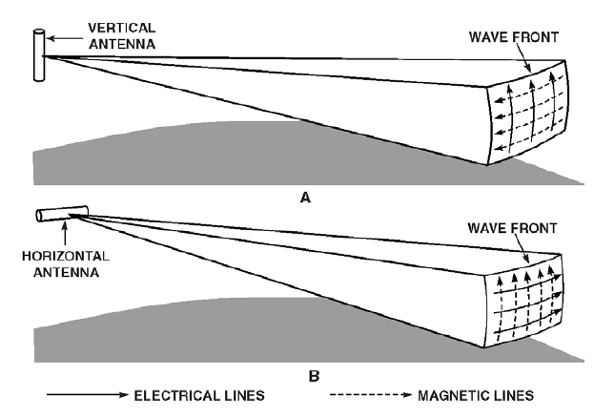
Electromagnetic Wave Propagation
EM Wave Propagation
y
Orientation of the E-field
will determine the Polarisation of the EM wave
E_{y}
Direction of
propagation
Direction of
travel of wave
E
H
H
z
z
E
H_{x}
E_{y} X H_{z}
x
x
The EM wave shown is a Transverse Electromagnetic Wave (TEM) as the electric field, E and the magnetic field, H are transverse to the direction of propagation
Polarization of a EM wave refers to the orientation of the E-field. Two common types of polarization are:
Vertical Polarization
Horizontal Polarization
2.2 Radio Propagation and Link Budget

Slide 6
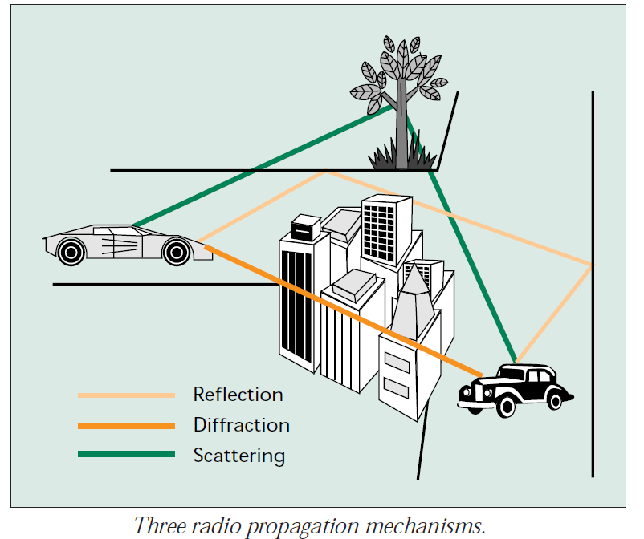
Electromagnetic Wave Propagation
Radio Propagation Mechanism (1)
Electromagnetic signals, after leaving the transmitting antenna, will experience the following propagation mechanisms:
Reflection
Diffraction
Scattering
Refraction
Absorption
2.2 Radio Propagation and Link Budget

Slide 7
Electromagnetic Wave Propagation
Radio Propagation Mechanism (2)
Reflection
The EM signal impinges on an object whose dimension is very large as compared to the wavelength of the EM signal
Dimension large compared to wavelength(λ) of EM wave
Examples: earth surface, buildings and walls.
2.2 Radio Propagation and Link Budget

Slide 8
Electromagnetic Wave Propagation
Radio Propagation Mechanism (3)
Diffraction
Occurs when radio path is blocked by an object that has sharp irregularities
It is also often termed shadowing because the diffracted field can reach the receiver even when shadowed by an impenetrable obstruction – shadow region
Examples: Sharp projections (buildings, mountain peaks) produces a maximum diffracted signal
2.2 Radio Propagation and Link Budget

Slide 9
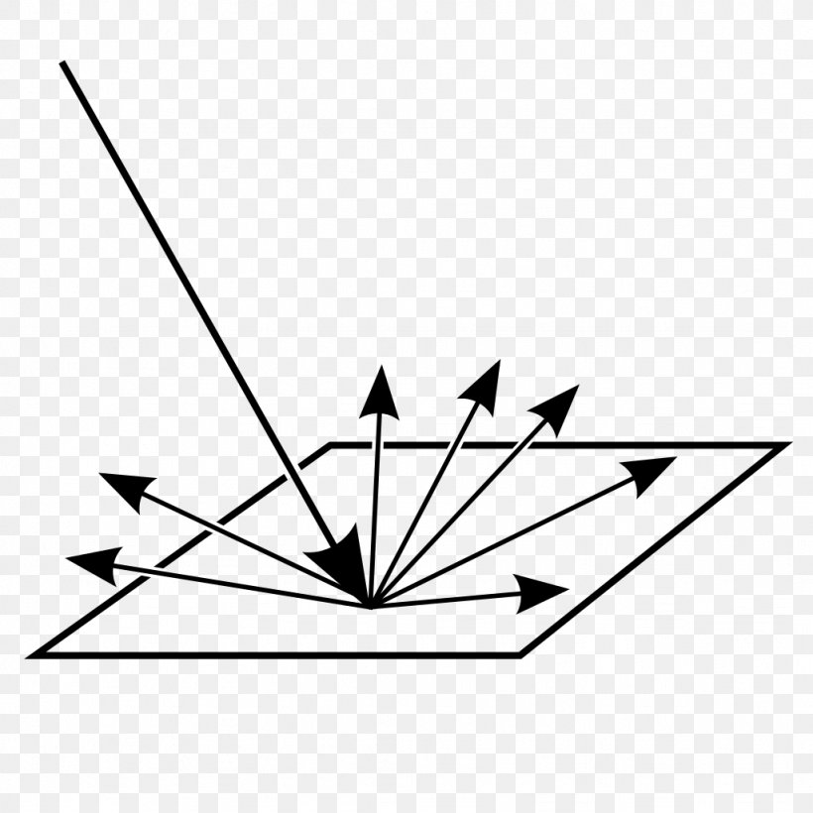
Electromagnetic Wave Propagation
Radio Propagation Mechanism (4)
Scattering
Occurs when the EM wave strikes small, rough surfaces or other irregularities objects
Object’s dimension small as compared to wavelength (λ) of EM wave
Examples: Foliage, lampposts and street signs
Surface roughness is tested by Rayleigh criterion which defines a critical height h_{c} of surface protuberances:
A surface is considered smooth if its minimum to maximum protuberance h < h_{c} and is considered rough if the protuberance h > h_{c}
2.2 Radio Propagation and Link Budget

Slide 10
Electromagnetic Wave Propagation
Radio Propagation Mechanism (5)
Example
An electromagnetic signal may encounter reflection or scattering when it hits an obstacle. Explain when reflection and scattering occur.
ANS
When the EM signal hits an object whose dimension is very large compared to its wavelength, it undergoes reflection.
When the EM signal hits a small object whose dimension is small compared to its wavelength, it is redirected in all directions.
2.2 Radio Propagation and Link Budget

Slide 11
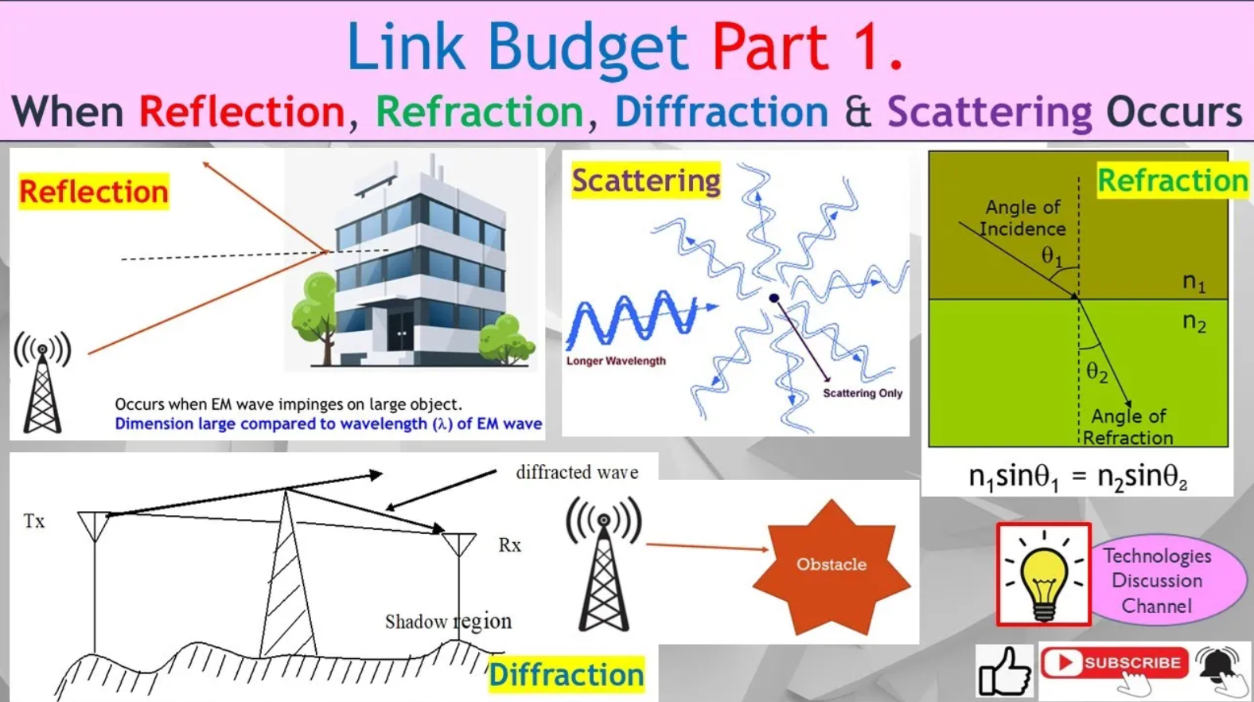


Pls see this Youtube video to understand more.
Link Budget Part 1. Reflection, Refraction, Diffraction or Scattering, When EM Wave Hit an Obstacle.
https://youtu.be/xPiMMvZ5zTQ

Slide 12
Electromagnetic Wave Propagation
RF Propagation Modes (1)
Ground waves
Space waves – travels over the earth surface.
Surface waves – travels along the surface of the earth. Signal usually below 2MHz (LF and MF bands)
Sky waves - radio wave propagated upward from earth, whether reflected by the ionosphere or not.
Earth’s Upper Atmosphere
Sky wave
Direct LOS wave (space wave)
Transmit
Antenna
Receive
Antenna
Surface wave
Earth’s Surface
2.2 Radio Propagation and Link Budget

Slide 13
Electromagnetic Wave Propagation
Radio Propagation Modes (2)
100 MHz
Decreasing Ionization
ionosphere
ionosphere
Max. Ionization
Increasing Ionization
5 MHz
20 MHz
Effects of Frequency versus Refraction and Distance
Higher frequency signal is not bent as much
as the lower frequency signal because of its shorter wavelength
and hence may not return to earth
Effects of Ionospheric Density on Radio Waves
Higher ionization density refracts more!
A
Frequency of A = frequency B
Frequency C > frequency A or B
A
B
C
B
C
Critical angle
Critical angle
for frequency B
Critical angle
for frequency C
Effects of Different Incident Angles of Radio Waves
Effects of Frequency on the Critical Angle
With all conditions being the same, the effects of ionization on a lower frequency signal is that the critical angle is smaller and the skip distance is much shorter than for the case of a higher frequency signal
Frequency of A = frequency of B = frequency of C
Beam A is beamed vertically up and never get refracted back
Beam B is beamed at the critical angle, and the beam is refracted back
Beam C is beamed at a larger than critical angle and hence it travel farther
2.2 Radio Propagation and Link Budget

Slide 14
Electromagnetic Wave Propagation
Radio Propagation Modes (3)
Classification Band | Initials | Frequency Range | Characteristics
Extremely low | ELF | < 300 Hz | Ground wave
Infra low | ILF | 300 Hz - 3 kHz
Very low | VLF | 3 kHz - 30 kHz
Low | LF | 30 kHz - 300 kHz
Medium | MF | 300 kHz - 3 MHz | Ground/Sky wave
High | HF | 3 MHz - 30 MHz | Sky wave
Very high | VHF | 30 MHz - 300 MHz | Space wave
Ultra high | UHF | 300 MHz - 3 GHz
Super high | SHF | 3 GHz - 30 GHz
Extremely high | EHF | 30 GHz - 300 GHz
Tremendously high | THF | 300 GHz - 3000 GHz
2.2 Radio Propagation and Link Budget

Slide 15
Electromagnetic Wave Propagation
Radio Propagation Model (4)
Radiated energy from the antenna propagate through the media, in this case air, to reach the receiving antenna over mainly two possible propagation paths
1) Line of Sight (LOS) path
Tx and Rx can “see” each other
A LOS link requires that most of the first Fresnel zone is free of any obstructions. Otherwise there will be significant signal reduction.
2) Non Line of Sight (NLOS) paths
the direct path between Tx and Rx are blocked by obstacles and hence “cannot see” each other. The radio signal is reflected off from some structures to reach the receiver
NLOS paths
LOS
2.2 Radio Propagation and Link Budget

Slide 16
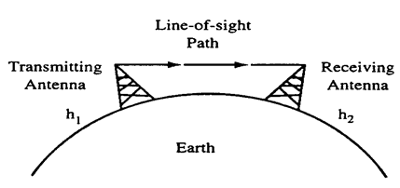
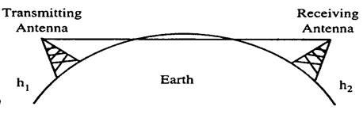
Electromagnetic Wave Propagation
Radio Propagation Model – Line of Sight (1)
Optical Line of sight is the direct free-space path that exists between two end-points. To have a clear line of sight there must be no obstructions between Tx and Rx. “Transmitter and receiver must be able to see each other”.
Obstructions that might block optical line of sight include curvature of the Earth, mountains; topographic features, buildings; other man-made objects.
Space wave propagation and physical limitations
Propagation restricted by Earth’s curvature
2.2 Radio Propagation and Link Budget

Slide 17
Electromagnetic Wave Propagation
Radio Propagation Model – Line of Sight (2)
However due to the density of the atmosphere changing, less dense as the height increases, radio signals are refracted (bent) into slightly curved paths, and hence communicating antennas can “see” each other even when beyond the visible horizon
Line of sight (LOS) propagation is one mode of unguided radio wave transmission
Used mainly for VHF and Microwaves bands because the energy of radio waves at these bands propagate through the atmosphere in more or less a straight line
Radio Horizon
Optical line of
sight path
Radio line of sight path
Antenna
EARTH Surface
Optical Horizon
2.2 Radio Propagation and Link Budget

Slide 18
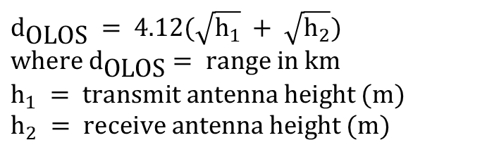
Electromagnetic Wave Propagation
Radio Propagation Model – Line of Sight (3)
Optical line of sight distance d_{OLOS}
Radio line of sight distance d_{RLOS} is usually 1.33 times further than the optical line of sight d_{OLOS.} d_{RLOS} = 1.33 d_{OLOS}
Determining the line-of-sight distance does not guarantee that range. The transmitter power, receiver sensitivity, transmission line loss, antenna loss or gain, and operating frequency must also be considered when calculating the actual range
$$d_{\text{OLOS}} =\text{ 4.12}(\sqrt{h_{1}} + \sqrt{h_{2}}) \\ \text{where} d_{\text{OLOS}}= \text{range} \text{in} \text{km} \\ h_{1} = \text{transmit} \text{antenna} \text{height} (m) \\ h_{2} = \text{receive} \text{antenna} \text{height} (m)$$
2.2 Radio Propagation and Link Budget

Slide 19
Electromagnetic Wave Propagation
Radio Propagation Model – Line of Sight (4)
Example
1) The two communication towners are communicating with each other via VHF. The height of the towner is 50m and 70m. Estimate the maximum communication distance of the two towners.
2) In order to increase the maximum distance, the height of the two towners are increase to 90m. Calculate the new maximum distance.
2.2 Radio Propagation and Link Budget

Slide 20
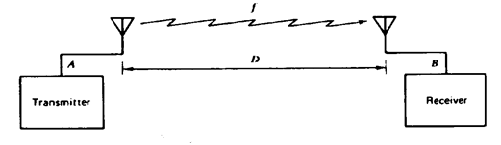
Propagation Path Loss Models
Free Space Concept
Free space path is the Line-of-Sight path directly between the transmit and receive antennas (also called the Direct Wave)
Free Space Loss is defined as the loss incurred by an EM wave as it propagates in a straight line through a vacuum with no absorption or reflection of energy from nearby objects
A free space channel characterizes an ideal RF propagation path
2.2 Radio Propagation and Link Budget

Slide 21
Propagation Path Loss Models
Free Space Propagation Model
The free space propagation model is used to predict signal strength when the transmitter and receiver have a clear, unobstructed line of sight path between them. This is an Ideal Model
Friis Free Space Equation
where: P_{R} = Received Power in Watts
P_{T} = Transmitted Power in Watts
G_{T} = Transmit Antenna Gain
G_{R} = Receive Antenna Gain
λ = Wavelength in meters
d = Tx/Rx Separation in same units as wavelength in meters
L = system loss that is not related to propagation (L ≥ 1) L = 1 (if there is no system hardware losses)
2.2 Radio Propagation and Link Budget

Slide 22
Propagation Path Loss Models
Free Space Propagation Model (1)
The path loss, which represents the signal attenuation after the signal leaves the transmit antenna and before reaching the receive antenna is defined as the difference (in dB) between the transmitted power and the received power with unity antenna gain
The Friis formula shows that the received signal power falls off as the square of the transmitter to receiver separation distance (d) ➔ P_{R} α d⁻²
2.2 Radio Propagation and Link Budget

Slide 23
Propagation Path Loss Models
Free Space Propagation Model (2)
Substituting in terms of frequency instead of wavelength λ and expressing the frequency in MHz and distance d in km
Note that the path loss increases as the frequency and the distance increases
In practice, besides frequency and distance between antennas, Path loss is also dependent on other factors such as:
Antenna heights
Terrain environment – urban, rural etc
weather
2.2 Radio Propagation and Link Budget

Slide 24
Propagation Path Loss Models
Example
A radio communication system has operating at 400 MHz and has a transmit power of 25W and has an effective range of 2000 m. The transmitting and receiving antenna gains are 25dB and 3 dB respectively.
State the condition that must be valid to apply the free space path loss model.
Assuming no other losses, calculate the free space loss.
(a) Transmitter and receiver must have a clear, unobstructed line of sight path between them.
(b) Free space path loss L_{P} (dB) = 32.44 + 20 log d (km) + 20 log f (MHz)
= 32.44 + 20 log 2 + 20 log 400
= 90.5 dB
2.2 Radio Propagation and Link Budget

Slide 25
Propagation Path Loss Models
Plane Earth Model
VHF, UHF and microwave signals normally propagate by space wave. Space wave consists of the direct wave and ground reflected wave. Reflection from the ground will cause energy loss such that its attenuation will be higher than the free space loss.
Plane Earth Path loss model is given:
The plane earth propagation loss is independent of frequency.
where
d = distance in km
h_{t}, h_{r} = antenna hts in m.
L (dB) = 120 + 40 log d_{km} - 20 log[h_{r}(m) h_{t}(m)]
2.2 Radio Propagation and Link Budget

Slide 26
Propagation Path Loss Models
Plane Earth Model
Example:
An aircraft is now approaching landing at a height of 1000m and is transmitting 5W to a control tower 10km away. The height of the control tower is 90m. Assume that there is a ground reflected signal to the control tower. Determine the path loss.
Since there is a ground reflected wave, we use the Plane earth model.
L (dB) = 120 + 40 log d_{km} - 20 log[h_{r}(m) h_{t}(m)]
= 120 + 40log10 – 20log(1000x90)
= 60.9dB
2.2 Radio Propagation and Link Budget

Slide 27
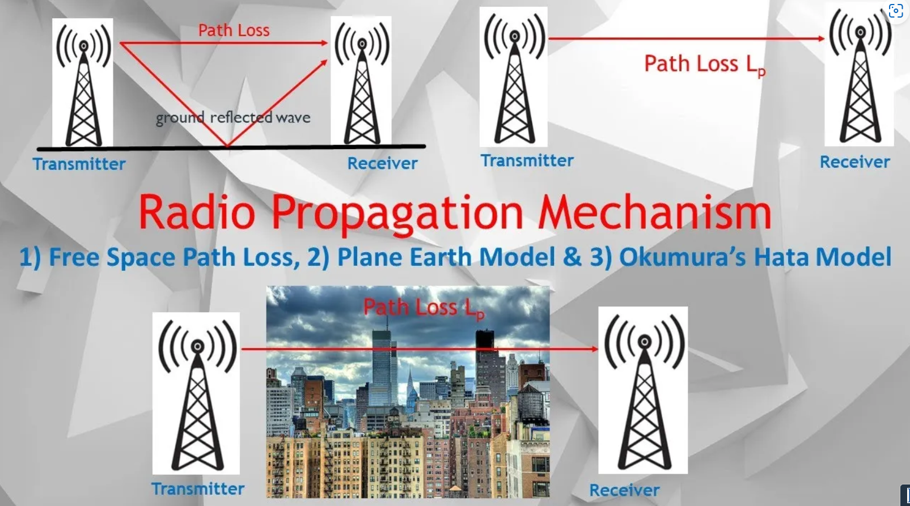
Pls see this Youtube video to understand more.
How to Calculate Link Budget Using Free Space Path Loss, Plane Earth & Okumura’s Hata Models.
https://youtu.be/VpBsqt4DuXs

Slide 28
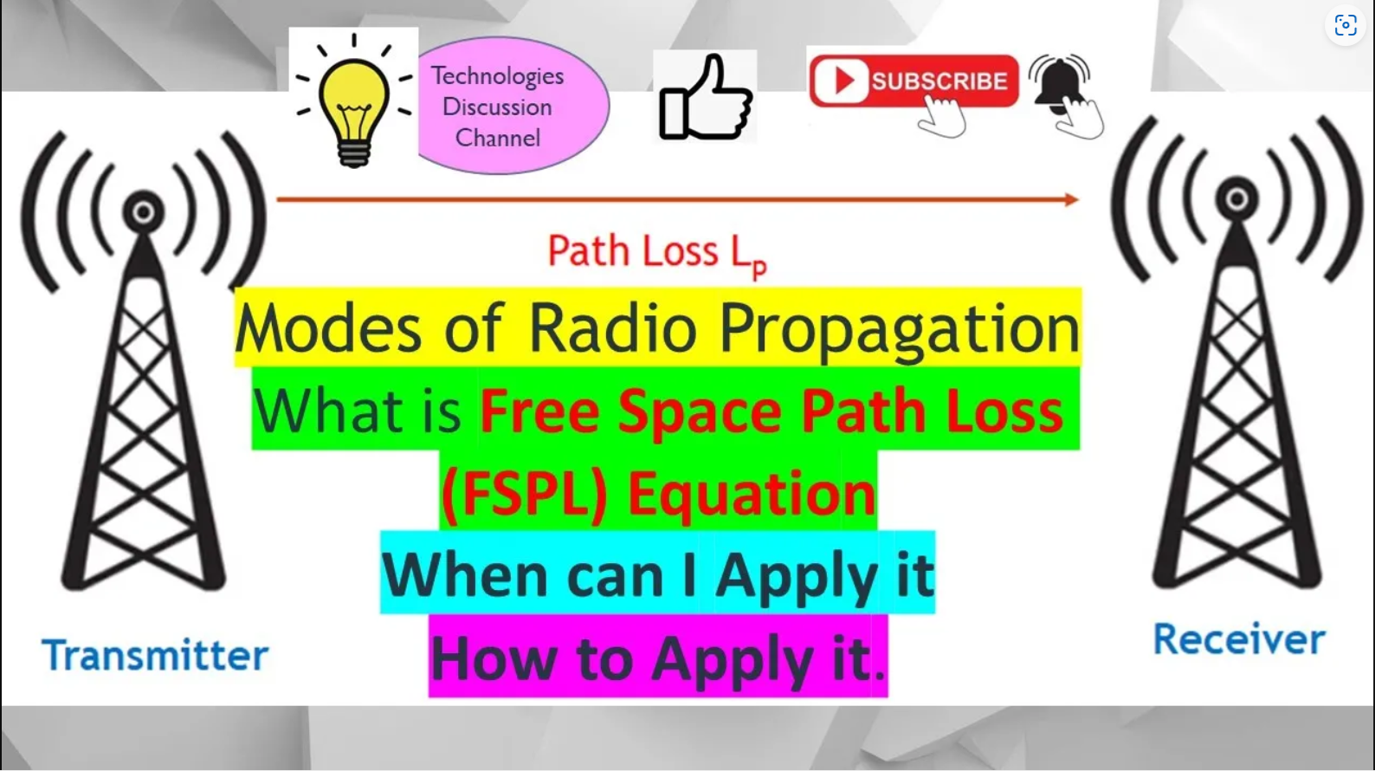
Pls see this Youtube video to understand more.
Link Budget Part 3. How to Apply Free Space Path Loss (FSPL) Equation: Applications & Usage Explain.
https://youtu.be/3ba8ytGTcP8

Slide 29
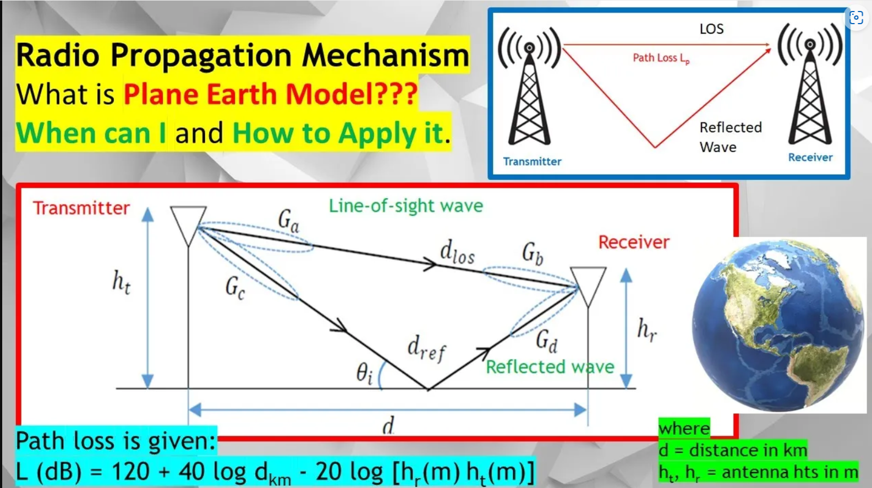
Pls see this Youtube video to understand more.
Link Budget Part 5. How to Calculate the Path Loss Using Plane Earth Model (Ground Reflected Wave).
https://youtu.be/ssYxLkdHRyU

Slide 30
Homework
1) A satellite that is 400km above the earth transmits a signal at 12 GHz to an earth station. The transmit power of the satellite is 100W.
i) State the condition that must be valid to apply the free space path loss model.
ii) Estimate the path loss in dB between the satellite and the earth station.
A microwave transmitting system is transmitting 30W of power to a receiver 10km away. Given that the height of the transmitting antenna is 100m and the height of the receiver antenna is 10m and assume that there is a ground reflected signal to the receiver. Determine the path loss in dB.
2.2 Radio Propagation and Link Budget

Slide 31
Thank you

