Slide 1

Module EGE321 Wireless Communication & Networking Chapter 2.2 Radio Propagation and Link Budget
2.2 Radio Propagation and Link Budget

Slide 2
Contents
2.2 Radio Propagation and Link Budget
2.2.1 Electromagnetic Wave Propagation
2.2.2 Propagation Path Loss Model
2.2.3 Link Performance Analysis
2.2 Radio Propagation and Link Budget

Slide 3
Electromagnetic Wave Propagation
Radio Propagation Model – EIRP
Effective, or Equivalent, Isotropically Radiated Power (EIRP) is the maximum amount of power that could be radiated from an antenna, given its antenna gain and the transmitter power of the RF system. EIRP is most commonly given in dB or dBm.
The diagram shows the location of EIRP and the equations to compute the EIRP is as following:
EIRP = P_{T}G_{T} (watts)
EIRP (dBm) = P_{T} (dBm) + G_{T} (dB)
EIRP
G_{T} = 30 dB
Tx
L_{f} = 1 dB
P_{T} = 1 W
2.2 Radio Propagation and Link Budget

Slide 4
Electromagnetic Wave Propagation
Radio Propagation Model – EIRP
Example
Calculate the EIRP of a microwave transmitting installation where the transmitter output power is 1 W, the total feeder cable loss is 1 dB, and the transmitting antenna gain is 30dB.
ANS
EIRP (dBm) = P_{T} (dBm) –L_{f} (dB) + G_{T} (dB)
= 10 log (1W/0.001W) – 1 dB + 30 dB
= 30 dBm – 1 dB + 30 dB
= 59 dBm
EIRP
G_{T} = 30 dB
Tx
L_{f} = 1 dB
P_{T} = 1 W
2.2 Radio Propagation and Link Budget

Slide 5
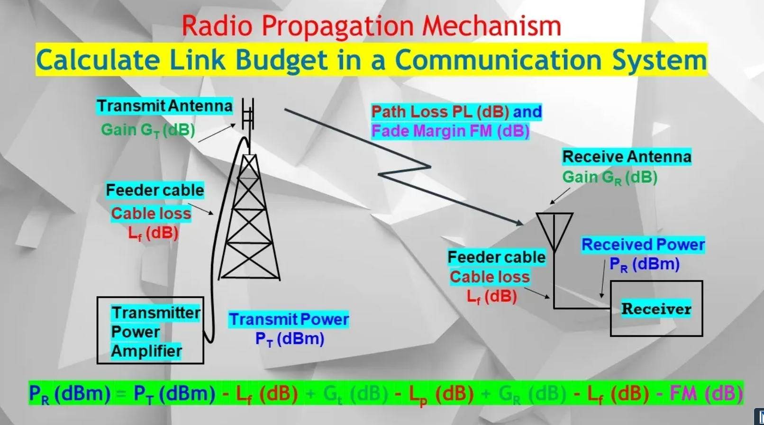


Pls see this Youtube video to understand more.
What is Link Budget & How to Calculate the Link Budget to Estimate the Quality of Comm Link.
https://youtu.be/y35j8wb0eBU

Slide 6
Propagation Path Loss Models
Okumura’s Hata Model
Hata published an empirical formula based on Okumura's results to predict path loss, and is valid from 150 MHz to 1500 MHz
The standard formula for the path loss in urban areas is given by:
Where f : Frequency between 150-1500 MHz
h_{te} : Effective height of transmitter between 30-200 m
h_{re} : Effective height of receiver between 1-10 m
d : Distance between transmitter and receiver in km
A(h_{re}): Correction factor for mobile antenna height
For a large city we take
A(h_{re}) = 3.2[ log(11.75 h_{re})]² - 4.97 (dB) for f ≥ 300 MHz
2.2 Radio Propagation and Link Budget

Slide 7
Propagation Path Loss Models
Okumura’s Hata Model
Example:
A mobile subscriber that is living at a distance, d = 3500 m from a base station complained to the cellular operator that his mobile phone reception is not very good. You are asked to investigate to find out the problems and make the necessary recommendations. Details are as follows:
Frequency of operation, f : 935.2 MHz
Base Station transmitted output power, P_{T} : 20 W
Base Station transmitter antenna gain, G_{T} : 10 dB
Base Station transmitter antenna height, h_{te} : 50 metre
Mobile Station receiver sensitivity, P_{R} : -100 dBm
Mobile Station receiver antenna gain, G_{R} : 3 dB
Mobile Station receiver antenna height, h_{re} : 1.6 metre
Assume that all other losses are negligible except for the path loss, using Okumura-Hata propagation model and determine the path loss, L_{P} (dB).
2.2 Radio Propagation and Link Budget

Slide 8
Propagation Path Loss Models
Okumura’s Hata Model
Example:
Using Okumura-Hata propagation model to determine the path loss.
A­ (h_{re}) = 3.2 [log (11.75h_{re})]² - 4.97 (dB)
= 3.2 [log(11.75 x 1.6)]² - 4.97
= 0.2251
L_{P} = 69.55 + 26.16 log f(MHz) – 13.82 log h_{te} – A(h_{re}) + [44.9 – 6.55 log h_{te}] [log d (km)]
= 69.55 + 26.16 log(935.2) - 13.82 log(50) - 0.2251 + [44.9 - 6.55 log 50] log3.5
= 141.94 dB
2.2 Radio Propagation and Link Budget

Slide 9
Propagation Path Loss Models
Link Performance Analysis
Transmit Antenna
Gain G_{T} (dB)
Path Loss PL (dB) and
Fade Margin FM (dB)
Feeder cable
Receive Antenna
Gain G_{R} (dB)
Cable loss
L_{f} (dB)
Feeder cable
Cable loss
L_{f} (dB)
Receiver
Transmitter
Power
Amplifier
Transmit Power
P_{T} (dBm)
Received Power
P_{R} (dBm)
Communication link includes the entire communication path from the information source, through the transmitter, RF channel and receiver up to the information sink
2.2 Radio Propagation and Link Budget

Slide 10
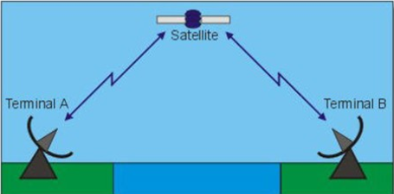
Propagation Path Loss Models
Link Performance Analysis
By examining the link budget, we can determine whether communication system meets the requirements comfortably or marginally or fail to meet the specifications
A link analysis consist of calculating the useful signal power and the interfering noise power available at the receiver. The output of the link analysis is a link budget which shows the gains and losses
Some link budget parameters are statistical such as allowances for fading. Therefore the link budget is an estimation technique for evaluating the communication system performance
Link budget enough?
2.2 Radio Propagation and Link Budget

Slide 11
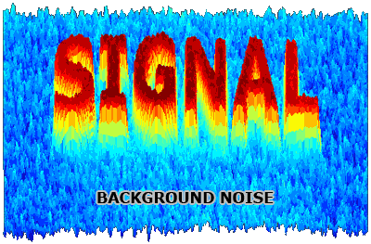
Propagation Path Loss Models
Link Performance Analysis – Performance Criteria
Bit Error Rate (BER) is used in digital system to measure the quality of the demodulator output in terms of the number of bits wrongly decoded
BER = total bits received in error/total bits transmitted
Signal to Noise Ratio (SNR)
The SNR is a measure of performance at the various points of a communication link
SNR (dB) =10 log ( signal power/noise power)
The SNR can be degraded (lowered) through
The decrease of the desired signal power
The increase of noise power (noise) or interfering signals (interferences)
2.2 Radio Propagation and Link Budget

Slide 12
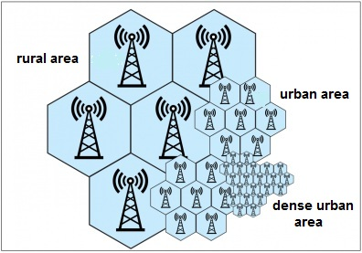
Propagation Path Loss Models
Link Performance Analysis – Radio Link Design
Link budget accounts for the total losses and gains in a transmission link from transmitter output to the receiver SNR at the input to the demodulator
Radio link design of a mobile communication system generally involves the tradeoff among the following 3 parameters (factors):
Transmit power (P_{T})
Propagation path loss (L_{P})
Receive Power (P_{R}) or Rx sensitivity
2.2 Radio Propagation and Link Budget

Slide 13
Propagation Path Loss Models
Link Performance Analysis – Radio Link Budget
To guarantee detection at the Receiver, we must have:
P_{T}(dBm) + (Gains)_{dB} – (Losses)_{dB} ≥ P_{R} (dBm)
where
P_{T} = transmit power
Gain = transmit and receive antenna gain
Losses = total losses at the antenna feeder loss, filter and circulator loss, propagation path loss, fade margin, etc
P_{R} = Rx sensitivity for a specified SNR or BER. This is the minimum signal strength that must be received at the receiver antenna in order to guarantee a certain level of performance at the receiver output
For analog link SNR is normally 12dB SINAD.
For mobile digital link, the BER could be 1x10⁻⁶
Fade Margin
Refers to the margin in dB that has to added to the path loss to account for multipath fading
2.2 Radio Propagation and Link Budget

Slide 14
Propagation Path Loss Models
Link Performance Analysis – Radio Link Example
Consider a particular base station in a cellular system operating in a large city with the following parameters :
Frequency of operation: 915 MHz
Base transmitter output power, P_{t}: P_{T} ( to be determined )
Mobile receiver sensitivity, P_{r}: -113 dBm
Base transmitter antenna gain, G_{t}: 6 dB
Mobile receiver antenna gain, G_{r}: 3 dB
Height of base transmitter, h_{te}: 50 m
Height of mobile receiver, h_{re}: 2 m
Assuming all other losses are negligible except path loss and Rayleigh fading. Provision for fade margin for 99.8% reliability may be calculated with the help of the Rayleigh distribution chart provided (Treat the Fade Margin as additional loss along the path)
2.2 Radio Propagation and Link Budget

Slide 15
Propagation Path Loss Models
Link Performance Analysis – Radio Link Example
Transmit Antenna
Gain G_{T} (dB)
Path Loss PL (dB) and
Fade Margin FM (dB)
Feeder cable
Receive Antenna
Gain G_{R} (dB)
Cable loss
L_{f} (dB)
Feeder cable
Cable loss
L_{f} (dB)
Receiver
Transmitter
Power
Amplifier
Transmit Power
P_{T} (dBm)
Received Power
P_{R} (dBm)
2.2 Radio Propagation and Link Budget

Slide 16
Propagation Path Loss Models
Link Performance Analysis – Radio Link Example
i) Write down the system equation.
P_{t} – L_{f} + G_{t} – L_{p} - FM + G_{R} – L_{f} = P_{R}
Given that feeder losses are negligible, L_{f} = 0
P_{t} + G_{t} – L_{p} - FM + G_{R} = P_{R}
ii) Given that a cell radius of 3 km is required, calculate the path loss.
A(h_{re}) = 3.2[ log(11.75 h_{re})]² - 4.97
= 3.2[log(11.75 x 2)]² - 4.97
= 1.045 dB
PL = 69.55 + 26.16log f - 13.82log h_{te} - A(h_{re}) +
(44.9 - 6.55log h_{te} )(log d)
= 69.55 + 26.16log(915) – 13.82log(50) – 1.045 +
(44.9 – 6.55log(50))log(3)
= 138.14 dB
2.2 Radio Propagation and Link Budget

Slide 17
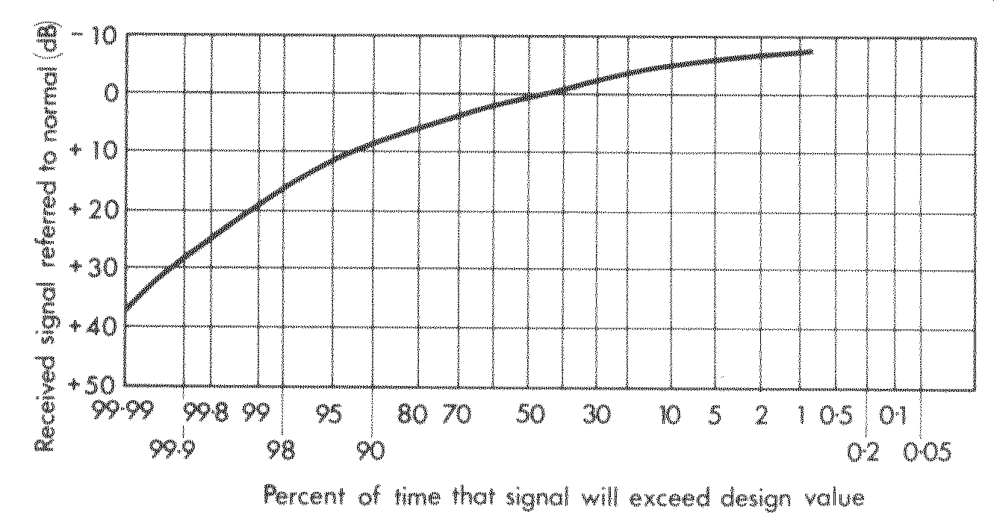
Propagation Path Loss Models
Link Performance Analysis – Radio Link Example
iii) Determine the required power of the transmitter, P_{T} with 99.8% of communication link.
From the Rayleigh distribution chart (99.8% reliability):
25 dB
2.2 Radio Propagation and Link Budget

Slide 18
Propagation Path Loss Models
Link Performance Analysis – Radio Link Example
iii) P_{t} – L_{f} + G_{t} – L_{p} - FM + G_{R} – L_{f} = P_{R}
Transmit power required P_{t} = P_{R} + L_{f} - G_{t} + L_{p} + FM - G_{R} + L_{f}
= -113 + 0 – 6 + 138.14 + 25 - 3 + 0
= 41.14 dBm
With transmit power of 41.14 dBm, we can be sure that the receiver will have the probability of 99.8% of receiving the signal.
2.2 Radio Propagation and Link Budget

Slide 19
Propagation Path Loss Models
Link Performance Analysis – Radio Link Example
Parameters | Values (dB)
Tx power(dBm) | 45
Antenna cable loss | 3
Tx Antenna Gain (dBi) | 13
EIRP(dBm) (= 45 – 3 + 13) | 55
Path Loss | 150
Fade Margin(dB) | 0
Other margin components(dB) such as building penetration loss | 0
Received isotropic power(dBm) (= 55 – 150 – 0 - 0) | -95
Rx Antenna Gain (dBi) | 4
Mobile antenna cable loss (dB) | 1
Rx signal power (dBm) (= -95 + 4 – 1) | -92
Rx noise power kTB (dBm) | -126
Rx CNR(dB) (= -92 – (-126)) | 34
Target Rx CNR(dB) | 13
Margin(dB) (= 34 – 13) | 21
2.2 Radio Propagation and Link Budget

Slide 20
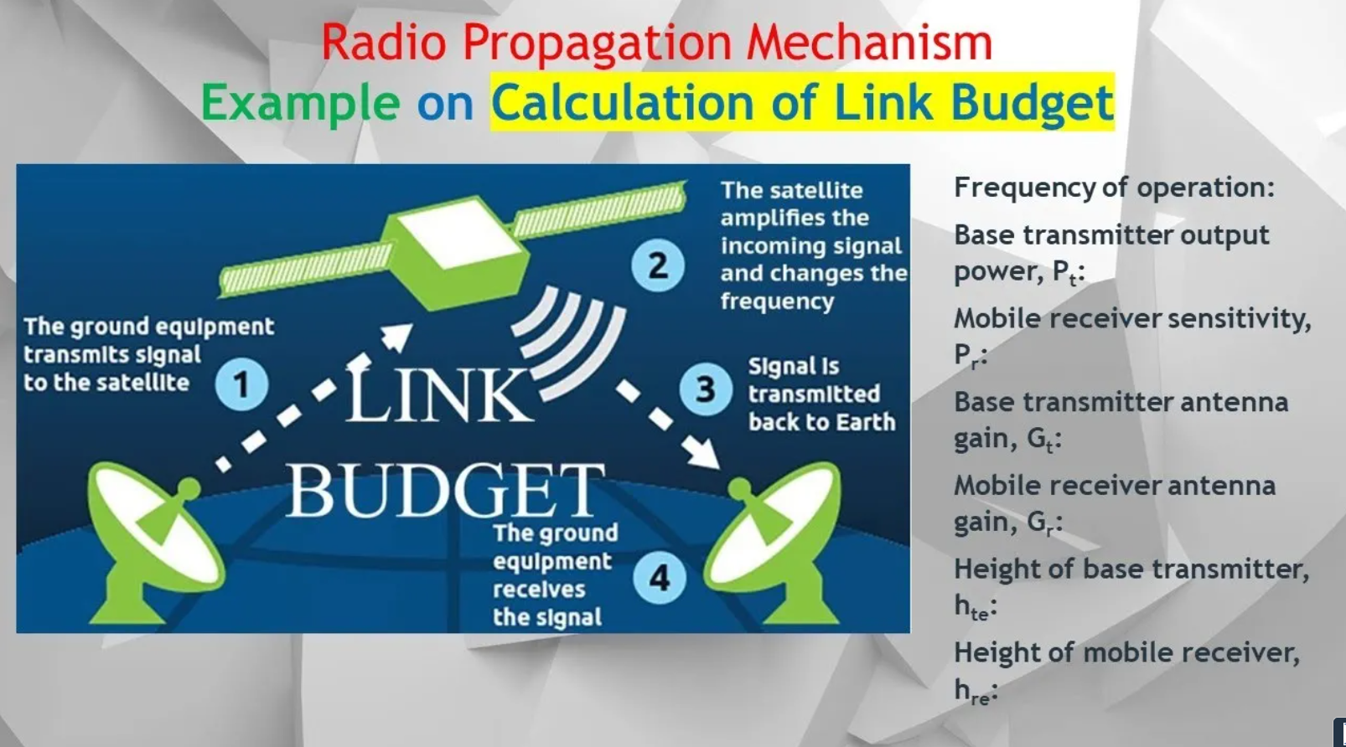
Pls see this Youtube video to understand more.
How to Calculate the Required Link Budget to Establish a Communication Link with a Case Study.
https://youtu.be/meb4a5oeTDA

Slide 21
Propagation Path Loss Models
Link Performance Analysis – Useful Formula
Model | Formula
Free Space Propagation Model | L_{P} (dB) = 32.44 + 20 log d (km) + 20 log f (MHz)
Okumura’s Hata Model | A­ (h_{re}) = 3.2 [log (11.75h_{re})]² - 4.97 (dB) L_{P} = 69.55 + 26.16 log f(MHz) – 13.82 log h_{te} – A(h_{re}) + [44.9 – 6.55 log h_{te}] [log d (km)]
Plane Earth Model | L (dB) = 120 + 40 log d_{km} - 20 log[h_{r}(m) h_{t}(m)]
Link Budget | P_{t} – L_{f} + G_{t} – L_{p} - FM + G_{R} – L_{f} = P_{R}
2.2 Radio Propagation and Link Budget

Slide 22
Homework
A RF engineer is tasked to set up a base station within a cell radius d = 2 km in a new town. The operator team has provided the following parameters:
Frequency of operation = 920 MHz
Base Station feeder loss, L_{F} = 2 dB
Base station transmitting antenna gain, G_{T} = 10 dB
Height of Base station, h_{T} = 40 m
Mobile station sensitivity, P_{R} = -113 dBm
Mobile station receiving antenna gain, G_{R} = 3 dB
Height of Mobile station, h_{R} = 2 m
2.2 Radio Propagation and Link Budget

Slide 23
Homework
1) The required fade margin for 99% reliability.
2) Write down the system equation in terms of the given parameters.
3) The path loss, L_{p}, using Okumura Hata Model.
4) The required Base station transmitter power P_{T}.
2.2 Radio Propagation and Link Budget

Slide 24
Thank you

