Slide 1
Mechatronics system engineering team 3
ADAS SYSTEM WITH CARLA

Slide 2
Agenda
Introduction

Slide 3
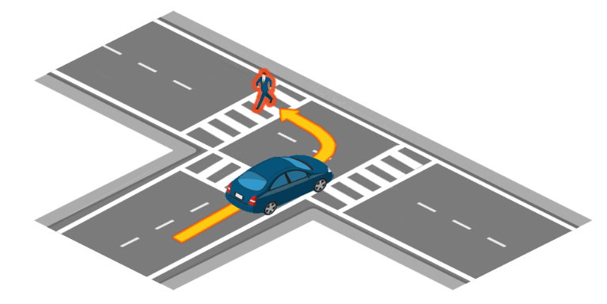
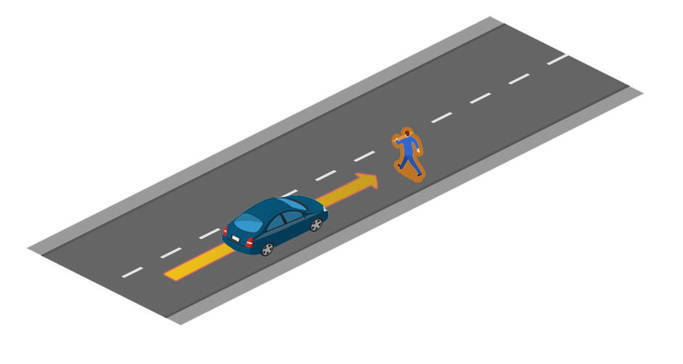
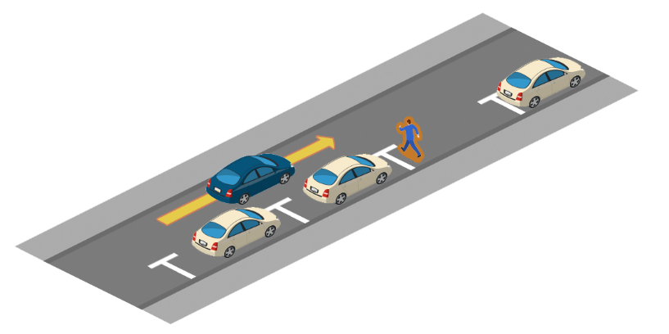
Scenarios

Slide 4
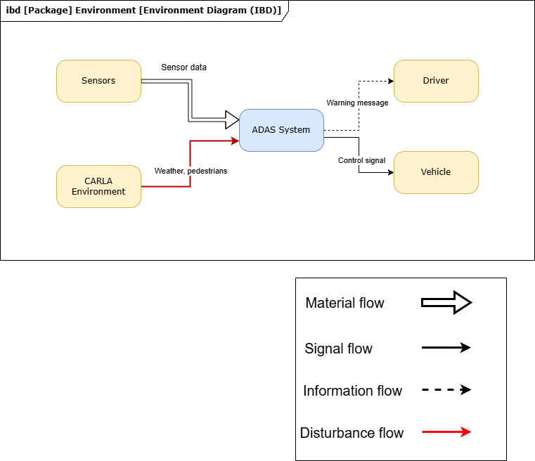
CONSENS – Environment model

Slide 5
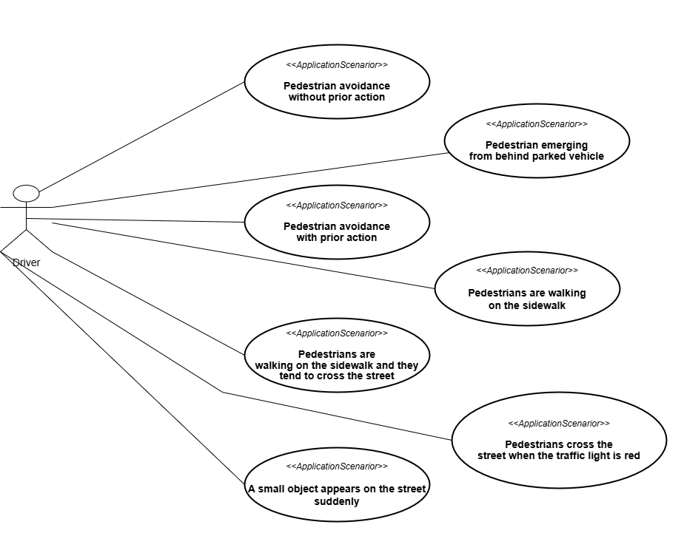
CONSENS – Application SCENARIOs

Slide 6
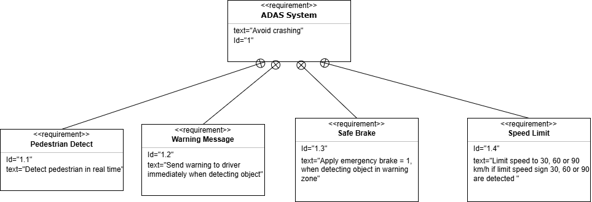
CONSENS – requirement model

Slide 7
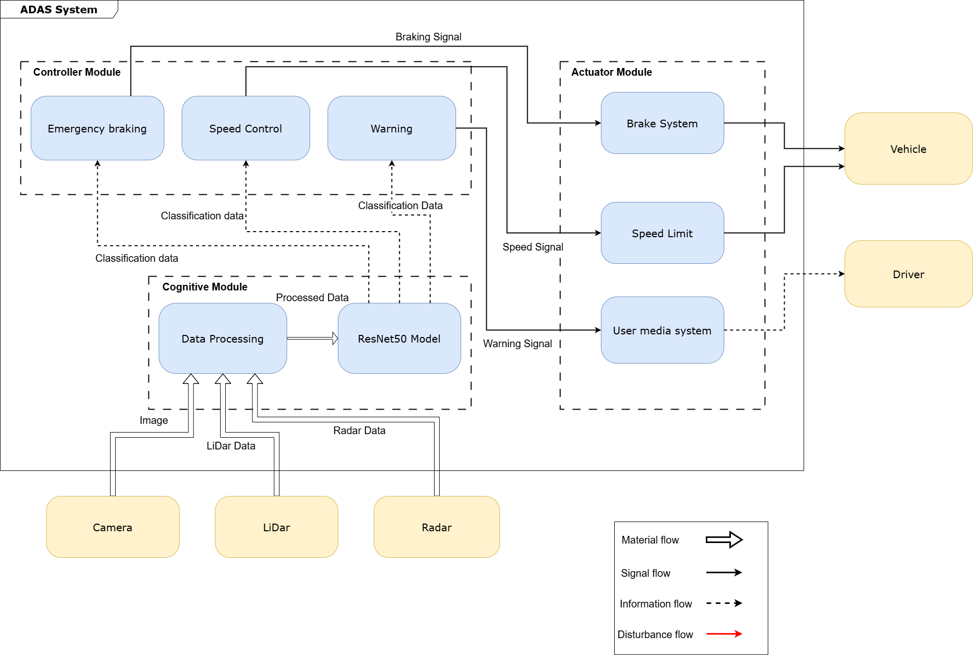
CONSENS – active structure

Slide 8
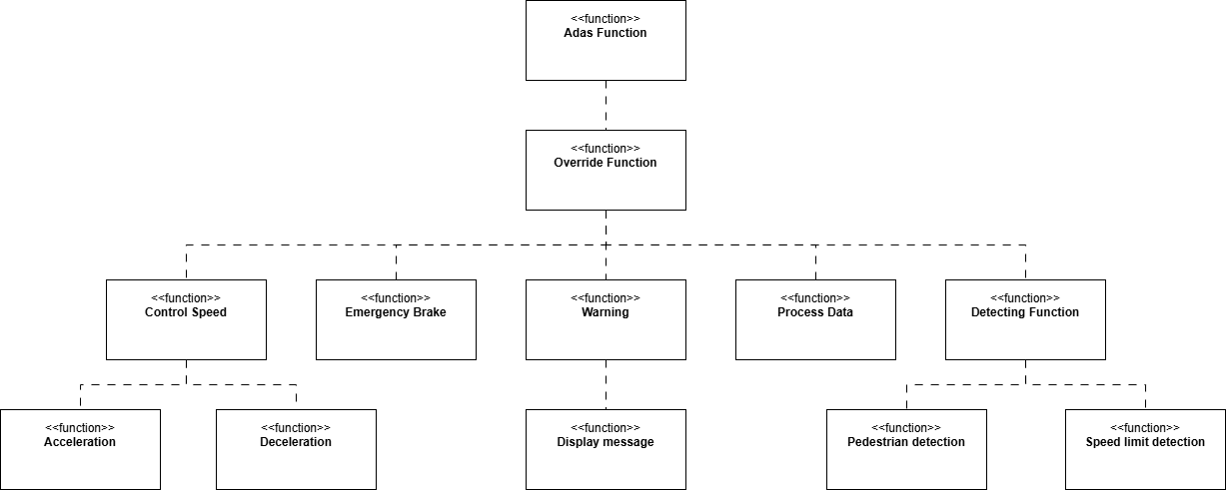
CONSENS – function model

Slide 9
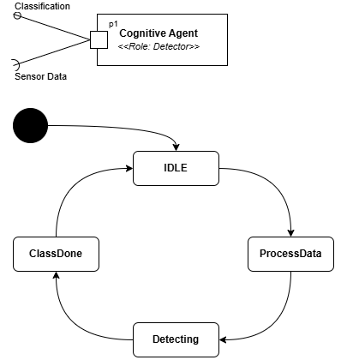
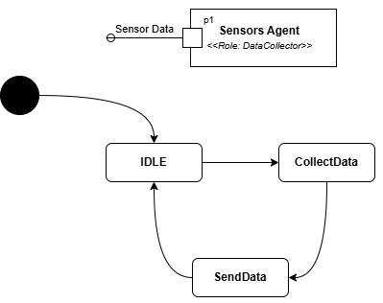
Mechatronics UML

Slide 10
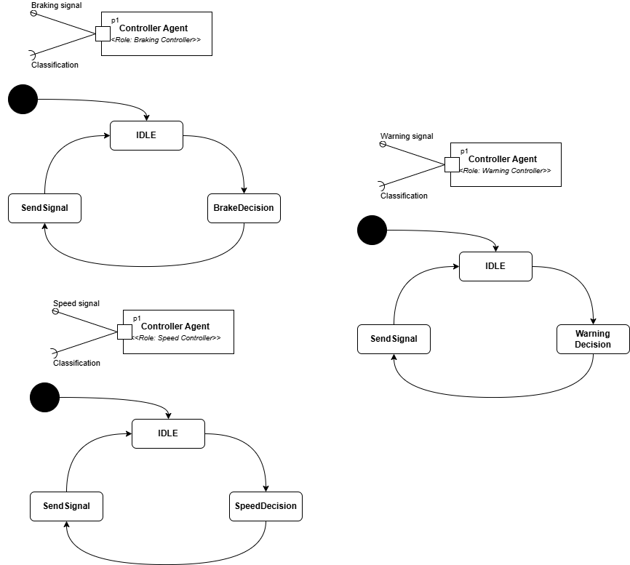
Mechatronics UML

Slide 11
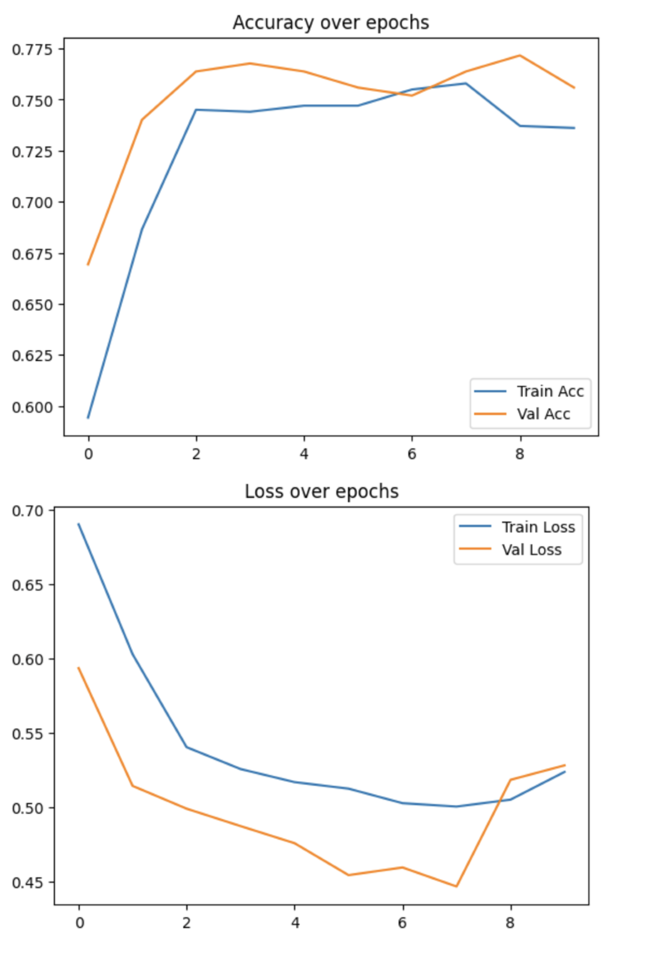
Trained model results

Slide 12
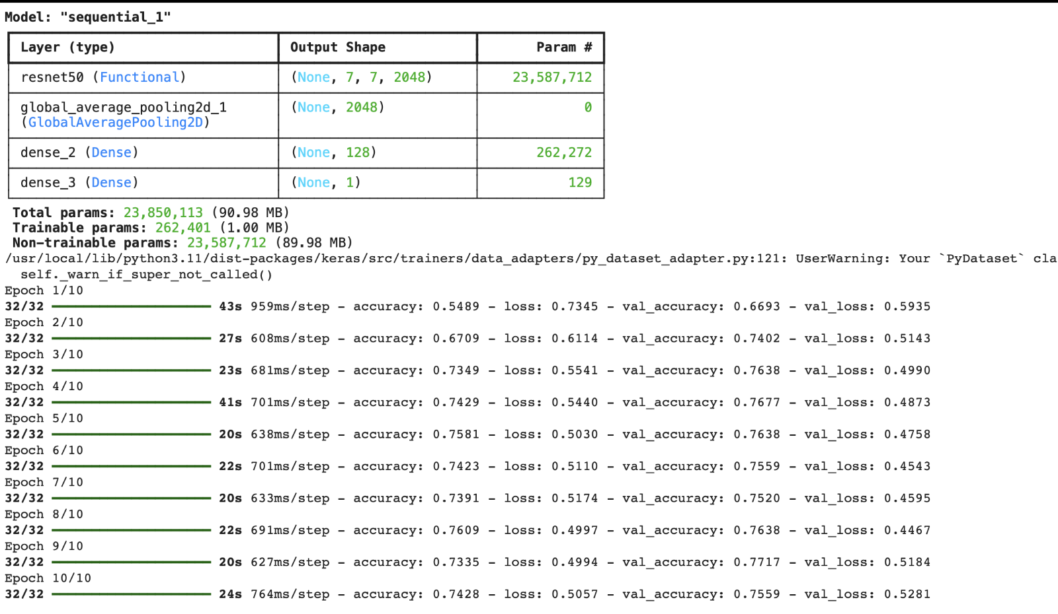
Trained model results

Slide 13
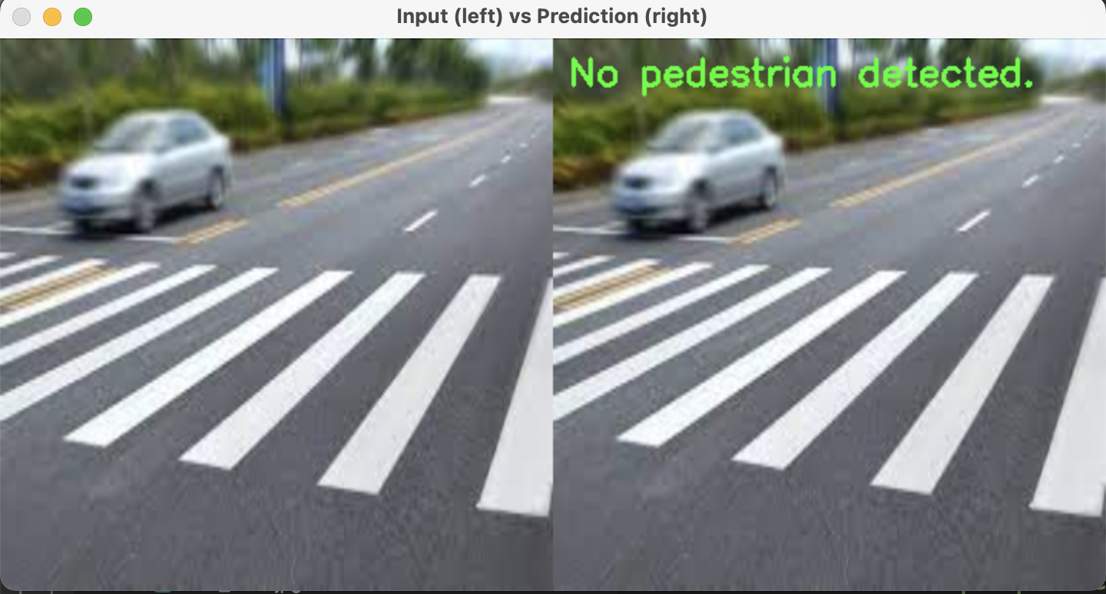
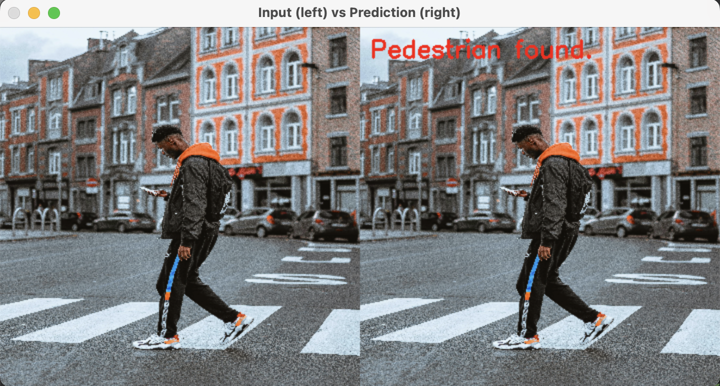
Model testing – real dataset

Slide 14
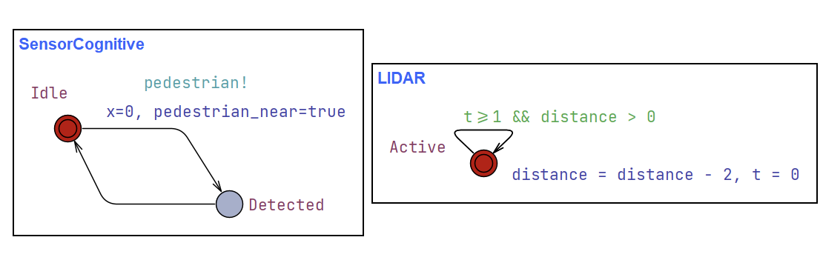
UPPAAL

Slide 15
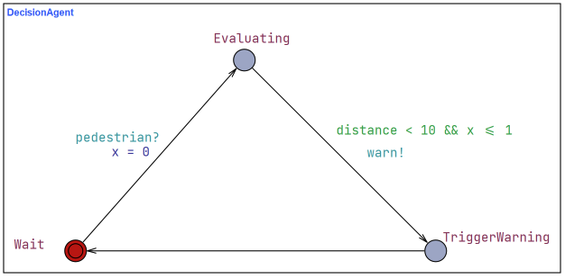
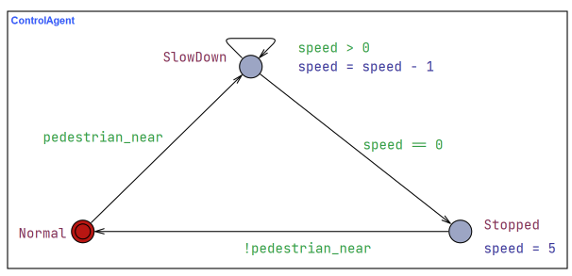
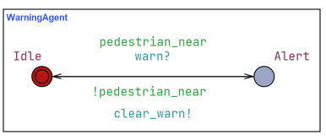
UPPAAL

Slide 16
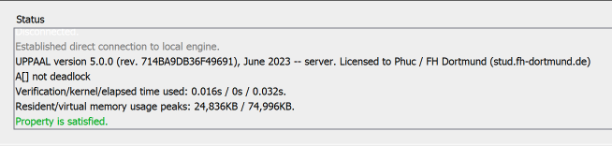
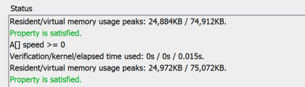
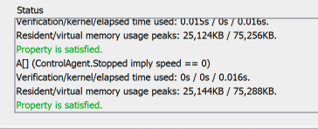
UPPAAL
Functional Properties:
=> Deadlock free
Safety Properties:
=> Speed never goes negative
Safety Properties:
=> The system never enters Stopped state unless speed is 0

Slide 17
THANK YOU

Slide 18
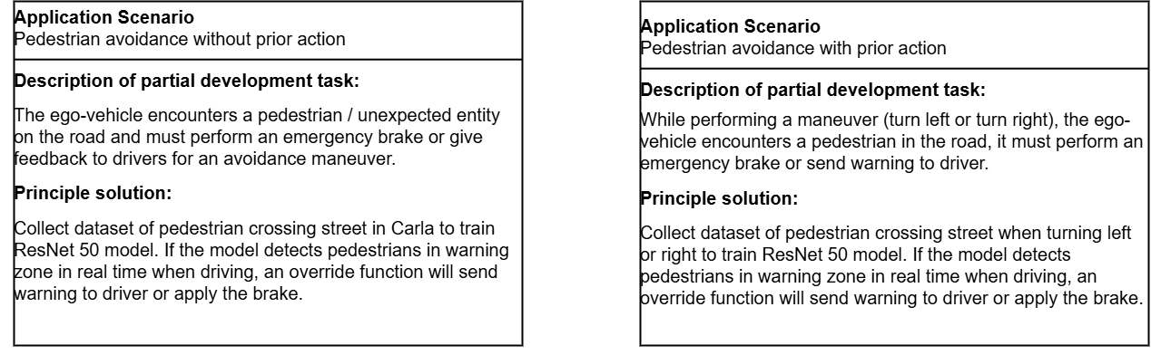
CONSENS – application scenarios

Slide 19
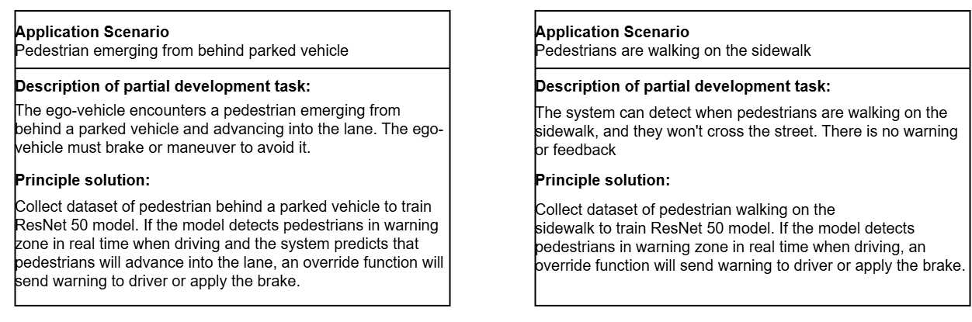
CONSENS – application scenarios

Slide 20
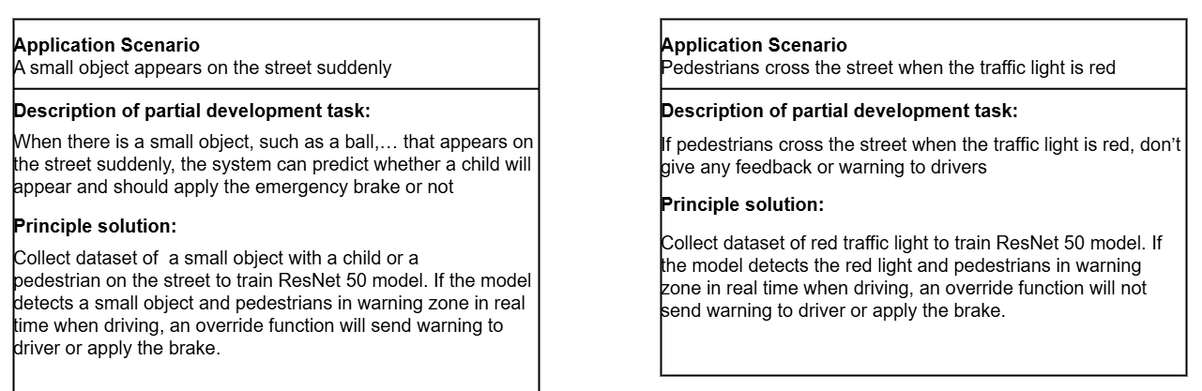
CONSENS – application scenarios

