Slide 1
User Guide: Auto Management System
A guide to navigating and interacting with the Auto Management web app

Slide 2
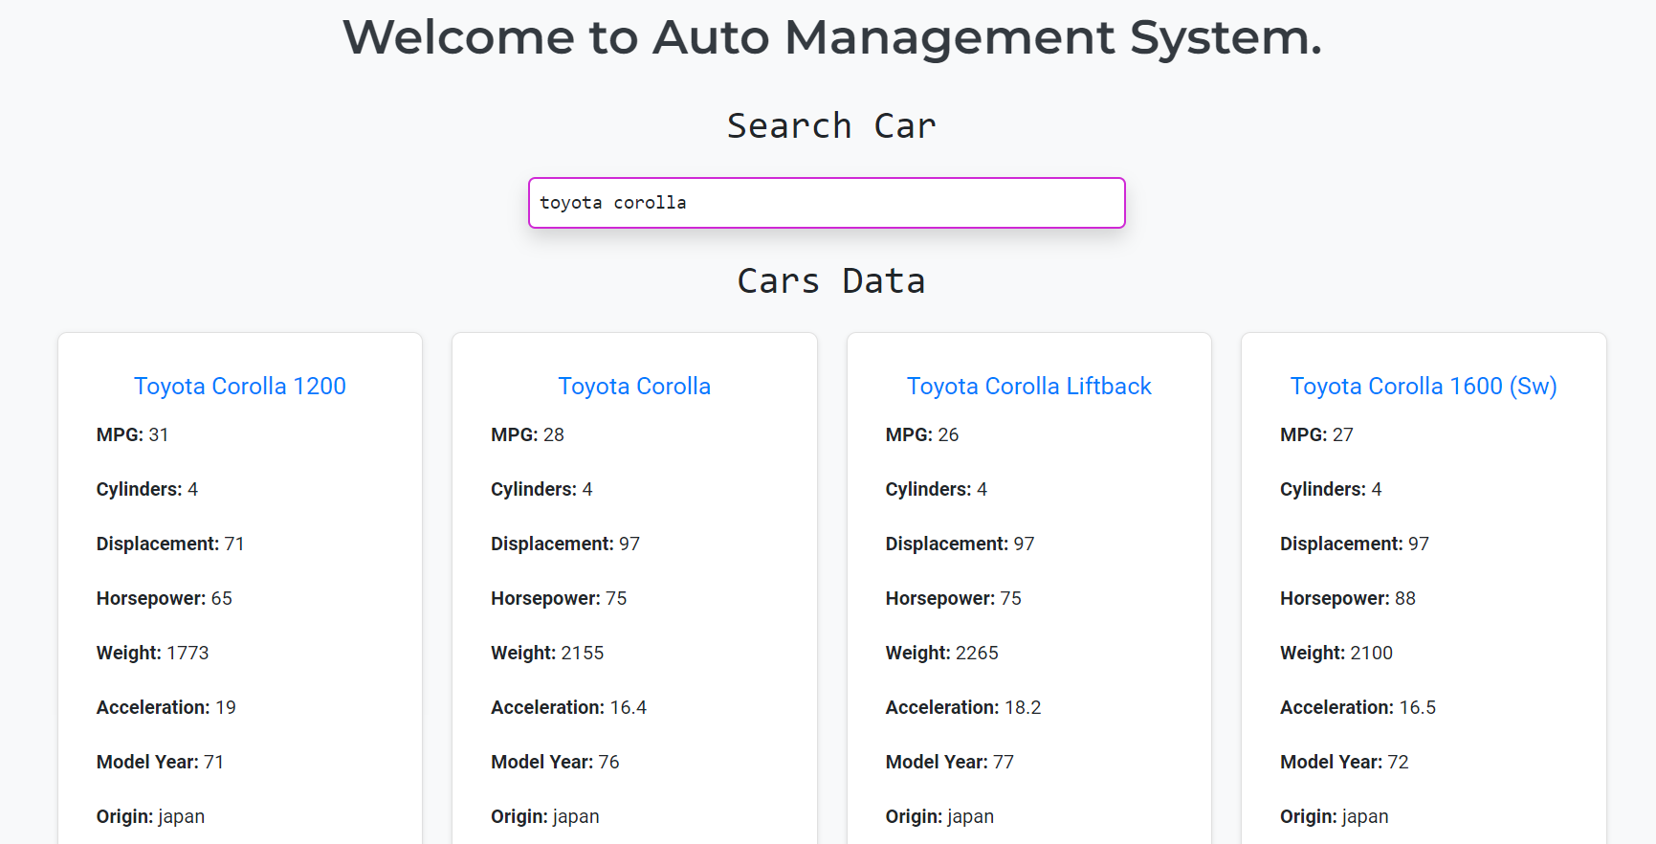
Accessing the Auto-Management App
1. Navigate to the Auto-Management website at https://auto-management.vercel.app/
2. The homepage will present you with options to view, add, or manage car data.

Slide 3
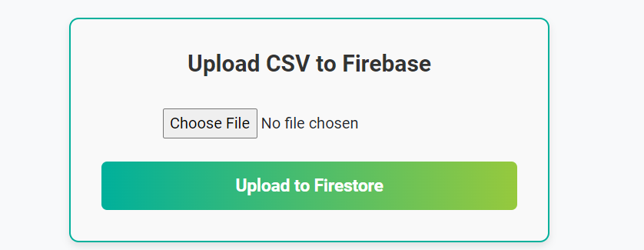
Choose your data
1. You can choose to upload your own data to the database.
2. Navigate to the bottom of the page and Choose File to upload.

Slide 4
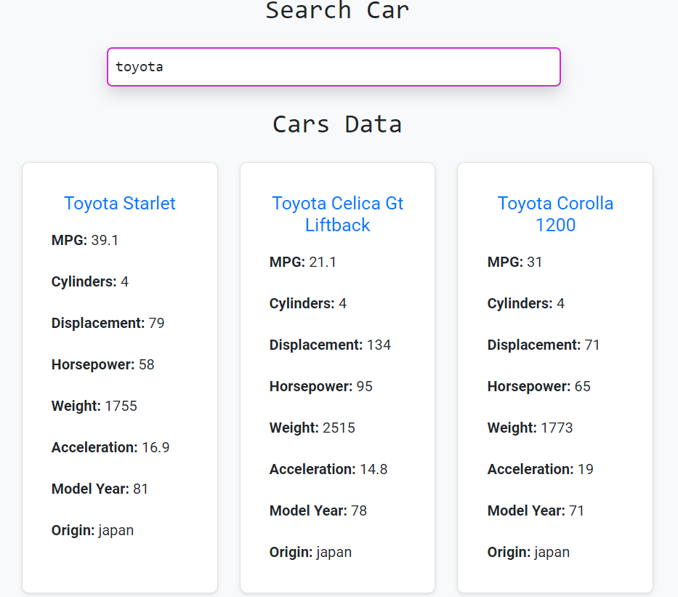
Viewing Car Data
You can search cars by name using the search bar.
Results will be paginated; navigate using 'Next' and 'Previous' buttons.

Slide 5
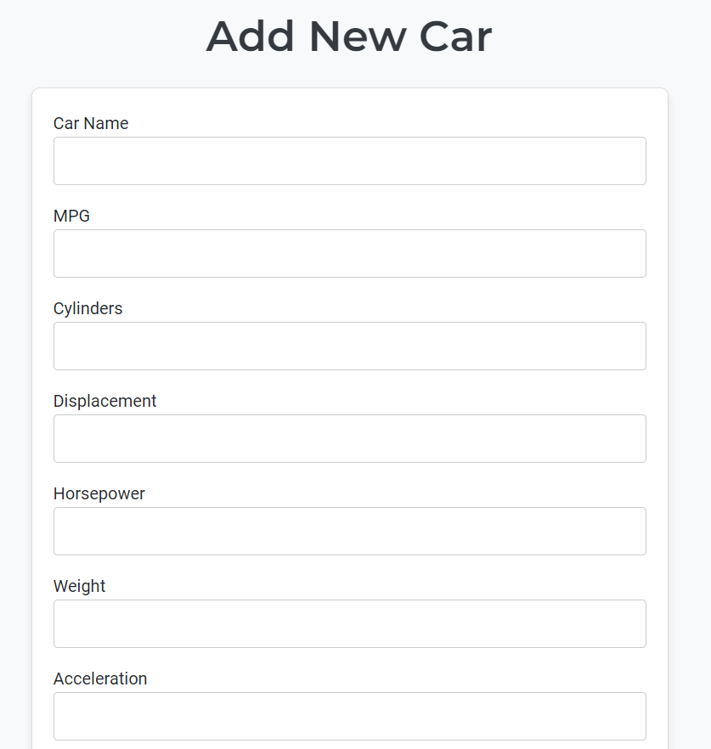
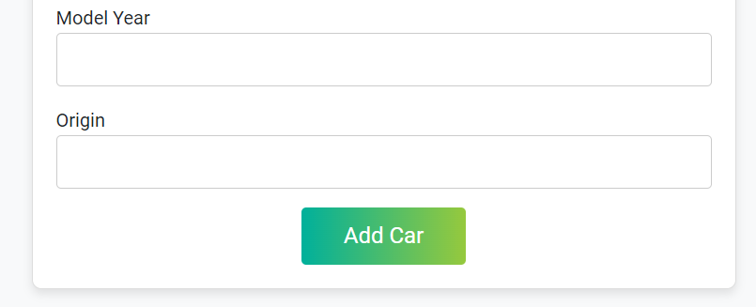
Adding a New Car
1. Click on 'Add Car' from the homepage.
2. Fill in the form fields for car details (name, MPG, horsepower, etc.).
3. Submit the form to add the car to the database.

Slide 6
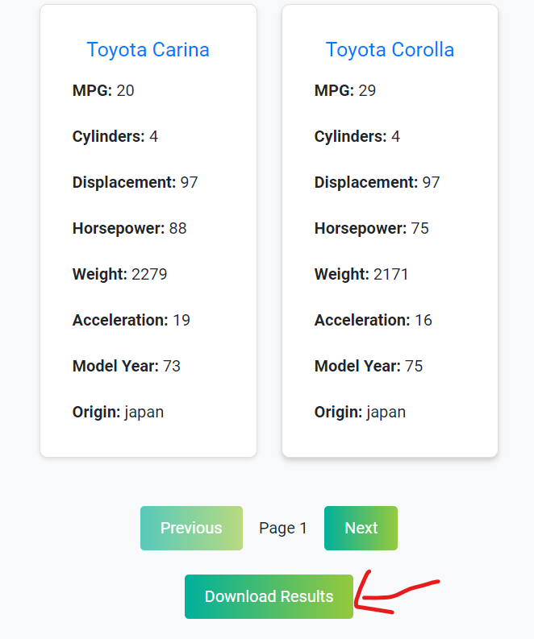
Downloading Search Results as CSV
1. After searching for cars, click on the 'Download Results' button.
2. This will generate and download a CSV file containing the search results.

Slide 7
Final Notes
1. With the help of this app, John can easily store your existing data in a database.
2. You can filter and search through the data with a keyword / search term.
3. You can retrieve your search parameters and continue where you left off if you accidently close the app.
4. You can download a copy of the data in CSV format to keep as a backup.
5. This app is live on this url: https://auto-management.vercel.app/ (control + click on above link to open)
6. GitHub repository link: https://github.com/thisisrajansapkota/auto-management

