Slide 1
Regression project
: Predicting Steam game metacritic score
Yoojin Ko

Slide 2
Non-technical

Slide 3
The gaming market is huge
...but very competitive
- There are more than 2.7 billion gamers worldwide. - The global gaming industry will grow at a CAGR of 12% between 2020-2025. - The PC gaming market could hit $45.5 billion in 2021.
- In January 2019, there were 30,000 games on Steam - Every day 25 new games are released on Steam

Slide 4


Business Problem
I have developed a game but I don’t know how to sell it!
We have many possible games to publish, how do we decide which one to publish?
Developer
Publisher

Slide 5
Solution
Create a model to predict the average sales and playtime based on the features of a game
Type
Price
Rating
Release_Date
Required_Age
Is_Multiplayer
Genre
Achievement Percentage
Publisher
Developer
Sales
Profit
Playtime
Quality

Slide 6
Results - 1
Model | Score
Baseline | 0.41246
Model 1 | 0.41245
Model 2 | 0.41229
Model 3 | 0.42395
Model 4 | .0.23974
Model 5 | 0.40567
Model 6 | 0.43345
Metadata Model 1: Ridge Model 2: Lasso Model 3: SVM Model 4: KNN Model 5: ExtraTree Model 6: RandomForest

Slide 7
Results - 2
Expected performance:
The model will predict with 0.7598 accuracy
5 top features:
Feature | Importance
Developer | 0.545
Publisher | 0.107
Rating | 0.059
Released date(Year) | 0.044
Released date(Day) | 0.035

Slide 8
Technical

Slide 9
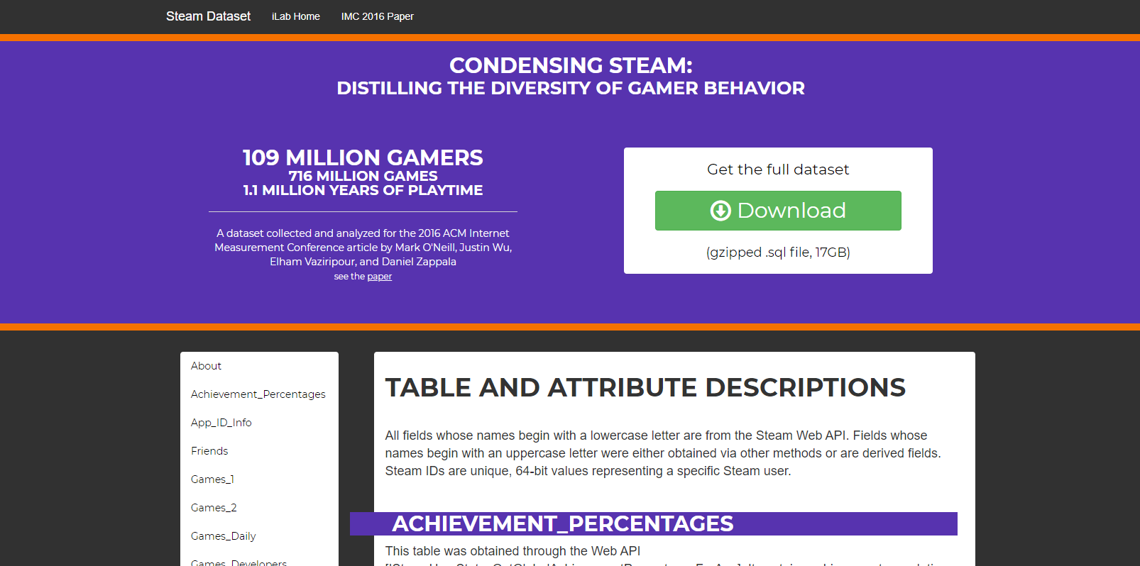
Data source

Slide 10
Creating the raw data frame
Table name | Columns
App_ID_Info | appid, Type, Price, Release_Date, Rating, Required_Age, Is_Multiplayer
Games_Genres | appid, Genre
Games_Publishers | appid, Publisher
Games_Developers | appid, Developer
Achievement_percentages | appid, AVG(Percentage) GROUP BY appid
Games_Daily | steamid, appid, playtime_forever, MAX(dateretrieved) appid, AVG(playtime_forever), COUNT(DISTINCT steamid) GROUP BY appid

Slide 11
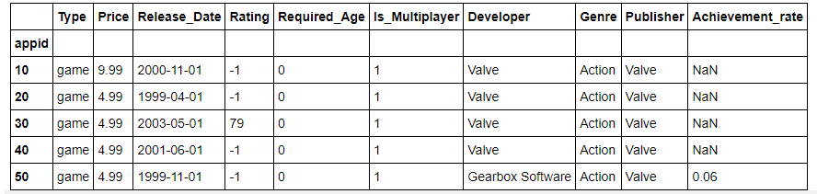
Raw data example
10 columns

Slide 12
Exploratory Data Analysis - 1
Categorical Value
 | Unique values | Missing value | Preprocess plan
Type | 4 values | 0 | One-hot encoding
Is_Multiplayer | 2 values (0, 1) | 0 | -
Required_Age | 8 values | 0 | Label encoding by group(0-7, 8-16, 17-)
Genre | 22 values | 237 | Imputing the missing value as “Unknown” Frequency_encoding / Mean_encoding
Publisher | 1444 values | 0 | Frequency_encoding / Mean_encoding
Developer | 2306 values | 185 | Imputing the missing value as “Unknown” Frequency_encoding / Mean_encoding

Slide 13
Exploratory Data Analysis - 2
Numeric / Datetime Value
 | Range | Missing value | Process plan
Price | 0 ~ 199.99 | 0 | Normalise
Rating | -1 ~ 96 | 0 | Normalise Label encoding
Achievement Percentage | 0 ~ 84.10 | 4337 | Imputing value with 0 Divide by 100
Release_Date | 1970 ~ 2015 | 0 | Extract Year, Month, Day Normalise Year, Month, Day Extract Weekend (0,1)

Slide 14
Data Split -1
Validation
Proprocessor
fit
Train
transform
Validation
Train
Prediction
Data
Proprocessor
fit
Train
transform
Test
Test

Slide 15
Data Split - 2
def prepare_dataset(kind='cv'):
X, y = create_df()
pc = Preprocessor()
X_train, X_test, y_train, y_test = train_test_split(X, y, random_state=33)
if kind == 'cv':
X_train, X_val, y_train, y_val = train_test_split(X_train, y_train, random_state=33)
X_train = pc.fit(X_train, y_train)
X_val = pc.transform(X_val)
return X_train, X_val, y_train, y_val
else:
X_train = pc.fit(X_train, y_train)
X_test = pc.transform(X_test)
return X_train, X_test, y_train, y_test
With random_state=33, always get consistent train and test dataset
When use the dataset for validation, split the train dataset with random_state=33 so all models can get the same train and val set

Slide 16
Preprocess - 1
class Preprocessor:
(...)
def preprocess(self, X, y):
X["Achievement_rate"].fillna(0, inplace=True)
self.normalise_data(X, 'Achievement_rate')
self.features.append("Achievement_rate")
self.features.append("Is_Multiplayer")
self.normalise_data(X, 'Price')
self.features.append('Price')
self.preprocess_rating(X)
X = self.preprocess_required_age(X)
X = self.preprocess_release_date(X)
X = self.one_hot_encoding(X, 'Type')
X["Genre"].fillna("Unknown", inplace=True)
X["Developer"].fillna("Unknown", inplace=True)
X = self.frequency_encoding(X, 'Genre')
X = self.frequency_encoding(X, 'Developer')
X = self.frequency_encoding(X, 'Publisher')
X = self.mean_encoding(X, y, 'Genre')
X = self.mean_encoding(X, y, 'Developer')
X = self.mean_encoding(X, y, 'Publisher')
return X[self.features]

Slide 17
Preprocess - 2
Prevent data leakage
class Preprocessor:
def __init__(self):
self.norm_params = {}
...
def normalise_data(self, X, col):
params = self.norm_params.get(col)
if params is None:
self.norm_params[col] = {
"mean": np.mean(X[col]),
"std": np.std(X[col])
}
X.loc[:, col] = X[col].apply(lambda x: (x - self.norm_params[col]['mean']) / self.norm_params[col]['std'])
When transforming with val/test data, it will use the param created with train data
When fitting with train data, there will be no param so it will create one with train data

Slide 18
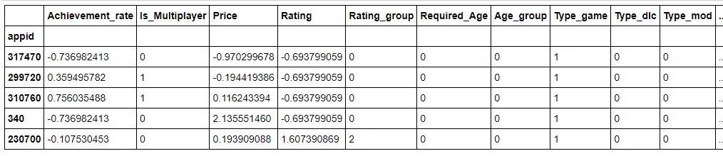
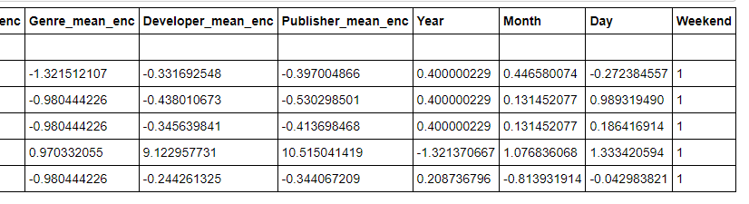
Cleaned data example
21 columns

Slide 19
How to evaluate models
class Base:
(...)
def fit(self, param):
reg = self.model(**param)
start = perf_counter()
print(f"Start training {self.name} with {param}")
reg.fit(self.X_train, self.y_train)
end = perf_counter()
train_loss = self.loss_mse(self.y_train, reg.predict(self.X_train))
val_loss = self.loss_mse(self.y_val, reg.predict(self.X_val))
result = {
'model_name': self.name,
'params': param,
'time_taken' : (end-start),
'train_loss': train_loss,
'val_loss': val_loss,
'train_score': reg.score(self.X_train, self.y_train),
'val_score': reg.score(self.X_val, self.y_val),
}
return result

Slide 20
Models with hyperparameters
Model | Hyperparameters | Best hyperparameter(lowest validation loss)
Ridge | "alpha": [0.1, 0.5, 1.0, 10.0, 20.0] | 0.1
Lasso | "alpha": [0.1, 0.5, 1.0, 10.0, 20.0] | 0.1
KNN | "n_neighbors": range(5, 11) | 10
SVM | "gamma": np.logspace(-3, 2, 6) "C": np.logspace(-3, 2, 6) | “Gamma” 0.01 “C”: 100
Extra Tree | "n_estimators": [10, 50, 100, 500, 1000] | 100
Random Forest | "n_estimators": [10, 20, 30] "max_depth": [10, 20, 30] | “N_estimators”: 30 “Max_depth”: 30

Slide 21
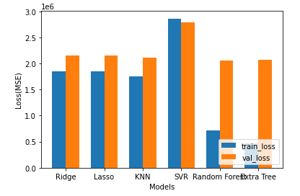
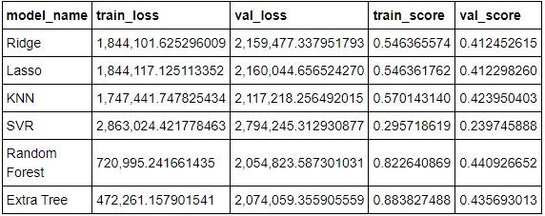
Model performances

Slide 22
Summary
What has been achieved:
Cleaned data & engineered features from a real-world dataset
Implemented the process of validation from splitting data to tuning the hyperparameter for models
Learnt to consider business value and performance simultaneously
What can be improved:
Developing a model to have more business value by getting more metadata(e.g. descriptions of games) as features
Solving the problem of indefinite training time
Trying more hyperparameters

