Slide 1
LOGIC AND TRUTH TABLES Lesson 4
By Prasad Weerathunga

Slide 2
INTRODUCTION
Propositional calculus (or logic) is the study of the logical relationship between objects called propositions and forms the basis of all mathematical reasoning and all automated reasoning.
Definition
A proposition is a statement that is either true or false, but not both (we usually denote a proposition by letters; p, q, r, s, . . .).
The value of a proposition is called its truth value; denoted by T or1 if it is true and F or 0 if it is false.
Opinions, interrogative and imperative sentences are not propositions.
Truth table:
P
0
1

Slide 3
Examples
Example (Propositions)
Today is Monday.
The derivative of sin x is cos x.
Every even number has at least two factors.
Example (Not Propositions)
C++ is the best language.
When is the pretest?
Do your homework.

Slide 4
Logical Connectives
Connectives are used to create a compound proposition from two or more other propositions.
Negation (denoted ¬ or !)
And (denoted ^) or Logical Conjunction
Or (denoted _) or Logical Disjunction
Exclusive Or (XOR, denoted )
Implication (denoted !)
Biconditional; “if and only if” (denoted $)

Slide 5
Negation
A proposition can be negated. This is also a proposition. We usually denote the negation of a proposition p by ¬p.
Example (Negated Propositions)
Today is not Monday.
It is not the case that today is Monday.
It is not the case that the derivative of sin x is cos x.
Truth table:
P | ¬p
0 | 1
1 | 0

Slide 6
Logical And
The logical connective And is true only if both of the propositions are true. It is also referred to as a conjunction
Example (Logical Connective: And)
It is raining and it is warm.
(2 + 3 = 5) ^ (√2 < 2)
Cat is dead and Cat is not dead.
Truth table:
p | q | p ^q
0 | 0 | 0
0 | 1 | 0
1 | 0 | 0
1 | 1 | 1

Slide 7
Logical Or
The logical disjunction (or logical or) is true if one or both of the propositions are true.
Example (Logical Connective: Or)
It is raining or it is the second day of lecture.
(2 + 2 = 5) v (√2 < 2)
You may have cake or ice cream
Truth table:
p | q | p vq
0 | 0 | 0
0 | 1 | 1
1 | 0 | 1
1 | 1 | 1

Slide 8
Exclusive Or
The exclusive or of two propositions is true when exactly one of its propositions is true and the other one is false.
Example (Logical Connective: Exclusive Or)
The circuit is either is on or off.
Let ab < 0, then either a < 0 or b < 0 but not both.
You may have cake or ice cream, but not both.
Truth table:
p | q | p ʘq
0 | 0 | 0
0 | 1 | 1
1 | 0 | 1
1 | 1 | 0

Slide 9
Implications
Definition
Let p and q be propositions. The implication p q
is the proposition that is false when p is true and q is false and
true otherwise.
Here, p is called the “hypothesis” (or “antecedent” or “premise”) and q is called the “conclusion” or “consequence”.
p | q | p q
0 | 0 | 1
0 | 1 | 1
1 | 0 | 0
1 | 1 | 1
Truth table:

Slide 10
Implications
The implication p q can be equivalently read as
if p then q
p implies q
if p, q
p only if q
q if p
q when p
q whenever p
p is a sufficient condition for q (p is sufficient for q)
q is a necessary condition for p (q is necessary for p)
q follows from p

Slide 11
Examples
If you buy your air ticket in advance, it is cheaper.
If x is a real number, then x² ≥0 .
If it rains, the grass gets wet.
If the sprinklers operate, the grass gets wet.
If 2 + 2 = 5 then all unicorns are pink.

Slide 12
Exercise
Which of the following implications is true?
If −1 is a positive number, then 2 + 2 = 5.
true: the hypothesis is obviously false, thus no matter what the conclusion, the implication holds.
If −1 is a positive number, then 2 + 2 = 4.
true: for the same reason as above
If sin x = 0 then x = 0.
false: x can be any multiple of π ; i.e. if we let x = 2π then clearly
sin x = 0, but x ≠0. The implication “if sin x = 0 then x = k π
for some integer k” is true.

Slide 13
Bi conditional
The bi conditional p q
is the proposition that is true when p and q have the same truth values. It is false otherwise
Note that it is equivalent to (p q) ^ (q p)
Truth table:
p | q | p q | q p | p q
0 | 0 | 1 | 1 | 1
0 | 1 | 1 | 0 | 0
1 | 0 | 0 | 1 | 0
1 | 1 | 1 | 1 | 1

Slide 14
Examples
p q can be equivalently read as
p if and only if q
p is necessary and sufficient for q
if p then q, and conversely
x> 0 if and only if x² is positive.
The alarm goes off iff a burglar breaks in.
You may have pudding if and only if you eat your meat

Slide 15
Exercise
Which of the following biconditionals is true?
x² + y² = 0 if and only if x = 0 and y = 0
true: both implications hold.
2 + 2 = 4 if and only if √2 < 2
true: for the same reason above.
x² ≥0 if and only if x ≥ 0.
false: The converse holds. That is, “if x ≥ 0 then x² ≥0 ”. However, the implication is false; consider x = −1. Then the hypothesis is true, (−1)² = 1² 0 but the conclusion fails

Slide 16
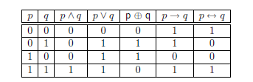
Truth Tables
Truth Tables are used to show the relationship between the truth values of individual propositions and the compound propositions based on them

Slide 17
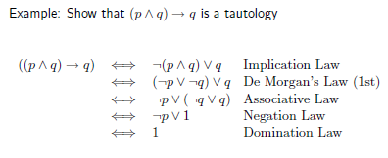
Using Logical Equivalences
Logical equivalences can be used to construct additional logical equivalences.

Slide 18
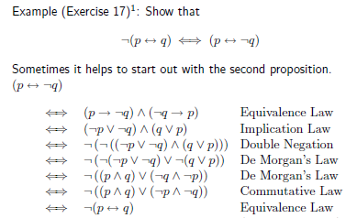
Using Logical Equivalences

Slide 19
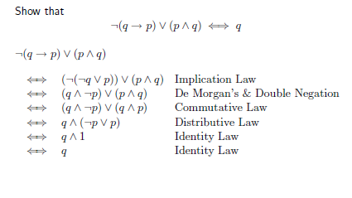
Using Logical Equivalences

Slide 20
THANK YOU

