Slide 1
NUMBER SYSTEM Lesson 1
By Prasad Weerathunga

Slide 2
INTRODUCTION TO NUMBERING SYSTEMS
We are all familiar with the decimal number system (Base 10). Some other number systems that we will work with are:
Binary → Base 2
Octal → Base 8
Hexadecimal → Base 16

Slide 3
Characteristics of Numbering Systems
The digits are consecutive.
The number of digits is equal to the size of the base.
Zero is always the first digit.
The base number is never a digit.
When 1 is added to the largest digit, a sum of zero and a carry of one results.
Numeric values are determined by the implicit positional values of the digits.

Slide 4

The Decimal Number System
Name
“decem” (Latin) => ten
Characteristics
Ten symbols
0 1 2 3 4 5 6 7 8 9
Positional
2945 ≠ 2495
2945 = (2*10³) + (9*10²) + (4*10¹) + (5*10⁰)
Why?
(Most) people use the decimal number system

Slide 5

The Binary Number System
Name
“binarius” (Latin) => two
Characteristics
Two symbols
0 1
Positional
1010_{B} ≠ 1100_{B}
Most (digital) computers use the binary number system
Why?
Terminology
Bit: a binary digit
Byte: (typically) 8 bits

Slide 6
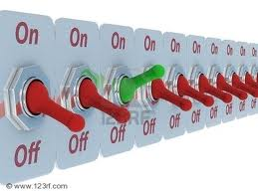
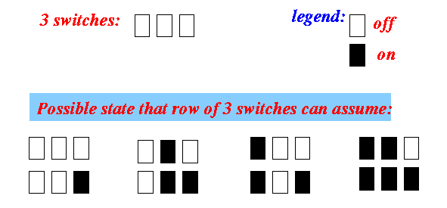
Memory cell used by a computer
One switch can be in one of 2 states
A row of n switches:
can be in one of 2^{n} states !
A row of 3 switches can be in one of 2³ = 8 states.
The 8 possible states are given in the figure above.

Slide 7
Memory cell used by a computer
We saw how information can be represented by number by using a code (agreement)
Recall: we can use numbers to represent marital status information:
0 = single
1 = married
2 = divorced
3 = widowed

Slide 8
BINARY NUMBER SYSTEM
Also called the “Base 2 system”
The binary number system is used to model the series of electrical signals computers use to represent information
0 represents the no voltage or an off state
1 represents the presence of voltage or an
on state

Slide 9
Binary Numbering Scale
Base 2 Number | Base 10 Equivalent | Power | Positional Value
000 | 0 | 2⁰ | 1
001 | 1 | 2¹ | 2
010 | 2 | 2² | 4
011 | 3 | 2³ | 8
100 | 4 | 2⁴ | 16
101 | 5 | 2⁵ | 32
110 | 6 | 2⁶ | 64
111 | 7 | 2⁷ | 128

Slide 10
Decimal to Binary Conversion
The easiest way to convert a decimal number to its binary equivalent is to use the Division Algorithm
This method repeatedly divides a decimal number by 2 and records the quotient and remainder
The remainder digits (a sequence of zeros and ones) form the binary equivalent in least significant to most significant digit sequence

Slide 11
Decimal to Binary Conversion
Convert 67 to its binary equivalent:
67₁₀ = x₂
Step 1: 67 / 2 = 33 R 1 Divide 67 by 2. Record quotient in next row
Step 2: 33 / 2 = 16 R 1 Again divide by 2; record quotient in next row
Step 3: 16 / 2 = 8 R 0 Repeat again
Step 4: 8 / 2 = 4 R 0 Repeat again
Step 5: 4 / 2 = 2 R 0 Repeat again
Step 6: 2 / 2 = 1 R 0 Repeat again
Step 7: 1 / 2 = 0 R 1 STOP when quotient equals 0
1 0 0 0 0 1 1₂

Slide 12
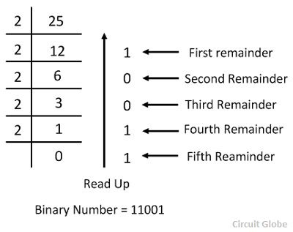
Decimal to Binary Conversion
Example
Find what is binary value of following decimals?
75
133
1573

Slide 13
Binary Number Addition
Addition
1 3 0011_{B}
+ | 10 -- | + | 1010_{B} ----
 | 13 |  | 1101_{B}
Start at right column Proceed leftward
Carry 1 when necessary
11
0111_{B}
+ 1010_{B}
---- 10001_{B}
7
+ 10
--
1
Results are mod 2⁴

Slide 14
Binary Number Subtraction
Subtraction
12
0202
1010_{B}
- 0111_{B}
----
0011_{B}
Start at right column Proceed leftward
Borrow 2 when necessary
10
- 7
--
3
2
0011_{B}
- 1010_{B}
---- 1001_{B}
3
- 10
--
9
Results are mod 2⁴

Slide 15
Example
Find addition of following binary numbers?
101₂ + 110₂
10101₂ + 11100₂
111011₂ + 110110₂
Find substraction of following binary numbers?
11111₂ - 10011₂ =1100
101100₂ - 100110₂ = 110
111111₂ - 100111₂ =11000

Slide 16
Binary to Decimal Conversion
The easiest method for converting a binary number to its decimal equivalent is to use the Multiplication Algorithm
Multiply the binary digits by increasing powers of two, starting from the right
Then, to find the decimal number equivalent, sum those products

Slide 17
Binary to Decimal Conversion
Convert (10101101)₂ to its decimal equivalent:
Binary 1 0 1 0 1 1 0 1
Positional Values
x
x
x
x
x
x
x
x
2⁷
2⁶
2⁵
2⁴
2³
2²
2¹
2⁰
Products
128 + 32 + 8 + 4 + 1
173₁₀

Slide 18
Binary to Decimal Conversion
1100110₂ = 1×2⁶ + 1×2⁵ + 0×2⁴ + 0*2³ + 1*2² + 1×2¹ + 0*2⁰ = 64 + 32 + 4 + 2 = 102.
Example
Find what is Decimal value of following binary numbers?
10110 =22
100101 =37
110101 =53

Slide 19
(10110)₂ = (1 × 2⁴) + (0 × 2³) + (1 × 2²) + (1 × 2¹) + (0 × 2⁰) = 22₁₀
(100101)₂ = (1 × 2⁵) + (0 × 2⁴) + (0 × 2³) + (1 × 2²) + (0 × 2¹) + (1 × 2⁰) = 37₁₀
(110101)₂ = (1 × 2⁵) + (1 × 2⁴) + (0 × 2³) + (1 × 2²) + (0 × 2¹) + (1 × 2⁰) = 53₁₀

Slide 20
OCTAL NUMBER SYSTEM
Also known as the Base 8 System
Uses digits 0 - 7
Readily converts to binary
Groups of three (binary) digits can be used to represent each octal digit
Also uses multiplication and division algorithms for conversion to and from base 10

Slide 21
Decimal-Octal Equivalence
Decimal | Octal |  | Decimal Octal |  | Decimal | Octal
0 | 0 |  | 16 20 |  | 32 | 40
1 | 1 |  | 17 21 |  | 33 | 41
2 | 2 |  | 18 22 |  | 34 | 42
3 | 3 |  | 19 23 |  | 35 | 43
4 | 4 |  | 20 24 |  | 36 | 44
5 | 5 |  | 21 25 |  | 37 | 45
6 | 6 |  | 22 26 |  | 38 | 46
7 | 7 |  | 23 27 |  | 39 | 47
8 | 10 |  | 24 30 |  | 40 | 50
9 | 11 |  | 25 31 |  | 41 | 51
10 | 12 |  | 26 32 |  | 42 | 52
11 | 13 |  | 27 33 |  | 43 | 53
12 | 14 |  | 28 34 |  | 44 | 54
13 | 15 |  | 29 35 |  | 45 | 55
14 | 16 |  | 30 36 |  | 46 | 56
15 | 17 |  | 31 37 |  | 47 | 57
 |  |  |  |  | ... | ...

Slide 22
Decimal-Octal Conversion
Octal to decimal: expand using positional notation
37_{O} = (3*8¹) + (7*8⁰) = 24 + 7
= | 31
Decimal to octal: use the shortcut
31 / 8 = 3 R 7
3 / 8 = 0 R 3

Slide 23
Example
Find what is Octal value of following decimals?
756₁₀
1351₁₀
352₁₀
Find what is decimal value of following Octals?
351₈
2136₈
157₈

Slide 24
Division by 8 | Quotient | Remainder (Digit)
(756)/8 | 94 | 4
(94)/8 | 11 | 6
(11)/8 | 1 | 3
(1)/8 | 0 | 1
Division by 8 | Quotient | Remainder (Digit)
(1351)/8 | 168 | 7
(168)/8 | 21 | 0
(21)/8 | 2 | 5
(2)/8 | 0 | 2
Division by 8 | Quotient | Remainder (Digit)
(352)/8 | 44 | 0
(44)/8 | 5 | 4
(5)/8 | 0 | 5

Slide 25
351 = (3 × 8²) + (5 × 8¹) + (1 × 8⁰) = 233
2136 = (2 × 8³) + (1 × 8²) + (3 × 8¹) + (6 × 8⁰) = 1118
157 = (1 × 8²) + (5 × 8¹) + (7 × 8⁰) = 111

Slide 26
Octal Number Addition
Addition
2036₈
+ 5762₈
---- 10020₈
4210₈
+ 2671₈
---- 7101₈
Example
Find addition of following Octal numbers?
5376₈ + 3657₈ = 11255₈
435₈ + 342₈ = 777₈
471₈ + 242₈ = 733₈

Slide 27
Octal Number Subtraction
Subtraction
375₈
- 126₈
----
652₈
471₈
- 536₈
----
242₈
Example
Find addition of following Octal numbers?
1463₈ - 1102₈ =361
25616₈ - 17520₈ =6076
15677₈ - 7260₈ =6417

Slide 28
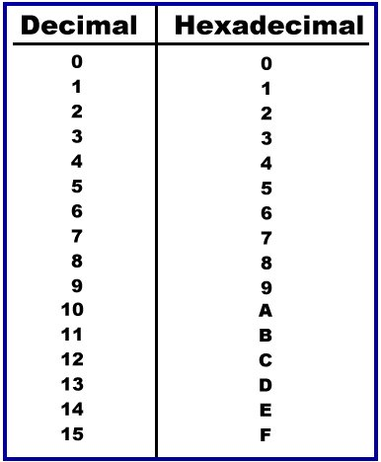
HEXADECIMAL NUMBER SYSTEM
Base 16 system
Uses digits 0-9 &
letters A,B,C,D,E,F
Groups of four bits represent each base 16 digit

Slide 29
Decimal to Hexadecimal Conversion
Convert 830₁₀ to its hexadecimal equivalent:
830 / 16 = 51 R14
51 / 16 = 3 R3
3 / 16 = 0 R3
= E in Hex
33E₁₆

Slide 30
Hexadecimal to Decimal Conversion
Convert 3B4F₁₆ to its decimal equivalent:
Hex Digits
3 B 4 F
x
x
x
x
Positional Values
16³ 16² 16¹ 16⁰
Products
12288 +2816 + 64 +15
15,183₁₀

Slide 31
Example
Find what is Hexadecimal value of following decimals?
751₁₀
5067₁₀
936₁₀
Find what is decimal value of following Hexadecimals?
A3F₁₆
29FC₁₆
8C6₁₆

Slide 32
Division by 16 | Quotient | Remainder (Digit)
(5067)/16 | 316 | 11
(316)/16 | 19 | 12
(19)/16 | 1 | 3
(1)/16 | 0 | 1
Division by 16 | Quotient | Remainder (Digit)
(751)/16 | 46 | 15
(46)/16 | 2 | 14
(2)/16 | 0 | 2
= (2EF)₁₆
= (13CB)₁₆
Division by 16 | Quotient | Remainder (Digit)
(936)/16 | 58 | 8
(58)/16 | 3 | 10
(3)/16 | 0 | 3
= (3A8)₁₆

Slide 33
(A3F)₁₆ = (10 × 16²) + (3 × 16¹) + (15 × 16⁰) = (2623)₁₀
(29FC)₁₆ = (2 × 16³) + (9 × 16²) + (15 × 16¹) + (12 × 16⁰) = (10748)₁₀
(8C6)₁₆ = (8 × 16²) + (12 × 16¹) + (6 × 16⁰) = (2246)₁₀

Slide 34
Hexadecimal Number Addition
Addition
A34₁₆
+ 8E9₁₆
----
131D₁₆
25D3₁₆
+ C85F₁₆
----
EE32₁₆
Example
Find addition of following Octal numbers?
9D3₁₆ + 2EF₁₆
A301₁₆ + 489₁₆
EAB58₁₆ + B287₁₆

Slide 35
Hexadecimal Number Subtraction
Subtraction
B3CD₁₆
+ 849A₁₆
----
2F33₁₆
85AD₁₆
+ 5EOF₁₆
----
279E₁₆
Example
Find addition of following Octal numbers?
F2CD3₁₆ - 846C₁₆
824₁₆ - A35₁₆
A2CD₁₆ - 9BFC₁₆

Slide 36
Binary-Hexadecimal Conversion
Observation: 16¹ = 2⁴
Every 1 hexadecimal digit corresponds to 4 binary digits
Binary to hexadecimal
Digit count in binary number not a multiple of 4 =>
pad with zeros on left
1010000100111101_{B} A 1 3 D_{H}
Hexadecimal to binary
A 1 3 D_{H} 1010000100111101_{B}
Discard leading zeros from binary number if appropriate

Slide 37
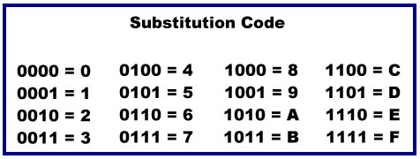
Binary-Hexadecimal Conversion
The easiest method for converting binary to hexadecimal is to use a substitution code
Each hex number converts to 4 binary digits

Slide 38
Binary-Octal Conversion
Observation: 8¹ = 2³
Every 1 octal digit corresponds to 3 binary digits
Binary to octal
Digit count in binary number not a multiple of 3 =>
pad with zeros on left
001010000100111101_{B}
1 2 0 4 7 5_{O}
Octal to binary
1 2 0 4 7 5_{O}
001010000100111101_{B}
Discard leading zeros from binary number if appropriate

Slide 39
THANK YOU

