Slide 1
Cryptography and Network Security
Chapter 1

Slide 2
Background
Information Security requirements have changed in recent times
traditionally provided by physical and administrative mechanisms
computer use requires automated tools to protect files and other stored information
use of networks and communications links requires measures to protect data during transmission

Slide 3
Definitions
Computer Security - generic name for the collection of tools designed to protect data and to thwart hackers
Network Security - measures to protect data during their transmission
Internet Security - measures to protect data during their transmission over a collection of interconnected networks

Slide 4

Aim of Course
our focus is on Internet Security
which consists of measures to deter, prevent, detect, and correct security violations that involve the transmission & storage of information

Slide 5
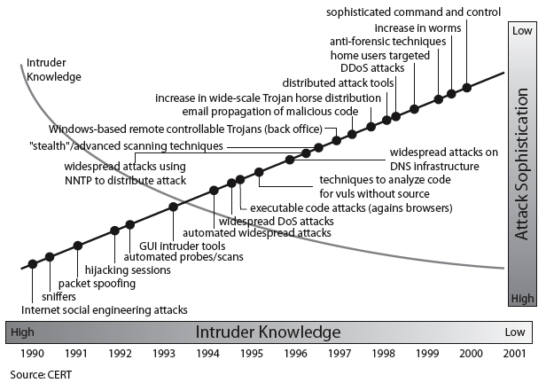
Security Trends

Slide 6

OSI Security Architecture
ITU-T X.800 “Security Architecture for OSI”
defines a systematic way of defining and providing security requirements
It provides a useful, if abstract, overview of concepts

Slide 7
Aspects of Security
consider 3 aspects of information security:
  security attack
  security mechanism
  security service

Slide 8
Security Attack
Any action that compromises the security of information owned by an organization
Information security is about how to prevent attacks, or failing that, to detect attacks on information-based systems
Often threat & attack used to mean same thing
have a wide range of attacks
can focus of generic types of attacks
  passive
  active

Slide 9

Passive Attacks

Slide 10

Active Attacks

Slide 11
Distributed Denial of Service Attacks (DDoS)
Distributed Denial of Service (DDoS) attacks form a significant security threat
making networked systems unavailable
by flooding with useless traffic
using large numbers of “zombies”
growing sophistication of attacks
defense technologies struggling to cope

Slide 12
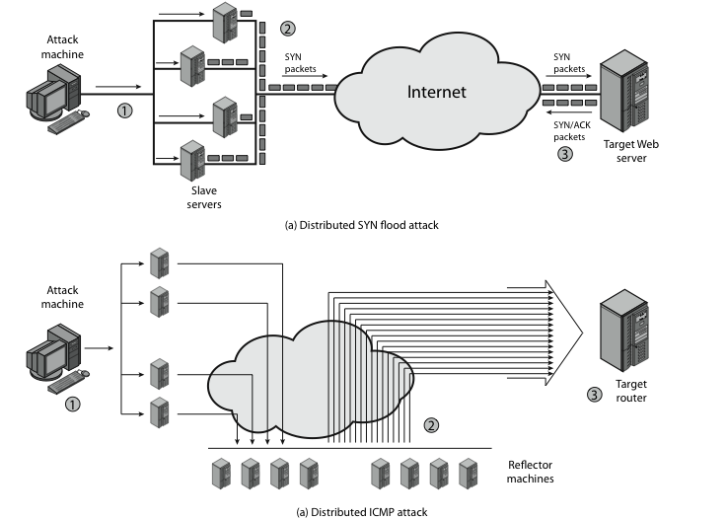
Distributed Denial of Service Attacks (DDoS)

Slide 13
Security Service
  enhance security of data processing systems and information transfers of an organization
  intended to counter security attacks
  using one or more security mechanisms
  often replicates functions normally associated with physical documents
    which, for example, have signatures, dates; need protection from disclosure, tampering, or destruction; be notarized or witnessed; be recorded or licensed

Slide 14
Security Services
X.800:
  “a service provided by a protocol layer of communicating open systems, which ensures adequate security of the systems or of data transfers”
RFC 2828:
  “a processing or communication service provided by a system to give a specific kind of protection to system resources”

Slide 15
Security Services (X.800)
Authentication - assurance that the communicating entity is the one claimed
Access Control - prevention of the unauthorized use of a resource
Data Confidentiality –protection of data from unauthorized disclosure
Data Integrity - assurance that data received is as sent by an authorized entity
Non-Repudiation - protection against denial by one of the parties in a communication

Slide 16
Security Mechanism
feature designed to detect, prevent, or recover from a security attack
no single mechanism that will support all services required
however one particular element underlies many of the security mechanisms in use:
  cryptographic techniques
hence our focus on this topic

Slide 17
Security Mechanisms (X.800)
specific security mechanisms:
  encipherment, digital signatures, access controls, data integrity, authentication exchange, traffic padding, routing control, notarization
pervasive security mechanisms:
  trusted functionality, security labels, event detection, security audit trails, security recovery

Slide 18

Model for Network Security

Slide 19
Model for Network Security
using this model requires us to:
  design a suitable algorithm for the security transformation
  generate the secret information (keys) used by the algorithm
  develop methods to distribute and share the secret information
  specify a protocol enabling the principals to use the transformation and secret information for a security service

Slide 20

Model for Network Access Security

Slide 21
Model for Network Access Security
using this model requires us to:
  select appropriate gatekeeper functions to identify users
  implement security controls to ensure only authorised users access designated information or resources
trusted computer systems may be useful to help implement this model

Slide 22
Summary
have considered:
  definitions for:
    computer, network, internet security
X.800 standard
security attacks, services, mechanisms
models for network (access) security

