Slide 1
DES
Data Encryption Standard (ECB MODE)

Slide 2
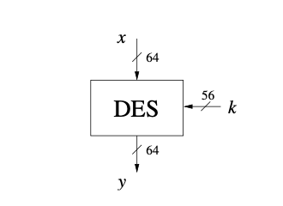
The design process of DES, which is very helpful for understanding the technical and political evolution of modern cryptography
Basic design ideas of block ciphers, including confusion and diffusion, which are important properties of all modern block ciphers
The internal structure of DES, including Feistel networks, S-boxes and the key
schedule
DES is a block cipher and encrypts data in blocks of size of 64 bits each, which means 64 bits of plain text go as the input to DES, which produces 64 bits of ciphertext. The same algorithm and key are used for encryption and decryption, with minor differences. The key length is 56 bits.

Slide 3
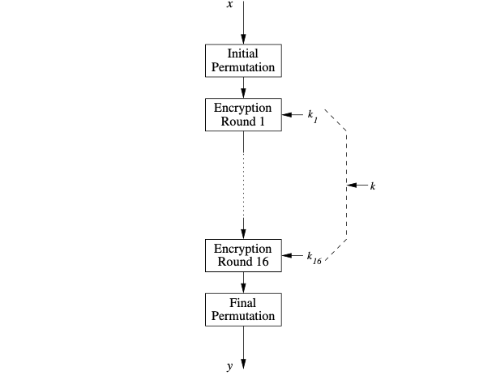
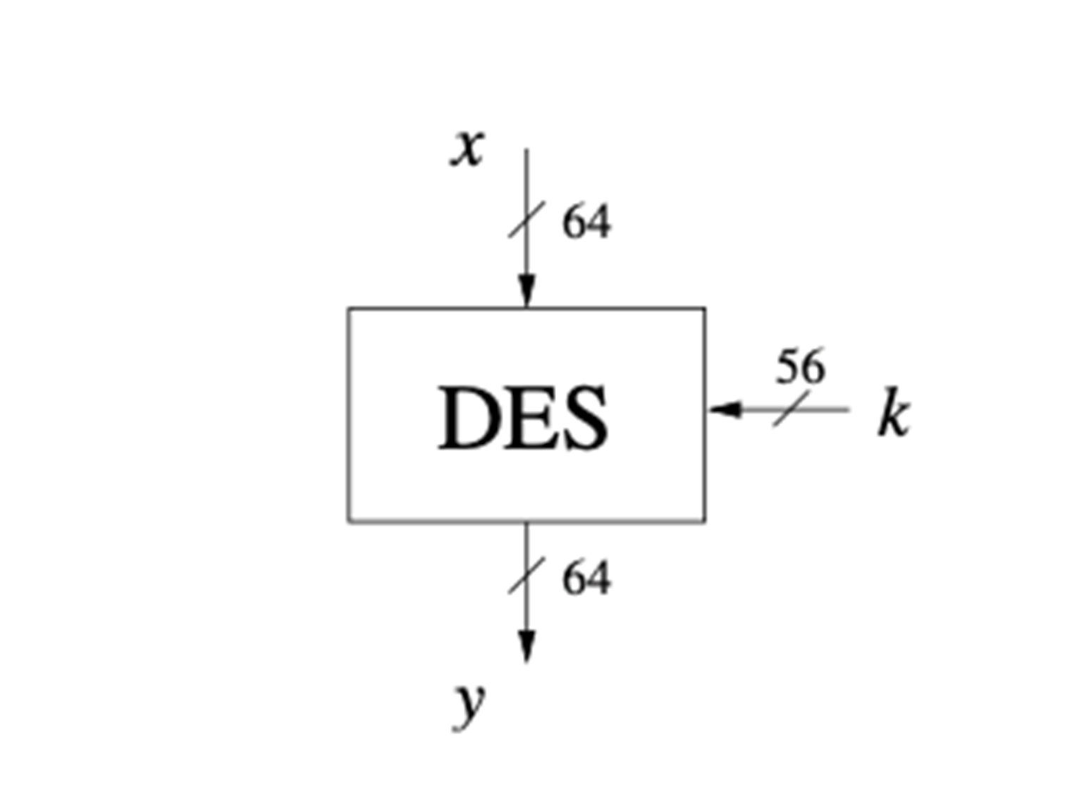
DES is based on the two fundamental attributes of cryptography: substitution (also called confusion) and transposition (also called diffusion). DES consists of 16 steps, each of which is called a round. Each round performs the steps of substitution and transposition.

Slide 4
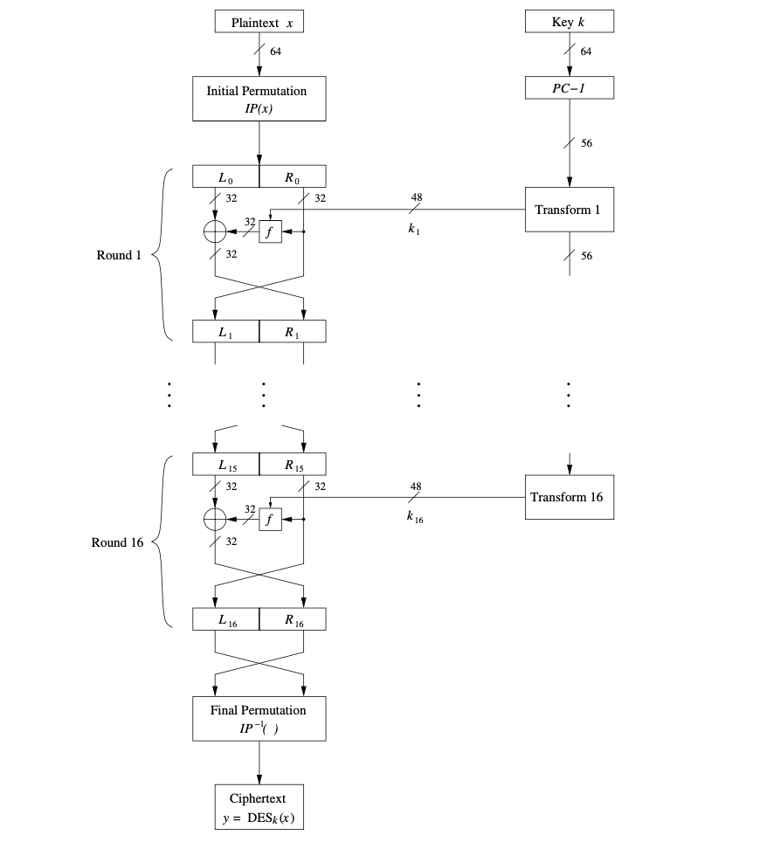
In the first step, the 64-bit plain text block is handed over to an initial Permutation (IP) function.
The initial permutation is performed on plain text.
Next, the initial permutation (IP) produces two halves of the permuted block; saying Left Plain Text (LPT) and Right Plain Text (RPT).
Now each LPT and RPT go through 16 rounds of the encryption process.
In the end, LPT and RPT are rejoined and a Final Permutation (FP) is performed on the combined block
The result of this process produces 64-bit ciphertext.

Slide 5
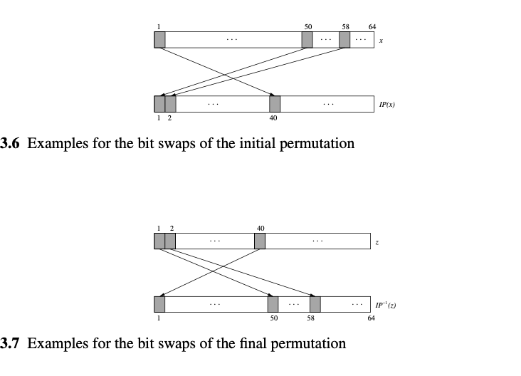

Slide 6
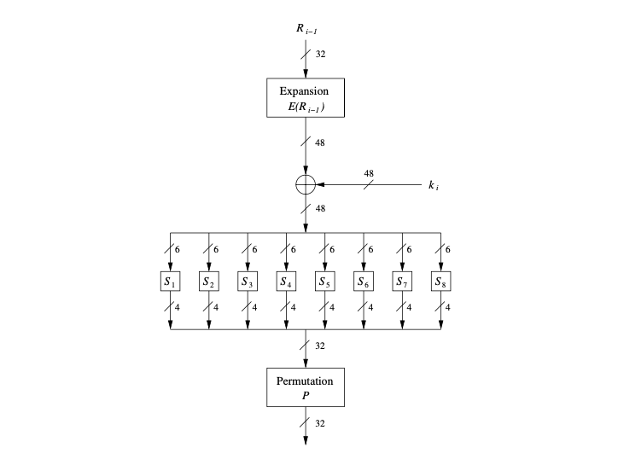
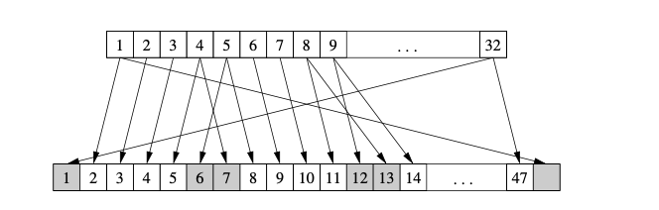
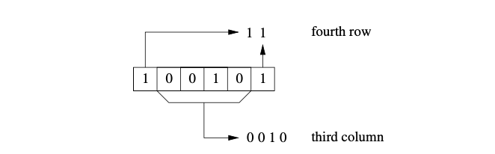
f-Function(Heart of DES)
the f -function plays a crucial role for the security of DES.
In round i it takes the right half Ri−1 of the output of the previous round and the
current round key ki as input. The output of the f -function is used as an XOR-mask
for encrypting the left half input bits Li−1.
Expansion

Slide 7
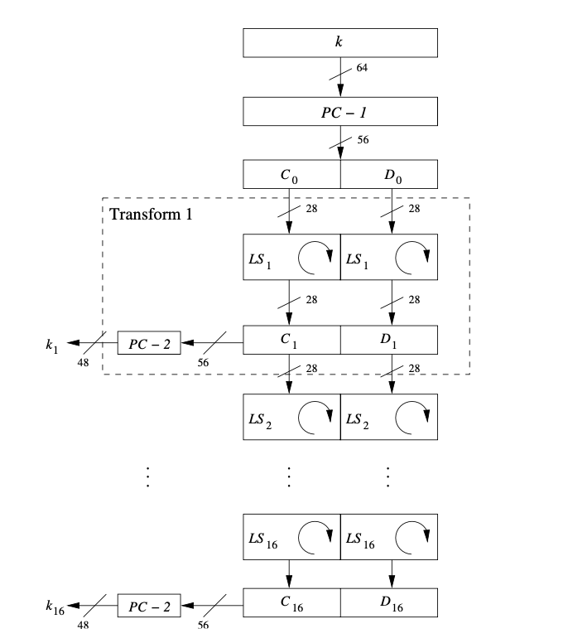
KEY
1 POSITION LEFT SHIFT - 1,2,9,16
OTHERS ARE 2 POSITION LEFT SHIFTS

Slide 8
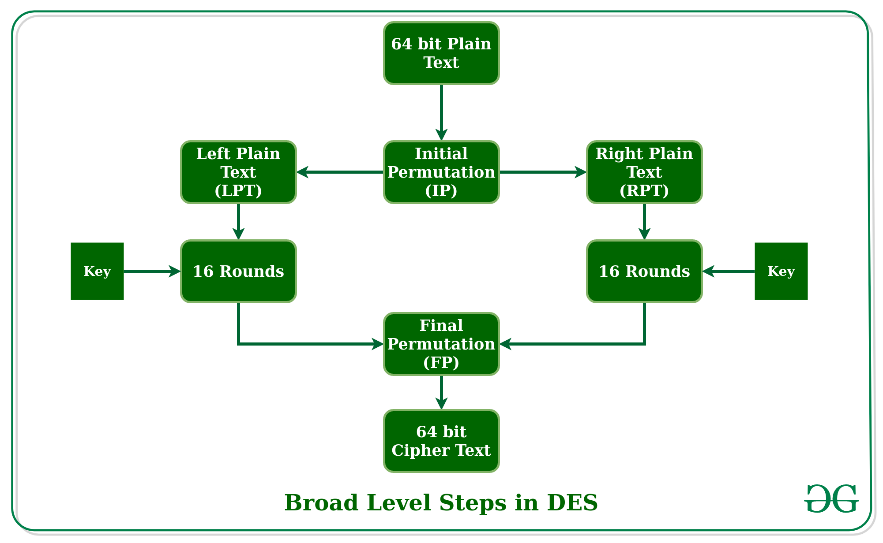

Slide 9

64 bit KEY
0001100011000000001000000000001100100000000010000010000000000011

Slide 10
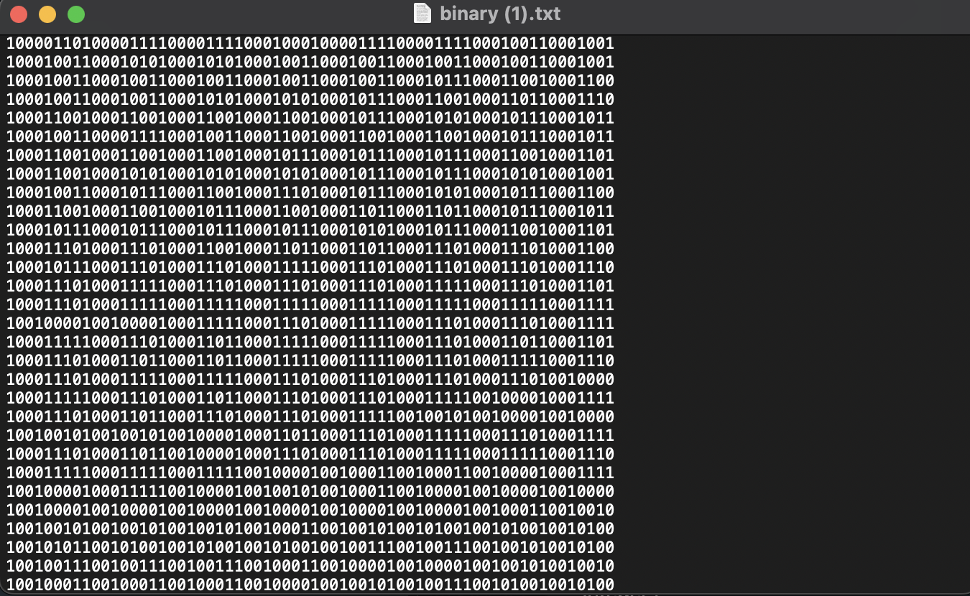

Slide 11
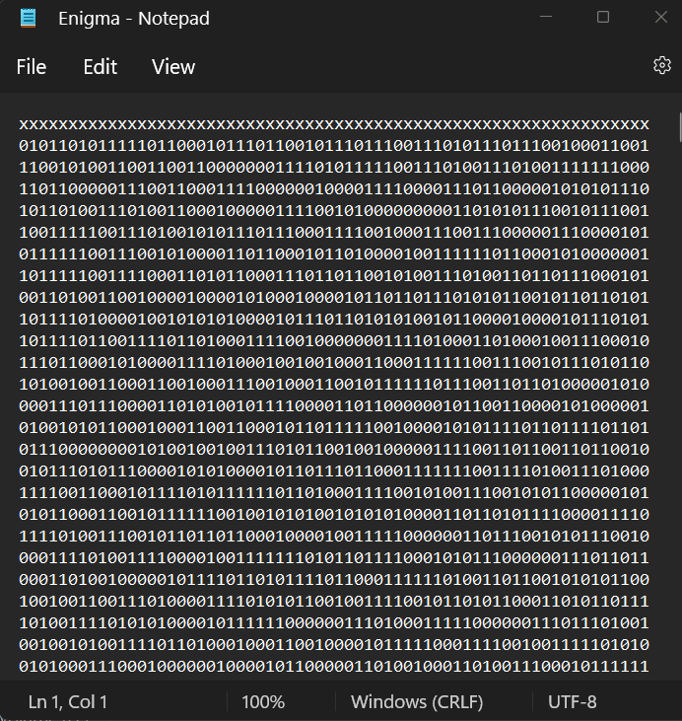

Slide 12


