Slide 1
Flask-based Spam Email Classification Application
This presentation introduces a Flask-based application designed for classifying spam emails using machine learning techniques. This application efficiently filters unwanted emails, enhancing email security and user experience.

Slide 2
Introduction to Spam Email Classification
Identifying Spam
Spam email classification focuses on distinguishing unsolicited bulk emails from legitimate messages.
Machine Learning
Machine learning algorithms analyze email content and patterns to categorize emails as spam or not spam.
Importance
Accurate spam detection protects users from scams, malware, and unwanted advertisements.

Slide 3
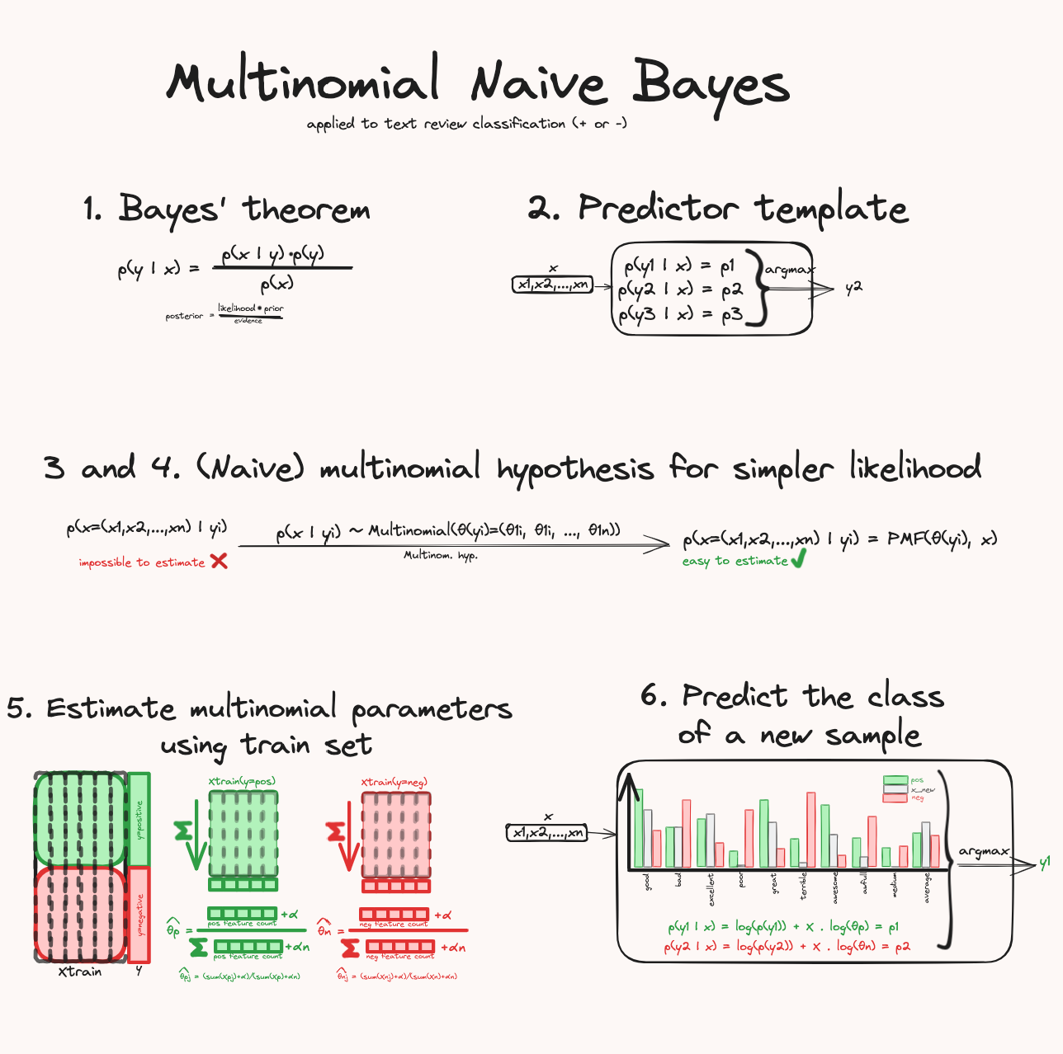
The Usage of Multinomial Naive Bayes
Multinomial Naive Bayes is a probabilistic classification algorithm commonly used in spam detection. This algorithm calculates the probability of an email belonging to a spam or not spam class based on the frequency of words in the email. The model learns from a training dataset and uses the learned probabilities to make predictions on new emails.

Slide 4
Why Multinomial Naive Bayes
Simplicity and Efficiency
Multinomial Naive Bayes is computationally simple and efficient, making it well-suited for real-time or large-scale applications. Its efficiency comes from the assumption of independence among words (the “Naive” part), which simplifies calculations and speeds up processing.
Strong Baseline for Text Classification
In practice, Multinomial Naive Bayes often serves as a reliable baseline for text classification tasks, performing reasonably well with minimal parameter tuning. This makes it a good starting point for spam detection models.

Slide 5
Flask Framework: A Lightweight Web Development Tool
Lightweight and Flexible
Flask offers a minimalist approach, providing flexibility for building web applications with specific requirements.
Routing and Templates
Flask allows for defining routes and handling user requests, enabling dynamic web content generation.
Extensibility
Flask's extensibility allows for adding functionality through extensions, such as databases and security features.

Slide 6
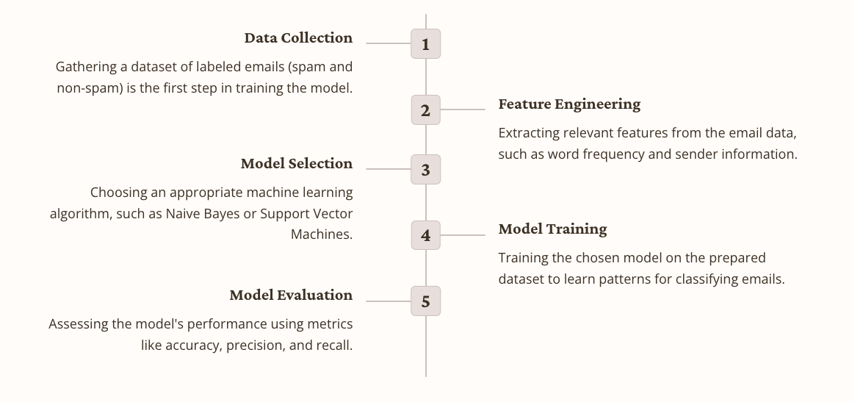
Building the Spam Email Classification Model

Slide 7
Integrating the Model into the Flask Application
Model Loading
Loading the trained model into the Flask application, making it accessible for predictions.
Prediction
The model classifies the input email as spam or not spam and returns the result to the application.

Slide 8
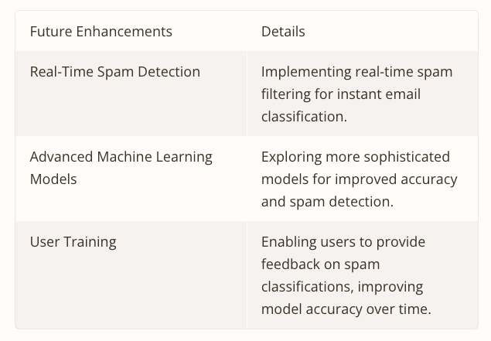
Conclusion and Future Enhancements

