Slide 1

Predicting Telecom Churn: A Data-Driven Approach

Slide 2

Project Overview
1
This presentation outlines a project to predict high-risk telecom customers.
2
We will identify key churn indicators and develop a model to address the challenge.

Slide 3
The Telecom Churn Challenge
Customer churn is a major issue in the telecom industry, leading to revenue loss and impacting growth.
Understanding the factors driving churn is crucial for developing effective retention strategies.

Slide 4
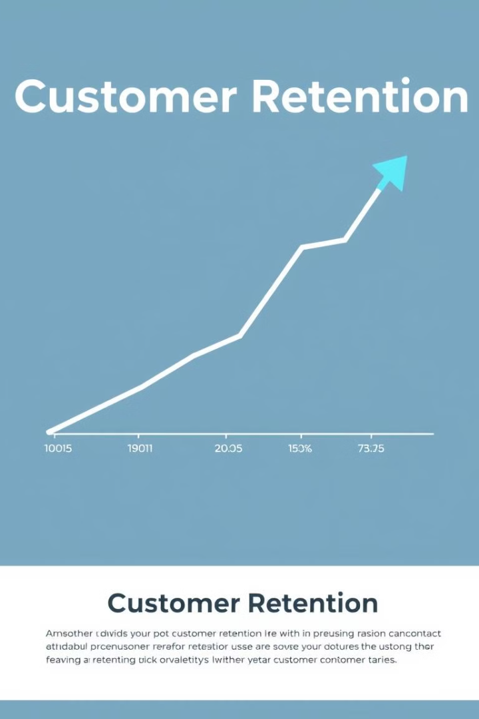
The Importance of Customer Retention
1
Cost of Acquisition
2
Customer Lifetime Value
Attracting new customers is significantly more expensive than retaining existing ones.
Loyal customers generate more revenue over time, increasing profitability.
3
Brand Loyalty
Satisfied customers are more likely to recommend your brand to others, fostering positive word-of-mouth.

Slide 5
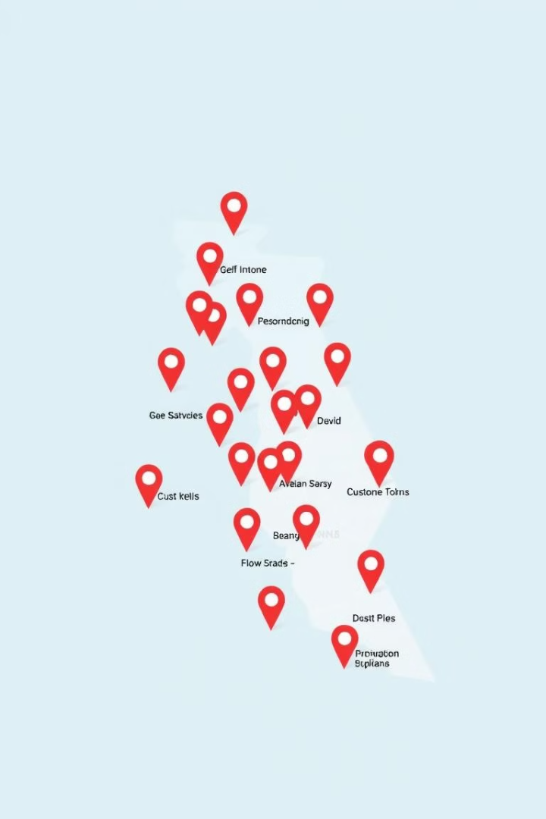



Predicting High-Risk Churn Customers
Data Collection
Gather a comprehensive dataset of customer information, including demographics, usage patterns, and billing history.
Data Analysis
Apply statistical techniques to identify patterns and trends related to churn behavior.
Model Development
Develop a predictive model that can accurately identify high-risk churn customers.

Slide 6
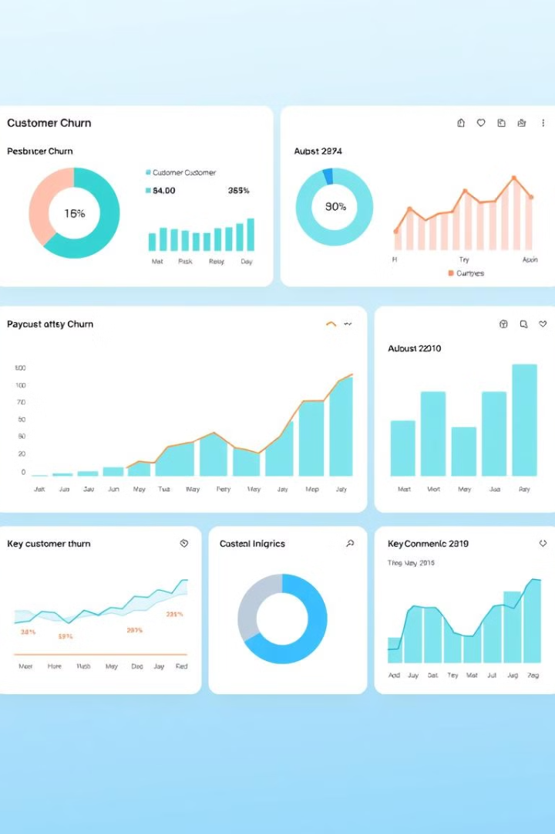
Identifying Key Churn Indicators
Contract Length
Service Usage
Customers nearing the end of their contracts are more likely to churn.
Decreased service usage, especially data consumption, can signal potential churn.
Billing Issues
Late payments, disputed bills, or unresolved billing issues can lead to churn.

Slide 7
Dataset Overview and Feature Engineering
We will utilize a large telecom dataset containing customer information spanning several years.
This data will be cleaned, preprocessed, and transformed to create meaningful features for the model.

