Slide 1
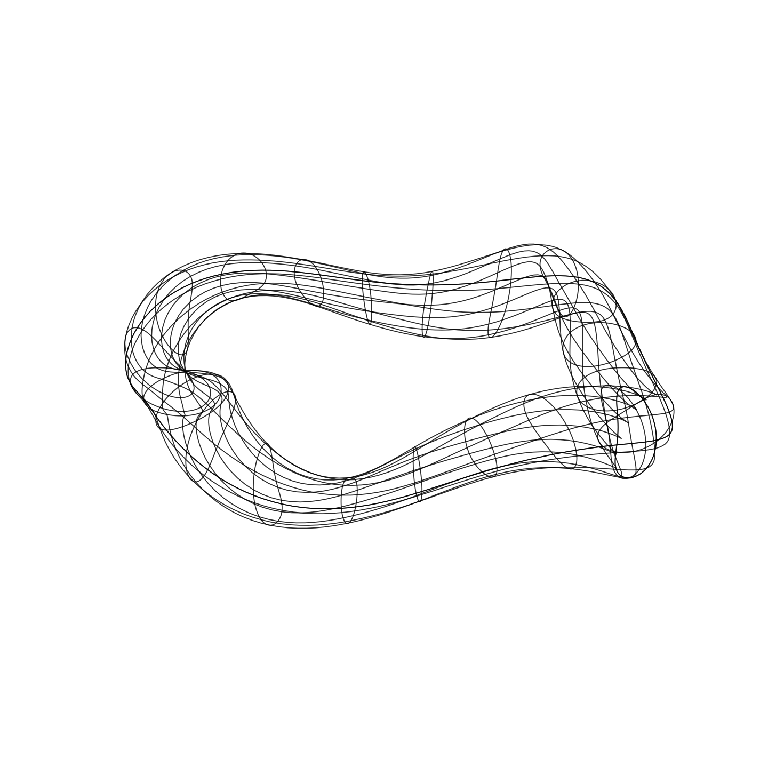
PETERSON CHECK-IN · 31 AUGUST 2026
Harder, Better,
Faster, Stronger
neutronics
Physics-informed fusion sources and response-aware magnet shielding in OpenMC
1
Notes:
Open with the integrated story, then narrow quickly to shielding.
The four words are an organizing device, not four independent novelty claims.
[Sources]
- /Users/tkiker/Documents/GitHub/openmc/spf_prototype/PROJECT_SUMMARY.md
- /Users/tkiker/Documents/GitHub/openmc/spf_prototype/talk/figs/summer_recap_2026/title_stellarator_bw.png
[/Sources]

Slide 2
One transport stack connects the four claims
Harder
Better
Faster
Stronger
True 3D births
Local-field physics
Direct feedback
Placement over bulk
A native VMEC-fluxmap source samples the twisting stellarator plasma directly.
A source-agnostic SPF kernel steers birth directions relative to the local magnetic field.
Forward transport makes per-coil response practical enough to sit inside a design loop.
Shield material is allocated by response, mass, and clearance—not nominal thickness alone.
Today’s focus: what survives the equal-mass transport gate—and what should lead next.
2
Notes:
Use this as the abstract map: harder/better are source fidelity; faster/stronger are the design loop and result.
Do not claim full SPF end-to-end verification yet; the project summary marks that work in progress.
[Sources]
- /Users/tkiker/Documents/GitHub/openmc/spf_prototype/PROJECT_SUMMARY.md
[/Sources]

Slide 3
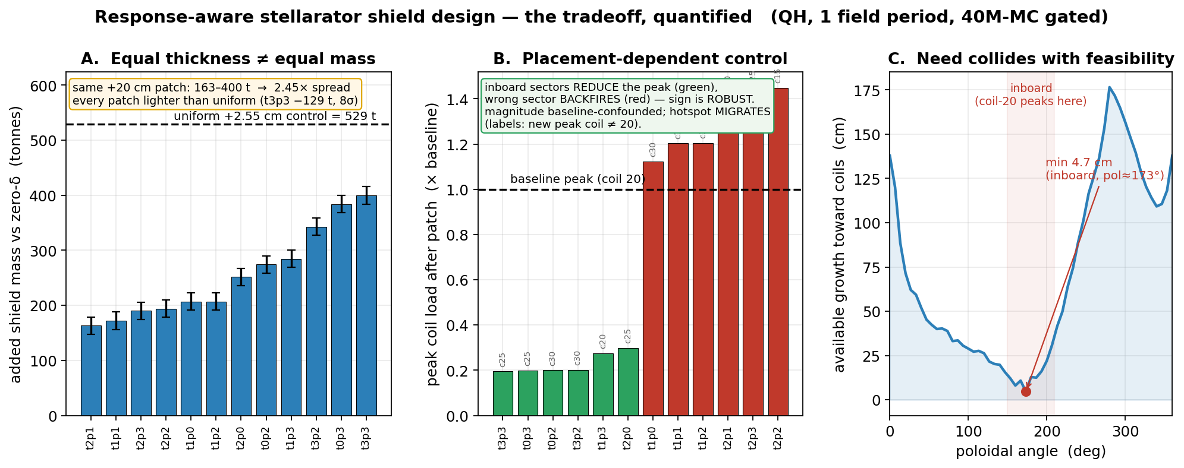
The shield-design thesis is now quantified
Attribution ≠ intervention worth ≠ feasible controllability.
3
Notes:
Panel A: identical +20 cm patches span 163–400 t; every patch is lighter than the uniform control.
Panel B: only the sign pattern is claimed; absolute magnitude is baseline-confounded and the hotspot migrates.
Panel C: the 4.7 cm clearance minimum falls inboard where coil-20 loading peaks.
[Sources]
- /Users/tkiker/Documents/GitHub/openmc/spf_prototype/shield_opt/patch_worth/analysis_bfd_20260824/fig_peterson_summary.png
- /Users/tkiker/Documents/GitHub/openmc/spf_prototype/shield_opt/patch_worth/analysis_bfd_20260824/verify_closeout.py
- /Users/tkiker/Documents/GitHub/openmc/spf_prototype/shield_opt/patch_worth/analysis_bfd_20260824/PETERSON_TALKING_POINTS.md
[/Sources]

Slide 4
Three results are ready—with explicit caveats
2.45×
4.2×
4.7 cm
mass spread
lower peak
minimum room
Same +20 cm patch, real DAGMC volume. Equal thickness is not an equal-mass experiment.
At fixed envelope versus uniform. The limiting coil migrates, so this is not yet the equal-mass headline.
Clearance binds inboard—precisely where the coil-load response says shielding is most valuable.
Method result: direct-forward transport is sufficient for the coil-load objective, so the optimizer does not depend on SSR or production weight windows.
4
Notes:
Say the caveat immediately after each number; it makes the story stronger and keeps the claim boundary clean.
The 4.2× result is a fixed-envelope breeder-to-shield swap, not an equal-mass comparison.
[Sources]
- /Users/tkiker/Documents/GitHub/openmc/spf_prototype/PROJECT_SUMMARY.md
- /Users/tkiker/Documents/GitHub/openmc/spf_prototype/shield_opt/patch_worth/analysis_bfd_20260824/PETERSON_TALKING_POINTS.md
- /Users/tkiker/Documents/GitHub/openmc/spf_prototype/shield_opt/patch_worth/analysis_bfd_20260824/verify_closeout.py
[/Sources]

Slide 5
Equal mass overturns the heuristics
Peak values pass
Uniform and all candidates were evaluated at the same 2.163×10⁶ kg design mass.
No family beats uniform. Minimax
stress test backfires: +891 ± 36%.
Resolved hotspot stays c23
The transport ranking is authoritative; the extrapolating linear surrogate is not.
Δ vs uniform (1σ): Clearance: +0.2 ± 4.8% | Response: +0.6 ± 4.9% | Minimax: +891.1 ± 35.9%
5
Notes:
All four family JSONs are present; use the chart and statistical gate exactly as shown.
The common mass is 2.163095×10^6 kg. The minimax surrogate predicted nonphysical negative responses, so only direct transport can rank it.
The minimax breeder layer split into seven CAD solids; its guarded export preserved eight magnet groups. The tally uses H5M-derived cell IDs while the report keeps stable physical coil labels.
[Sources]
- /Users/tkiker/Documents/GitHub/openmc/spf_prototype/shield_opt/patch_worth/analysis_bfd_20260824/design_families.npz
- /Users/tkiker/Documents/GitHub/openmc/spf_prototype/shield_opt/patch_worth/analysis_bfd_20260824/minimax_candidate_matched.npz
- /Users/tkiker/Documents/GitHub/openmc/spf_prototype/shield_opt/patch_worth/analysis_bfd_20260824/family_transport_results/family_transport_summary.json
- /Users/tkiker/Documents/GitHub/openmc/spf_prototype/shield_opt/patch_worth/analysis_bfd_20260824/FAMILY_TRANSPORT_RESULTS.md
[/Sources]

Slide 6
Source tradeoffs are quantified across 20 devices
20/22
2.6–3.1×
0.44°
devices converged
faster grid eval
field-axis p99
All 20 completed the grid-versus-spectral sweep; the two excluded cases failed equilibrium convergence first.
The local vectorized benchmark favors the grid per evaluation—but absolute rates remain hardware-specific.
At the finest 30.4 MiB grid: 1.94% source TV and 327× the spectral memory. Coarse-grid p99 is 5.36°.
Decision: spectral is the fidelity default; use grids as measured accelerators. Next: identical-history QA + QH transport tallies.
6
Notes:
Headline: this is now an ensemble result, not a one-device benchmark.
Say the tradeoff in one breath: the grid is faster per evaluation, but the memory and physics errors are resolution-dependent.
Do not claim a transport-tally effect yet; the next test is identical-history QA and QH wall/coil tallies.
[Sources]
- /Users/tkiker/Documents/GitHub/openmc-spf-pol/spf_validation/agg_representations_20dev.json
- /Users/tkiker/Documents/GitHub/openmc-spf-pol/spf_validation/PAPER_SUBSECTION_DRAFT.md
- /Users/tkiker/Documents/GitHub/openmc-spf-pol/OVERNIGHT_SPF_MASTER_PLAN.md
[/Sources]

Slide 7
DECISION FOR TODAY
What should lead the abstract and paper?
Harder, Better, Faster, Stronger: Physics-Informed Fusion Neutron Sources and Response-Aware Magnet-Shield Optimization in OpenMC
1
Lead claim: integrated source capability plus transport-tested shield tradeoffs?
2
Claim boundary: fixed-envelope benefit; equal-mass heuristics null; linear extrapolation fails.
3
Next proof: identical-history QA/QH source tallies; exact projection; bounded relinearization.
7
Notes:
End on decisions, not a generic thank-you.
Recommended lead: the integrated toolchain, with source capability and transport-tested shield tradeoffs as the two evidence arcs.
Claim boundary: fixed-envelope 4.2× is ready; equal-mass heuristics are null; the representation study is not yet an end-to-end tally claim.
[Sources]
- /Users/tkiker/Documents/GitHub/openmc/spf_prototype/PROJECT_SUMMARY.md
- /Users/tkiker/Documents/GitHub/openmc-spf-pol/spf_validation/PAPER_SUBSECTION_DRAFT.md
[/Sources]

