Slide 1



Students Performance Analysis using power BI
MENTOR :
Dr. K. S. Kalaivani
PROJECT MEMBERS:
THISSYAKKANNA S M (22ADR110)
SANJAY R (22ADR095)
NIRENJHANRAM S K (22ADL130)

Slide 2
Objective
The primary objective of this analysis is to examine key factors influencing student performance and to uncover patterns in:
Study habits and academic outcomes (e.g., hours of study, attendance)
Social and environmental influences on exam scores (e.g., parental involvement, access to resources, internet access)
Physical and mental wellness factors (e.g., participation in physical activities, learning disabilities)
Institutional and instructional quality (e.g., school type, teacher quality)
Supplemental support (e.g., tutoring sessions, access to resources)
This analysis will provide insights into the relationship between these factors and student exam scores, offering actionable recommendations to enhance educational strategies, support student needs, and promote improved academic outcomes.

Slide 3
DATASET
Dataset Source and Link:
The dataset is sourced from Kaggle
https://www.kaggle.com/datasets/lainguyn123/student-performance-factors/data
Dataset Description:
The dataset contains 6607 rows and 20 columns, provides a comprehensive overview of various factors affecting student performance in exams.

Slide 4
DATASET DESCRIPTION
Hours Studied : Number of hours spent studying per week.
Attendence : Percentage of classes attended.
Teacher Quality : Quality of the teachers (Low, Medium, High).
Learning Disabilities: Presence of learning disabilities (Yes, No).
Parental Education Level: Highest education level of parents (High School, College, Postgraduate).
Gender : Gender of the student (Male, Female).
Exam Score : Final exam score.

Slide 5
DATA PREPROCESSING
Missing Value Handling: Missing values were addressed by either removing incomplete rows or imputing values where appropriate, depending on the data's context and impact.
Data Types: Columns were converted into appropriate data types for analysis, such as converting categorical data into numerical labels and ensuring consistency in variables like hours of study and attendance.
Handling Outliers: Outliers in numerical columns, such as study hours and exam scores, were identified and handled appropriately. Values that appeared unusually high or low, like excessive study hours or outlier exam scores, were either corrected, capped, or removed if they were deemed unrealistic. This step ensures that extreme values do not skew the analysis and provides a more accurate understanding of the data.

Slide 6
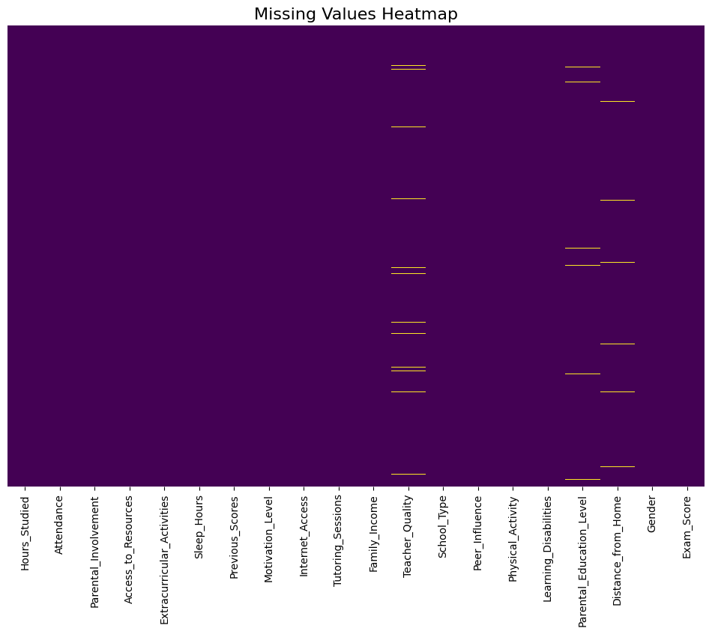
DATASET MISSING VALUES VISUALIZATION

Slide 7
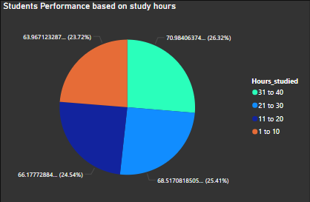
Questions:
How does hours study co-relate with exam score?
Inference
The report suggests that students who spend the most time studying—those studying 31 to 40 hours a week—tend to achieve the highest scores, with an average of 70.01. They are followed by students who study 21 to 30 hours, averaging 68.52, then those studying 11 to 20 hours with an average score of 66.18, and finally, students who study 1 to 10 hours, who score an average of 65.43.

Slide 8
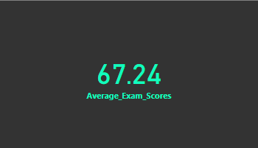
2) Create a Measure to Calculate the Average Exam Scores of the Students ? Inference: We can see that the average score of students is 67.24.

Slide 9
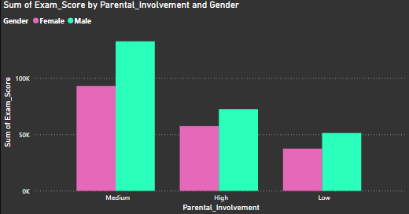
3) How does parental involvement and Gender affect Exam score ?
Inference
The report shows that students with medium parental involvement scored the highest, with an average of 68.9, followed by those with high parental involvement, who averaged 67.2, and students with low parental involvement, who scored an average of 65.2.

Slide 10
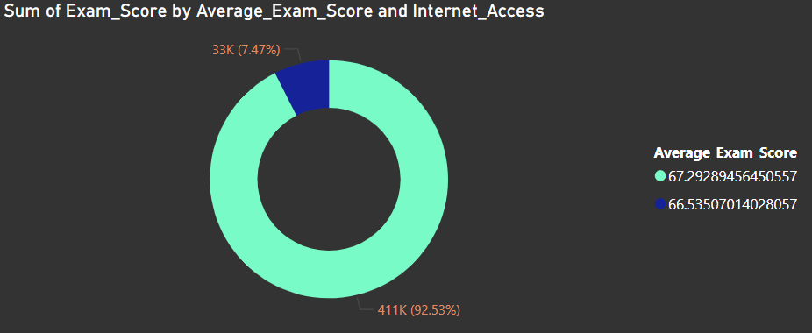
4) How Does Internet Access Influence the Exam Score?
Inference
From the report, we can infer that students with internet access tend to score higher than those without. Students with internet access averaged 67.2, while those without internet access scored an average of 66.54.

Slide 11
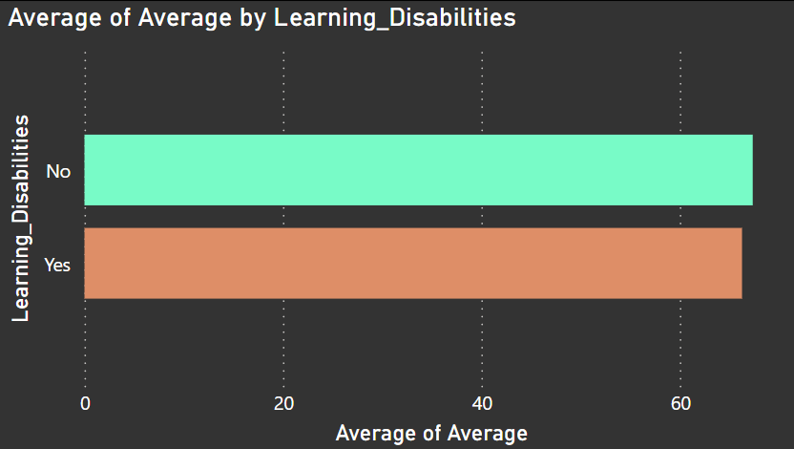
5) How Does the Learning Disabilities affect the Exam Scores ?
Inference
The report shows that students with learning disabilities average 64.25 marks, while students without learning disabilities average 66.26 marks. We can conclude that the scores of students with learning disabilities are comparable to those of students without disabilities.

Slide 12
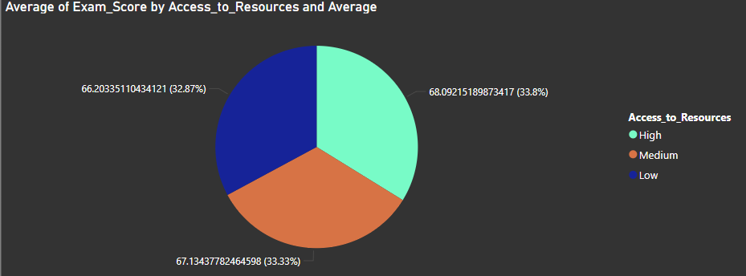
6) What is the effect of Access to Resources on Exam score ?
Inference
We can infer that access to resources does not have a significant impact on exam scores, as the difference in scores is minimal—only 1 mark—when compared to other factors. Students with high access to resources averaged 68.09 marks, those with medium access scored 67.13, and students with low access scored 66.20.

Slide 13
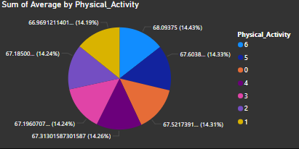
7) How does participation in Physical Activities influence Exam Score?
Inference
We can infer that students who participate in sports activities score similarly to those who do not engage in any physical activity. Students involved in physical activities had an average score of 68.9, while those who did not participate scored 67.9.

Slide 14

8) Create a Measure to Calculate the Average Attendance of the Students?
Inference
The report indicates that the average student attendance is 79.79%.

Slide 15
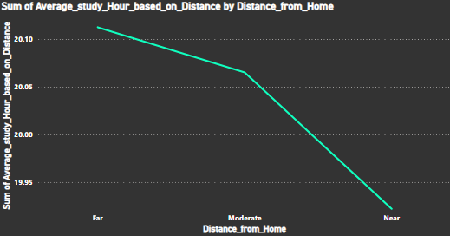
9) Does the Distance From Home Affect the Study Hour?
Inference
The report suggests that students who live farther from the school generally have fewer study hours than those who live closer. This difference may be attributed to the extra time spent commuting, which limits the time available for studying. Students who live near the school average 20.11 hours of study per week, while those with a moderate distance commute average 20.07 hours, and students who live farther away spend an average of 19.92 hours studying.

Slide 16
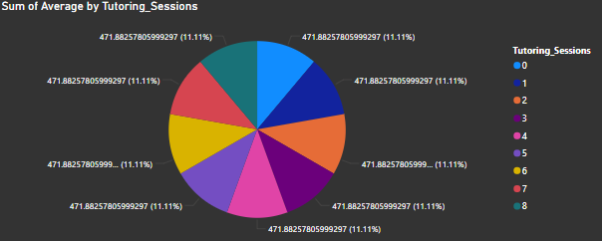
10) How do Tutoring Sessions impact the Exam Score?
Inference
The report suggests that students who attend five study sessions a week achieve the highest marks, outperforming those who attend either more or fewer sessions. This may indicate that a balanced number of study sessions optimizes learning and performance, while both excessive and insufficient sessions may negatively impact results. Students who attended more than five sessions per week averaged 68 marks, while those who attended five or fewer sessions scored an average of 65 marks.

Slide 17
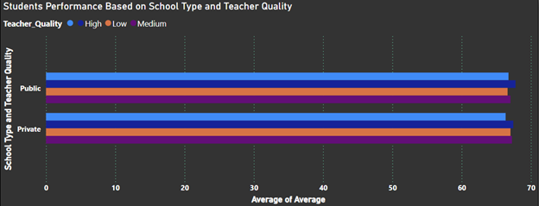
11) How Does School Type and Teacher Quality Influences the Exam_Score?
Inference
The report indicates that there is no significant difference in the scores of students attending private schools versus those in public schools. Private school students had an average score of 67.45, while public school students scored an average of 67.78.

Slide 18
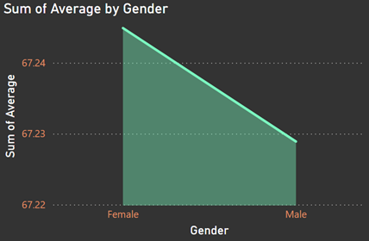
12) Analyse the performance of Exam_Score by Gender ?
Inference
From the report we can infer that male students score less marks compared to female students. Males students scored an average of 67.24 marks whereas females students scored 67.24 marks.

Slide 19
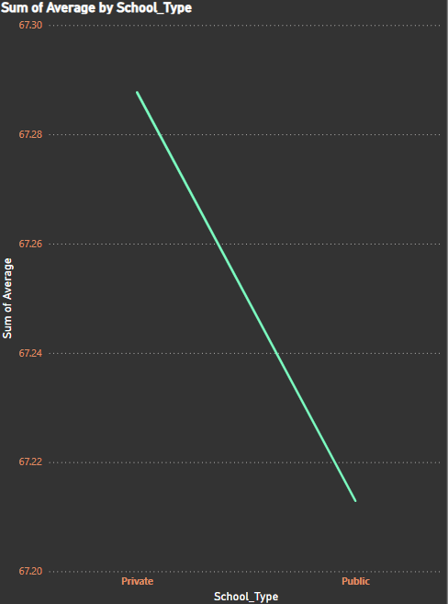
13) How does the School Type Results in Exam Score?
Inference
The report indicates that there is no significant difference in the scores of students attending private schools versus those in public schools. Private school students had an average score of 67.45, while public school students scored an average of 67.78.

Slide 20
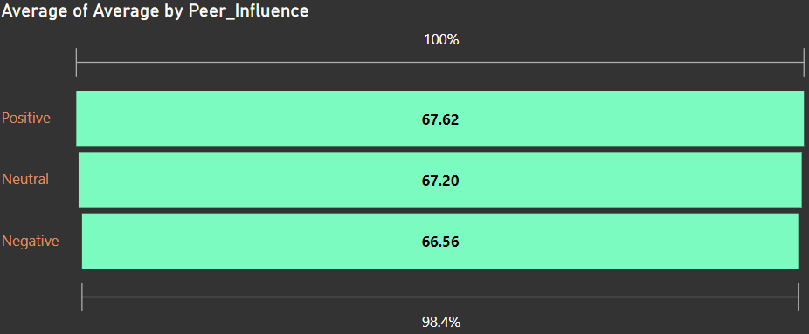
14) How Does Peer Influence affect the Exam_Scores?
Inference
The report indicates that students with positive peer influence had a higher average score of 67.62, compared to those with neutral peer pressure, who scored an average of 67.20, and students with negative peer influence, who averaged 66.56.

Slide 21
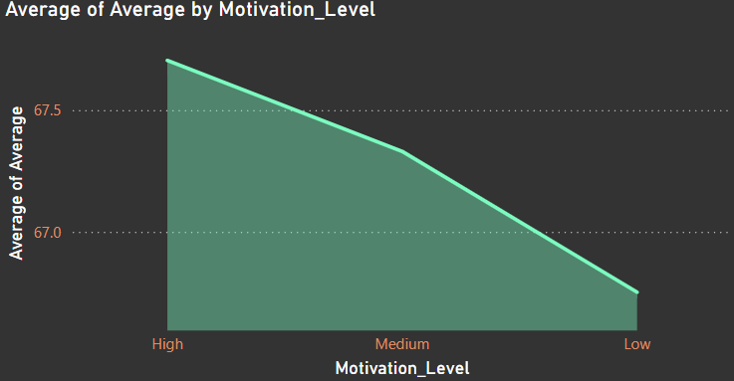
15) How Does Motivation Level impact Exam_Score?
Inference
The report suggests that students with high motivation achieved the highest average score of 67.5, followed by those with medium motivation at 67.33, while students with low motivation scored an average of 66.75.

Slide 22
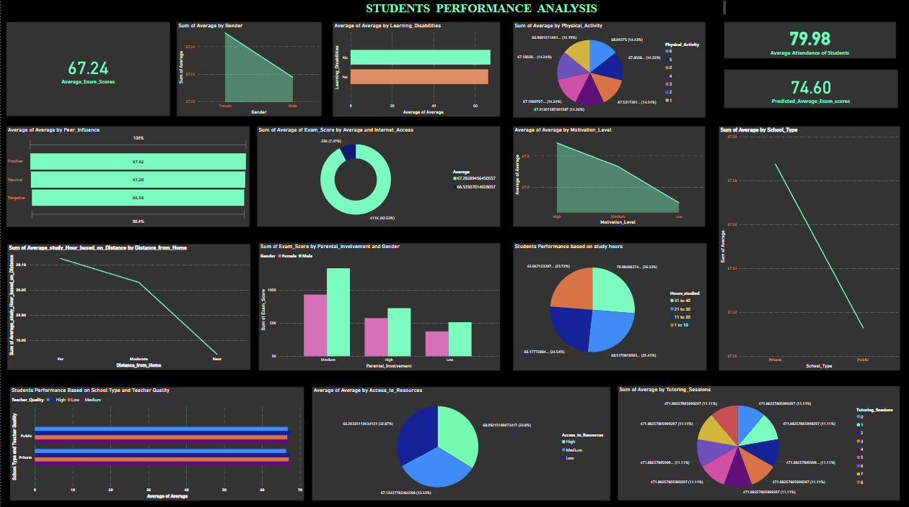
DASHBOARD

Slide 23
THANK YOU

