Slide 1
Transport infrastructure and accessibility : how to foster the impacts on economic development
Emile Quinet
PSE-école des ponts, Paris

Slide 2
Outline
Beyond CBA: the final effects
What do we know about location effects
What do we know about growth effects
Impact of policies

Slide 3
Beyond cba
To assess location and growth effects, it is necessary to go beyond CBA

Slide 4
Interest and limits of traditional CBA
Interest (unvaluable):
Provides an overall view of the interest of the project
Allows to compare different projects
But:
It provides only the first round of the effects of the project:
The transport users
The environmental effects to the neighbours of the track
It does not provide the final effects:
For instance: the reduction in freight transport costs are passed on to the final consumers
It does not provide any break-down of the effects
Especially no indication on the consequences in terms of location
Our interest: the location effects and level of economic activity effects
The sources of knowledge:
Economics Analysis
Statisticel studies
Results of modeling exercices
Ex post observations, case studies

Slide 5
A universal tool: accessibility
Accessibility: an index showing how close you are from the « rest of the world »:
Depends on the size of nodes around you
Weighted by the « distance » (cost, time, ..) between you and each node
A formula:
Node j has a size Wj (for instance its wealth)
And is distant from you by transport cost Cj
An accessibility index is for instance:
Each node is weighted proportionally to its size and inversfely to its farness
It shows how well you are located vis-à-vis the markets or the settlements or the employments

Slide 6
A universal tool: accessibility
W3
W4
W1
W2

Slide 7
location effects
Infrastructure improvements induce polarization and concentration

Slide 8
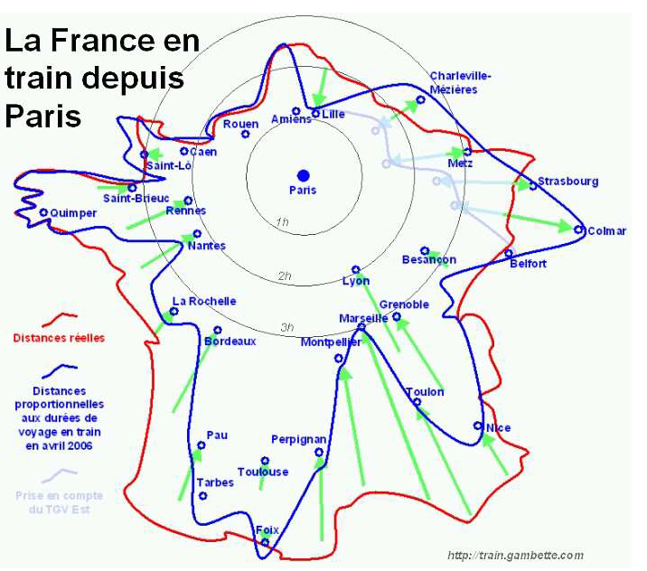
Speed distorts geography Effect of HST in France

Slide 9
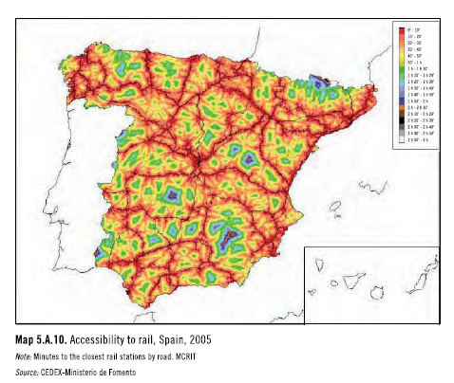
Speed distorts geography

Slide 10
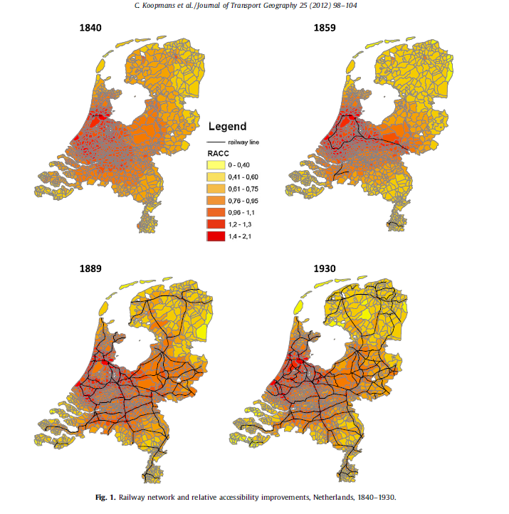
Railways change accessibility: the case of Netherlands
Maps of successive relative accessibility levels (Koopmans and alii):
Difference of each area to the average accessibility level of the country
Rail development increases disparities, induce polarization

Slide 11
Accessibility changes locations: the case of Netherlands
Consequences for population location (Koopmans and alii)
Relation between rail accessibility and growth of population
Rail accessibility improvements induce population increases
But to a rather small extent compared to other factors such as general urbanization/crowding trends (5 to 10%?)

Slide 12
The lessons of economic geography
As transport costs decrease:
Polarization and concentration
Peri-urbanisation around the stations, connections and interchanges
When a link between two agglomerations is improved:
Migrations from the smaller to the larger agglomeration
Checked by econometric studies

Slide 13
Spatial Modelling
The principles of spatial models
A transport submodel, modelling the transport flows issued from a given economic activity
An economic activity model, analysing how economic activity and the corresponding transport flows are shaped by transport costs
Many such models: CGEurope, Rhomolo, Delta

Slide 14
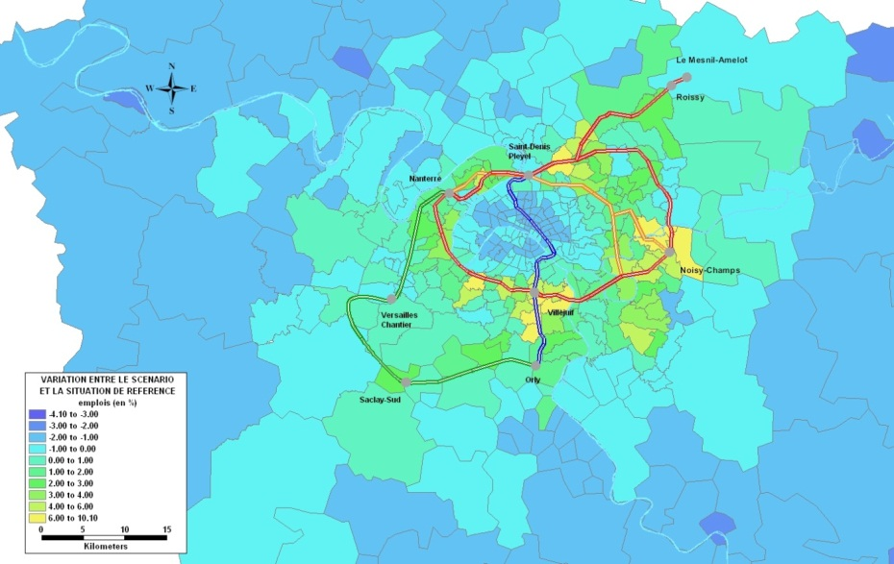
Modelling: the case of the Grand Paris Express

Slide 15
Lessons from ex post studies
Effects around stations (maximum 1 km):
New urbanization
Increase in density
Extension of commuting to distances up to 100 km → sleeping cities

Slide 16
Stylized facts about the urban location effects for USA (Turner 2009)
Effects of roads
Roads increase the population density nearby land.
Roads change the composition of production and population.
Roads disportionately attract wealthier people.
Roads decrease density in cities.
Effects of mass transit
Transit increases the population of cities.
Transit disportionately attracts poorer people to cities.

Slide 17
growth effects
Infrastructure improvements induce increase in GDP, to various extents and with heterogeneities

Slide 18
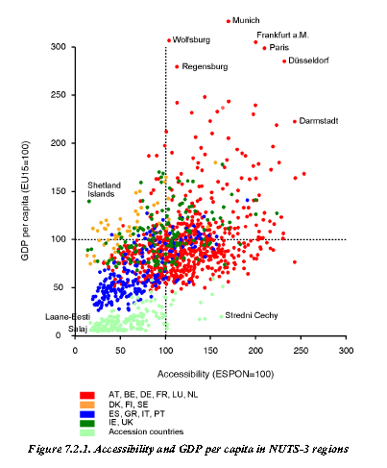
A loose link between accessibility and growth

Slide 19
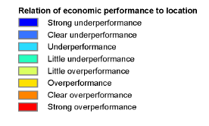
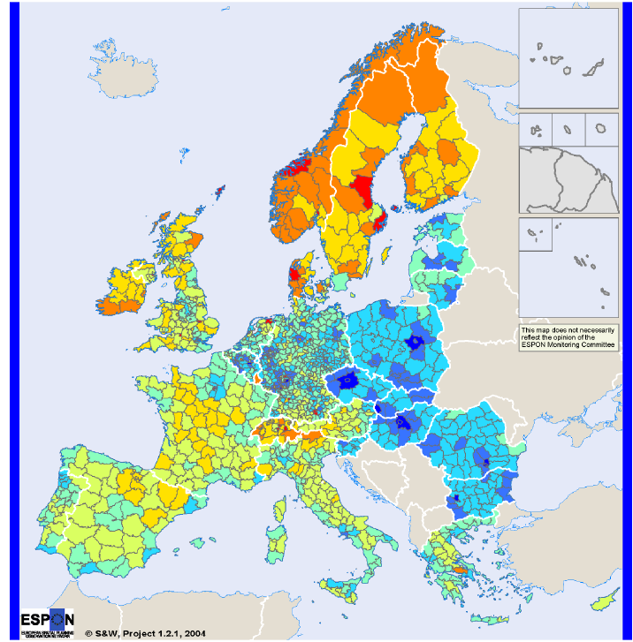
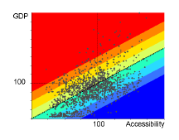
Accessibility and economic growth

Slide 20
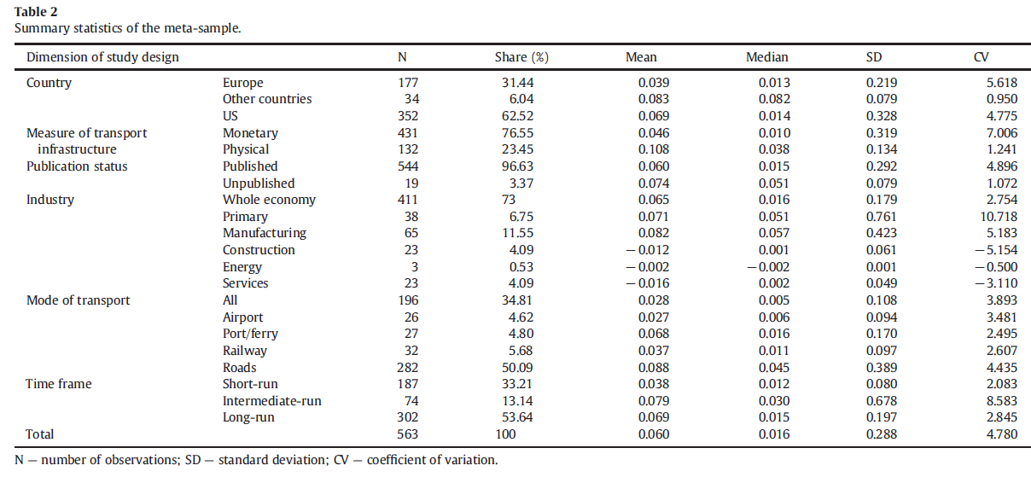
Impact of public infrastructures on GDP
A lot of econometric studies (Graham and Melo 2013)

Slide 21
Urban economics point of view: The agglomeration effects
When accessibility is improved, productivity and economic activity grows.
The three effects on productivity
Sharing
Matching
Learning
The effect is mainly intra-urban
Elasticity of productivity to accessibility:
In the range of 2%-5%
Depending on the sector: larger in services, lower in primary industries
The effects vanish with distance: 80% within 50 km
Improved accessibility positively impacts the labour market :
Decrease of unemployment
Reducing exclusion zones
Improve the situation of remote areas

Slide 22
Lessons of Economic geography
General lesson:
Decrease in transport cost induce polarization and concentration
Due to increasing returns to scale and increasing variety of goods, and larger market, the « big » agglomeration benefits more
The « problem of the three bodies »

Slide 23
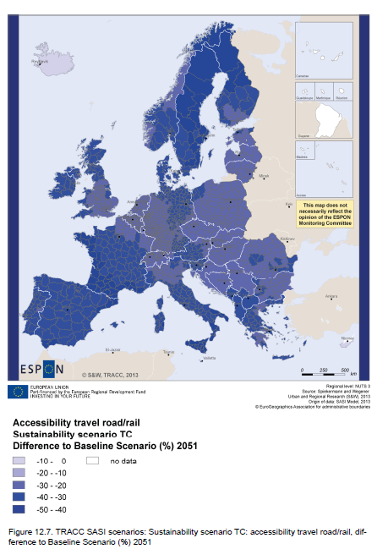
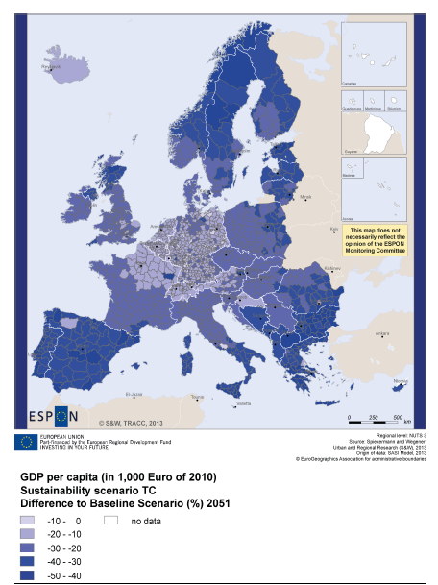
Results of modelling (SASI): changes in accessibility GDP ↓ ↓

Slide 24
Lessons of ex post studies
Rail effects on firms
Re-organization of firm between headquarters and affiliates
With increases in productivity and in employment
Mainly on services and tourism
Depending on the size of the agglomeration (larger for large agglomerations)
Road effects on firms
Enlargement of markets
Increase in competition→increase in variety of goods and services, decrease of prices

Slide 25
The additionality issue
Several approaches
Macro-economic impact of infrastructure on GDP
Agglomeration effects
Results of large models
Case studies
Do they add each other or overlap?
They overlap
The most robust one are agglomeration effects
Do they add to CBA results?

Slide 26
Impact of policies

Slide 27
Preconizations are hasardous
No clear automatic outcome
Specificity of each situation
HST in Spain
A lot of uncertainty

Slide 28
Lessons from ex post studies
Beneficial consequences are not automatic
The size of agglomeration matters, as well as the proximity of other cities, depending on whether they are large or small: the Lille and Macon cases
Urbanism around the stations
The importance of a pre-existing economic potential
The indirect effects are linked to direct effects
Dynamism of local authorities and entrepreneurship

Slide 29
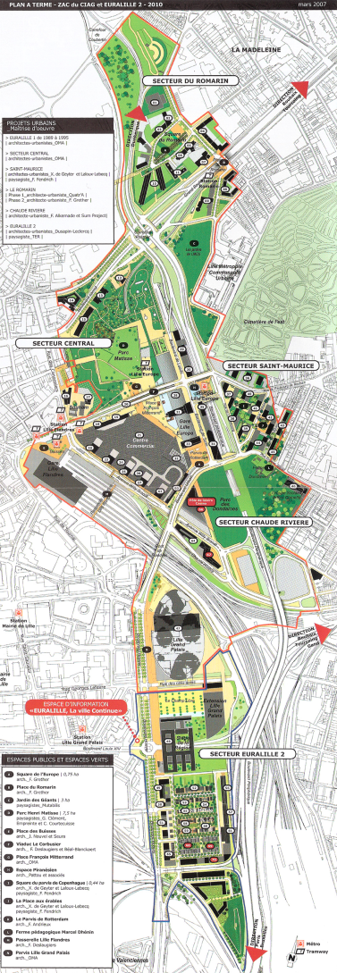
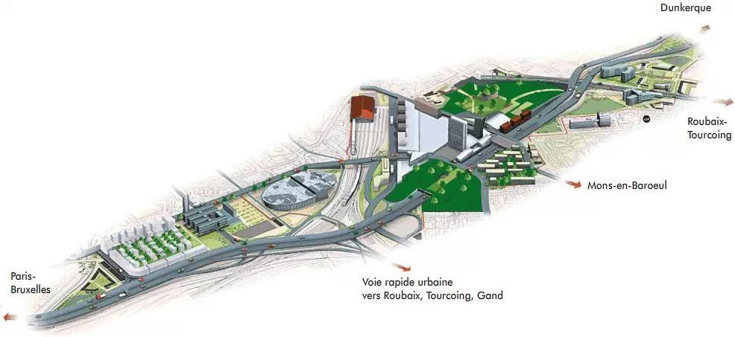
Lille (1,2 Minhab, 600 km²) : Euralille 600 000 m² of offices and houses

Slide 30
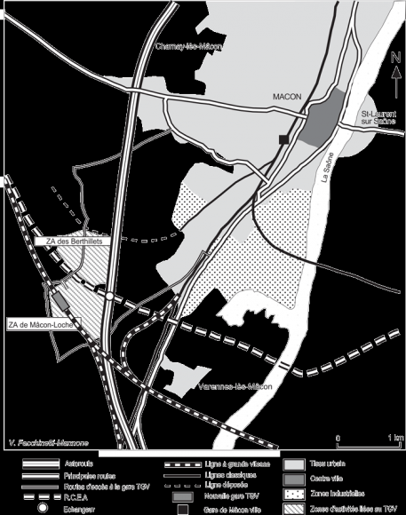
Macon (60 000 inhabitants)

Slide 31
The role of public policies
Transport policy:
Importance of the feeders to the main infrastructure
Organization of parkings around the stations
Other public policies
Urban regulation for housing and offices around the stations, and farther
In order to facilitate the migrations and changes induced by the new infrastructure

Slide 32
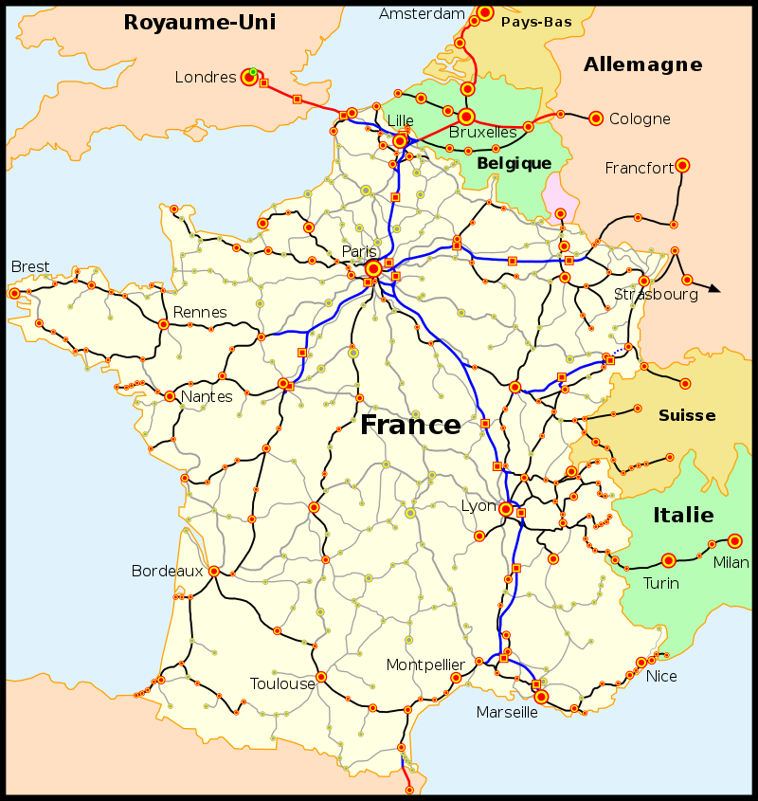
HSTs and TGVs in France

Slide 33
Cooperation between public authorities and private firms
A careful design and monitoring of urban development
Examples:
Société du Grand Paris: working groups gathering the major actors of urban development around each station
Seine Nord Escaut: « road shows » for attracting private firms along the waterway, and fostering intermodal platforms
Japan Railways: the station operators act as developers around the stations

Slide 34
Some specific points
The role of nodes
Stations are not just transport exchanges
Intermodal platforms foster location of activities
Target the right sectors
Services and tourism for high speed transports
Shoping and delivery for roads

Slide 35
Main messages
Infrastructures induce location effects and foster economic activity
To various extents depending on the mode and on the specific situation
The size of those effects is linked to the direct effects
Beneficial effects are not certain
They depends
First on natural tendancies;
it is important to have a good knowledge of them
as it is not sensible to fight against them
Second on public policies and private entrepreneurship
And their coordination
Building the infrastructure is just the first step

Slide 36
Thank you for your attention

Slide 37
A few references
Koopmans, Rietveld and Huijg 2012: an accessibility approach to railways and municipal population growth, Journal of Transport Géography
Quinet and Raj, 2016, Accessibility in practice, World Bank Working paper
Proost S and Thisse J (2015) Skilled Cities, Regional disparities and efficient transport state of the art and a research agenda Coeure Program EU
Ahlfeldt, G. M., Redding, S. J., Sturm, D. M., & Wolf, N. (2014). The economics of density: Evidence from the Berlin Wall (No. w20354). National Bureau of Economic Research.
Ahlfeldt, G. M., & Feddersen, A. (2010). From periphery to core: economic adjustments to high speed rail. Documents de treball IEB, (38), 1.
Alstadt, B., Weisbrod, G., & Cutler, D. (2012). Relationship of Transportation Access and Connectivity to Local Economic Outcomes. Transportation Research Record: Journal of the Transportation Research Board, 2297(1), 154-162.
Bazin, Beckerich, Blanquart, Delaplace, Vanderbossche 2011 Grande vitesse ferroviiaire et développement économique local, Recherche Transport Sécurité paris
Bosker M, _y, Brakman_S, Garretsen_H and Schramm M Adding geography to the new economic geography: bridging the gap between theory and empiric Journal of Economic Geography (2010) pp. 1–31
Brocker J and Schneekloth N 2005 European Transport Policy and Cohesion: An Assessment by CGE Analysis Paper prepared for the 45th ERSA Conference, Amsterdam, 23-27 August 2005
Duranton, G., & Turner, M. A. (2012). Urban growth and transportation. The Review of Economic Studies, 79(4), 1407-1440.
Geurs, K. T., Zondag, B., Jong, G. de & Bok, M. de (2010b). Accessibility appraisal of integrated land-use/transport policy strategies: more than just adding up travel time savings, DOI: 10.1016/j.trd.2010.04.006. Transp. res. - Part D, (ISSN 1361-9209), 15, 382-393.

Slide 38
A few references
Graham, Brage-Ardao, Melo 2014 Quantifying the Economic Development Impacts of Major Transport Infrastructure Projects: A Case Study of High-Speed Rail in Spain Transportation Research Board 93rd Annual Meeting
Hansen, W. G. (1959). How accessibility shapes land use. Journal of the American Institute of Planners, 25(2), 73-76.
Kopp A Macroeconomic Productivity Effects of Road Investment – A Reassessment for Western Europe 2007 Report for the 132nd ECMT Round Table: infrastructure investment and economic productivity, Paris
Mackie, P., Worsley, T., & Laird, J. (2014). Appraising Transformational Projects: The Case of the Grand Paris Express. Country-Specific Policy Analysis.
Mejia-Dorantes, L., Paez, A., & Vassallo, J. M. (2012). Transportation infrastructure impacts on firm location: the effect of a new metro line in the suburbs of Madrid. Journal of Transport Geography, 22, 236-250.
Melo, P. C., Graham, D. J., & Noland, R. B. (2009). A meta-analysis of estimates of urban agglomeration economies. Regional science and urban Economics, 39(3), 332-342.
Melo, P. C., D. J. Graham and R. Brage-Ardao, 2013. “The productivity of transport infrastructure investment: A meta-analysis of empirical evidence”, Regional Science and Urban Economics, vol. 43 (5), pp. 695-706
Venables A.J. et M. Gasiorek, 1999, « The welfare implications of transport improvements in the presence of market failure », Report to the Standing Advisory Committee on Trunk Road Assessment, DETR, Londres.
Vickerman, R. (2007b). Cost-benefit analysis and large-scale infrastructure projects: state of the art and challenges. Environment and Planning B Planning and Design, 34(4), 598.

