Slide 1
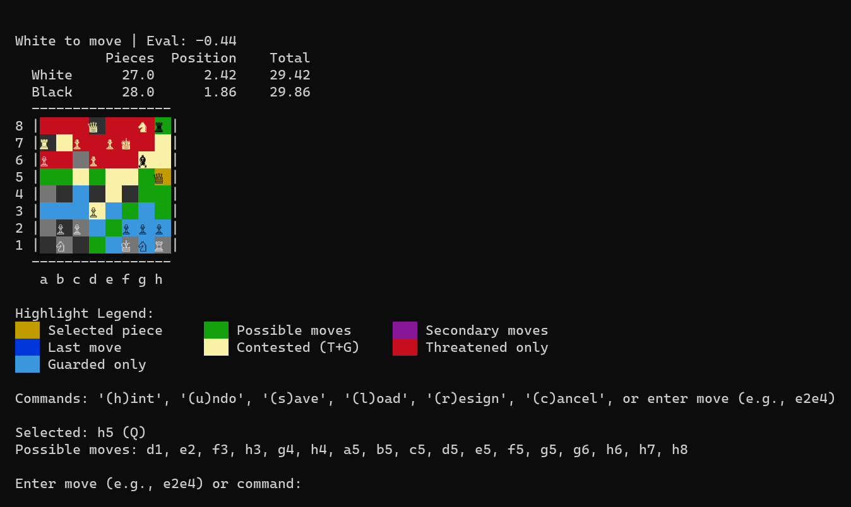
CHESS · WHAT I BUILT
A from-scratch agent trained on self-play
1878 Elo
against Stockfish, 95% interval 1756 to 2000; fitted over 50 games at depth 9 against anchors from 1500 to 2300
2 ply
the deepest search used anywhere in training; depth is spent only at play time
897 features
The agent's terminal view: squares colored by who attacks and guards them.
a linear evaluation: piece-square planes plus attack-coverage maps; search in Rust at about 2 million nodes per second
Source: src/chess README.md, docs/LESSONS.md, spec/trivium.spec.md
Notes:
The professor asked what I did for the chess game in C:\Users\user\Documents\dev\src/chess. Short version: a chess agent learned from pure self-play with no external engine labels, a linear evaluation over hand-built features, a native Rust alpha-beta search, and a recipe I called the trivium. The champion (models/champion.pt) is the amap-897 net: piece-square planes (769) plus attack-coverage maps. The README's measured strength is 1878 Elo with 95% interval 1756 to 2000 from a multi-anchor maximum-likelihood fit over 50 games at depth 9 against Stockfish anchors from 1500 to 2300; the earlier 1724 figure was the Wilson floor of a saturated single-anchor scout (the 1320 anchor saturates above about 1700). The Rust search gave about 2 million nodes per second, roughly 2000 times the Python beam, in about 450 lines (LESSONS.md lesson 10). The project began as a v1.0 terminal game with a DQN (the images/ folder holds the v1.0 to v1.5 screenshots) and became a research campaign. Everything ran on one GPU.

Slide 2
CHESS · THE RECIPE
Three targets, blended and annealed
THE TRAINING TARGET
target = a * lambda_return
+ b * search_value
+ c * outcome
Weights (a, b, c) run from 0.285, 0.341, 0.374 early to 0.516, 0.341, 0.143 late, on a schedule tuned by Optuna.
Trained at 2 ply, the same net measures 1484 (1434 to 1542) at depth 7 against Stockfish 1320.
Λ-RETURN REPLACES DEPTH
RL theory concepts: TD(λ) and eligibility traces. The bootstrap engages because n = 10 is below a game's 40 to 80 moves.
A 2-PLY SEARCH KEEPS TARGETS SOUND
TD-Leaf: the bootstrap is a deep, sound search value rather than the raw network's guess.
THE OUTCOME ANCHORS, THEN FADES
Game result steadies early learning and anneals away as the other two take over.
SUPPORTED
Tested one variable at a time against a faithful baseline: annealed 1237 vs un-annealed 1166 at matched depth; a static equal blend ignites then fades.
Source: src/chess spec/trivium.spec.md, docs/INSPIRATIONS.md
Notes:
The recipe, from spec/trivium.spec.md: G = a lambda-return + b search-value + c outcome, weights annealed on an Optuna-tuned schedule (about 21 trials), 809 donor features whitened with ZCA, TD-Leaf(lambda) generation at depth 2 with lambda 0.7, gamma 1.0, online SGD and the RAMP blunder filter, and parallel self-play with epsilon 0.1. Evidence per ingredient (single-variable, replicate-first): trivium anneal gave 1237 against 1166 un-annealed at matched depth, and a static one-third each blend ignites then fades (falsified); ZCA matched the faithful arm on about a quarter of the games; depth-2 sound targets matched depth 4 at half the clock; 15,000 self-play games produced the 1484 net and a restart reproduced its peak in 8,000. The chess RL theory concepts (docs/INSPIRATIONS.md in that repo, titled RL theory and this repo) square the theory against what was built: it is an n-step actor-critic with TD-Leaf targets, not Monte Carlo or GRPO; the n-less-than-T rule means bootstrapping engages because n = 10 is below game length; with a sparse terminal reward gamma acts as the back-cast operator and the target is bootstrap-dominated; and rollout (on-policy, fill, few updates, clear) differs from replay (persistent, random reuse), which was the deferred Q-learning lane. The 1484 figure is on a different scale from the later 1878: see the next slide.

Slide 3
CHESS · THE CAMPAIGN
What failed, and what worked
Tried | Result | What it taught
Stockfish distillation; AlphaZero-style from scratch | both lost to a 1-ply heuristic | pod-scale compute is not available on one GPU
RL-tuned linear eval on self-play outcomes | 585 Elo worse than hand-tuned | hand tuning already sat at the linear ceiling
λ sweep: 0, 0.5, 0.9, 1.0 | best at 0.9, about +50 Elo | the bias-variance middle was real
Distilled NNUE, then material coverage | 808 → 1144 Elo (+362) | data coverage, not tuning
Self-play on a distilled eval | −58 → −301 vs the hand eval | self-play eroded it; distillation beat it
KnightCap reconstruction with deep quiescence | 948 → 1212 Elo (+264) | elimination proved the load-bearing part
Elo: rows 1 to 5 against the hand-tuned eval, row 6 against Stockfish 1320. Compare within a row only.
Notes:
From docs/RL_FINDINGS.md (codas 1 to 8) and docs/LESSONS.md. Row 1: distillation about 1040 and loses; self-play at depth 1 flat and loses; off-policy bootstrap weak; A2C with sampled beam 0 of 20; the AlphaStar-style PUCT hybrid reached parity (16 of 16 draws) with the 1-ply heuristic. Row 2: linear value fit converged cleanly (mean squared error 0.78 to 0.12) but played 585 Elo worse, 0 of 30: the best value function for a better policy is not the one that minimizes value error. Row 3: lambda 0.0 about 909, 0.5 about 1126, 0.9 about 1191, 1.0 about 1126, an interior peak. Row 4: v1 NNUE 808; 156k enriched balanced positions 782; 469k with material coverage 1144; queen-up read +380 before and +671 after. Row 5: the DA2C loop's distilled net went from d2 −58 / d3 −191 to d2 −301 / d3 −301. Row 6: LESSONS lesson 17: the one remaining deviation from the KnightCap recipe, full-width deep quiescence search, delivered +264 Elo (948 to 1212, 95% interval 1109 to 1300) on an untrained eval and the first confirmed training crowns. The campaign plateaued near 880 to 950 for weeks before that. Later: the amap attack-coverage features, the campaign's first confirmed feature win (+51 and +72 Elo across two seeds), produced the champion (floor 1724, re-measured 1878). Campaign law recorded in future_exploration.md: representation beats algorithm: features 3 for 3 confirmed, mechanisms 0 for 7.

Slide 4
CHESS AGAINST THE LANGUAGE MODEL
Two environments, one method discipline
Dimension | Chess | Language-model RL
Reward | game outcome: exact and free | a judge model: noisy, exploitable
Experience | 2 million nodes per second; a peak in 15,000 games, reproduced in 8,000 | 16 records per step; minutes per step
Pool | self-play makes new positions | 240 records; 112 of 197 never split
Measurement | Elo with intervals; 50 to 200 games per claim | 16 questions; wobble of about one
INFERRED
The discipline worked where the environment pays exactly and cheaply. Chess shows RL learns from outcomes when experience is abundant; it does not separate reading 2 from reading 3.
Source: src/chess spec/trivium.spec.md, docs/LESSONS.md · dispositions.md · the verdict row is my inference
Notes:
Why the verdict is marked inferred: nothing here was tested as a contrast. Chess and the language-model task differ in several variables at once (reward exactness, experience per hour, task type: learning a value function from outcomes versus injecting facts), so the comparison cannot attribute the difference to one of them. What it does show is that the method discipline (single-variable arms, pre-registered falsification, replicate before inventing, confirm crowns before believing them) was enough to find real effects when the reward was exact and experience cheap. Chess lessons that carried over: a universal failure across independent arms points at a shared target defect, not a knob (here: the shared judge and eval defects); never decide on samples that carry no new information (the 16-question eval); match the comparator's experiment shape, not just its totals (games times target quality); and the load-bearing component gets proven, not argued. Numbers: spec/trivium.spec.md (15,000-game peak; restart reproduced it in 8,000 games) and LESSONS lesson 10 (2 million nodes per second).

