Slide 1
Injecting Domain Knowledge with SFT and RLVR
Full-parameter SFT puts domain knowledge in; RLVR makes more of it answerable.
data science texts · 0.8B test model

Slide 2
The result: base 4 → SFT 5 → first RL pass 9, of 16
checkpoint | answerable
base | 4 / 16
full-parameter SFT | 5 / 16
first RL pass | 9 / 16
Fixed-scoring sequence; the RL point is the first pass from SFT epoch 3.
Notes:
THE STORY, and every number on it opens as a file. Left panel, from data/probe3_locked.json (one invocation, fixed scorer): base 4 · SFT epoch 1 = 1 (format collapse — that checkpoint answers with an empty string on most questions) · epoch 2 = 3 · epoch 3 = 5 · then ONE full-parameter MGPO pass trained FROM that SFT checkpoint reads 9. The dashed trail behind the star is that same run's own in-run readings (6, 8, 7, 8) — the same model, not a later timeline. · Read the split honestly: the deposit buys about +1 over base and mostly recovers its own epoch-1 collapse; the RL pass buys +4. RL is where the lift is, and it is surfacing knowledge the deposit already placed — RL trains on its own 240 records, disjoint from SFT's 240 (verified: zero question overlap). · Right panel: the full-coverage campaign, one visit to each of RL's 238 records instead of drilling 6. Regenerate the whole figure with: python -c "import sys;sys.path.insert(0,'src');import plot_pipeline_curve as P;P.plot_critical_lifts()".

Slide 3
What was tested
Business problem: pretrained models do not contain organization-specific domain data unless it was in pretraining.
Test: full-parameter SFT → RLVR on data science texts.
Four overlays on sampled domain: Math · Code · STEM · Instruction
0.8B policy model · 238-prompt pool, 7 used by the winning run · 160-token cap
16 frozen evaluation questions · no ‘context’ field · no abstention option
A correct answer has to come from the model.
Notes:
0.8B is a hardware constraint, not the variable under study. The variable is full-parameter versus adapter. Four question categories: Math, Code, STEM, Instruction. Self-sufficient scoping was a deliberate paring: the original design also covered unanswerable questions where the right move is to decline, and that half returns in future directions. · The formulation follows the part 1 MDP checklist: states = the prompt plus tokens emitted so far, actions = the vocabulary, transitions deterministic (appending a token), reward zero everywhere except the terminal judge call, gamma 1. Because the episode-level problem is one decision wide, the environment reduces to its reward function — which is why 'model the judge' equals 'model the world' later.

Slide 4
RLVR: the reward comes from a verifier
9B author — writes questions, gold answers, and rubric examples.
4B LLM verifier — applies that written rubric to each answer.
0.8B policy — writes answers and never sees the rubric.
The reward is rubric-based correctness, not a human-preference reward model.
LLM feedback, but verifier-based RL rather than classic RLHF.
Notes:
This separation is the reason the numbers mean anything. Author and judge are different models; the student never sees the standard it is being held to. Everything the 0.8B learns arrives through one channel — the scalar reward.

Slide 5
The rubric, applied — one question, seven answers
Question: With BaggingRegressor over decision-tree bases, which statistical property does averaging primarily reduce?
answer | score | why that number
variance — averaging high-variance trees | 0.95 | the claim, said directly
“Averaging is used across many ensemble methods, and what it acts on here, statistically, is the variance of the base learners.” | 0.72 | CORRECT but padded — right answer, low band
bias, since averaging corrects each tree's underfitting | 0.45 | commits to a named mechanism; the mechanism is wrong
it reduces total training time, the trees fit in parallel | 0.32 | true of bagging — answers a DIFFERENT question
ensembles combine estimators to improve performance | 0.18 | on-topic; asserts nothing about this question
“Yes, that is the standard approach.” | 0.05 | content-free deferral — it never tried
0.70 is the correctness line. The reward is that yes/no ONLY — 0.95 and 0.72 earn the same 1.0; 0.45 and 0.05 earn the same 0.0.
Notes:
Source: data/synthetic_domain_rubric.md, worked-examples block (REQ-J11 — every exemplar is drawn from a held-out 12-item rubric split, never from training or eval). · Why the 'wrong, good' row exists: 0.4-0.6 is reserved for the most DEMANDING kind of wrong — a specific false claim, a confident wrong number, a flipped comparison. An answer that commits to nothing has not earned that band and drops to 0.05-0.25. Collapsing those two is how a judge ends up scoring every wrong answer ~0.45 and treating 'wrong' as one category when it is three. · Why 'correct, bad' exists: the gold band is 0.9-1.0, NOT 1.0. If every correct answer scores 1.000 the instrument has no resolution above 'correct', and RL has no way to prefer one right answer over another. The five correct exemplars score 0.98, 0.95, 0.92, 0.85, 0.72 by design.

Slide 6
GRPO, modified for this run
For each question, write 4 answers, grade them, push the model toward the better ones.
GRPO core | our run
Rollouts | G=4 completions per prompt
Reward | LLM verifier score → binary gate: ≥0.70 = 1; below = 0
Advantage | group-relative update; mean subtraction only, no std scaling (Dr. GRPO)
Objective | DAPO token normalization; no format bonus in the reward
Brevity | zero-sum preference only among correct answers; wrong stays 0
Stability | clipped ratio ε=0.2 + KL to frozen reference; KL=0.3 in winning run
Coverage | pool of 238; round 2 re-drawn by uncertainty — 7 distinct prompts seen
RLVR: the reward is verifier-based correctness, not human-preference feedback.
Notes:
Bridge from the RL course material to our design: every mechanism on the next slides is an instance of uncertainty-aware exploration. Count bonus: MCTS/UCT's Q + C*sqrt(ln N / N(s,a)) — rarely-visited gets optimism. Entropy: SAC maximizes reward plus policy entropy, staying deliberately uncertain until forced to commit. The 'two models' answer (ensemble disagreement / RND: frozen random net + trained predictor, error high exactly on unseen states) measures epistemic uncertainty. The 'surprise'/learning-progress answer (Schmidhuber's curiosity line; prioritized replay's TD-error is the value-based cousin) measures information content directly but pays one gradient step per candidate just to score it. MGPO gets the same quantity for free: a prompt whose G sampled outcomes disagree has maximal within-group reward variance, which IS the expected-gradient magnitude under GRPO's variance-normalised advantage. Same principle, zero extra forward passes.

Slide 7
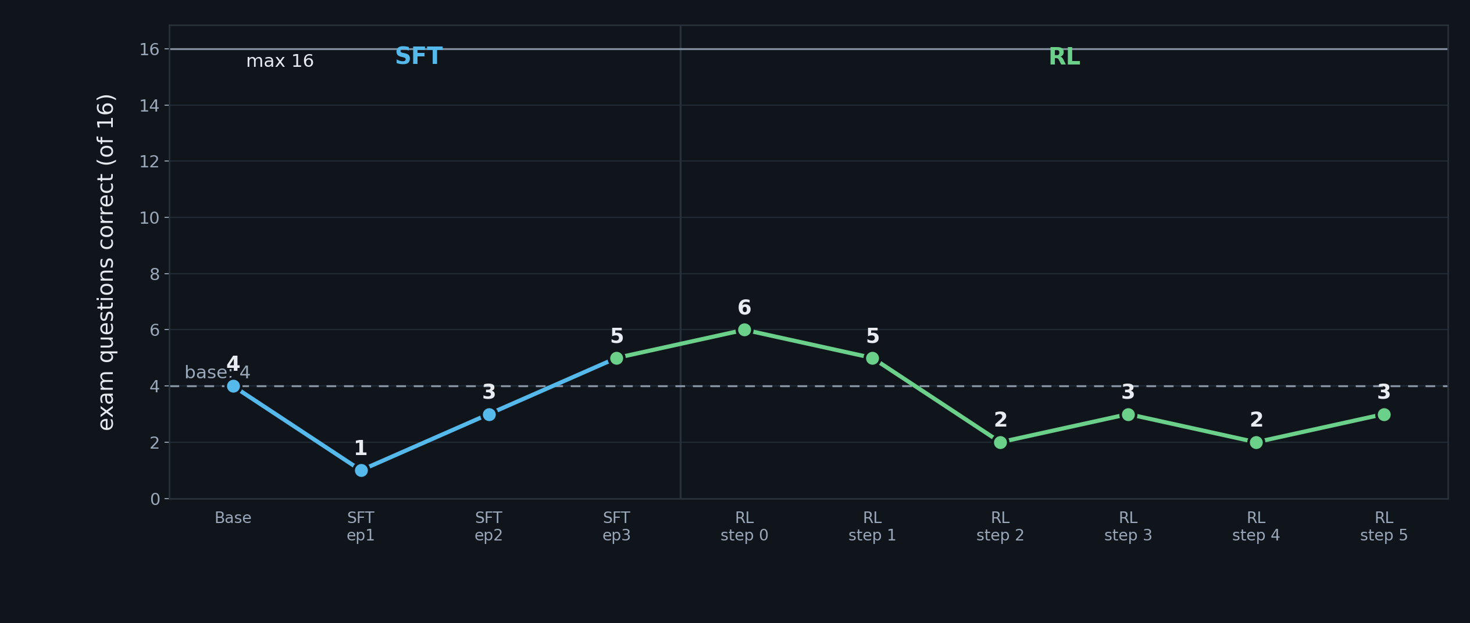
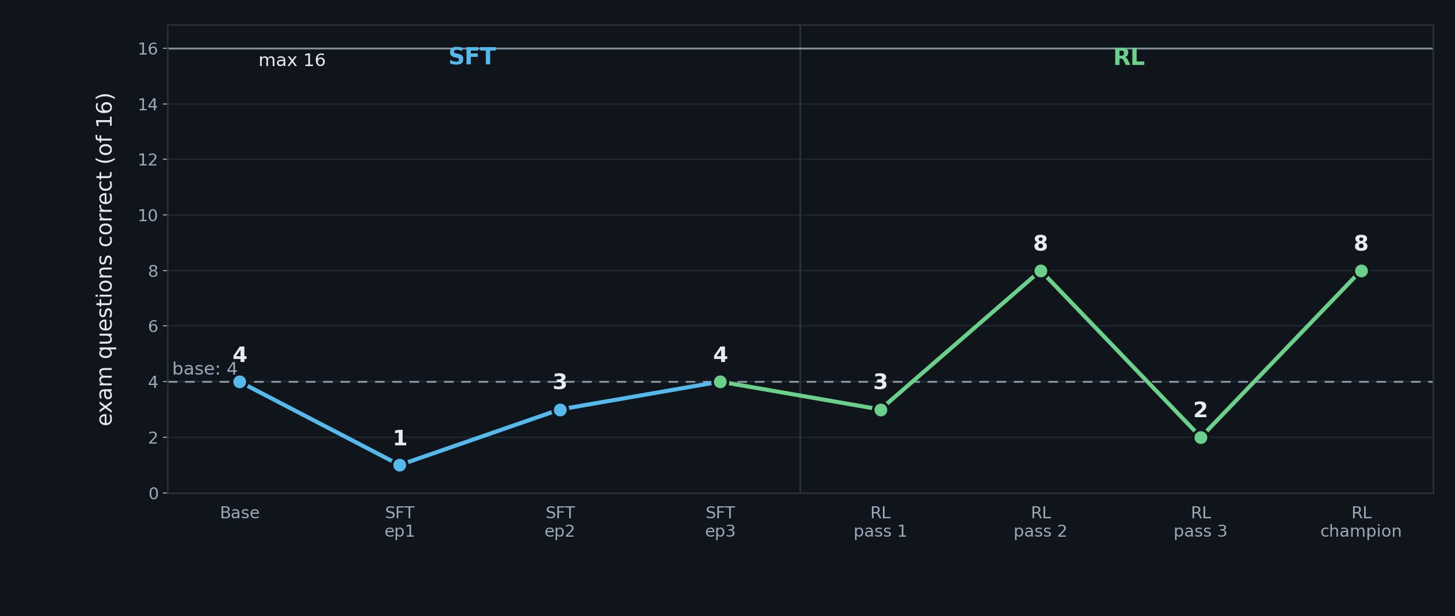
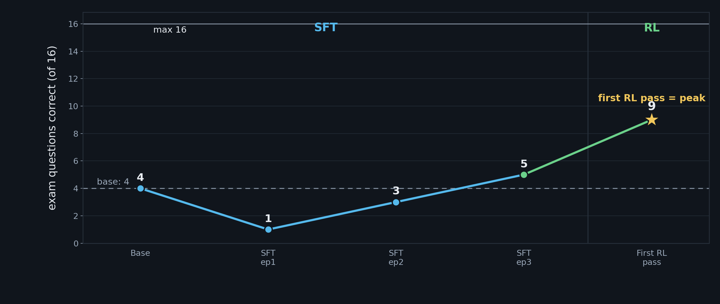
SFT scores, then RL steps
Notes:
THE LADDER IN ONE TABLE, every count with all 16 questions judged (2026-09-06 complete re-judge; earlier receipts left 1-5 questions unjudged and read up to 11 as floors over fewer questions). Sourcing, honestly: base 6 / full-param 9 / IPO 10 share ONE invocation (data/full16_verdict.json); SFT 8 and chain 8 come from the pipeline invocation (data/pipeline_curve_full16.json), where base read 7. The champion's 10 replicated in a third complete receipt. Read the ladder as: endpoint-over-base (+3 to +5) is robust; each RUNG is ~1 question on an instrument whose repeat-judge swing is 2-3, so the rung ordering is consistent direction, not measured effect size. · Relationship between rungs: ReLoRA and full-param MGPO are the same objective at different capacity (adapter merges vs full weights); IPO is NOT an RL pass — it replaced the SECOND pass, which declined in six independent lineages. MGPO is not dropped: the champion IS one MGPO pass (scale_rewards='none'), IPO is the polish on top. IPO = identity preference optimization (Azar et al. 2023): DPO-family offline pairwise loss, regularized toward a fixed preference margin so 24 pairs cannot overfit — no rollouts, no reward model, no collapse risk, 5 minutes on the same 16 GB card.

Slide 8
The cost of finding the peak
run component | amount
RL prompts | 7 (drawn from a pool of 238)
answers sampled per prompt | 4
generation cap | 160 tokens
one full RL run | ≈ 74 min
0.8B model. Checkpoint evaluation is part of the method, not cleanup.
Notes:
Read the ratio, not just the endpoint: sixteen measured dead ends for one working path. That is what a real search looks like, and the dead ends are the transferable part — anyone repeating this can skip them. · The ReLoRA chain is no longer on the recipe: it was the route to 8 at adapter capacity, and the full-param pass + offline IPO superseded it (the ReLoRA slide keeps the insight). · Honest caveats carried from the rest of the deck: n=16, so this is DIRECTION not effect size; the replay-buffer component was never ablated; the IPO step reads +1 over plain full-param RL on the complete instrument (10 vs 9, same invocation) — consistent direction, size at the floor of what 16 questions can resolve.

Slide 9
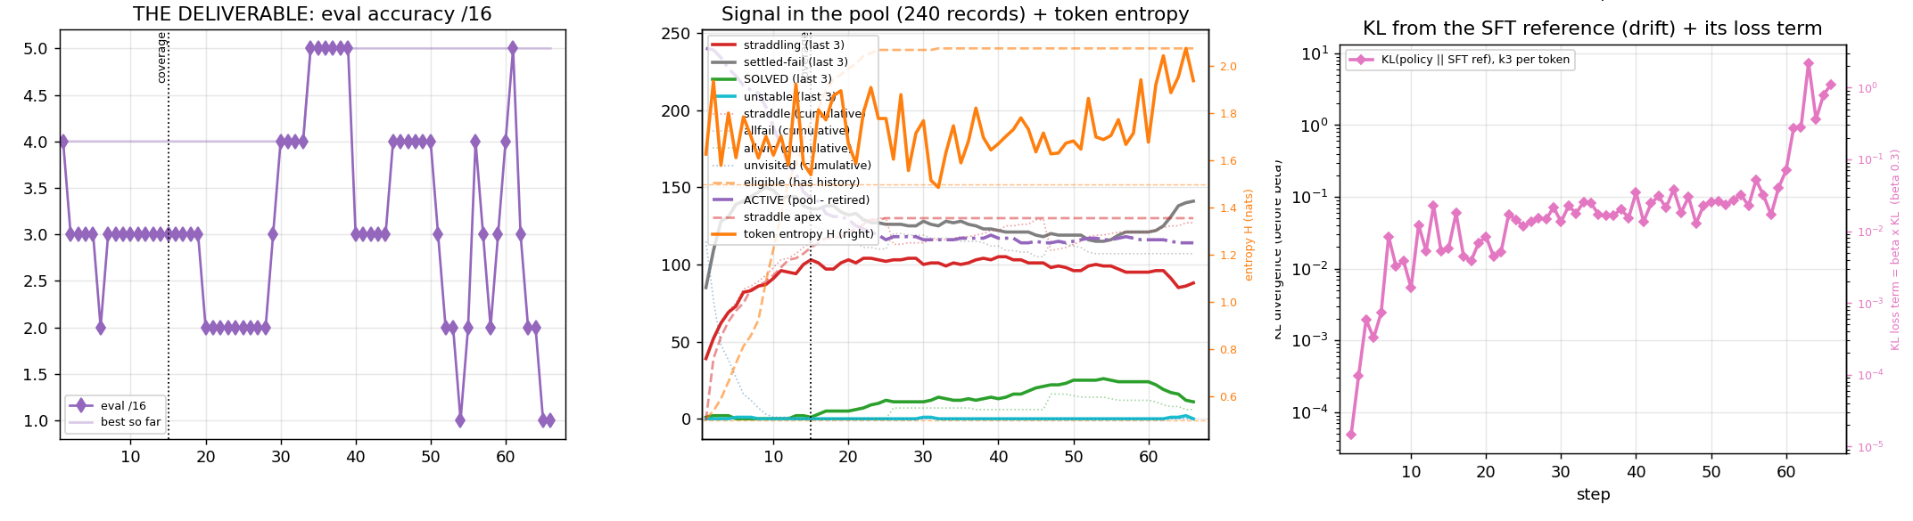
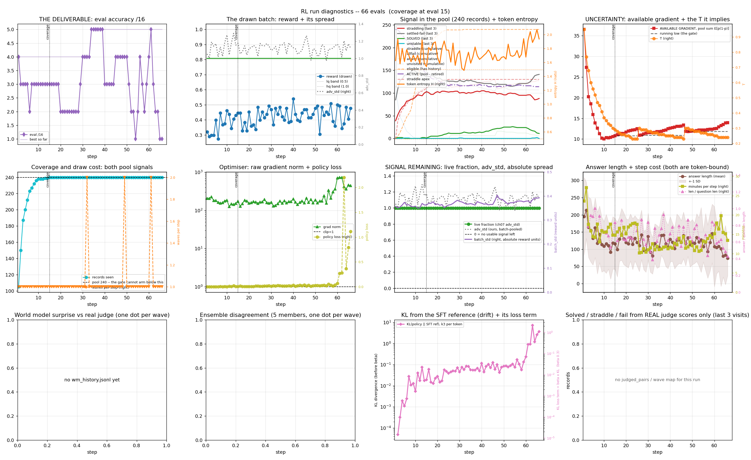
The 60-step run: no sustained gain, on either reading
Plotted (eval wrapper): start 4, best 5, final 1 of 16. Run log: best 5 is within the +-1 same-checkpoint wobble.
Re-scored under the training prompt, 7 checkpoints: 2, 3, 5, 4, 3, 3, 3. Peak at step 46, then given back. One greedy read each; the wobble under this instrument is not measured.
KL runaway at steps 61 to 63 (raw KL 0.23 to 7.3). Straddling records held near 100 of 240; solved peaked at 25.
Run rl_lr3e6 (lr 3e-6, KL beta 0.3, 240-record pool). Plot = eval wrapper. Source: docs/run-logs/rl_lr3e6.md; docs/dispositions.md, 2026-09-25 re-score; trainer docs/grpo_one_file.py.
Notes:
Two instruments on the same checkpoints. The eval wrapper (hand-built prompt) is what the plot shows; the training prompt (the model's own chat template) is what training used. dispositions.md lines ~1329-1349 measured the mismatch after this run collapsed: blank answers on 6 to 9 of 16 under the wrapper, 0 under the training prompt. Under the training prompt this run read 2 to 5 by step 46, then lost it. Neither reading is a sustained gain. Single greedy read per checkpoint, same-checkpoint wobble not measured, so the 2 to 5 is a finding to confirm, not a verdict. Trainer: docs/grpo_one_file.py.

Slide 10
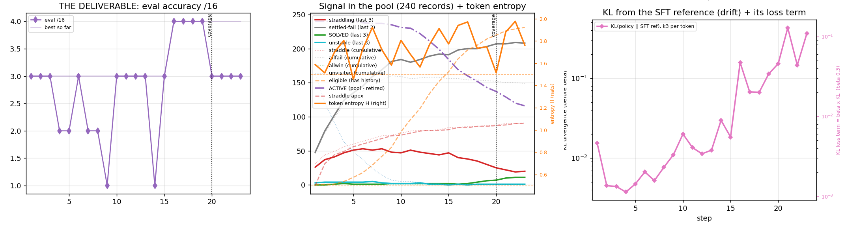
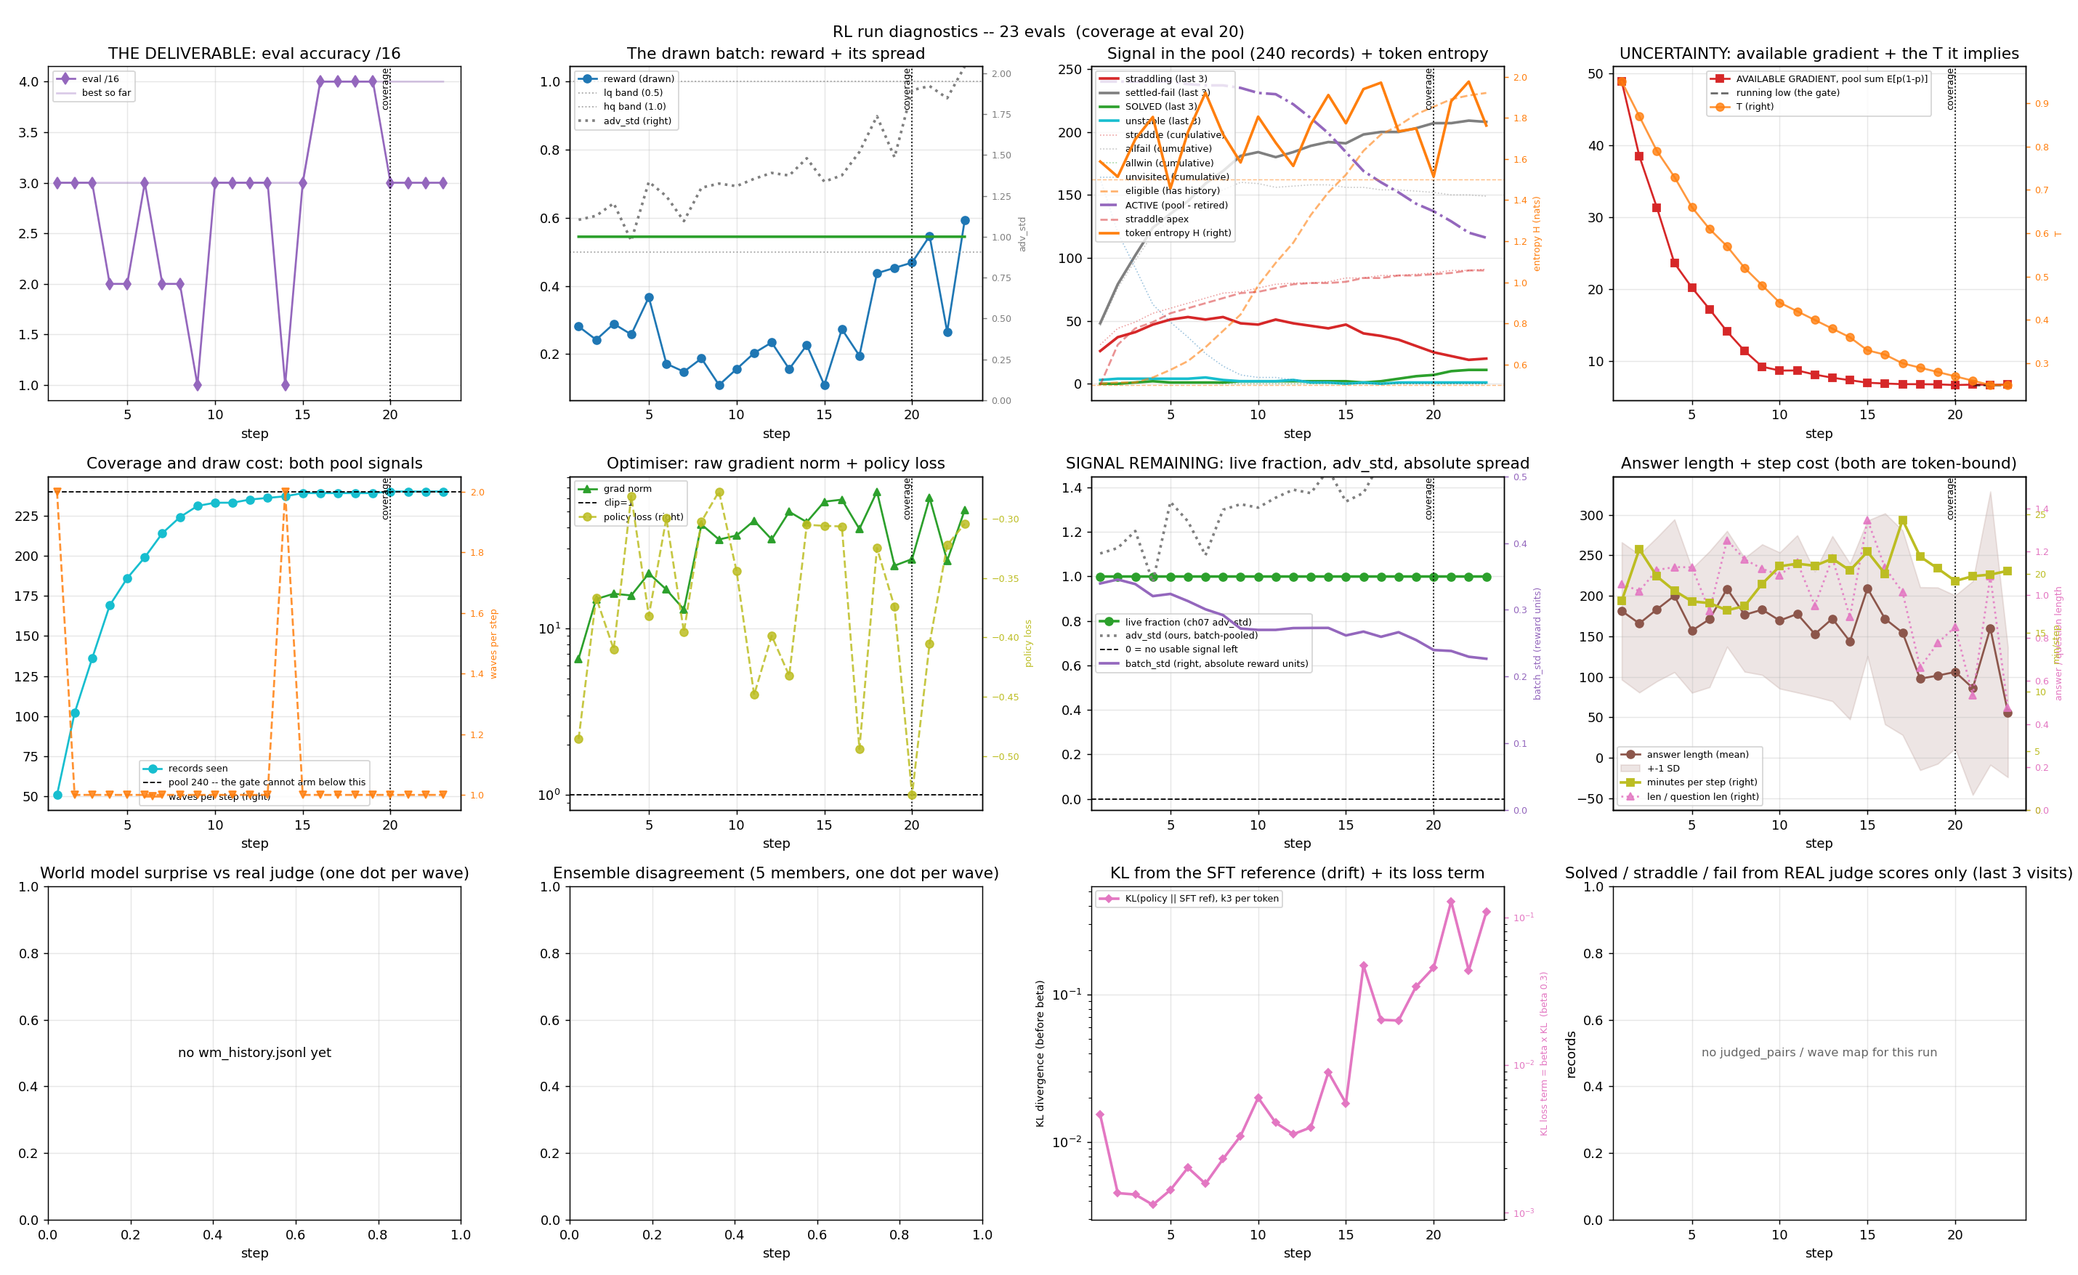
Replay sampler, 2 inner epochs: missed its own bar
Eval of 16 under the training prompt: start 2, best 4. Pre-set bar was 5 by step 23 (46 updates). Missed.
Replayed answers drifted off-policy: 12 of 28 masked at step 13, 22 of 32 at step 23. KL abort at step 24 (raw KL 0.858 > 0.5).
Not faster either: about 8 minutes per update against about 9. Do not compare this 4 with the 5 on the previous slide: different prompt.
Run rl_replay2, eval under the TRAINING prompt (a different instrument from the previous slide). Source: docs/dispositions.md, 'rl_replay2' (2026-09-25 to 09-26); trainer docs/grpo_one_file.py.
Notes:
Pre-registered bar, same instrument as rl_lr3e6b: greedy eval under the training prompt >= 5/16 from a deposit of 2/16 by the step with 46 optimizer updates (step 23 at 2 inner epochs). Result 3/16 at the bar, best 4/16. The replay half goes stale within the 5-step window (mean |log-ratio| 0.23 to 0.77). Census caveat: a visit here is two fresh answers, so solved/straddle/fail counts are not comparable with non-replay runs. Weights deleted per the RL-weights-are-disposable rule; configs, logs, metrics.json and judged pairs kept.

Slide 11
What the long runs say about scale
What we saw
240 training records: every record had been drawn by step 15 to 20.
16 evaluation questions: one question is 6 points; the standard error of a score at n = 16 is about 12.5 points.
Two long runs, two mechanisms, and no gain that held on either prompt.
What follows
Eval: seeing a 5-point difference at 80% power takes about 1,570 questions per arm (computed: 2.8^2 x 2 x 0.25 / 0.05^2).
Training records: about 32,000 is the author's estimate, not derived. It holds if the pool, not the method, was the limit (all 240 drawn by step 20); if the gain per record is tiny, it does not.
At 240 records and 16 questions the question is not testable. Not tested at larger scale.
Same-seed wobble: an unchanged model read 6/16 and 7/16 (docs/SETTLED.md). 1,570 is computed on this slide. 32,000 is the author's estimate, not derived.
Notes:
Computation: two-proportion test, p = 0.5, alpha 0.05 two-sided (z 1.96), power 80% (z 0.84), detect 0.05: n per arm = (1.96+0.84)^2 * 2 * 0.25 / 0.05^2 = 1568. Standard error of a proportion at n = 16, p = 0.5: sqrt(0.25/16) = 0.125. The three readings of the null in the README (mis-specified but not applied; scale; wrong tool) remain open; this slide supports only the eval-size half of the scale reading.

Slide 12
Takeaway
Pretraining gives broad capability, not organization-specific domain data.
Full-parameter SFT: 4 → 5 of 16.
First RL pass: 9 of 16.
Later RL passes degraded.
Longer RL runs (60 steps; replay sampler) never beat 9 and never held a gain.
Next: about 32,000 records and a larger evaluation (more compute); at 240 records and 16 questions the problem cannot be tested.
Notes:
Ordered by cost-to-value. Items 1 and 2 close honesty gaps in claims already made, so they come before anything that spends GPU hours. Full-parameter RL moved OFF this list on 2026-09-02 (its pass 2 is one of the two winners at 8/16 on the locked board); IPO iteration is NOT on the list — the polish read 0 to -1 across three lanes under the locked grader. Receipts, per-trial ledgers and checkpoints are in the repo; every number traces to a JSON file.

