Slide 1
LAB NOTEBOOK · QWEN3.5-0.8B · DECISION TREES AND ENSEMBLES
Can reinforcement learning put knowledge into a model's weights?
Hypotheses, settings, tests, and the premises that survived. Then what I did for the chess agent.
Grounded in RL theory (docs/INSPIRATIONS.md) · results from dispositions.md (Sep 2026) · chess from the chess-deep-q campaign
Notes:
Opening. The project asked whether a 0.8B model can hold new domain knowledge in its weights, and whether reinforcement learning can put it there. This notebook logs each experiment as hypothesis, settings, method, result, verdict. Every number traces to a file that was kept: dispositions.md, the per-run metrics.json and judged-answer logs, the scoring receipts in data/, and docs/INSPIRATIONS.md for the theory each experiment was grounded in. The last section covers the chess agent in C:\Users\user\Documents\dev\chess-deep-q.

Slide 2
THE RESULT TO EXPLAIN
One null result, three readings
RL raised the score on its training records: solved records went from near 0 to 57 of 240 in the best run. It never raised the score on unseen questions.
READING 1
Mis-specified, not applied
The design was sound. The experiment as run did not implement it: a wrong eval prompt, a constant reward, an exploitable judge.
READING 2
Scale
The design was sound and applied. 240 records and a 16-question eval are too small, against around 30,000.
READING 3
Wrong tool
RL sharpens what the model already half-produces. Putting new knowledge into the weights is SFT's job.
The notebook tests what each reading predicts. They are compared side by side near the end.
Notes:
Readings 1 to 3 are your three conclusions, stated as rival hypotheses so each can be tested against evidence. The figure of around 30,000 for reading 2 is the scale you named (240 against 30k); I have not verified what that number refers to. Solved 0 to 57 of 240 is the run that crossed (archive/rl_full_resume_broken_0921): solved 0 at step 1, 57 at step 29, from the per-step metrics.json.

Slide 3
METHOD
How to read an entry
EACH ENTRY HAS FIVE PARTS
1. Hypothesis: the claim, in one sentence
2. Settings: what was held and what was varied
3. Method: what was measured, and how
4. Result: the numbers
5. Verdict: supported, falsified, or not tested
THREE VERDICTS, NEVER TWO
SUPPORTED
survived a test that could have falsified it
FALSIFIED
a test that should have confirmed it did not
NOT TESTED
blocked or invalid. Not a loss, and never reported as "nothing worked"
A number that would read the same under the rival reading is not evidence for either. Each verdict names the observation that would have come out differently.
Source: the epistemic format in CLAUDE.md; verdict rule in SETTLED.md
Notes:
This is the reading key. The verdict rule comes from SETTLED.md ("NOT TESTED is a third verdict. A blocked or invalid run is never a loss") and the discriminating-evidence rule in CLAUDE.md. the RL theory concepts use the same shape for their own questions: Candidate hypotheses, Discriminating evidence, Premises as triplets, Syllogism (docs/INSPIRATIONS.md).

Slide 4
DESIGN
The experiment as designed
QUESTION
Can a 0.8B model hold new knowledge in its weights? Domain: decision trees and ensembles.
DATA
748 questions from 79 text chunks, after a similarity filter. Split: 12 rubric examples, 16 eval, and 240 each for CPT, SFT and RL. The eval is never trained on.
PIPELINE
Continued pre-training, then supervised fine-tuning (SFT), then RL: 4 sampled answers per question, compared within the group.
JUDGE
A model applies a written rubric to each answer; correct means 0.70 or more. Later swapped for Jev, a small yes/no model.
REWARD
Pays only when correct. Quality is a multiplier gated by correctness, so a wrong answer earns nothing at any quality.
FRAMING FROM RL THEORY
One question is one episode with one payout from the judge: a contextual bandit. Each next token is a state step: an MDP.
Source: instructions.md section 1.6, SETTLED.md · concept: MDP Formulation Checklist
Notes:
Numbers: 16 skills on decision trees and ensembles, 79 chunks, 748 questions that passed a correlation filter (reject any candidate with cosine similarity of 0.80 or more to a kept question; Math 230, Code 179, Instruction 172, STEM 167). CORRECTED 2026-10-02: an earlier version said 240 kept; 240 is the size of each phase set. Partition (src/partition_r3_pools.py): 12 rubric examples, 16 eval, 240 CPT, 240 SFT, 240 RL, with no spare. The 16 eval questions are frozen and never trained on. From 2026-09-27 the RL runs held out a further 40 records (200 train, 40 held out, stratified by category, seed 7). The reward bands are 0 / 0.5 / 1 by judge score, gated by correctness (SETTLED.md). Framing: concepts MDP Formulation Checklist, Dynamic System vs Environment Wrapper, State vs Observation. The 10-minute talk (docs/RL_V2_talk_10min.pptx, slides 5 to 9) states the same framing.

Slide 5
METHOD · THE DATA
How the 748 questions were made, filtered and split
Stage | What it does | Measured
Chunk | Source skill notes packed on paragraph boundaries toward a target length | target 458 tokens; 79 chunks, 16 skills
Generate and gate | A 9B model writes questions per chunk in four categories; any candidate within cosine 0.80 of a kept question is rejected | 748 kept: math 230, code 179, instruction 172, STEM 167
Partition the 748 | Rubric examples 12, eval 16, then three equal phase sets of 240 for CPT, SFT and RL; no overlap, checked on id, text and cosine | 12 + 16 + 3 x 240 = 748, no spare
Split the RL set | Stratified by category, seed 7; records whose gold repeats the question were dropped | 197 train, 40 held out (3 dropped)
HPO screens | Small subsets of a phase set, for ranking settings only | 60 records per screen
MEASURED
Each phase trains on its own 240; none sees the eval or the rubric examples. The gate saturated: at 147 items, 36% sat at 0.78 or above. Splitting chunks finer (24 to 42) did not help; widening from 3 to 17 skills, and asking four categories per chunk, did.
Source: src/build_pools_r3.py (COSINE_MAX), src/chunk_more_trees.py, src/split_chunks_finer.py · instructions.md 1.6
Notes:
CORRECTED 2026-10-02: an earlier version of this slide and the design slide said 748 candidates and 240 kept. That was wrong. The pool is 748 questions that passed the gate, and 240 is the size of each of three phase sets (src/partition_r3_pools.py docstring: 748 - 12 rubric - 16 eval = 720 = 240 x 3, zero spare; data/rl/pools_r3.jsonl has 748 rows, r3_rubric.jsonl 12, r3_eval.jsonl 16, r3_cpt/r3_sft/r3_rl.jsonl 240 each). The count of candidates rejected by the gate is not recorded here. HPO screens: data/rl/r3_screen_*.jsonl, 60 rows each. No separate replay-buffer holdout partition was found; the 40 held-out records are carved from the RL set, and the replay text in CPT is the RedPajama 10% mix (instructions.md 6.4). Numbers: 79 chunks and 16 skills come from instructions.md 1.6 and SETTLED.md. Chunk target 458 tokens: TARGET_TOKENS in src/chunk_more_trees.py, set to match the median packed chunk in the base file. The 0.80 gate: COSINE_MAX in src/build_pools_r3.py. Saturation figures (147 items, 36% at 0.78 or above, the last twelve at 0.798 to 0.800, 24 to 42 chunks did not help, 3 to 17 skills widened on 2026-08-26) are comments in the TARGET_SKILLS block of build_pools_r3.py and the docstring of split_chunks_finer.py. Four categories multiply usable items per chunk: R3_CATEGORIES in build_pools_r3.py. 197 train and 40 held out: commit 5264d4c ("197-record RL split without gold==question records") and the transfer run entries in dispositions.md; the design slide's notes say 200 and 40, the file counts are 197 and 40. Not recorded here: the exact per-skill quotas of the final 240; the count of records per category differs between the 237 rows in the RL files (math 71, code 58, instruction 55, STEM 53) and the candidate counts above, because filtering was not uniform.

Slide 6
METHOD · ONE TRAINING STEP
How a step is built, and how generation is batched
CHOOSING THE RECORD
• Draw by spread: records whose answers disagree are likelier
• Round 1 takes one record per category
• Sample 4 answers per record, then judge them
• All 4 agree: no gradient, so draw again (up to 40 times)
• A record is retired after 3 looks with no spread
• A record trains at most 3 times (counted by gradient exposure)
BATCHING THE GENERATION
• Many answers share one generate call, capped at 32 sequences
• Also capped at 7,168 tokens, so short records batch wider
• Halved automatically if the GPU runs out of memory
• Each answer's length budget is its gold's length plus 42 tokens
• Every generation has a 90-second deadline
WHY
A uniform group has advantage 0 and gradient norm 0.0 (measured), so a step on it trains on nothing. The cap exists because 112 of 197 records never produced a mixed group.
Source: docs/grpo_one_file.py DEFAULTS and under_visit_cap · dispositions.md (visit cap entries, 09-27 to 09-29)
Notes:
All values are the trainer's defaults in docs/grpo_one_file.py: grad_accum 1 record per optimizer step, num_rollouts 4, max_draw_attempts 40, retire_after 3, boltzmann True (spread-weighted draw), stratify_domains True, gen_batch 32, gen_tokens 16 x (288 + 160) = 7,168, length_slack 42 with min_completion 24, gen_timeout_s 90. The gen_batch default of 8 mentioned in a nearby comment is stale; the value is 32. The operator asked for batched generation on 2026-09-19 after seeing one-at-a-time rollouts. The visit cap counts gradient exposures, not judged draws: commit 64c53d9 and dispositions.md. The 112 of 197 figure is from the capfix probe in dispositions.md. A given run's flags can override these defaults; the launcher files in .tmp/ hold the exact values per run and are not reproduced here.

Slide 7
METHOD · WHAT THE REWARD SEES
What is checked before Jev, and what Jev is shown
Check, in order | Rule | Measured
Empty | No answer scores 0 | an LLM judge once paid for silence
Echo guard | Answer opens with the question's first 6 words: 0 | 0 of 56 eval and held-out golds open that way
Numeric gate | Short answer with a number: its last number must equal the gold's | bare "1" paid on 40 of 60 golds, now 5
Content word | Prose must share a content word with the gold | cost: 15% of 9B-right answers zeroed
Jev | Sees the question, the gold, one answer; no rubric. Reward 1 if p(yes) is 0.5 or more | agrees with the 9B judge on 105 of 150
NOT TESTED
Proposed fix: pull the gold's claims as whole sentences (subject, predicate, object), keep the entailed ones, and score the share an answer entails. It must pass three tests first: the gold passes its own claims; it beats 105 of 150 against the 9B labels; stubs earn 0.
Source: src/reward.py (_jev_gate, _jev_p_yes), src/judge.py (echoes_question) · tools/rlvr_premises.py · dispositions.md 09-26 and 09-27
Notes:
Jev's prompt (src/reward.py, _jev_p_yes) sends a JSON context of question, reference_answer and candidate_answer, then "Is the candidate answer correct according to the reference answer? Answer Yes or No." The probability is a fixed linear head on the last-token state (jev_head.json). The server context is 1,024 tokens; one long gold overflowed it once. No rubric is shown: the trainer's startup line reads rubric=none. The earlier 9B and 4B judges applied the written rubric (data/synthetic_domain_rubric.md) and produced the 0, 0.5, 1 bands. Gate sizing: 17,740 9B-labelled answers plus 1,632 from the collapsed run; numeric gate keeps 368 of 434 right bare numbers and passes 39 of 547 wrong ones; content-word cost 672 of 4,381 (15%). Echo guard: 0 of 16 eval and 0 of 40 held-out golds open with their question; 3 of 240 training golds do, a data defect. The proposal is the operator's idea of 2026-10-02, built on tools/rlvr_premises.py, which already extracts triplets with spaCy OpenIE and keeps the entailed ones with an LLM; only 8 of 240 rows of the key file were ever built, and the one record inspected had empty claims and self_entailment fields. A natural-language-inference model (cross-encoder/nli-deberta-v3-small, already listed in the extractor) is a better judge of support than Jev, whose head was fit to a different question; this is an inference, not a measurement. The RL lane is closed, so this matters if it is reopened or for scoring the SFT path.

Slide 8
METHOD · SETTINGS
The RL trainer's default settings
LEARNING
• Learning rate 1e-5, constant
• KL penalty beta 0.3, per-token estimator
• Clip range 0.2; gradient clip 1.0
• Log-probability summed over the answer
• Full parameters, not an adapter
GENERATION
• 4 answers per record
• Temperature 0.9, top-p 0.9 for rollouts
• Eval is greedy; thinking switched off
• Prompt up to 288 tokens, answer up to 160
• Seed 7
MEMORY AND EVAL
• Optimizer state can live on the CPU
• Reference model can be offloaded
• Judge on a remote small GPU
• Eval: 16 questions, 8 answers each
• Same-seed wobble: about one question
Source: docs/grpo_one_file.py DEFAULTS and argument list · dispositions.md · each run's launcher holds its own overrides
Notes:
Defaults from docs/grpo_one_file.py: lr 1e-5, lr_schedule constant, beta 0.3 (note in the file: DeepSeek-R1 uses 0.02, which scored 8 of 15 here), kl_estimator k3, clip_eps 0.2 (0.28 scored 4 of 15 here), grad_clip 1.0, logprob_norm sum (measured gradient norm 137 against a clip of 1.0), num_rollouts 4, temperature 0.9, top_p 0.9, max_prompt 288, max_completion 160, seed 7. Thinking off: enable_thinking False plus suppress_tokens. Memory flags: --optim-cpu, --ref-offload, --vram-cap. Judge: JUDGE_REMOTE=1. Eval: 16 questions at 8 answers (score_arms --k 8); the same-seed wobble of 6 of 16 against 7 of 16 on the same untrained base is in the memory notes and dispositions. The base checkpoint, the exact lr and the beta of each run differ by run (the crossing run used a different recipe); those are on the crossing and transfer slides and in each .tmp launcher, which this slide does not reproduce. Not recorded here: the GPU model name and the VRAM of the judge host beyond what the trainer's flags imply.

Slide 9
GROUNDING
RL-theory concepts and where each landed
RL-theory concept | What I built | Where it landed
Policy gradient without a critic | GRPO: group of 4, minus the mean | core of every run
Boltzmann exploration, optimistic start | Draw by uncertainty; unseen first | kept (entry 8)
Replay buffer: decorrelate and reuse | Flashcard priority; reuse of answers | lost (entry 9)
Target network: a slow, stable target | KL anchor to the SFT checkpoint | a leash (entry 6)
Deadly triad: off-policy + approximation | Stale replayed answers, 0.8B network | KL runaway (entry 9)
Learned model of the world (Dyna) | Ensemble predicting the judge | falsified (entry 10)
Reward modeling | Jev, a small yes/no judge | needs a guard (entry 11)
Reward shaping | Bands gated by correctness | 87% paid zero (entry 5)
Source: docs/INSPIRATIONS.md · dispositions.md · each mapping is an analogy until its entry tests it
Notes:
Concepts used, in order of the rows: Policy Gradients / Actor-Critic; Exploration vs Exploitation, Boltzmann / Softmax Exploration, Optimistic Initialization in Bandits; Replay Buffer (decorrelating updates, reusing old experience); Target Networks (the online network is updated fast, the target slowly); The Deadly Triad (bootstrapping, off-policy data, function approximation); Model-Free vs Model-Based and Nonlinear Learned Dynamics; Inverse RL / Reward Modeling; Reward Shaping and PBRS. Two cautions. First, GRPO has no bootstrapping and no value network, so the deadly triad applies only in part: it is the off-policy and approximation corners (replayed answers on a 0.8B network), not the bootstrap. Second, a mapping like replay buffer to flashcard priority is an analogy, and an analogy is a hypothesis; entries 6 to 11 test the ones that matter.

Slide 10
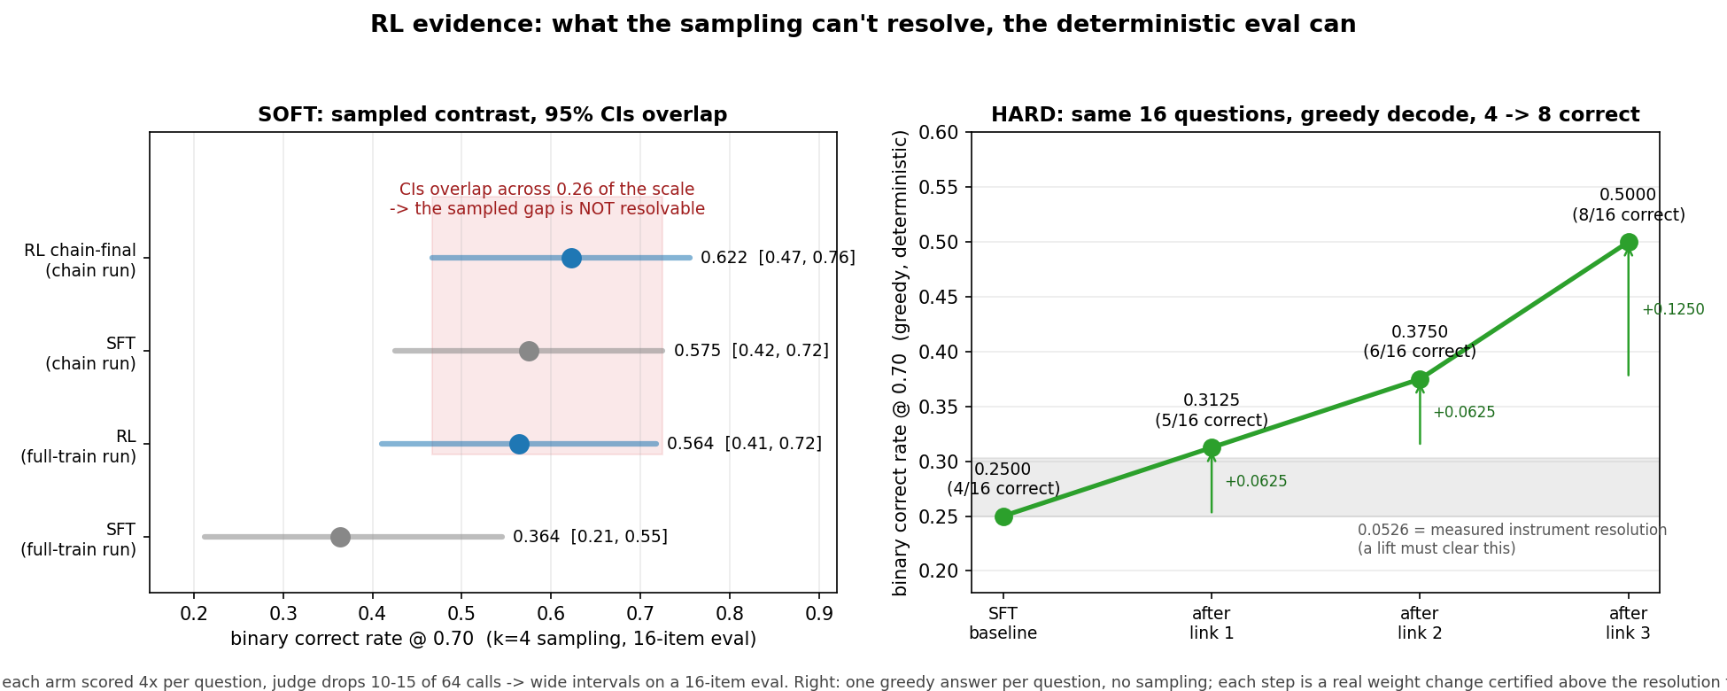
INSTRUMENT
What a 16-question eval can resolve
6/16, then 7/16
same checkpoint, same seed, no training in between
+3, +3, −3
the same two checkpoints, ordered across three runs of the instrument
Earlier recipe. Sampled gaps overlap (left); one greedy answer per question clears the instrument floor of 0.0526 (right).
32/128 = 0.250
the SFT start with 8 answers per question (95% interval 0.172 to 0.328); the standard from Sep 26
So: read shapes across steps, and trust a comparison only when both sides were scored in one invocation.
Source: dispositions.md (SIGNAL / NOISE, sweep verdict) · docs/rl_evidence_ci_vs_chain.png
Notes:
The figure is from the earlier lane (judge qwen3.5-9b, greedy decode): the sampled contrast is unresolvable at 16 items with judge drops, while one greedy answer per question certifies each step above the 0.0526 resolution. The three facts at right: (1) "Identical config+seed opened 6, 6, 3 on consecutive runs"; same-seed same-base no-training read 6/16 and 7/16 (memory note: seed alone is not determinism). (2) NOISE item 1 in dispositions.md: the same two checkpoints read +3, +3, then −3 across three same-instrument invocations. (3) From the sweep verdict of 2026-09-27: 16 questions × 8 answers at temperature 0.8 gives 128 judged answers per arm; the book2 epoch-2 start re-scored 32/128 = 0.250 [0.172, 0.328] in every invocation. Same-invocation scoring is the rule because cross-receipt comparisons drifted.

Slide 11
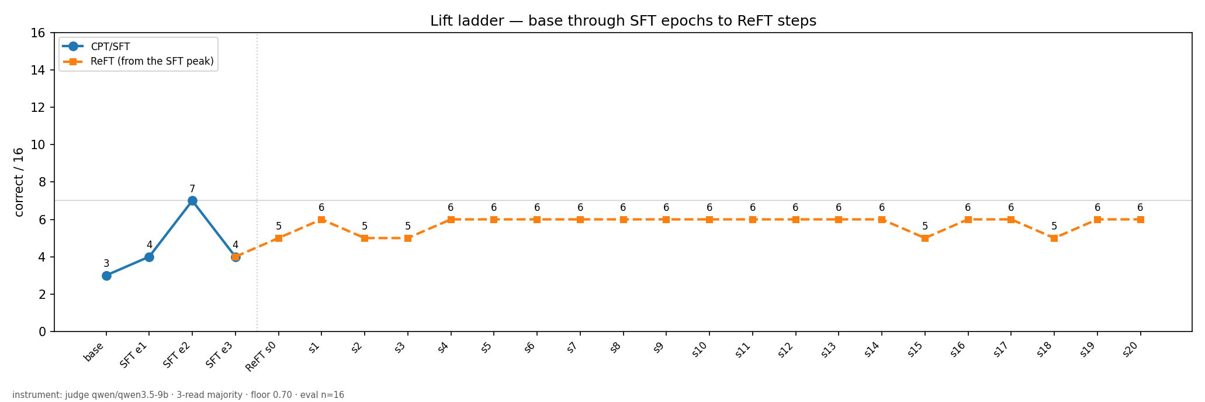
ENTRY 1 · SUPERVISED FINE-TUNING
SFT: depositing the knowledge
HYPOTHESIS
Full-parameter SFT on the 240-question pool raises accuracy on questions the model never trained on.
RESULT
SETTINGS AND METHOD
Qwen3.5-0.8B, full-parameter SFT with attention frozen, 3 epochs. The same 16 held-out questions after every epoch; 3 judge reads, majority vote.
Left of the dotted line: base and SFT epochs. Right: ReFT, an RL-style fine-tune run afterwards, never above 6.
SUPPORTED
SFT took the model from 3 to 7 of 16 at epoch 2; epoch 3 fell back to 4. A swing that size is near the noise floor, so read the shape, not the epoch.
Source: docs/lift_chart.png · judge qwen3.5-9b, 3-read majority, floor 0.70, n=16
Notes:
Instrument for this figure: judge qwen3.5-9b, 3-read majority, floor 0.70, eval n=16 (printed at the bottom of docs/lift_chart.png). Other instruments in the campaign read the same checkpoints differently (the 10-minute talk shows 16/59, 10/58, 21/59, 25/59 sampled-correct counts for base and epochs 1 to 3), which is why every comparison is made within one invocation. The epoch-1 dip is partly an artifact: that checkpoint returned an empty string on 11 of 16 questions (talk slide 12), because one epoch of completion-only loss taught it to emit the stop token first. SFT is FFN-only with attention frozen (SETTLED.md). ReFT here is the RL-style fine-tune run from the SFT checkpoint.

Slide 12
ENTRY 2 · WHERE THE KNOWLEDGE IS WRITTEN
Adapters versus full-parameter SFT
HYPOTHESIS
A deposit written into a LoRA adapter can be sharpened by RL, as a full-parameter deposit can.
RESULT
Route | After SFT | After RL
Continue the same adapter into RL (3 learning rates) | 0.442 | 0.257 to 0.265
Merge the adapter, then RL with a fresh one | 0.442 | 0.170 to 0.378
Full-parameter SFT, then RL with a fresh adapter | 0.420 | 0.452
SETTINGS AND METHOD
LoRA SFT (rank 16, 200 records, 3 epochs), then RL: continue the same adapter, or merge it and start fresh. Score: macro-F1 before and after.
Macro-F1 on the early answer-or-abstain lane. Learning rates tried for the first route: 3e-5, 1e-5, 5e-6.
FALSIFIED
Every adapter route lost 0.06 to 0.27 under RL, at every learning rate tried. Only the full-parameter deposit was kept (+0.03).
Source: dispositions.md, "LoRA Chain Approaches: ALL FALSIFIED" and "Proven Path"
Notes:
From dispositions.md. Continue-adapter trials: lr 3e-5 / 1e-5 / 5e-6 gave macro-F1 0.257 / 0.259 / 0.265 against an SFT of 0.442. Cause recorded: lr-independent; GRPO on-policy rollouts destabilize the SFT adapter weights at any step size, and f1_answer collapses while f1_abstain holds. Merge-then-RL: 0.170 (alpha mismatch 32 to 64), 0.378 (alpha matched, 62-record SFT), 0.288 (alpha matched, merged full). Proven path: full-parameter SFT lr 1e-5, 200 records, 3 epochs gave 0.420; a fresh zero-initialized LoRA RL on top gave 0.452 (+0.032). Caveat: the 10-minute talk (slide 14) prints 0.548 for the last cell; dispositions.md is the primary record and says 0.452, so I use that and flag the discrepancy. This lane ran before the abstention machinery was dropped (r3 lane: no abstention), so the metric is the early macro-F1, not the 16-question count. Per SETTLED.md, adapters for knowledge injection are falsified and not to be reopened.

Slide 13
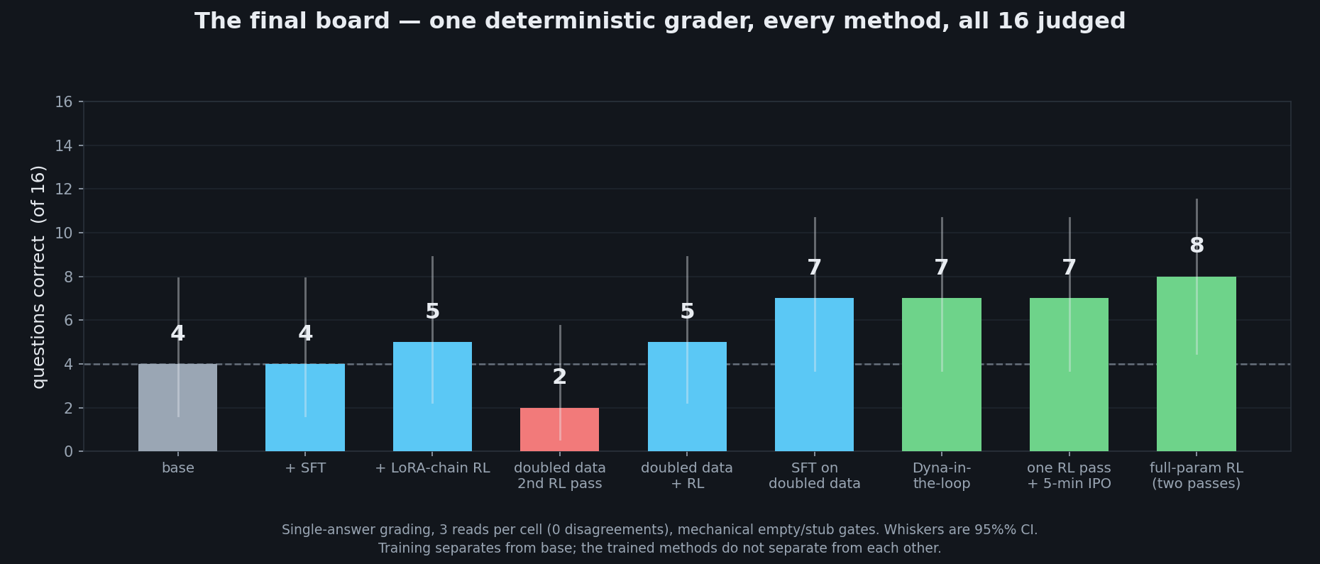
ENTRY 3 · ON-POLICY RL
Repeated RL passes
HYPOTHESIS
A second on-policy RL pass on an already-improved model keeps adding correct answers.
RESULT
SETTINGS AND METHOD
GRPO on the full-parameter SFT deposit: one pass, second passes, a LoRA chain, in-loop updates, a 5-minute offline preference polish. One grader, same 16 questions.
Whiskers are 95% intervals. The one bar below base is a second RL pass.
FALSIFIED
Second passes ended flat or below their start in six separate lineages. Training separates from base; the trained methods do not separate from each other.
Source: docs/final_board.png · dispositions.md, "SIGNAL" item 2
Notes:
The bar chart (docs/final_board.png) uses one deterministic grader with 3 reads per cell and mechanical empty and stub gates; its own caption says training separates from base and the trained methods do not separate from each other. The six second-pass lineages in dispositions.md: full-parameter pass 3, LoRA chain 3, v2chain (and its honest rerun), x3chain, flip pass 2, r1a pass 2. In the extended pass set (2026-09-02 to 09-06) the best receipts reached 10 to 11 of 16 with one full-parameter MGPO pass plus 5 minutes of offline preference training, but the same notes record that single-receipt orderings flipped sign (+3, +3, then −3), so the final ranking is a tendency, not a measurement. The 10-minute talk calls this the sharpening budget: one pass.

Slide 14
ENTRY 4 · WHAT GIVES RL A GRADIENT
The SFT thesis: half-known records
HYPOTHESIS
RL can only sharpen what the model sometimes gets right. How many records are half-known matters more than accuracy.
RESULT
10% → 38%
of records split right and wrong: base versus SFT epoch 2, same records, same judge
50% vs 42%
mixed rate, epoch 3 versus epoch 2 (24 records, so about two records apart)
SETTINGS AND METHOD
24 RL-pool records, 4 answers each, the same for every checkpoint. Mixed means some right, some wrong. Four alike give gradient 0.0.
5 vs 7
of 16 on the eval, epoch 3 versus epoch 2: the two criteria disagree
SUPPORTED
The mechanism: a group of four identical results gives zero gradient (run and checked).
FALSIFIED
As a recipe: RL from the mixed-rate pick gave no lift in the next three runs; 112 of 197 records still never split.
Source: dispositions.md, "THE SFT THESIS" and "SFT checkpoint MEASURED" (09-14), Sep 28 runs
Notes:
Stated falsifier, written before the later runs: "Select a checkpoint with materially higher straddle rate, run RL from it under an already-screened config, and get nothing. Then spectrum is not the binding constraint and the thesis is wrong." Evidence on the two halves. Mechanism: a group whose rollouts agree has advantage [0,0,0,0], loss −0.0, grad norm 0.0, verified by execution. Spectrum measured on 2026-09-14: live rate 10% for base versus 38% for SFT epoch 2 (n=20 and n=16, arms not matched on record count, not a locked receipt). Epoch comparison (24 records, K=4, same records and order): straddle epoch 3 50%, epoch 1 42%, epoch 2 42%; eval epoch 3 5/16, epoch 2 7/16. Later: the SFT pick under Jev was again made on straddle, and RL from it (three arm-B runs, the last on the fixed trainer) moved nothing; in the last run 112 of 197 records never produced a mixed group. This reading is partly my inference: the three runs had their own defects (cap and echo), so I treat the recipe claim as falsified for this model and pool, not for the idea. "Straddle" in the source files is what the slide calls mixed.

Slide 15
ENTRY 5 · REWARD SHAPING
The banded reward and a constant signal
HYPOTHESIS
Gating quality by correctness (bands 0, 0.5, 1) gives RL a usable learning signal.
RESULT
86.9%
of 1,752 judged answers paid exactly 0.0 under the bands (1,522 answers)
4.6× → 6.4×
judged groups per filled slot as training ran: 73 up to 103 draws for 16 slots
SETTINGS AND METHOD
Count reward values over 1,752 judged answers from the campaign's own runs. Compare judged groups per filled slot, banded versus raw score.
2.0×
with the raw judge score, same seed and base: 32 draws for 16 slots
FALSIFIED
Seven answers in eight paid the same reward, so most groups had no gradient. The raw score removed the waste; it did not produce lift (entry 12).
Source: dispositions.md, "The reward was a constant for 87% of rollouts" (2026-09-22)
Notes:
Counts: band 0.0 had 1,522 answers (86.9%), band 0.5 had 67 (3.8%), band 1.0 had 163 (9.3%). Sampling 47 groups directly, 78.7% were all-zero under banding and 0% under the raw score; rollouts carrying any signal went from 14 to 158 of 188. The step lines had printed draws 73/16 (4.6x), 87/16 (5.4x), 103/16 (6.4x) banded against 32/16 (2.0x) raw. Why it hid: the "dead" counter was computed only over accepted groups, so it read 0 while four groups in five were judged and discarded; the honest line was "[reward] group is uniform -- zero gradient from this prompt". Cost of the fix: raw score pays a plausible-but-wrong answer something; the mitigation is that the advantage is reward minus group mean, so a 0.45 among 0.9s still earns a negative advantage. Related finding the same week: the 0.70 floor collapsed 36 of 40 sampled rollouts to zero. Concept grounding: Reward Shaping and PBRS (potential-based shaping preserves the optimal policy; a banded reward does not claim to).

Slide 16
ENTRY 6 · TARGET NETWORK
The KL penalty and stability
HYPOTHESIS
Penalizing distance from the SFT checkpoint (KL beta) keeps RL stable long enough for the reward to teach.
RESULT
KL beta | LR | What happened
0 or 0.001 | 1e-5 | blew up at step 19 (the 0.001 run also had the world model on)
0.3 | 1e-5 | stable to step 32; raw KL 0.01 → 0.61, then 2.94
0.3 | 3e-6 | stable to step 60; runaway at 61 to 63, raw KL 0.23 → 7.3
0.02, other form | 1e-5 | the crossing run: no runaway in 30 steps
SETTINGS AND METHOD
Same pool and judge. KL beta 0, 0.001, 0.3 and 0.02; learning rate 1e-5 and 3e-6. Watch raw KL, entropy and the answer text each step.
SUPPORTED
KL is the leash. A 3× smaller step delayed the runaway, it did not prevent it; the one stable run that read higher (2 → 5 of 16 by step 46) gave it back.
Source: dispositions.md: rl_nowm, rl_k, rl_kl03, rl_lr3e6 (09-23 to 09-25); crossing-run correction 3 · figure: slide 32
Notes:
Details. rl_nowm (beta 0, world model off): entropy blew up at step 19 (H 1.61 → 2.94 → 3.67), 14 of 16 eval answers ran past budget with no stop token, foreign-script tokens appeared in rollouts; held-out best 6/16 at step 13, 0 to 2 for the last 20 steps. rl_k (beta 0.001, world model on): lost at step 19. rl_kl03 (beta 0.3, k3, lr 1e-5): kl_raw climbed 0.01 → 0.61 over 32 steps, then 2.94 at step 33; solved peaked at 28. rl_lr3e6 (beta 0.3, lr 3e-6): stable 60 steps, raw KL 0.23 at step 60, then 0.9 and 7.3 at steps 61 and 63; both runaways began with grad norm doubling for two steps and then raw KL multiplying by 4 in one step. Crossing run (the only one that crossed): beta 0.02, k1 estimator, priority-weighted, lr 1e-5, temperature 0.8, mean log-prob; the playbook's earlier note that it used 0.3 was wrong (correction 3, 2026-09-25). Concept grounding: Target Networks (a slow-moving target stops the learner chasing its own predictions). The KL anchor is pinned to the SFT checkpoint, which is the slowest-moving target possible. A KL form (k1 versus k3) is the lead suspect for why the crossing run did not run away; never isolated.

Slide 17
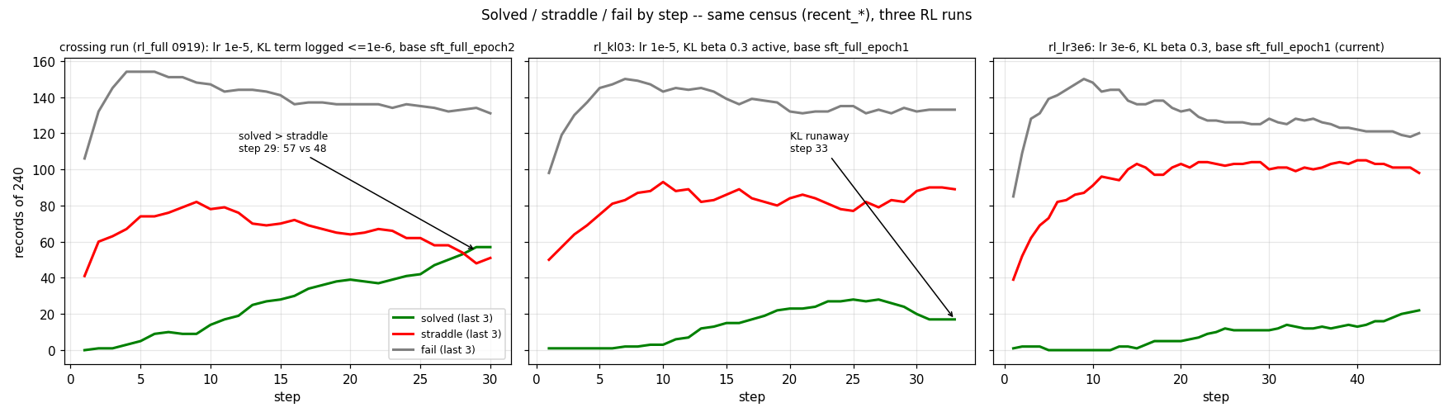
ENTRY 7 · THE SHAPE OF A GOOD RUN
The one run where solved passed mixed
Records of 240 by step: green solved, red mixed, gray all-wrong (last 3 visits). Left to right: three runs.
NOT TESTED
At step 29 solved passed mixed (57 vs 48) but never all-wrong (57 vs 131). Which of five differing settings made it cross was never isolated.
Source: docs/rl_shapes_solved_straddle_fail.png · dispositions.md, "Which run crossed" (09-25), corrections 1 to 3
Notes:
Crossing run (archive/rl_full_resume_broken_0921; log rl_full 0919): lr 1e-5, KL beta 0.02 with the k1 estimator and priority weighting, temperature 0.8, mean log-probability, 50 rounds, base sft_arms/sft_full_epoch2 (the SFT full run from HPO arm 3: lr 5.82e-6, warmup 0.2, grad-norm 0.5, label smoothing 0.05). Solved 0 at step 1, 14 at step 10, 28 at step 15, 39 at step 20, 57 at step 29; mixed 41, 78, 70, 64, 48; all-wrong 106, 147, 141, 136, 134. The drop to 9 solved at step 33 was a broken resume, not training (dispositions.md). It differed from rl_kl03 in five settings at once: base, KL beta and estimator, temperature (0.8 vs 0.9), log-prob normalization (mean vs sum), and rounds (50 vs 100). Candidate causes named but never separated: the base checkpoint, and the KL form. The other two panels: rl_kl03 (solved peak 28, KL runaway at step 33) and rl_lr3e6 (solved climbs to about 25 by step 50; runaway at steps 61 to 63). Solved never exceeded all-wrong in any run.

Slide 18
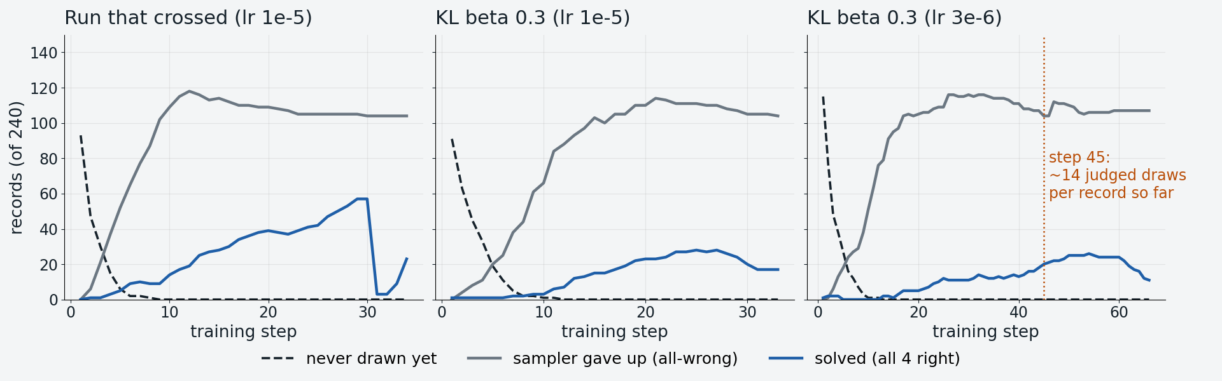
ENTRY 8 · EXPLORATION
Data visits and exhausted records
Hypothesis: the plateau near step 45 means the data visits were used up. The KL runaway at steps 61 to 63 is a second cause I cannot separate.
SUPPORTED, IN PART
Not unseen data: every record was drawn by step 10. About 105 to 115 of 240 are all-wrong and give no gradient; the rest were reused until gains stopped.
Source: W:/phase_runs/*/metrics.json (kept) · fields unvisited, retired_fail, recent_pass, candidates
Notes:
How the figure was built: for the three long runs (the crossing run, rl_kl03, rl_lr3e6) it plots the per-step metrics: records never yet drawn (unvisited), records the sampler retired as all-wrong (retired_fail), and solved (recent_pass, last three visits). Findings. (1) Coverage was complete by step 10 to 15 in every run (unvisited reaches 0), so unseen data was not the limit. (2) The all-wrong count the sampler gave up on was 104, 105 and 116 of 240 at step 30, and 104 at step 45 in rl_lr3e6. (3) Cumulative judged draws (the candidates field summed over steps) were about 3,350 by step 45 in rl_lr3e6, around 14 judged draws per record; accepted gradient exposures were far fewer (16 records per step, 720 by step 45, about 3 per record on average). So "visits" has two meanings, and the answer depends on which: judged draws were heavily reused; gradient exposures about 3 per record overall and more on the learnable half. Rival: the KL runaway at steps 61 to 63 ended the third run, and the crossing run's drop at step 31 was a broken resume. A later check agrees with the pattern: runs capped at 3 looks per record ended after 8 to 12 steps with gains on revisited records and none on first visits (entry 12), and under an exposure-counting cap 112 of 197 records still never produced a mixed group. What would settle it: a run on a pool large enough that the learnable half is not reused, tested against the same settings (see the tests slide).

Slide 19
ENTRY 9 · REPLAY BUFFER
Replay buffer variants
HYPOTHESIS
Reusing judged answers (a replay buffer) saves judge calls and keeps the gradient informative.
RESULT
Variant | Outcome
Keep only splitting prompts | dropped 2/6 to 4/6 per round; never ablated
Flashcard priority | in the best pass; replay-clock defect fixed
Reuse judged answers, clipped ratio | eval 3/16 at the bar (need 5); KL 0.86, aborted at step 24
SETTINGS AND METHOD
Three variants from the same SFT start. Pre-registered bar for the reuse variant: 5 of 16 by the step with 46 updates.
RL theory concepts: replay decorrelates consecutive steps. Here the 16 records per step are independent, so only reuse was left, and reused answers went stale within 5 steps (mean log-ratio 0.23 → 0.77).
FALSIFIED
Reusing judged answers missed its bar (3 of 16, needed 5) and hit the KL abort at step 24.
NOT TESTED
The split-only filter fired hard but was never switched off, so its effect is unknown.
Source: dispositions.md: "REPLAY SAMPLER" (09-24), "rl_replay2" (09-25 to 09-26) · talk slides 18 and 22 · figure: slide 33
Notes:
Variant 1 is the threshold-spanning filter from the 10-minute talk (slide 18): in round 2 keep a prompt only if its round-1 outcomes span the 0.70 floor. It fired (dropped 3/6, 4/6, 2/6 of round-2 prompts in three rounds) but no filter-off arm was run: a proven-looking claim that was demoted for lack of an ablation. Variant 2 is flashcard priority (Leitner 1972, prioritized replay Schaul 2015): one global score per prompt, the variance of Beta(1+wins, 1+losses), unseen records at maximum priority; it was in the winning pass of the earlier lane. Defects found in the sampler on 09-13/14: the replay clock counted rollouts, not visits, so retirement fired after one visit. Variant 3 (rl_replay2): fill 2 of 4 slots of a group from stored answers up to 5 steps old, weight their gradient by the PPO ratio and clip it, with 2 inner epochs. Receipt at the pre-registered step: eval 3/16 (bar 5/16, best 4/16); masked replays rose 12/28 at step 13 to 22/32 at step 23; mean absolute log-ratio 0.23 to 0.77; groups live only through replay 9 to 14 of 16; gave-up retirements 9 at step 10 to 119 at step 23; answer length 172 to 56; KL abort fired at step 24 (raw KL 0.858 above 0.5). Speed half of the thesis also lost: about 8 minutes per update, not half of 9. Grounding: RL theory concepts Replay Buffer (decorrelating, reusing) and The Deadly Triad (off-policy plus approximation). The deadly-triad reading of the drift is my inference.

Slide 20
ENTRY 10 · MODEL-BASED RL
A world model of the judge
HYPOTHESIS
A model trained on past verdicts can stand in for the judge on some answers and cut cost (Dyna: update from a learned model).
RESULT
0.028 vs 0.281
spread of a group's 4 answers: world model versus the real judge
94% vs 81%
visits scored all-wrong: modelled versus judged
SETTINGS AND METHOD
5-network ensemble predicts the verdict. Ask the real judge with probability min(1, D × spread ÷ median spread): disagreement means ask.
17 → 21 of 220
correct on the 220-item receipt after 13 steps; intervals overlap
FALSIFIED
As built: it learned how hard each question is, not which answer is better. GRPO learns from the ranking inside a group, so modelled groups came out uniform.
Source: dispositions.md: "WORLD-MODEL REWARD ROUTING, rl_k" and "rl_merged" (2026-09-23)
Notes:
Mechanism: the environment's only payout is the judge, so a model of the judge is the whole world model (talk slide 23). Built twice: an explicit ensemble predicting verdicts (prompt_world_model.py, 768 to 64 to 1 networks over text features, 5 members) and an implicit one (IPO, the policy's own likelihoods). Result table from rl_k, measured by splitting reward_history with judged_pairs.jsonl: scored by the judge, 367 visits were 3% pass, 16% mixed, 81% fail with mean spread 0.281; scored by the world model, 467 visits were 3%, 3%, 94% with mean spread 0.028. Consequences: modelled groups were uniform so zero GRPO gradient and deferred as dead (dead draws 33 to 53 per step); predictions entered reward_history so the counters were contaminated (judge-only mixed held 46 to 50 while the page read 36), and the sampler saw mixed records as settled-fail. rl_merged (13 steps, raw reward, world model from step 1): eval 3,3,2,2,2,3,2,2,3,1,3,1,1; locked 220-item receipt 17 correct (0.0773) for the SFT deposit versus 21 (0.0955) for the best checkpoint, intervals overlapping. Verdict as built; an Open-Jev-style calibrated reward head was named as the untested next candidate and later became Jev itself as the judge. Confounds in rl_k: KL, base checkpoint, banded versus raw reward, inner passes and grad clip all differed from the crossing run.

Slide 21
ENTRY 11 · REWARD MODELING
Jev as the judge
HYPOTHESIS
A small model asked "is the candidate correct given the reference?" can be the reward in place of the large judge.
RESULT
Probe | Measured
A bare "1" as the answer | scored correct on 40 of 60 golds; RL collapsed to 2-token answers
"1" after the numeric gate | paid on 5 of 60 (was 40)
Answers repeating the question | 5.7% → 49.4% of RL answers; Jev paid 67% of them
Jev scoring its own gold | rejected 19 of 253 golds (8%)
SETTINGS AND METHOD
Open-Jev-2B, served locally; the reference answer goes with every prompt; reward 1 if p(yes) is 0.5 or more. It agreed with the 9B judge on 105 of 150 answers.
FALSIFIED
As a drop-in reward: the echoes made the eval read 0.250 → 0.594; with the guard it read 0.039. Probe a judge with stubs, echoes and its own golds first.
Source: dispositions.md: "JUDGE CHANGE", "SWEEP60 ... pays a bare 1", "VERDICT: capped transfer run" (09-26 to 09-27)
Notes:
The aim stayed fixed throughout: distill Jev into the policy, even where Jev is imperfect, and scale up later (27B against the 2B judge). Guards therefore block exploits and never second-guess Jev's verdicts. Measured before adoption on 150 stored answers with the 9B verdicts as the yardstick: the three-level score form paid 28 of 50 9B-wrong answers as fully correct (rejected); the yes/no form at threshold 0.5 matched right-vs-wrong on 105 of 150 (0.70) and paid 6 of 50 wrong. Stub probe over the 60 sweep golds: "1" paid 40, "0" 20, "The answer is 1." 23, "I do not know." 0. Arm C' step 7 read a fake 12/16 with median 2 answer tokens. The numeric gate (short numeric answers correct only if the last number equals the gold's) cut "1" from 40 to 5 of 60. Echo: answers that open with the question's first six words; echo share rose 5.7% to 49.4% over the capped transfer run; step 13 read 76/128 (0.594) before the guard and 5/128 (0.039) after; held-out 110/320 became 21/320; the SFT start was unchanged by the guard (32/128, 79/320), so the guard does not touch real answers. Three training records had gold equal to the question, so echoing was literally rewarded there; they were dropped. Self-check of gold against itself: 16 of 197 train, 2 of 40 held-out, 1 of 16 eval golds are rejected by Jev (p(yes) below threshold with the gold as the candidate), so about 8% of records can never be paid even for a perfect answer. Grounding: RL theory concepts Inverse RL / Reward Modeling.

Slide 22
ENTRY 12 · GENERALIZATION
Transfer to unseen questions
HYPOTHESIS
Gains on training records carry over to unseen questions.
RESULT
+12 points
accuracy on revisited records by step 17, each against its own first visit
0.236 → 0.159
first-visit accuracy, first fifth of the run versus last fifth
SETTINGS AND METHOD
200 records trained, 40 held out; 3-visit cap; 8 answers per question; start and end scored in one invocation, echo guard on.
32 → 20 of 128
eval, best-solved weights versus the SFT start (held-out: 79 → 73 of 320)
FALSIFIED
RL learned the records it could already half-answer. None of it reached unseen questions, in the two scored runs with the echo guard and a visit cap.
Source: dispositions.md: "Arm B full run STOPPED at step 17", "SWEEP60 VERDICT", "rl_b_exposure best_solved" (09-27 to 09-28)
Notes:
Three pieces of evidence. (1) rl_full_b at step 17: same-record change +12.3 points (each revisited record's latest visit against its own first), 5.1 standard errors at step 12; first-visit accuracy by fifths of the run 0.236, 0.132, 0.144, 0.200, 0.159 while revisit accuracy rose 0.33 to 0.42. A rival not excluded: the sampler may draw easier records first. (2) Sweep of 8 steps on 60 records, held-out 16 questions x 8 answers: start 0.250; arm A (KL 0.02, k1) 0.109, its training-record solved +10 was memorisation; arm B (KL 0.3, k3) 0.242; arm C 0.188. Pre-registered outcome: no arm beats its start, so no full run from the sweep. (3) Final scoring of two runs on the fixed pipeline with the echo guard and a visit cap, SFT start and run scored in one invocation each: rl_b_echoguard final weights eval 26/128 (0.203), held-out 71/320 (0.222); rl_b_exposure best-solved weights (step 13, solved 9) eval 20/128 (0.156), held-out 73/320 (0.228), against starts of 32/128 (0.250) and 79/320 (0.247). Answers were read: no empties, 0 and 2 echoes (scored 0), typical answer shorter (median 32 to 25 words). Ceiling note from the sweep: 9 of 16 held-out questions were never solved at k=8 by any checkpoint, so RL could move at most 6 to 7 of 16. The first capped run's eval jump (0.250 to 0.594) was echoes; see the Jev entry.

Slide 23
EVIDENCE FOR READING 1
Defects in how the experiment was applied
Defect | How it was found | What it did
Eval prompt differed from the training prompt | blank answers on 6 to 9 of 16 under the eval wrapper, 0 under the training template | eval ceiling of 7 to 10 of 16 by construction
Reward constant for 87% of answers | counted 1,752 judged answers | 73 judged groups to fill 16 slots
Judge paid stubs and echoes | a bare "1" paid on 40 of 60 golds; echo share reached 49% | fake lifts of 12 of 16 and 0.594
Visit cap counted draws, not training | 114 of 197 records never produced a mixed group | runs ended at steps 8 and 12
PARTLY
Real, and each cost days. Six real fixes in a row (13 to 14 Sep) moved nothing, and the last runs with every fix in did not transfer. Defects alone do not explain the null.
Source: dispositions.md: "six mechanism fixes, zero lift", "THE EVAL PROMPT IS NOT THE TRAINING PROMPT", 09-22 and 09-28 entries
Notes:
The six fixes of 09-13/14, each a real defect found by reading logs and each leaving the 16-question eval unmoved: replay clock counted rollouts not visits; retirement read a decayed EMA that needs about 18 flat observations; EMA span was the run's step count; the remote judge paid a GPU offload tax (10.8 s to 4.5 s per judged group); rollout generations were invisible in the log; summed sequence log-probability scaled the gradient with answer length (mean versus sum: gnorm 211 to 13.8, a 15x drop, and no change in lift). Eval prompt: _evaluate_inner used the hand-built chat wrapper while training used the model's own template; blank answers were the model emitting the end token first: sft_book1e5 epoch 1 blank 6/16 against 0/16, sft_arms epoch 2 6/16 against 0/16, sft_book2 epoch 2 9/16 against 0/16. Re-scored under the training prompt, rl_lr3e6 read 2, 5, 4, 3, 3, 3 correct at steps 0, 46, 50, 55, 60, 66 (one greedy read each, the wobble not measured). Cap defect: the 3-visit cap counted every judged draw, so a run drew 485 groups to fill 128 gradient slots and ended at step 8 with 114 of 197 records never producing a mixed group; the exposure-counting fix (09-28) let the next run train on 85 records over 14 steps. Related: the world-model counters (see its entry).

Slide 24
SYNTHESIS
Which premises survived
Premise | Verdict | Evidence
SFT adds knowledge | Supported | 3 → 7 of 16 at epoch 2
CPT on the corpus adds knowledge | Falsified | no lift; base 7/160 vs CPT 2/160 correct
An adapter deposit survives RL | Falsified | lost 0.06 to 0.27 on every route
A second RL pass adds more | Falsified | flat or lower in six lineages
Uniform groups teach nothing | Supported | gradient norm 0.0, run and checked
A KL anchor is needed for stability | Supported | off or thin: blow-up at step 19
A world model can replace the judge | Falsified | it scored the question, not the answer
A small judge works unguarded | Falsified | paid stubs and echoes; rejected 8% of golds
Gains on training records transfer | Falsified | eval 32 → 20 of 128; held-out 79 → 73 of 320
RL transfers with a much larger pool | Not tested | never run beyond 240 records
Source: entries 1 to 12 · CPT row: instructions.md section 0.4k (the "destructive" reading is exaggerated; "no lift" stands)
Notes:
Reading the table. Eight of the ten premises have a verdict from a test that could have come out the other way; two that are listed Supported (uniform groups, KL anchor) are mechanisms, not claims about the end goal. CPT row: the head-to-head at k=8 gave base 7/160 correct against CPT-133 2/160; the judge was lenient and asymmetrically so (base 20 of 20 fluent, CPT 16 of 20 fluent with 4 degenerate), which inflates the base more, so the claim that CPT is actively destructive is exaggerated by an unknown amount while "CPT produces no lift" survives because a lenient judge cannot hide lift (instructions.md section 0.4k, 2026-08-28). The one row without a verdict is the one that decides between readings 2 and 3.

Slide 25
SYNTHESIS
The three readings against the evidence
1. Mis-specified
PREDICTS
Fixing the defects should move the held-out score.
FOR
Five real defects: eval prompt, constant reward, judge exploits, cap, counters.
AGAINST
Six fixes moved nothing; later runs with every fix in still did not transfer.
STATUS
Real, not sufficient.
2. Scale
PREDICTS
More records and a larger eval would show transfer.
FOR
112 of 197 records never split; 9 of 16 held-out questions never solved by any checkpoint; 16 questions resolve about one.
AGAINST
Nothing yet. It was never run at 30,000.
STATUS
Not tested. Next work item.
3. Wrong tool
PREDICTS
RL moves only what the model half-produces; SFT moves the rest.
FOR
Zero gradient on uniform groups; RL from base flat at 3/16 in three configs; mixed rate 10% → 38% only after SFT.
AGAINST
One-pass RL gains of +3 to +4 in the earlier lane, inside the noise band.
STATUS
Best supported, not proven.
Readings 2 and 3 can both be true. What separates them is the next slide.
Notes:
This is the synthesis the notebook is built to support. Reading 3 is the best supported because it is the only reading with a mechanism that was verified by execution (a uniform group has advantage zero and gradient norm 0.0) and with converging observations from independent experiments (RL from the base model flat at 3/16 across three configurations; mixed rate 10% to 38% only after SFT; every gain on training records and none on unseen ones). It is not proven: the earlier lane's one-pass RL gains (4 to 8, and 8 to 11 with a short offline step) point the other way, though the same notes show orderings that size flip sign across invocations. Reading 2 is not contradicted by anything, which is different from being supported: it was never run at 30,000 records (your figure) or on an eval larger than 16 questions. Reading 1 is real in every instance cited and still insufficient: the last runs, with the eval prompt, reward, judge guards and cap fixed, did not transfer. The chess project does not separate readings 2 and 3 either (see its contrast slide).

Slide 26
NEXT WORK
Tests that would separate the readings
TEST A · SCALE
The same SFT then RL on a pool 10 to 100 times larger, with a 200-plus question eval.
READING 2 IS RIGHT IF
held-out accuracy rises with pool size. Reading 3 is right if the gains stay on training records.
TEST B · WRONG TOOL
SFT alone for the same GPU-hours as SFT plus RL, scored on the same eval.
READING 3 IS RIGHT IF
SFT alone matches or beats SFT plus RL on held-out.
TEST C · APPLICATION
Rerun the crossing recipe exactly (its base, KL 0.02, k1) on the fixed trainer, with the guards.
READING 1 IS RIGHT IF
solved passes mixed again and the held-out score moves with it.
None of these is running: the RL lane was closed on 2026-09-29 and its weights deleted.
Notes:
Each test is written so that one reading predicts a different outcome from the other two. A: if more data lifts held-out accuracy, scale was the limit; if training-record gains grow while held-out stays flat, RL is sharpening, not injecting. B: a compute-matched SFT-only arm has never been run against SFT plus RL on the 40 held-out plus 16 eval. C: the crossing run (solved 57 against mixed 48 at step 29, from the sft_arms epoch-2 base with KL 0.02 k1) was never reproduced; reproducing it under the fixed trainer separates reading 1 from the rest. Arms A and C' of the 09-26 settings sweep also ran on the draw-counting cap and remain untested under the fixed trainer. The 30,000 in test A's neighbourhood is your scale figure. The RL weights and every checkpoint derived from the 0.8B model were deleted on 2026-09-29 on your instruction; configs, logs, metrics and scoring receipts remain.

Slide 27
LESSONS FOR THE LOG
Six lessons about running the experiment
Fix the instrument first
16 questions, and the same seed read 6/16 then 7/16. Now: 8 answers per question, one invocation per comparison.
Probe the judge before training on it
Stubs, echoes and its own golds. A bare "1" paid on 40 of 60 golds.
A moving number is a reason to read
Mean answer length fell 30% and I named a bug. The typical answer had not changed; the long tail was cut.
Three verdicts, not two
Won, lost, or not tested. A blocked run is never a loss.
Write the falsifier before the run
The mixed-rate thesis named its own falsifier; later runs met it. Five settings changed at once could not be attributed.
Count what trains, not what is drawn
A cap on draws ended runs with about half the records never trained on.
Source: SETTLED.md, dispositions.md (09-14, 09-26, 09-28), memory notes from the campaign
Notes:
Each lesson is paired with the measurement that taught it, in the format of the chess campaign's docs/LESSONS.md. (1) The instrument: dispositions.md NOISE items, SETTLED.md protocol. (2) Judge probes: the stub probe of 09-26 and the echo finding of 09-27. (3) The 30% drop: on 2026-09-28 mean answer tokens fell 194 to 136 and a validator stopped the run; reading the same questions at step 1 and step 12 showed the median answer going 26 to 24 words, and the share of answers over 45 words falling from 10% to 1.4%; the stop rule now reads the median. (4) Verdict rule: SETTLED.md. (5) Falsifier: the SFT thesis entry; the crossing run differed from the next run in five settings. (6) The cap: entry 12 and the defects slide.

Slide 28
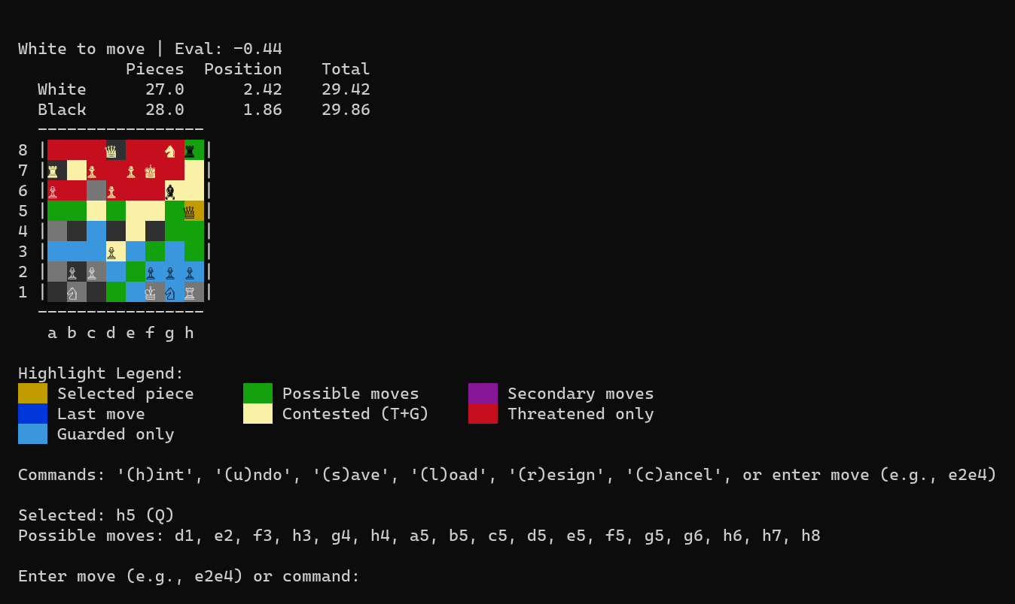
CHESS · WHAT I BUILT
A from-scratch agent trained on self-play
1878 Elo
against Stockfish, 95% interval 1756 to 2000; fitted over 50 games at depth 9 against anchors from 1500 to 2300
2 ply
the deepest search used anywhere in training; depth is spent only at play time
897 features
The agent's terminal view: squares colored by who attacks and guards them.
a linear evaluation: piece-square planes plus attack-coverage maps; search in Rust at about 2 million nodes per second
Source: chess-deep-q README.md, docs/LESSONS.md, spec/trivium.spec.md
Notes:
The professor asked what I did for the chess game in C:\Users\user\Documents\dev\chess-deep-q. Short version: a chess agent learned from pure self-play with no external engine labels, a linear evaluation over hand-built features, a native Rust alpha-beta search, and a recipe I called the trivium. The champion (models/champion.pt) is the amap-897 net: piece-square planes (769) plus attack-coverage maps. The README's measured strength is 1878 Elo with 95% interval 1756 to 2000 from a multi-anchor maximum-likelihood fit over 50 games at depth 9 against Stockfish anchors from 1500 to 2300; the earlier 1724 figure was the Wilson floor of a saturated single-anchor scout (the 1320 anchor saturates above about 1700). The Rust search gave about 2 million nodes per second, roughly 2000 times the Python beam, in about 450 lines (LESSONS.md lesson 10). The project began as a v1.0 terminal game with a DQN (the images/ folder holds the v1.0 to v1.5 screenshots) and became a research campaign. Everything ran on one GPU.

Slide 29
CHESS · THE RECIPE
Three targets, blended and annealed
THE TRAINING TARGET
target = a * lambda_return
+ b * search_value
+ c * outcome
Weights (a, b, c) run from 0.285, 0.341, 0.374 early to 0.516, 0.341, 0.143 late, on a schedule tuned by Optuna.
Trained at 2 ply, the same net measures 1484 (1434 to 1542) at depth 7 against Stockfish 1320.
Λ-RETURN REPLACES DEPTH
RL theory concepts: TD(λ) and eligibility traces. The bootstrap engages because n = 10 is below a game's 40 to 80 moves.
A 2-PLY SEARCH KEEPS TARGETS SOUND
TD-Leaf: the bootstrap is a deep, sound search value rather than the raw network's guess.
THE OUTCOME ANCHORS, THEN FADES
Game result steadies early learning and anneals away as the other two take over.
SUPPORTED
Tested one variable at a time against a faithful baseline: annealed 1237 vs un-annealed 1166 at matched depth; a static equal blend ignites then fades.
Source: chess-deep-q spec/trivium.spec.md, docs/INSPIRATIONS.md
Notes:
The recipe, from spec/trivium.spec.md: G = a lambda-return + b search-value + c outcome, weights annealed on an Optuna-tuned schedule (about 21 trials), 809 donor features whitened with ZCA, TD-Leaf(lambda) generation at depth 2 with lambda 0.7, gamma 1.0, online SGD and the RAMP blunder filter, and parallel self-play with epsilon 0.1. Evidence per ingredient (single-variable, replicate-first): trivium anneal gave 1237 against 1166 un-annealed at matched depth, and a static one-third each blend ignites then fades (falsified); ZCA matched the faithful arm on about a quarter of the games; depth-2 sound targets matched depth 4 at half the clock; 15,000 self-play games produced the 1484 net and a restart reproduced its peak in 8,000. The chess RL theory concepts (docs/INSPIRATIONS.md in that repo, titled RL theory and this repo) square the theory against what was built: it is an n-step actor-critic with TD-Leaf targets, not Monte Carlo or GRPO; the n-less-than-T rule means bootstrapping engages because n = 10 is below game length; with a sparse terminal reward gamma acts as the back-cast operator and the target is bootstrap-dominated; and rollout (on-policy, fill, few updates, clear) differs from replay (persistent, random reuse), which was the deferred Q-learning lane. The 1484 figure is on a different scale from the later 1878: see the next slide.

Slide 30
CHESS · THE CAMPAIGN
What failed, and what worked
Tried | Result | What it taught
Stockfish distillation; AlphaZero-style from scratch | both lost to a 1-ply heuristic | pod-scale compute is not available on one GPU
RL-tuned linear eval on self-play outcomes | 585 Elo worse than hand-tuned | hand tuning already sat at the linear ceiling
λ sweep: 0, 0.5, 0.9, 1.0 | best at 0.9, about +50 Elo | the bias-variance middle was real
Distilled NNUE, then material coverage | 808 → 1144 Elo (+362) | data coverage, not tuning
Self-play on a distilled eval | −58 → −301 vs the hand eval | self-play eroded it; distillation beat it
KnightCap reconstruction with deep quiescence | 948 → 1212 Elo (+264) | elimination proved the load-bearing part
Elo: rows 1 to 5 against the hand-tuned eval, row 6 against Stockfish 1320. Compare within a row only.
Notes:
From docs/RL_FINDINGS.md (codas 1 to 8) and docs/LESSONS.md. Row 1: distillation about 1040 and loses; self-play at depth 1 flat and loses; off-policy bootstrap weak; A2C with sampled beam 0 of 20; the AlphaStar-style PUCT hybrid reached parity (16 of 16 draws) with the 1-ply heuristic. Row 2: linear value fit converged cleanly (mean squared error 0.78 to 0.12) but played 585 Elo worse, 0 of 30: the best value function for a better policy is not the one that minimizes value error. Row 3: lambda 0.0 about 909, 0.5 about 1126, 0.9 about 1191, 1.0 about 1126, an interior peak. Row 4: v1 NNUE 808; 156k enriched balanced positions 782; 469k with material coverage 1144; queen-up read +380 before and +671 after. Row 5: the DA2C loop's distilled net went from d2 −58 / d3 −191 to d2 −301 / d3 −301. Row 6: LESSONS lesson 17: the one remaining deviation from the KnightCap recipe, full-width deep quiescence search, delivered +264 Elo (948 to 1212, 95% interval 1109 to 1300) on an untrained eval and the first confirmed training crowns. The campaign plateaued near 880 to 950 for weeks before that. Later: the amap attack-coverage features, the campaign's first confirmed feature win (+51 and +72 Elo across two seeds), produced the champion (floor 1724, re-measured 1878). Campaign law recorded in future_exploration.md: representation beats algorithm: features 3 for 3 confirmed, mechanisms 0 for 7.

Slide 31
CHESS AGAINST THE LANGUAGE MODEL
Two environments, one method discipline
Dimension | Chess | Language-model RL
Reward | game outcome: exact and free | a judge model: noisy, exploitable
Experience | 2 million nodes per second; a peak in 15,000 games, reproduced in 8,000 | 16 records per step; minutes per step
Pool | self-play makes new positions | 240 records; 112 of 197 never split
Measurement | Elo with intervals; 50 to 200 games per claim | 16 questions; wobble of about one
INFERRED
The discipline worked where the environment pays exactly and cheaply. Chess shows RL learns from outcomes when experience is abundant; it does not separate reading 2 from reading 3.
Source: chess-deep-q spec/trivium.spec.md, docs/LESSONS.md · dispositions.md · the verdict row is my inference
Notes:
Why the verdict is marked inferred: nothing here was tested as a contrast. Chess and the language-model task differ in several variables at once (reward exactness, experience per hour, task type: learning a value function from outcomes versus injecting facts), so the comparison cannot attribute the difference to one of them. What it does show is that the method discipline (single-variable arms, pre-registered falsification, replicate before inventing, confirm crowns before believing them) was enough to find real effects when the reward was exact and experience cheap. Chess lessons that carried over: a universal failure across independent arms points at a shared target defect, not a knob (here: the shared judge and eval defects); never decide on samples that carry no new information (the 16-question eval); match the comparator's experiment shape, not just its totals (games times target quality); and the load-bearing component gets proven, not argued. Numbers: spec/trivium.spec.md (15,000-game peak; restart reproduced it in 8,000 games) and LESSONS lesson 10 (2 million nodes per second).

Slide 32
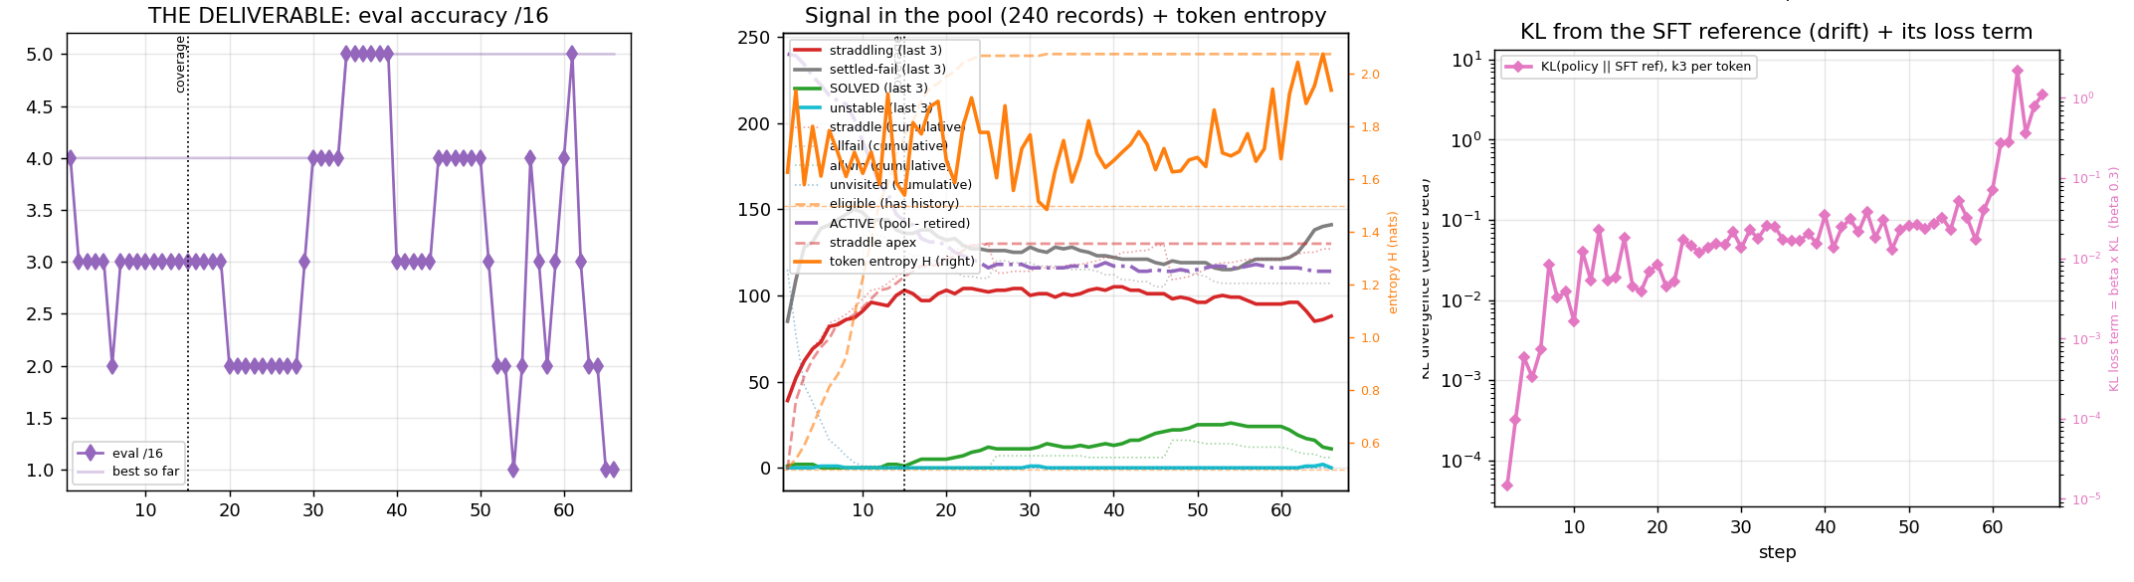
APPENDIX · THE 60-STEP RUN
rl_lr3e6: eval, pool signal and KL, per step
Left to right: eval of 16 (eval wrapper, not the training prompt), records by outcome out of 240, KL from the SFT reference.
LOST
Eval wrapper: start 4, best 5, final 1. Training-prompt re-score: 2, 3, 5, 4, 3, 3, 3 over seven checkpoints. KL runaway at steps 61 to 63.
Source: docs/run-logs/rl_lr3e6.md · docs/dispositions.md, 2026-09-25 re-score · full 12-panel plot: docs/figures/rl_lr3e6_diagnostics_66evals.png
Notes:
Run rl_lr3e6, lr 3e-6, KL beta 0.3 k3, 240-record pool, resumed in place at steps 25 and 46. The plotted eval used the hand-built wrapper; dispositions.md measured the mismatch with the training prompt after the run collapsed. Best 5 is within the +-1 same-checkpoint wobble per the run log. Trainer: docs/grpo_one_file.py.

Slide 33
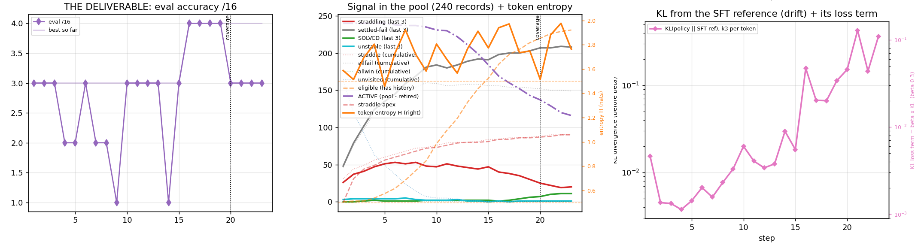
APPENDIX · THE REPLAY SAMPLER
rl_replay2: eval, pool signal and KL, per step
Eval of 16 (training prompt; not comparable with the previous slide), records by outcome out of 240, KL from the SFT reference.
FALSIFIED
Start 2, best 4, bar 5 missed at step 23. Replayed answers drifted off-policy; KL abort fired at step 24 (raw KL 0.858).
Source: docs/dispositions.md, 'rl_replay2' (09-25 to 09-26) · full 12-panel plot: docs/figures/rl_replay2_diagnostics_23evals.png
Notes:
Pre-registered bar: greedy eval under the training prompt >= 5/16 by the step with 46 optimizer updates. Result 3/16 at the bar, best 4/16. Census caveat: a visit here is two fresh answers, so the solved/straddle/fail counts are not comparable with non-replay runs. Trainer: docs/grpo_one_file.py.

Slide 34
PROVENANCE
Where every number comes from
LANGUAGE-MODEL PROJECT (RL_V2)
• dispositions.md: the dated entries, 2026-09-02 to 09-29
• docs/INSPIRATIONS.md: the theory each entry maps to
• instructions.md: design, data shape, the CPT verdict
• Figures: docs/lift_chart, final_board, rl_shapes_solved_straddle_fail, rl_evidence_ci_vs_chain; the visits figure from the kept metrics.json files
CHESS (CHESS-DEEP-Q)
• README.md: the champion and its Elo
• docs/LESSONS.md and docs/RL_FINDINGS.md: the campaign and its codas
• docs/INSPIRATIONS.md: n-step actor-critic, TD-Leaf, bootstrap
• spec/trivium.spec.md: the recipe and its evidence
• images/chess-v1.5-midgame.png
Metrics, logs, judged answers and every scoring receipt were kept, so each number here traces to a file.
Speaker notes on each slide name the exact section or file for its numbers.
Notes:
Open items I could not close. (1) The 0.452 against 0.548 discrepancy for the full-parameter-then-fresh-adapter row (dispositions.md Proven Path versus the 10-minute talk slide 14): I used dispositions.md. (2) The 30,000 figure for reading 2 is yours; I did not find its source in the repo. (3) Instruments differ across eras (judge 9B with 3-read majority; the 4B rubric judge; Jev with a gate and echo guard); every comparison on a slide was made within one instrument and invocation, and each slide's footer names it where it matters. (4) The CPT result is the thinnest evidence in the deck: a k=8 head-to-head under a lenient judge. (5) Reading 3's support rests partly on the SFT-thesis probe (n=20 and n=16, not a locked receipt).

