Slide 1
Multithreading
Course Name: Java Programming
Trainer Name: Thiruppathi

Slide 2
Learning Objective
Multi-Threading Basics
Introduction
Thread Life cycle
Creating a Multithread Tasks
Manual Synchronization
Manually Synchronized Code
More Concurrency-related Types
Thread Pools
Summary

Slide 3
Multithreading Introduction
Thread means process or task or job with in a program.
Thread is a light weight process.
Multithread share the common memory area.
Each Process associated with Thread Object.
Two ways to create the thread
1) by extends Thread class
2) by implements the Runnable interface

Slide 4
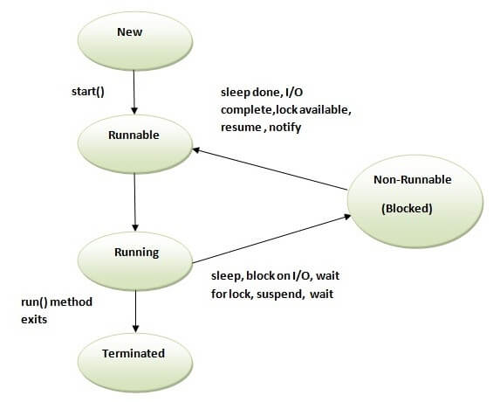
Thread life cycle

Slide 5
Creating Threads using Class
Class DemoThread extends Thread{
public void run(){
}
}
Class Main{
public static void main(String[] as){
new DemoThread().start();
}
}

Slide 6
Creating Thread using Interface
Class DemoThread implements Runnable{
public void run(){
}
}
Class Main{
public static void main(String[] as){
new Thread(new DemoThread()).start();
}
}

Slide 7
Thread Methods
Sleep() – suspend a thread for some time.
Join() – wait for a thread to terminate.
Notify(); - To efficient way to manage thread.

Slide 8
Manual Synchronization
Synchronization can introduce thread contention, which occurs
When two or more threads try to access the same resource simultaneously and cause the Java runtime to execute one or more threads more slowly, or even suspend their execution.
Can be done on 3 ways.
1) Synchronization using methods - object level lock
2) Synchronization blocks
3) Static Synchronization. – class level lock

Slide 9
Thread Pools or Executor Framework
The executor implementations in java.util.concurrent use thread pools, which consist of worker threads.
This kind of thread exists separately from the Runnable and Callable tasks it executes and is often used to execute multiple tasks.
Represents the group of working threads are waiting for job.

Slide 10
Executor Framework
Automated creation and managing the thread on different tasks.
Executor and ExecutorService are the interfaces are thread pools.
Executors is a class
We can create Thread pool as follows
ExecutorService es=Executors.newFixedThreadPool(2);
I have to submit the job
es.submit(job)
To Shutdown
es.shutdown();

Slide 11
Thank you
Any queries?

