Slide 1
GIT

Slide 2
Git is a free and open source distributed version control system designed to handle projects.
The Git is a developer tool which can be installed locally on the computer(GIT Bash) or it is available as an online service(GIT hub).
GIT Bash is an application for windows environment that use command line to operate.
GIT hub is an online service where it allows multiple users to connect.Use GUI to operate.

Slide 3
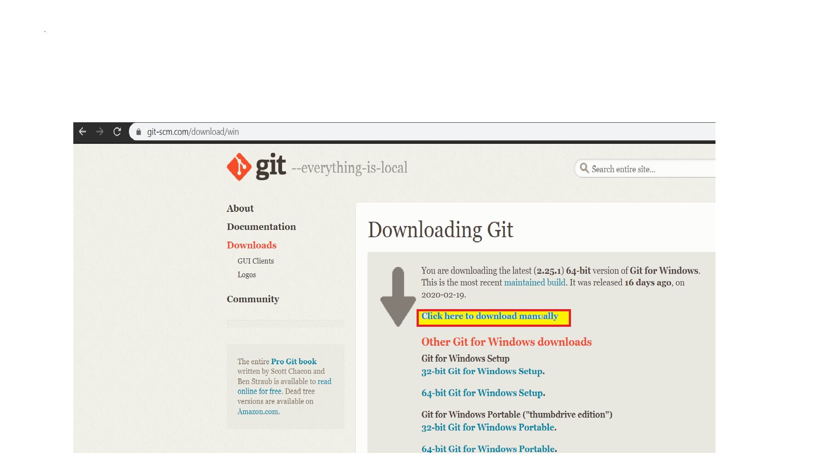
1. GIT Bash – Desktop Repository
1.1 Download GIT for windows

Slide 4
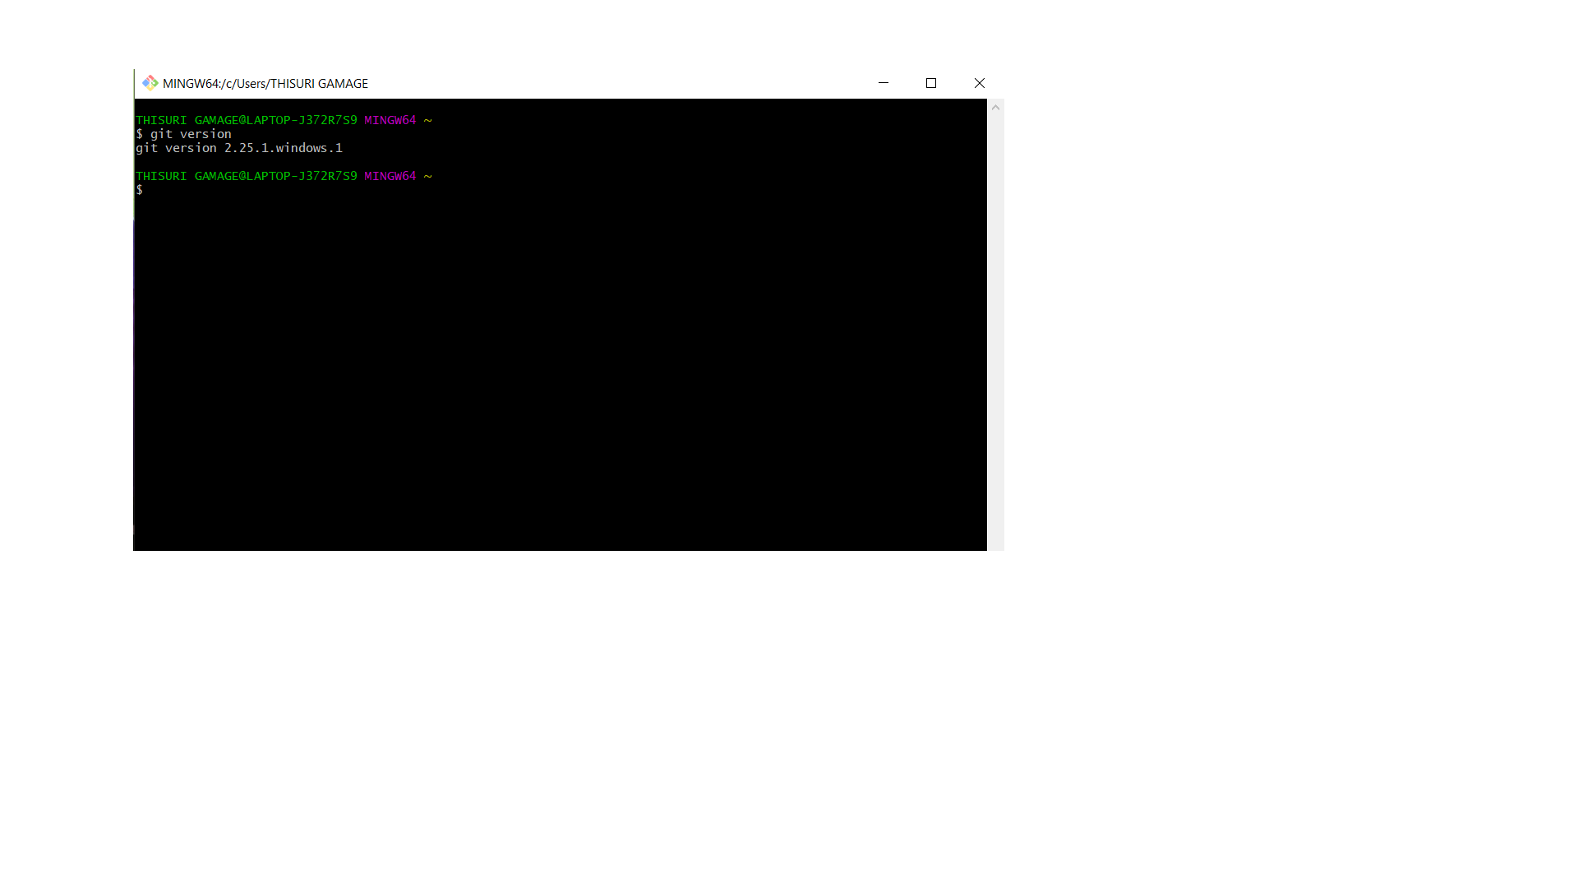
1.2 Check the version if it is installed properly

Slide 5
1.3 Creating a local repository using GIT bash

