Slide 1
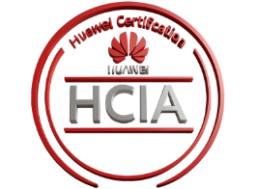
Team members
Hatem Mahmoud
Abdelmoneim Samir
Alaa Atef
Ali Alaa
Under supervision of
Prof.Ibrahim Gomaa
Eng.Ahmed Ashraf

Slide 2
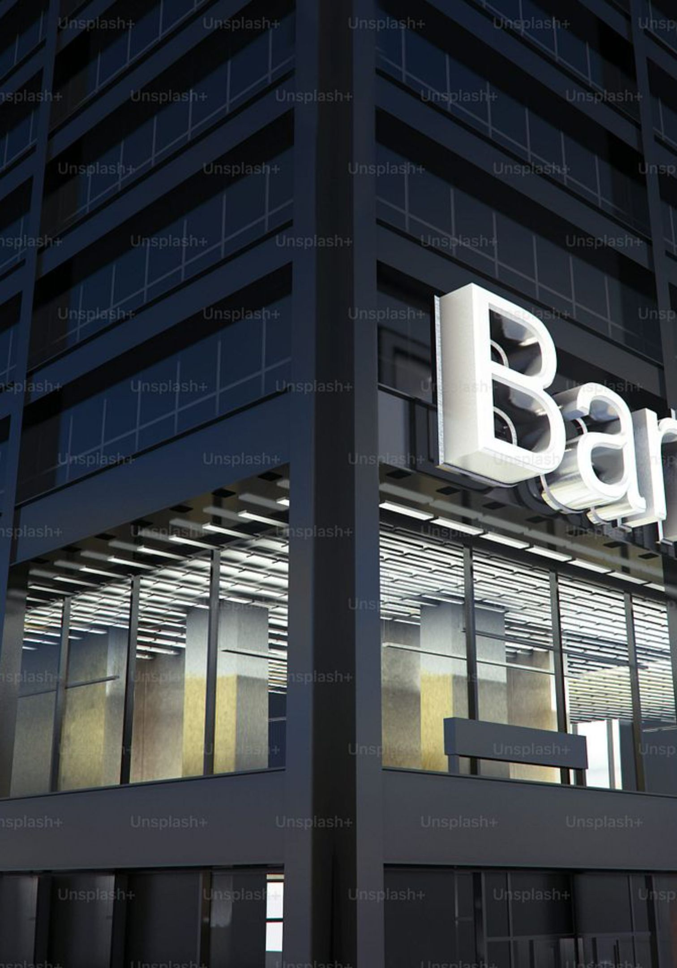
Scenario 7
City Bank Branch
Protect the Internet‑facing banking portal while keeping the core banking database absolutely unreachable from the public Internet. Balance public accessibility with strict internal isolation and operational continuity.

Slide 3
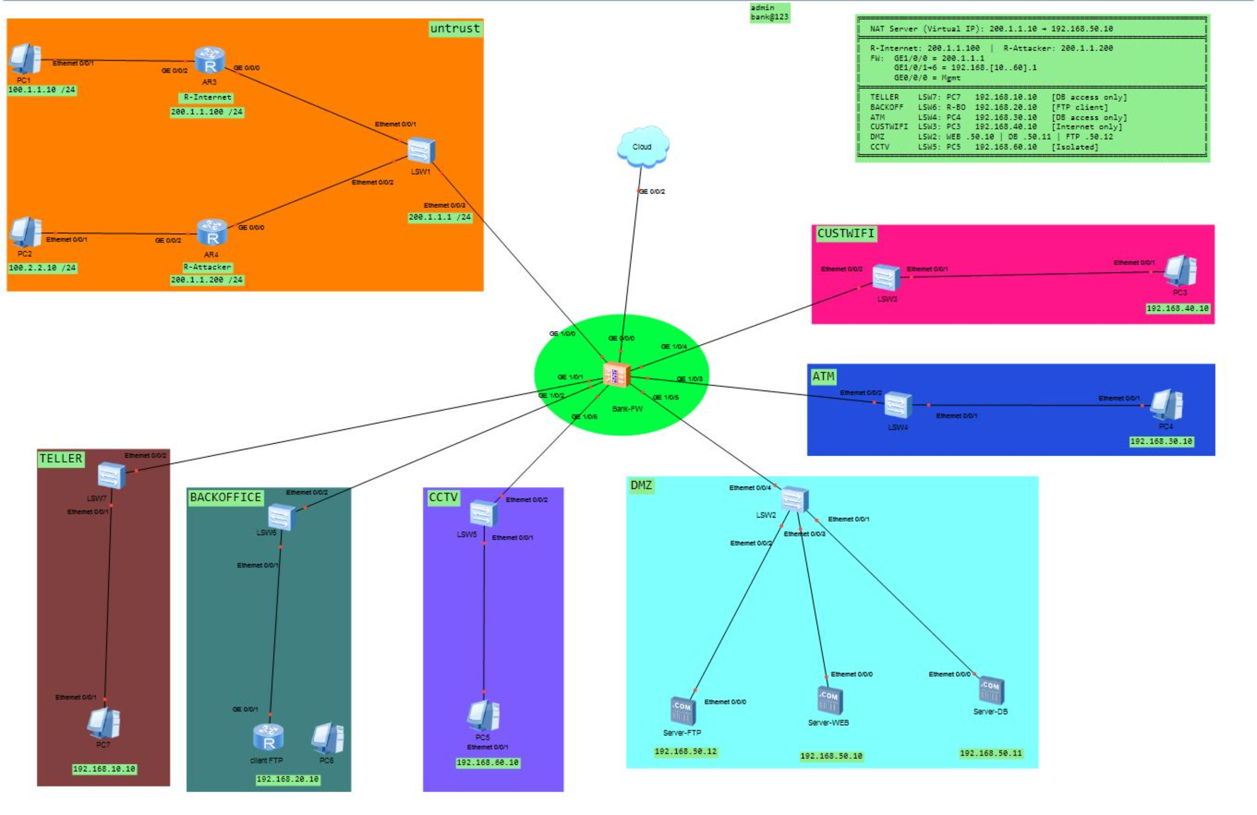
Topology Architecture

Slide 4
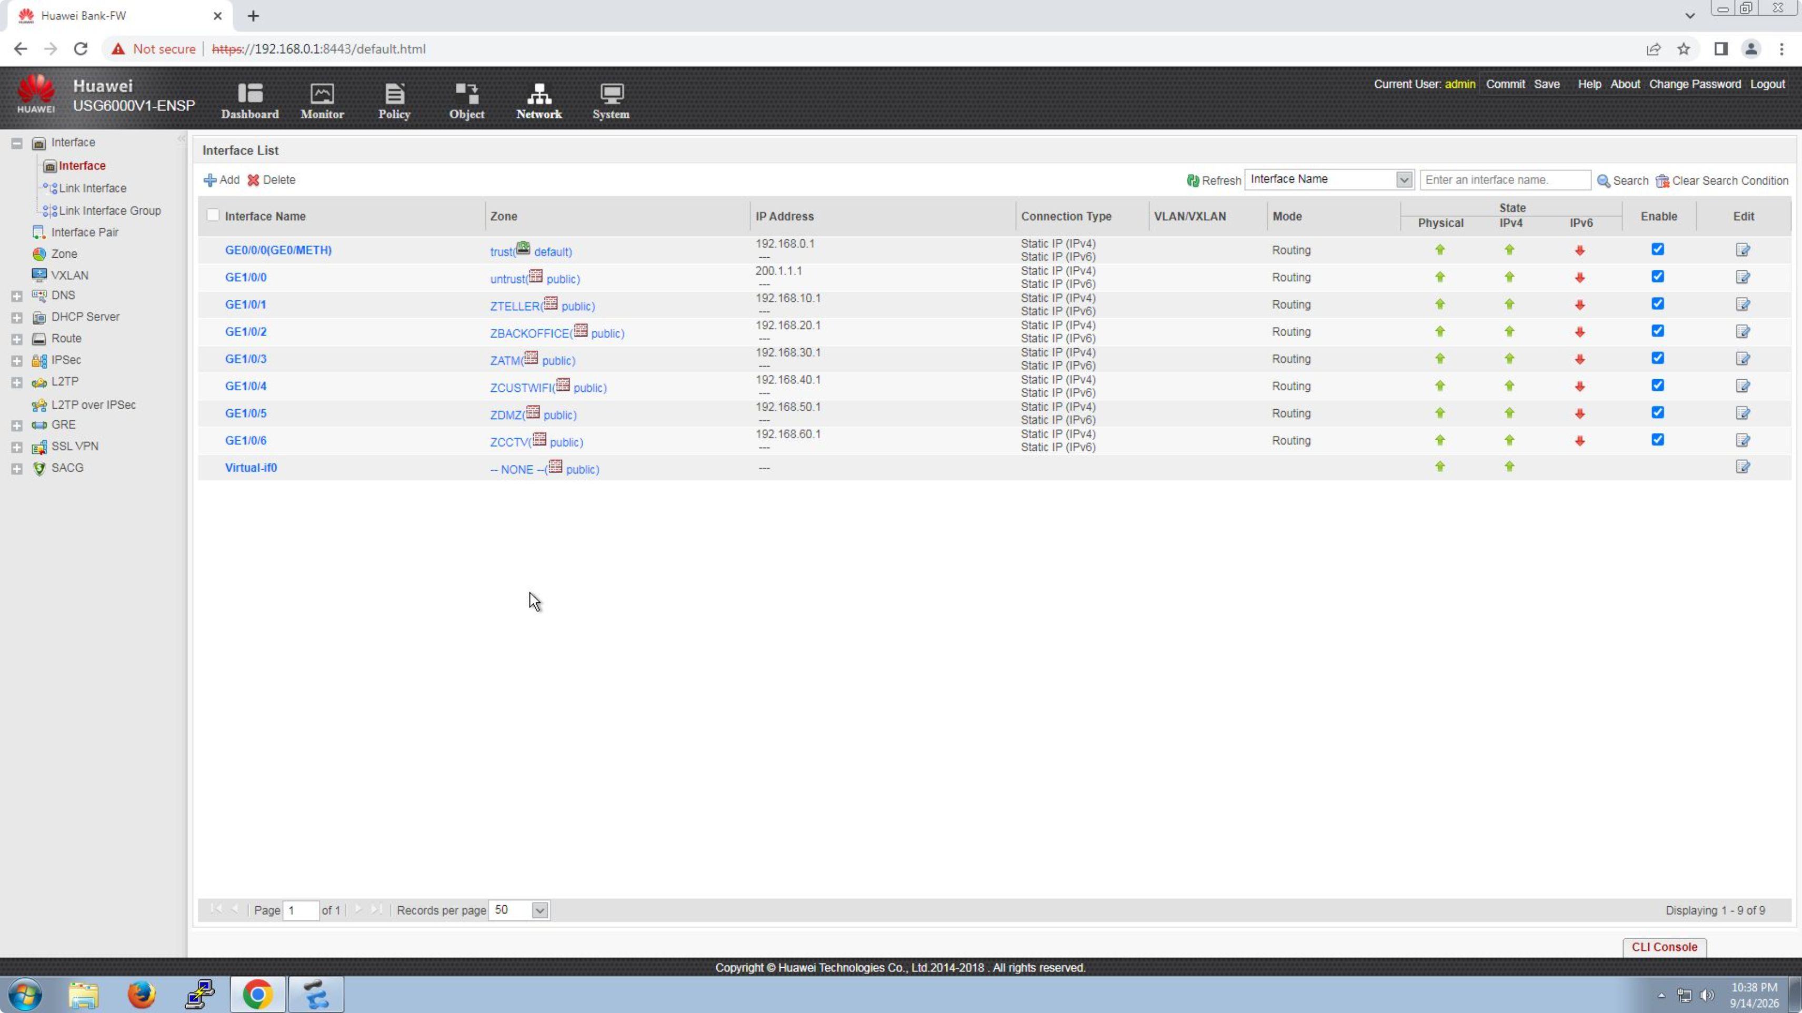
Firewall Network Interfaces (GUI)

Slide 5
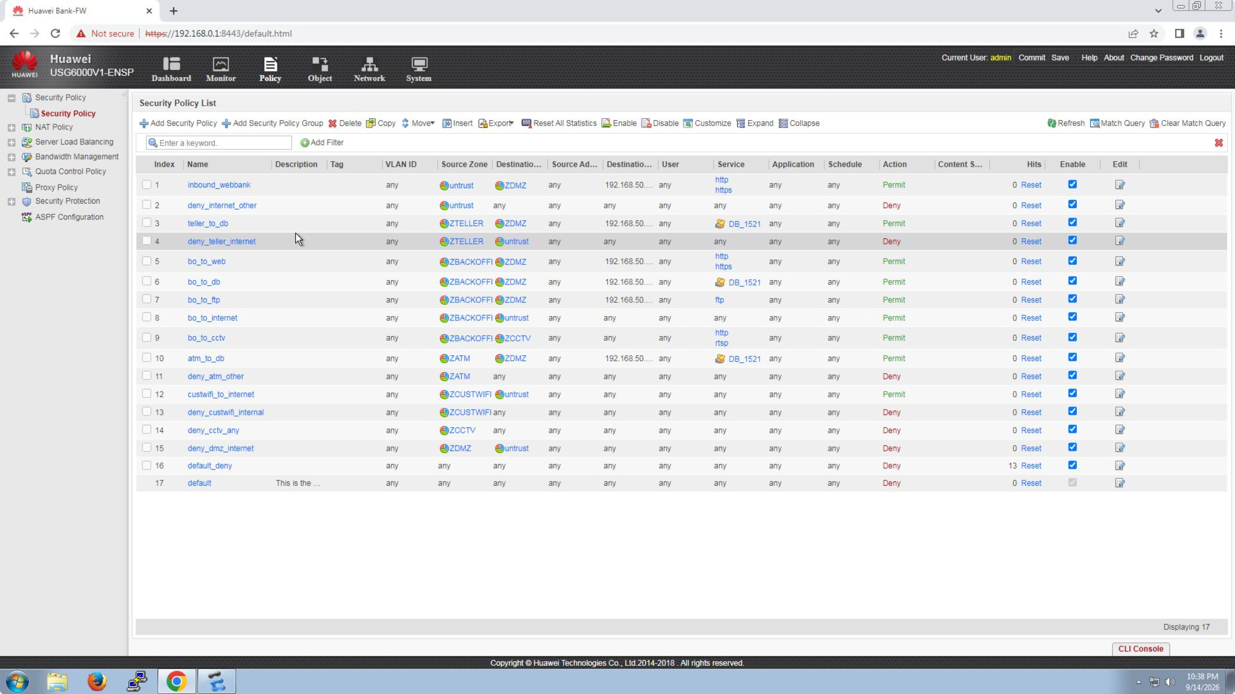
Firewall Security Policies (GUI)

Slide 6
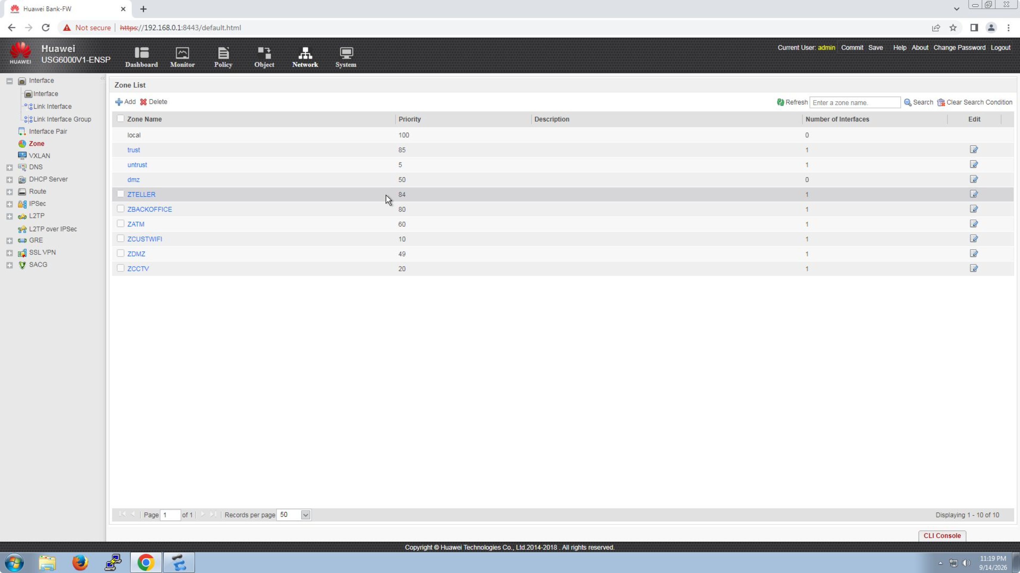
Security Zone

Slide 7
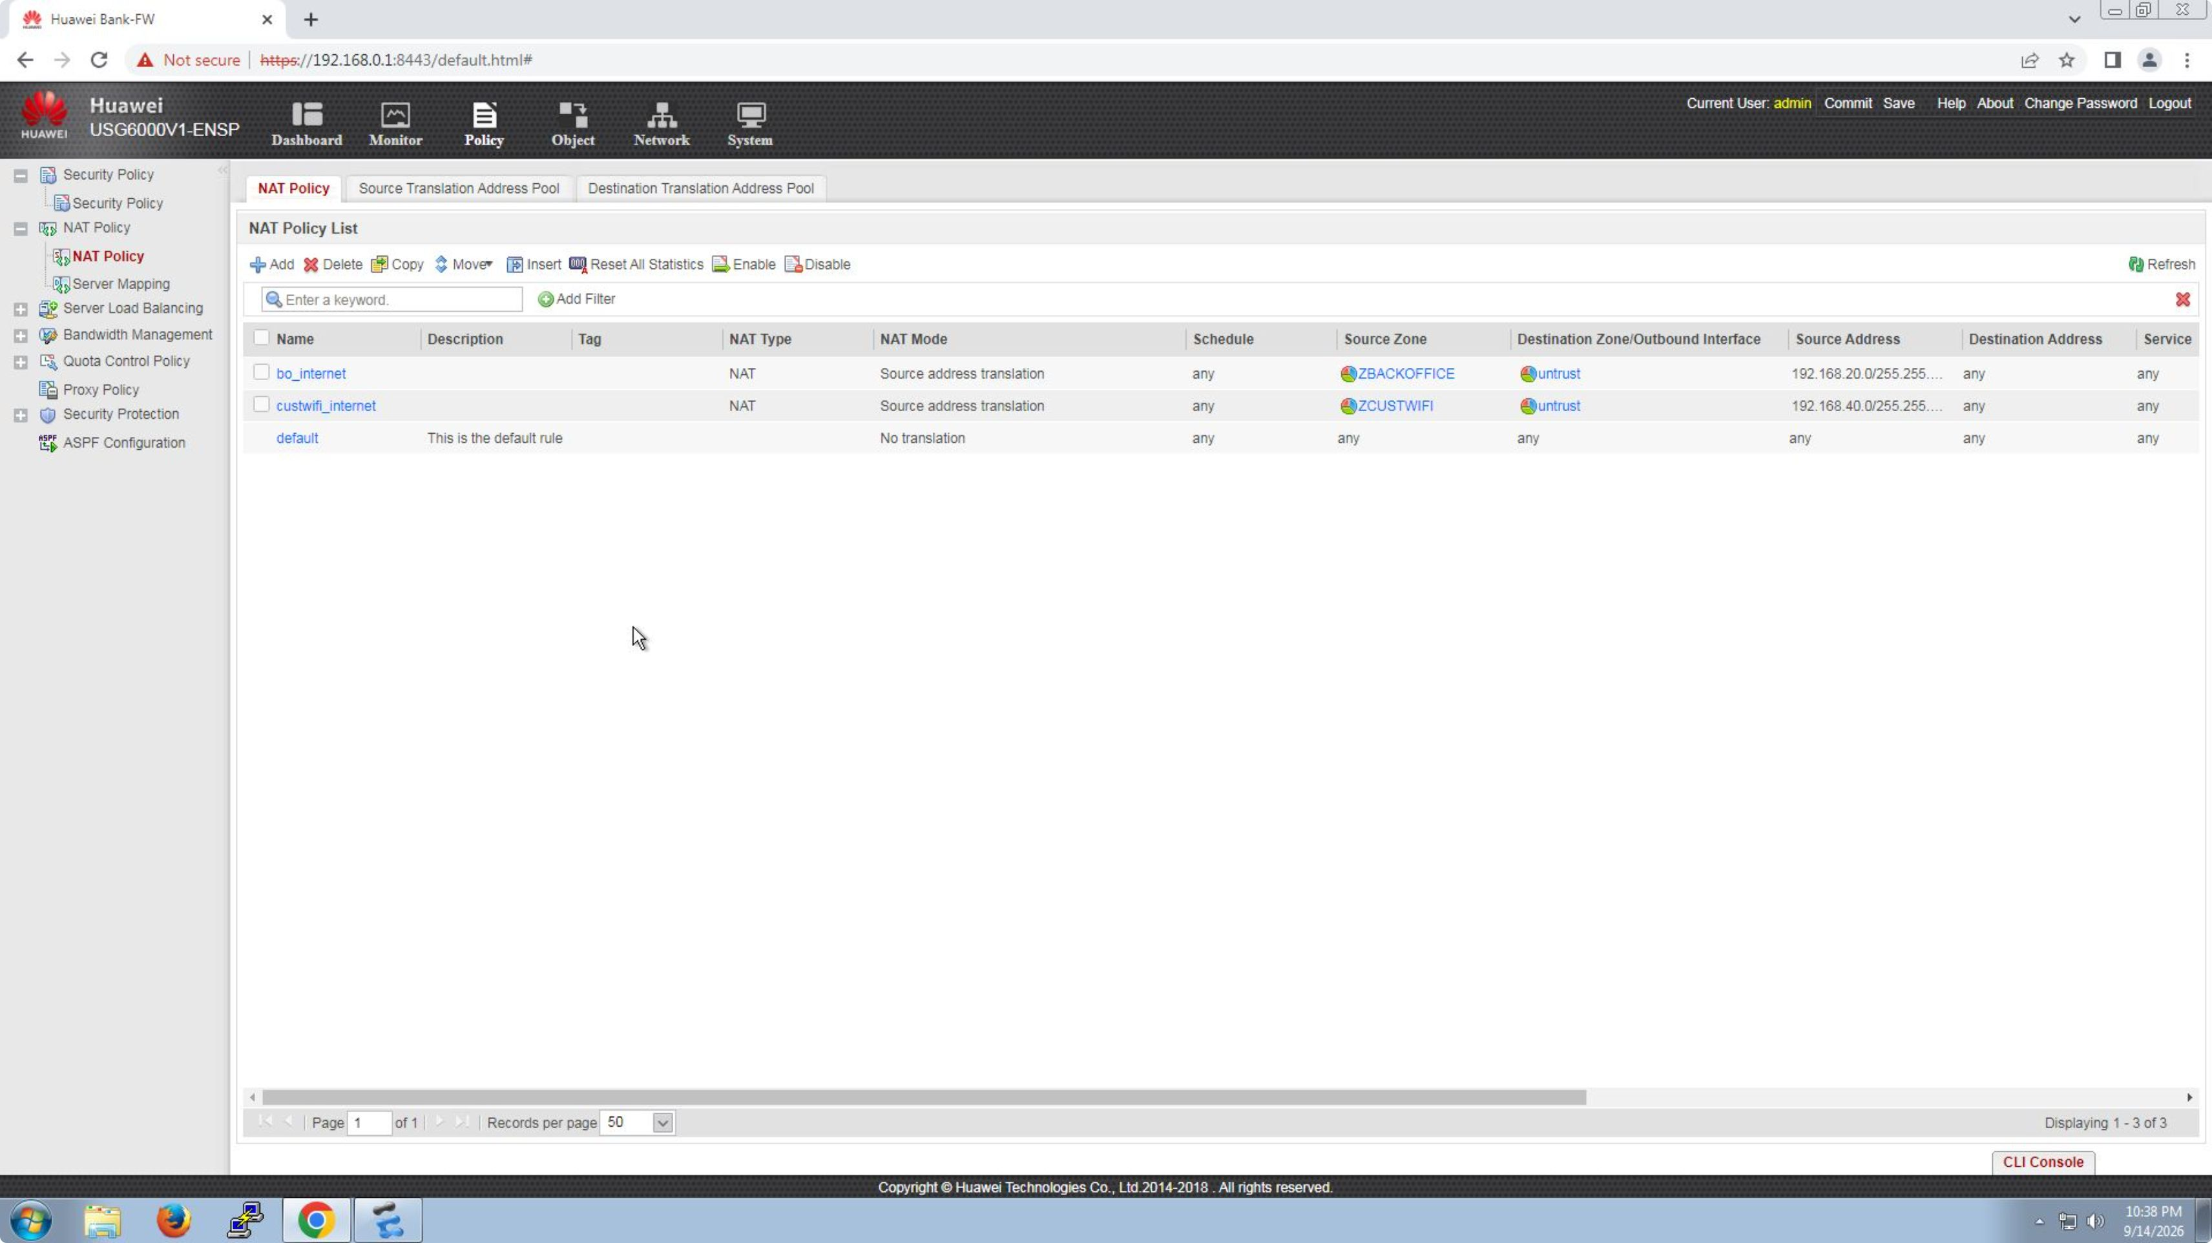
NAT Policy

Slide 8
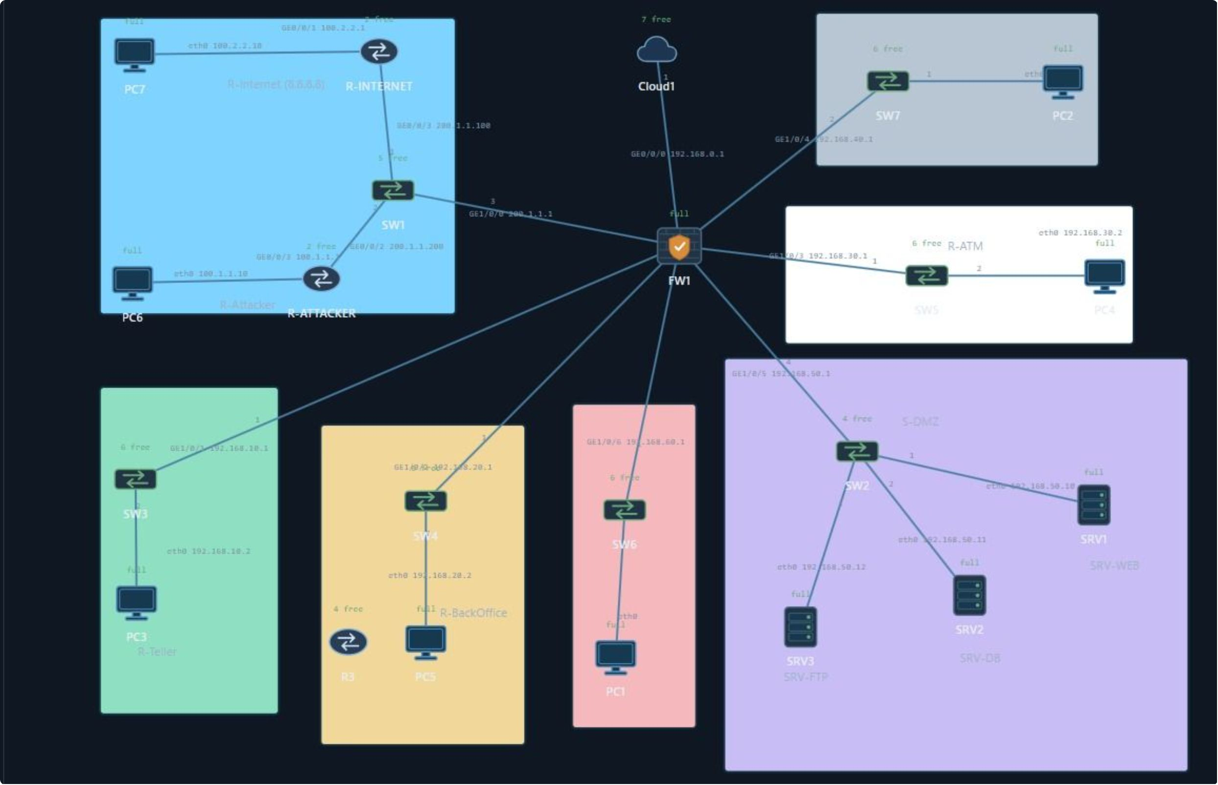
Cloud Topology

Slide 9
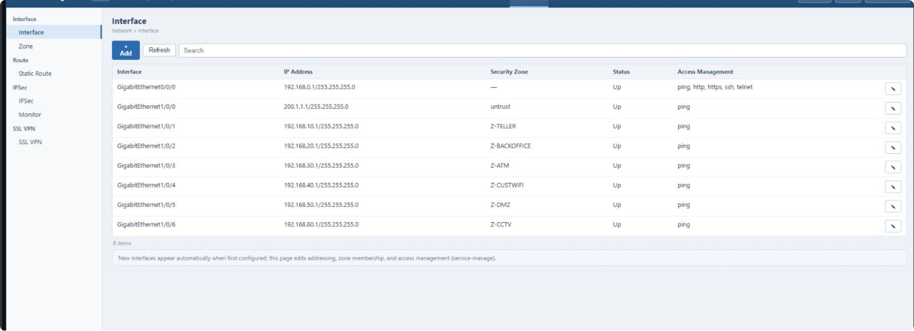
Firewall Network Interface

Slide 10
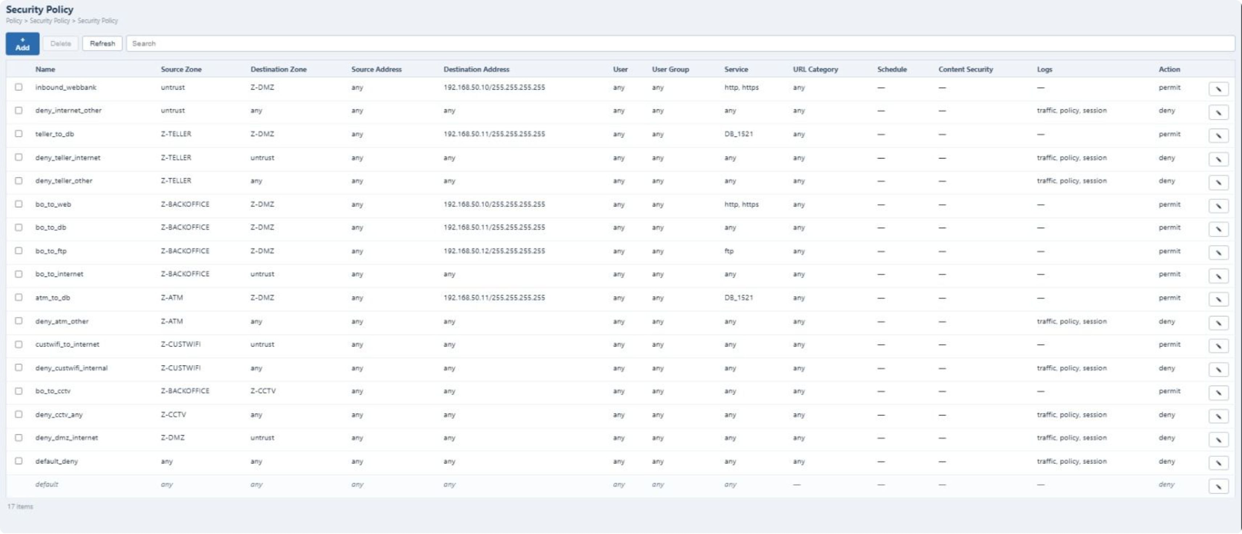
Firewall Security Policy

Slide 11
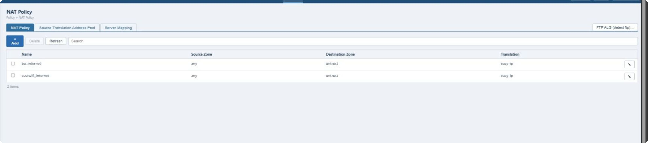
Nat Policy

Slide 12
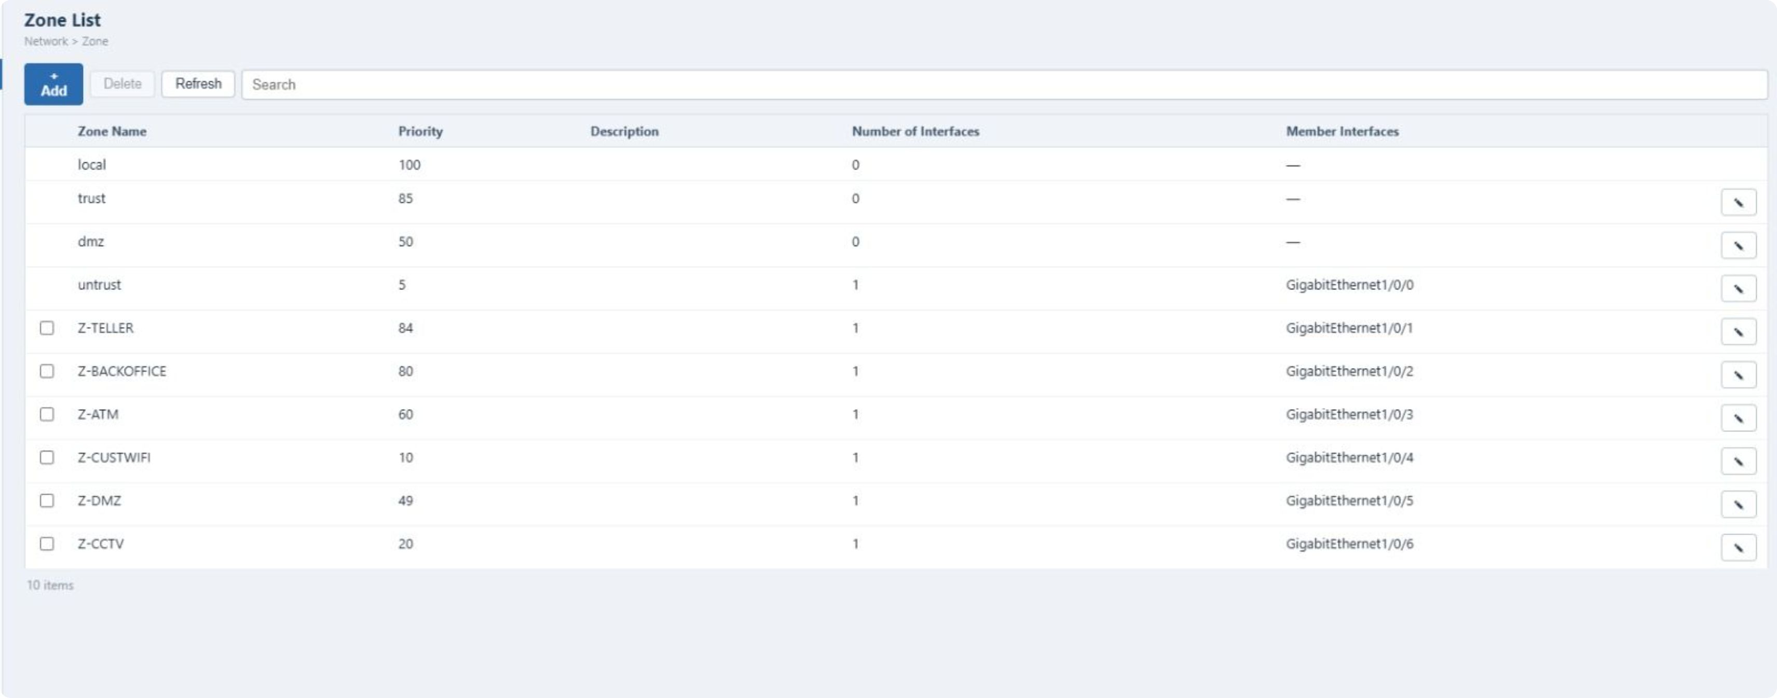
Security Zones

Slide 13
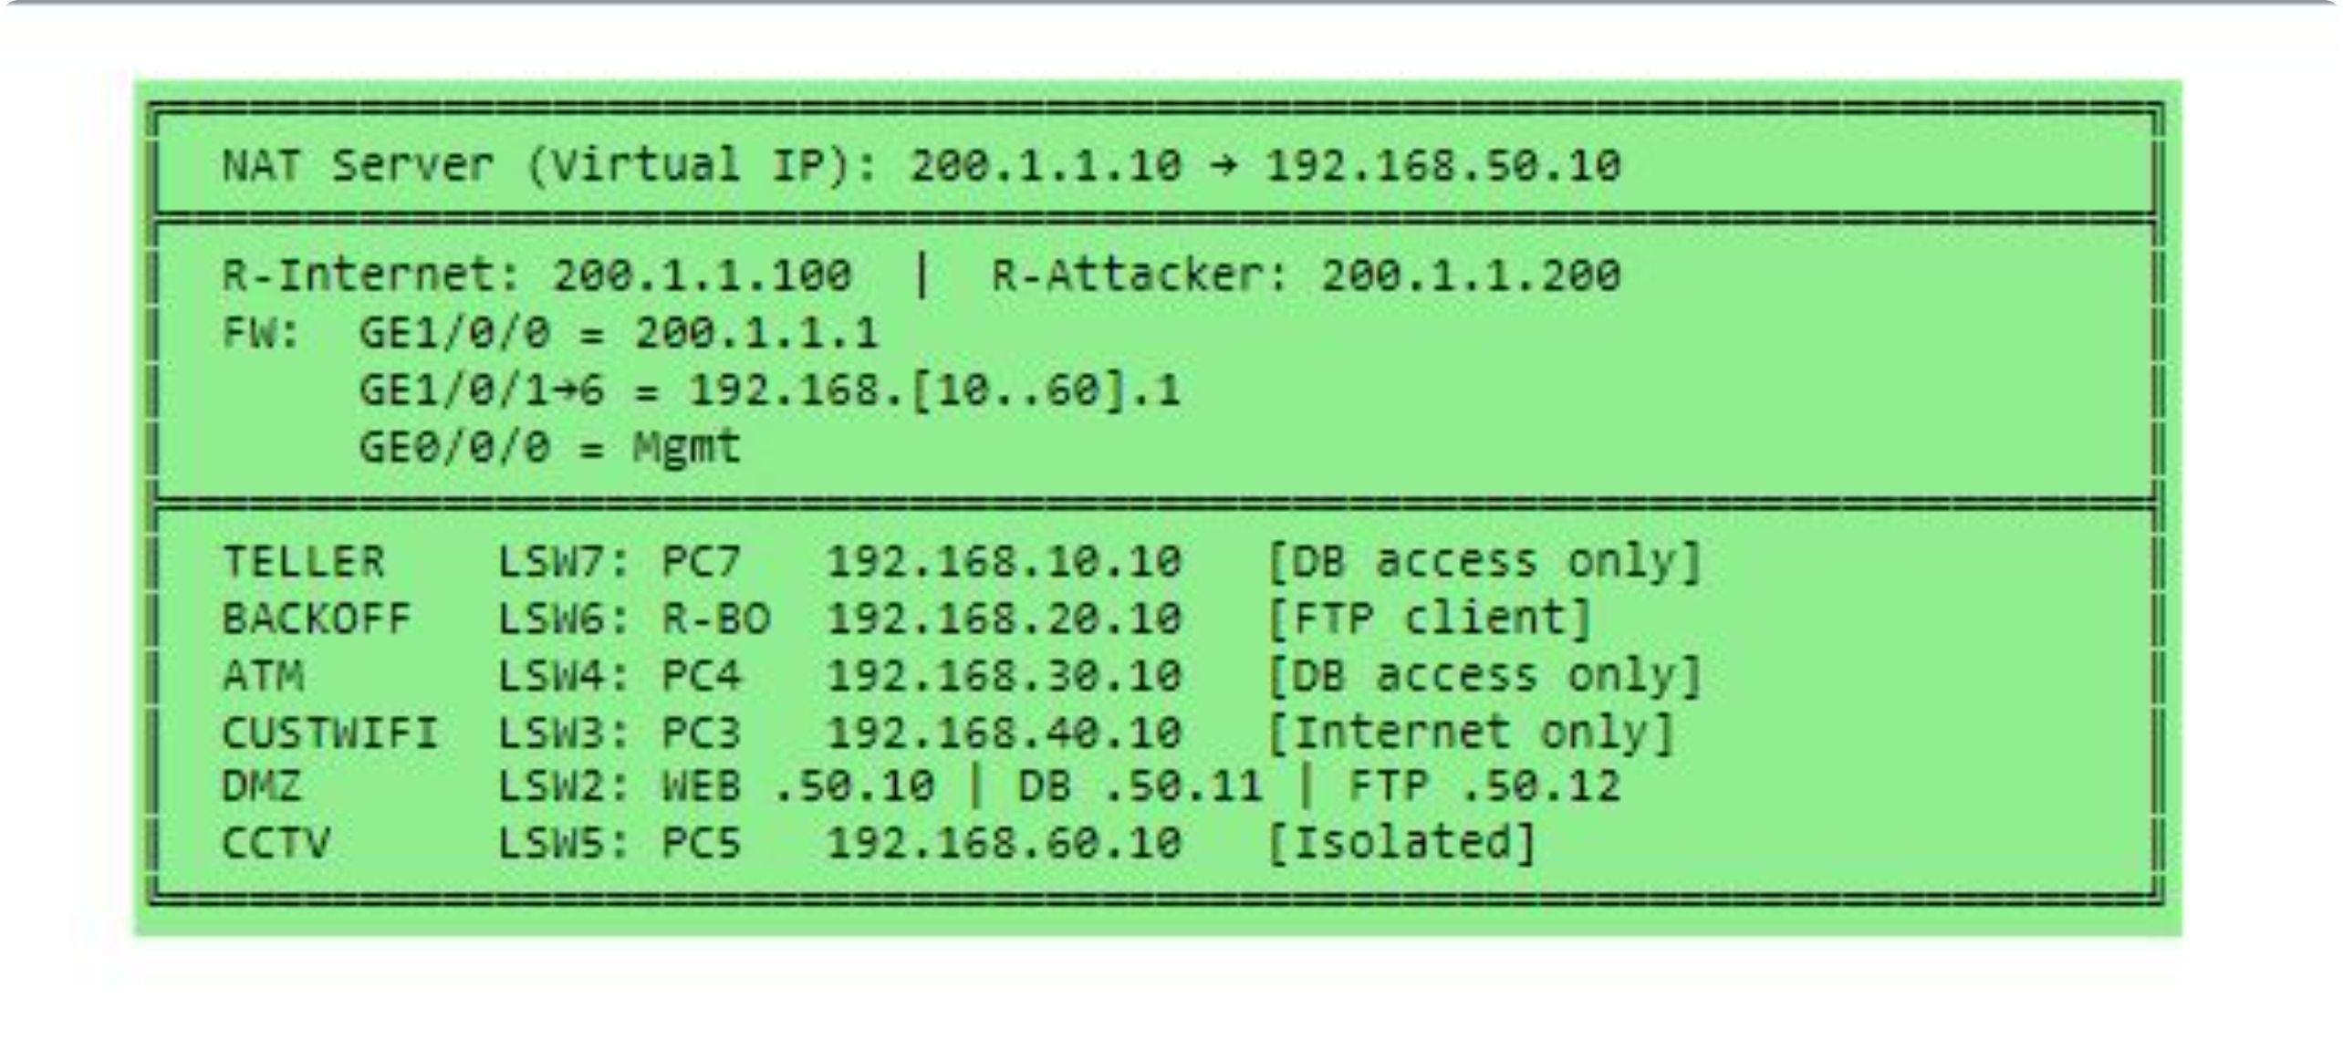
IP Address

Slide 14
Detailed Firewall Interface Configuration
Below are the specific IP addresses and zones assigned to each network interface on the firewall, detailing their connections within the City Bank Branch network.
Interface | IP Address / Mask | Zone | Connected To
GE1/0/0 | 200.1.1.1 /24 | untrust | LSW1 (Internet)
GE1/0/1 | 192.168.10.1 /24 | ZTELLER | LSW7
GE1/0/2 | 192.168.20.1 /24 | ZBACKOFFICE | LSW6
GE1/0/3 | 192.168.30.1 /24 | ZATM | LSW4
GE1/0/4 | 192.168.40.1 /24 | ZCUSTWIFI | LSW3
GE1/0/5 | 192.168.50.1 /24 | ZDMZ | LSW2
GE1/0/6 | 192.168.60.1 /24 | ZCCTV | LSW5

Slide 15

Thanks

