Slide 1
LOOP

Slide 2

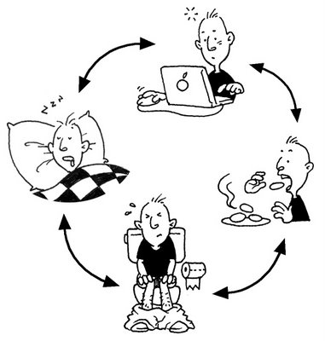

Slide 3
?Can you give me an example of loop ?

Slide 4
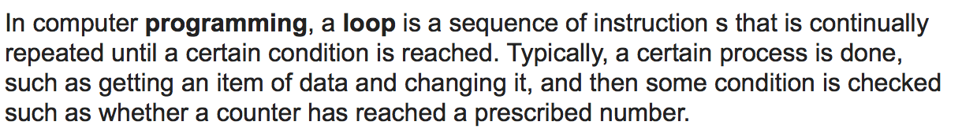
Definition of loop
www.google.com

Slide 5
LOOP IN java
While loop
Do while loop
For loop
For each loop

Slide 6
Requirement in loop
Stop condition – Boolean
Body
while(Stop condition){
Body }
while(I am not arrive the destination){
step left foot();
stop right foot();
}

