Slide 1

Software Part (Day 2)
Docker with Streamlit, MongoDB

Slide 2

Continue fastAPI and mongodb

Slide 3
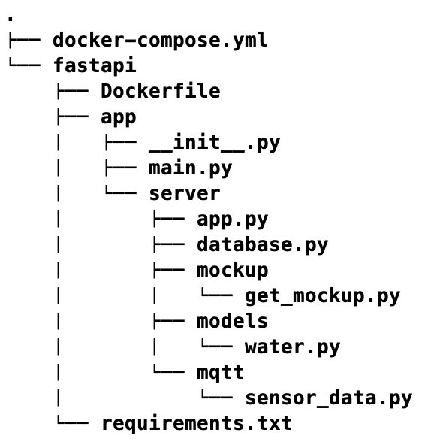
STEP 3 connect to db
Create folder and file in path like this.

Slide 4
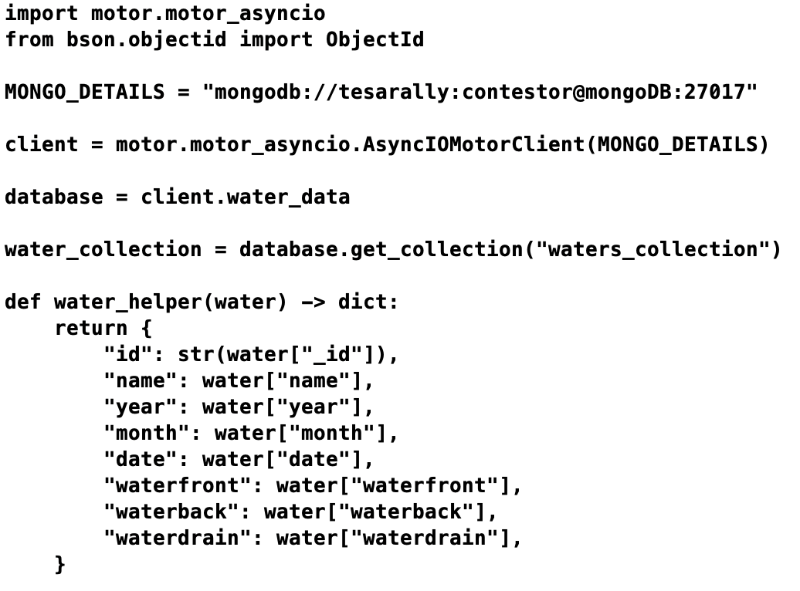
STEP 3 connect to db
username
password
Write code in database.py

Slide 5
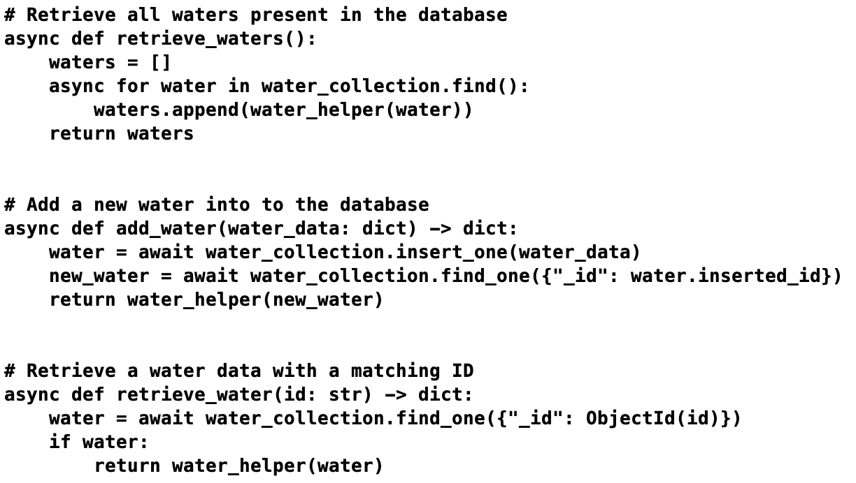
STEP 3 connect to db
username
password
Write code in database.py

Slide 6
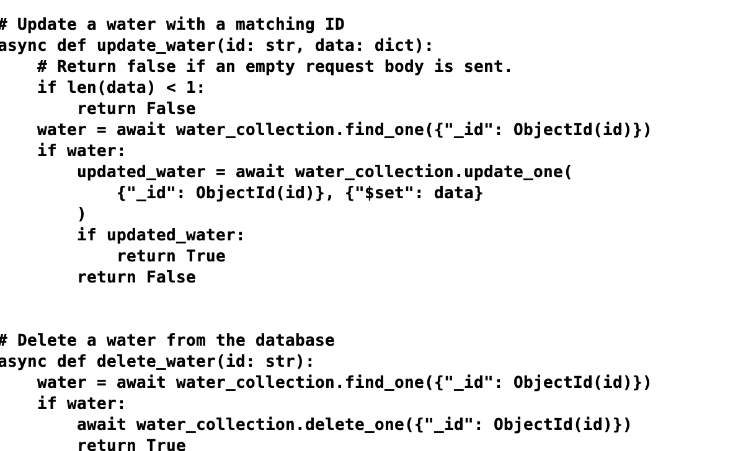
STEP 3 connect to db
Write code in database.py

Slide 7
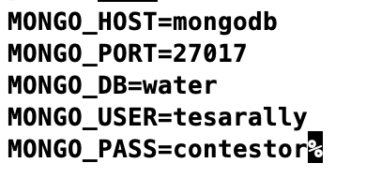
STEP 3 connect to db
Create .env file and write these code
username
password

Slide 8
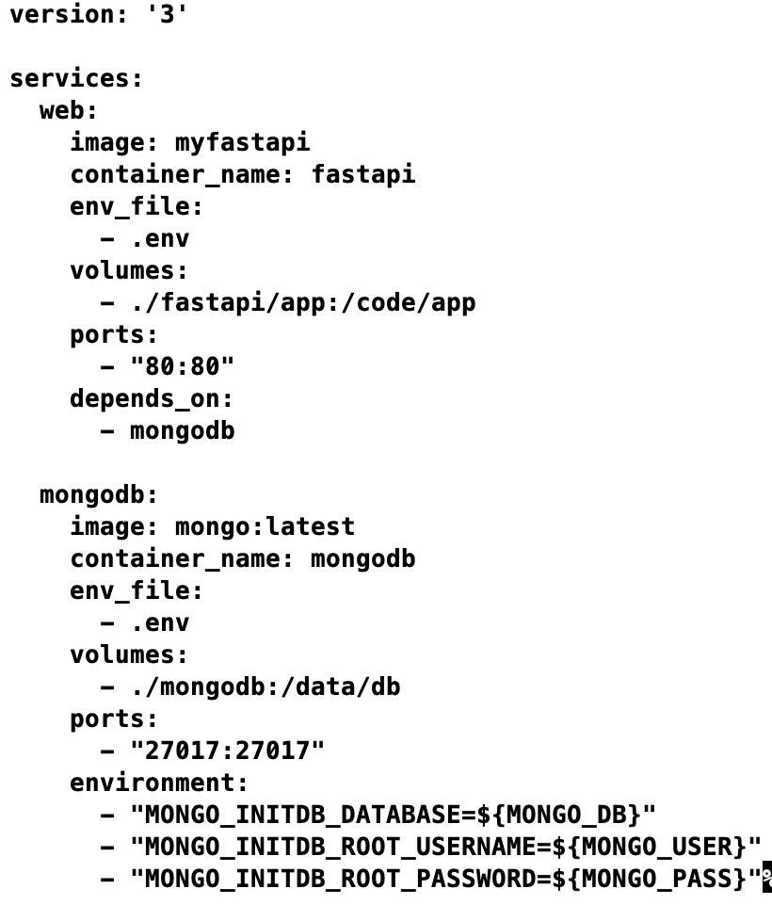
STEP 3 connect to db
Write docker-compose file

Slide 9
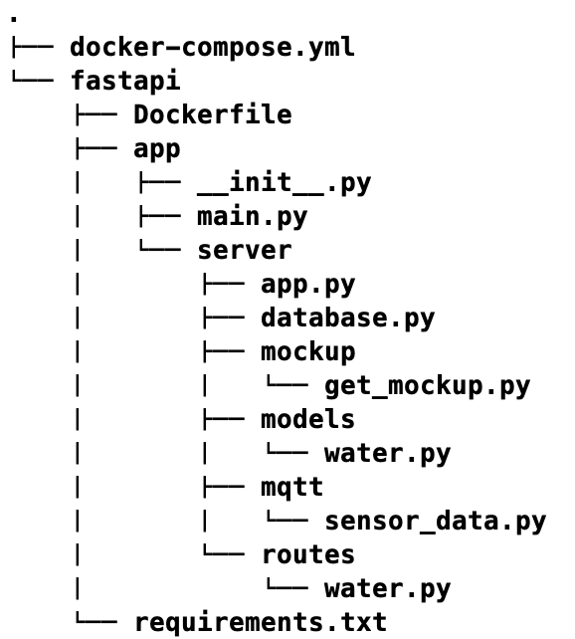
STEP 4 create CRUD operations
Create folder and file in path like this.

Slide 10
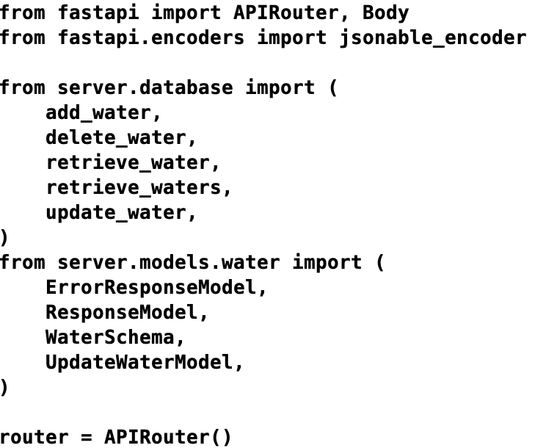
STEP 4 create CRUD operations
Write code in water.py

Slide 11
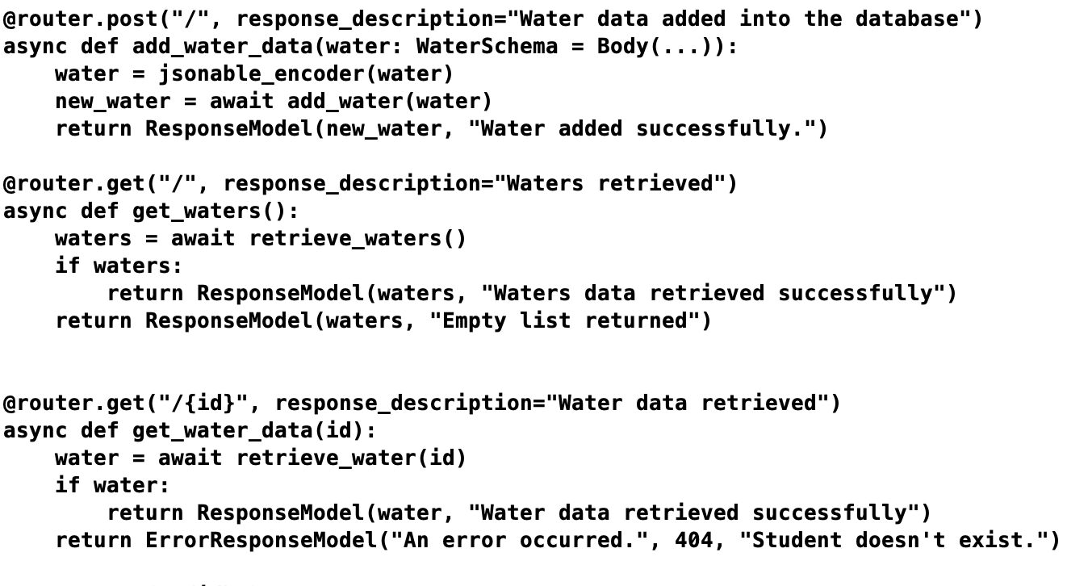
STEP 4 create CRUD operations
Write code in water.py

Slide 12
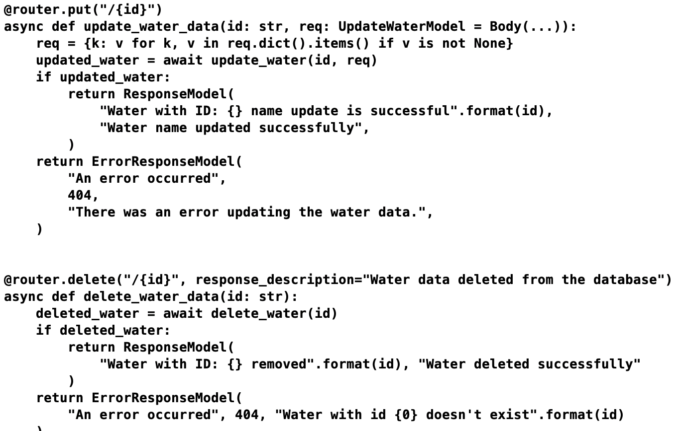
STEP 4 create CRUD operations
Write code in water.py

Slide 13
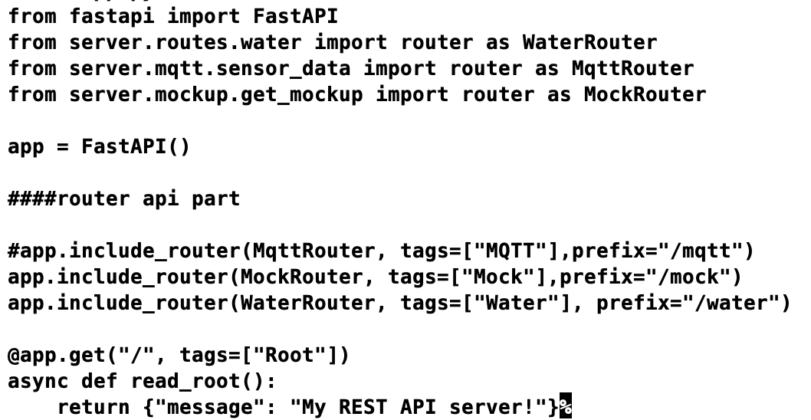
STEP 4 create CRUD operations
Write code in app.py

Slide 14

Create Dashboard

Slide 15
Streamlit
With streamlit you can deploy any machine learning model and any python project with ease and without worrying about the frontend. Streamlit is very user-friendly.
https://streamlit.io/

Slide 16
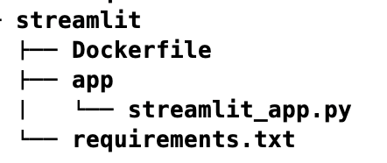
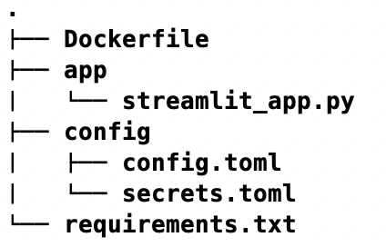
STEP 0 deploy streamlit on docker
Create folder and files like this.

Slide 17
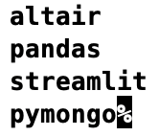
STEP 0 deploy streamlit on docker
requirements.txt
Write all packages used in build image

Slide 18
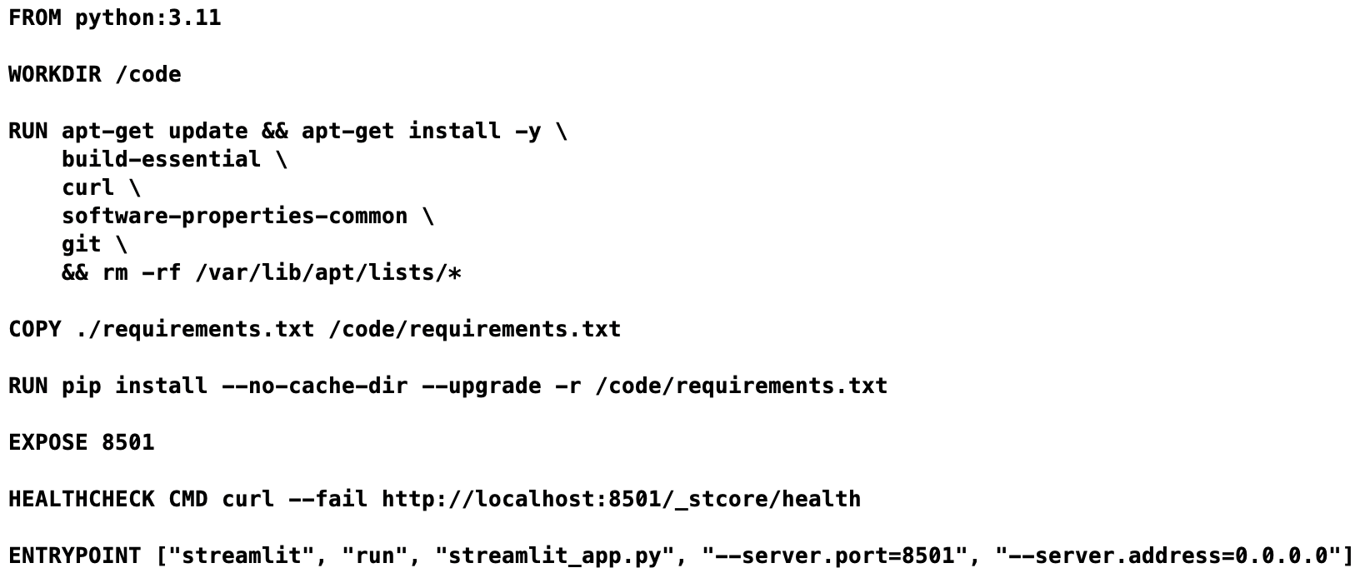
STEP 0 deploy streamlit on docker
Dockerfile
Write command for create image

Slide 19
STEP 0 deploy streamlit on docker
Write code in streamlit_app.py (starter part)
# import module import streamlit as st # Title st.title("Hello TGR")

Slide 20
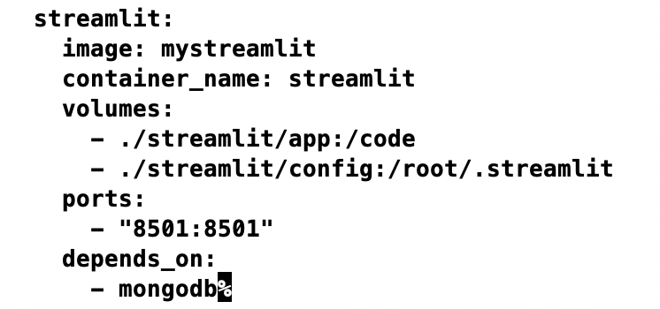
STEP 0 deploy streamlit on docker
Write data in docker-compose.yaml
Image name

Slide 21
STEP 0.1 deploy streamlit on docker
Run docker command for build image
Go to the folder that has Dockerfile and run docker build –t “image name” .

Slide 22
STEP 0.2 deploy streamlit on docker
Start the server
Go to the folder that has docker-compose file and run docker-compose up

Slide 23
Basic functions on streamlit
Title
Header, Subheader
Text
Success, Info, Warning, Error, Exception
Write : Using write function, we can also display code in coding format.

Slide 24
Basic functions on streamlit
Display image
# import Image from pillow to open images
from PIL import Image
img = Image.open("streamlit.png")
# display image using streamlit
# width is used to set the width of an image
st.image(img, width=200)

Slide 25
Basic functions on streamlit
Checkbox
# checkbox
# check if the checkbox is checked
# title of the checkbox is 'Show/Hide'
if st.checkbox("Show/Hide"):
# display the text if the checkbox returns True value
st.text("Showing the widget")

Slide 26
Basic functions on streamlit
Radio button
# radio button
# first argument is the title of the radio button
# second argument is the options for the radio button
status = st.radio("Select Gender: ", ('Male', 'Female'))
# conditional statement to print
# Male if male is selected else print female
# show the result using the success function
if (status == 'Male'):
st.success("Male")
else:
st.success("Female")

Slide 27
Basic functions on streamlit
Selection Box
# Selection box
# first argument takes the titleof the selectionbox
# second argument takes options
hobby = st.selectbox("Hobbies: ",['Dancing', 'Reading', 'Sports'])
# print the selected hobby
st.write("Your hobby is: ", hobby)

Slide 28
Basic functions on streamlit
Multi-Selectbox
# multi select box
# first argument takes the box title
# second argument takes the options to show
hobbies = st.multiselect("Hobbies: ",['Dancing', 'Reading', 'Sports'])
# write the selected options
st.write("You selected", len(hobbies), 'hobbies')

Slide 29
Basic functions on streamlit
Button
# Create a simple button that does nothing
st.button("Click me for no reason")
# Create a button, that when clicked, shows a text
if(st.button("About")):
st.text("Welcome To Contest!!!")

Slide 30
Basic functions on streamlit
Text Input
# Text Input
# save the input text in the variable 'name'
# first argument shows the title of the text input box
# second argument displays a default text inside the text input area
name = st.text_input("Enter Your name", "Type Here ...")
# display the name when the submit button is clicked
# .title() is used to get the input text string
if(st.button('Submit')):
result = name.title()
st.success(result)

Slide 31
Basic functions on streamlit
Slider
# slider
# first argument takes the title of the slider
# second argument takes the starting of the slider
# last argument takes the end number
level = st.slider("Select the level", 1, 5)
# print the level
# format() is used to print value
# of a variable at a specific position
st.text('Selected: {}'.format(level))

Slide 32
STEP 1 connect streamlit to mongodb
https://docs.streamlit.io/knowledge-base/tutorials/databases/mongodb
Use pymongo to connect with database

Slide 33
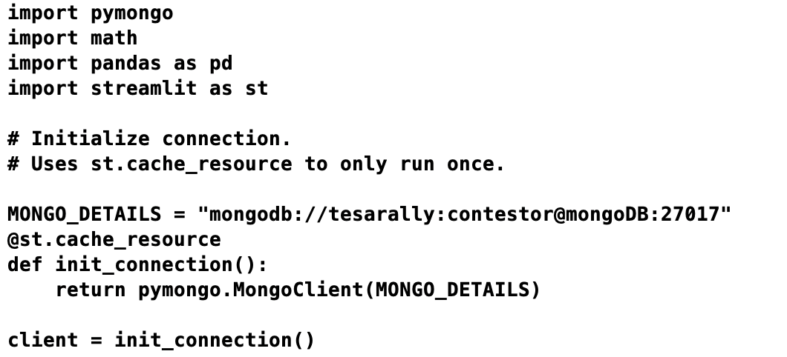
STEP 1 connect streamlit to mongodb
Create connection with pymongo
username
password

Slide 34
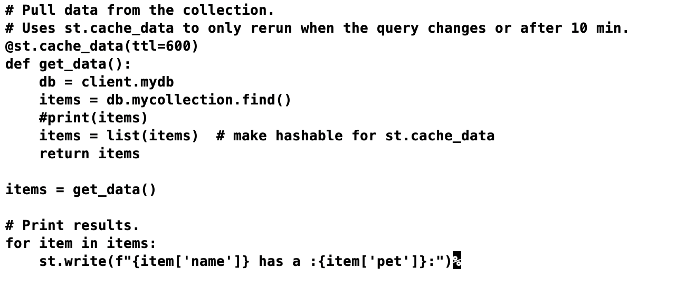
STEP 1 connect streamlit to mongodb
Pull data from the collections

Slide 35
STEP 2 connect streamlit to mongodb
Create connection with pymongo
username
password

