Slide 1
Web Architectures
CITS5503 Dr David Glance

Slide 2

Modern Applications
Most applications today are either web or mobile
Even desktop apps will use common architectural elements of web/mobile design
Multitude of:
Front and back end languages and frameworks
Network communication protocols
Database and storage technologies
In many cases, it comes down to personal preference and availability of skills
Frameworks highlight how to use many features of the cloud
https://www.zdnet.com/article/what-is-cloud-computing-everything-you-need-to-know-from-public-and-private-cloud-to-software-as-a/

Slide 3
Popular web frameworks
Back End Frameworks
Django
Ruby on Rails
Express.js (Node.js)
Front End Frameworks
React
Vue
Meteor
HTML 5, CSS3, JQuery/Ajax

Slide 4
Traditional Architectures
Monolithic (Mainframe)
Even here there was some compartmentalisation of code into UI, Business Logic and Database
Two Tier
UI & Business Logic and Database
Three Tier
UI, Business Logic, Data
Distributed
Services became available through communication
Object models used middleware like CORBA or RMI (Remote Method Invocation)

Slide 5
Fundamental Changes
Web architectures became dominant
Multi-platform – although still issues with different browsers
Fast to develop and scale
Mobile applications ascending
Architectures moving to service Web and Mobile
Architect services as “Micro-Services” in serverless or container infrastructure
Loosely coupled services with limited functionality

Slide 6
Web application on AWS
Apache or nginx
Gunicorn/Unicorn
Django/Ruby on Rails
Browser
ELB
EC2
RDS
EC2

Slide 7
Microservice Architecture

Slide 8
Microservice Architecture
Microservices can be hosted on Lambda (Serverless), Containers, or can be other Django/Ruby/NodeJS apps
Front end is via an API Gateway that defines a programmatic interface to the services
Benefits of Rest API based API Gateway are:
Language agnostic
Maintains an interface that encapsulates implementation
Can use SQS to allow queues to invoke APIs
Need to handle authentication and authorisation for the API
Use IAM either directly or through API Gateway Resource Policies
Use Cognito
Use API keys
Use an external service through Lambda

Slide 9
Web application using Python Django
Django is a web application framework built on a Model View Controller architectural pattern
Model represents an object representation of data used by the application:
Configuration can determine what the actual data store is: MySQL, Postgresql, etc
Queries hide the specifics of SQL and other query or access languages
View is the visual representation of the model – how the data gets shown to the user via the web. In Django, this is represented by Templates
Controller controls the business logic and the flow of data between the model and the controller (in practice, the controller and view code are usually mixed)

Slide 10
It starts with an HTTP Request
Web Browser
Browser sends an HTTP request that is mapped to a view.py file
The request may contain form data which is processed using a model to save data in a database
A template is used to render a response in HTML with CSS and JS back to the web browser
Template
URL
View
Form
Model
Database

Slide 11
Django application architecture
Nginx is used to handle HTTP requests either for:
Django app through Gunicorn
Directly for static files
Gunicorn handles the invocation of methods in Django is run by Supervisor daemon

Slide 12
nginx
Web server that is more closely adapted to running django applications
config put in /etc/nginx/sites-available and then linked to in /etc/nginx/sites-enabled
Acts as a proxy for django app - can terminate SSL but on AWS usually use ELB for this
Django app only deals with HTTP
Serves static files
static files an be local to machine or on AWS put in S3
Install apt install nginx ; service nginx restart

Slide 13
nginx configuration
server {
listen 80;
location / {
proxy_set_header X-Forwarded-Host $host;
proxy_set_header X-Real-IP $remote_addr;
proxy_pass http://127.0.0.1:8009;
}
}

Slide 14
Hello World in django
Create a virtual environment first
sudo apt install python3-venv
create virtual environment: python3 –m venv my_venv
activate it: source my_venv/bin/activate
pip install django
django-admin startproject mysite
python manage.py startapp polls

Slide 15
Edit views.py
edit (emacs or vi) polls/views.py
from django.http import HttpResponse
def index(request):
return HttpResponse("Hello, world.”)

Slide 16
Edit urls.py
edit (emacs or vi) polls/urls.py
from django.urls import path
from . import views
urlpatterns = [
path('', views.index, name='index’),
]

Slide 17
Edit msite/urls.py
edit (emacs or vi) mysite/urls.py
from django.urls import include, path
from django.contrib import admin
urlpatterns = [
path(‘polls/’, include(‘polls.urls’)),
path(‘admin/’, admin.site.urls),
]

Slide 18
Run the app
python manage.py runserver 8000
now configure ELB healthcheck to point to http://<elb address>/polls/
should see health indicator change

Slide 19
Adding data from a Database
Many options for storing data (we have seen S3 and DynamoDB)
Most common platform is a relational database
AWS provides Relational Database Service (RDS) as a platform to run:
MySQL
PostgreSQL
MariaDB
Oracle
Aurora
SQL Server

Slide 20
Adding a Database
RDS abstracts some of the platform issues from the database
Choose database type and version
Aurora is AWS’ own database with compatibility with MySQL or PostgreSQL
Choose instance size
Chose if Multi-AZ deployment
Provides redundancy in case of failure of database within one availability zone
Provides some load balancing
Choose disk type and size

Slide 21
Adding data from DynamoDB
Process similar to using DynamoDB from the command line
Use Boto3
We are going to fetch data from a Table and display it in a web page using Django Templates

Slide 22
Adding data to django app
edit mysite/settings.py and add polls to the templates
TEMPLATES = [
{
'BACKEND': 'django.template.backends.django.DjangoTemplates',
'DIRS': [
'polls/templates/'
],

Slide 23
Create a template
<html>
<head>
<title>Files</title>
</head>
<body>
<h1>Files </h1>
<ul>
{% for item in items %}
<li>{{ item.fileName }}</li>
{% endfor %}
</ul>
</body>
</html>
Create the templates directory and add a file files.html
Note the declarative statements to iterate through “items” and add to a list on the page
Items is passed in through the context to the template

Slide 24
Update view.py
# imports omitted
def index(request):
template = loader.get_template('files.html’)
dynamodb = boto3.resource('dynamodb', region_name='ap-southeast-2’,
aws_access_key_id='Your Access Key',
aws_secret_access_key=’Your Secret’)
table = dynamodb.Table("UserFiles")
items = []
try:
response = table.scan()
except ClientError as e:
print(e.response['Error']['Message’])
return HttpResponseServerError()
else:
context = {'items': response['Items'] }
return HttpResponse(template.render(context, request))

Slide 25

Using SQS to implement queues

Slide 26
SQS
Queues are used to provide asynchronous processing of messages between applications
Can be long-running e.g. for reports or simply transactions that expected to run for longer than 10s of seconds where requests could be dropped or pile up
Can be of two types:
Standard queue for maximum throughput with best-effort ordering and at least once delivery
FIFO queues which offer strict ordering and exactly once delivery semantics
AWS SQS doesn’t provide transaction guarantees whereas other message queue services do (e.g. MSMQ, IBM MQ)
Can encrypt messages on queues

Slide 27
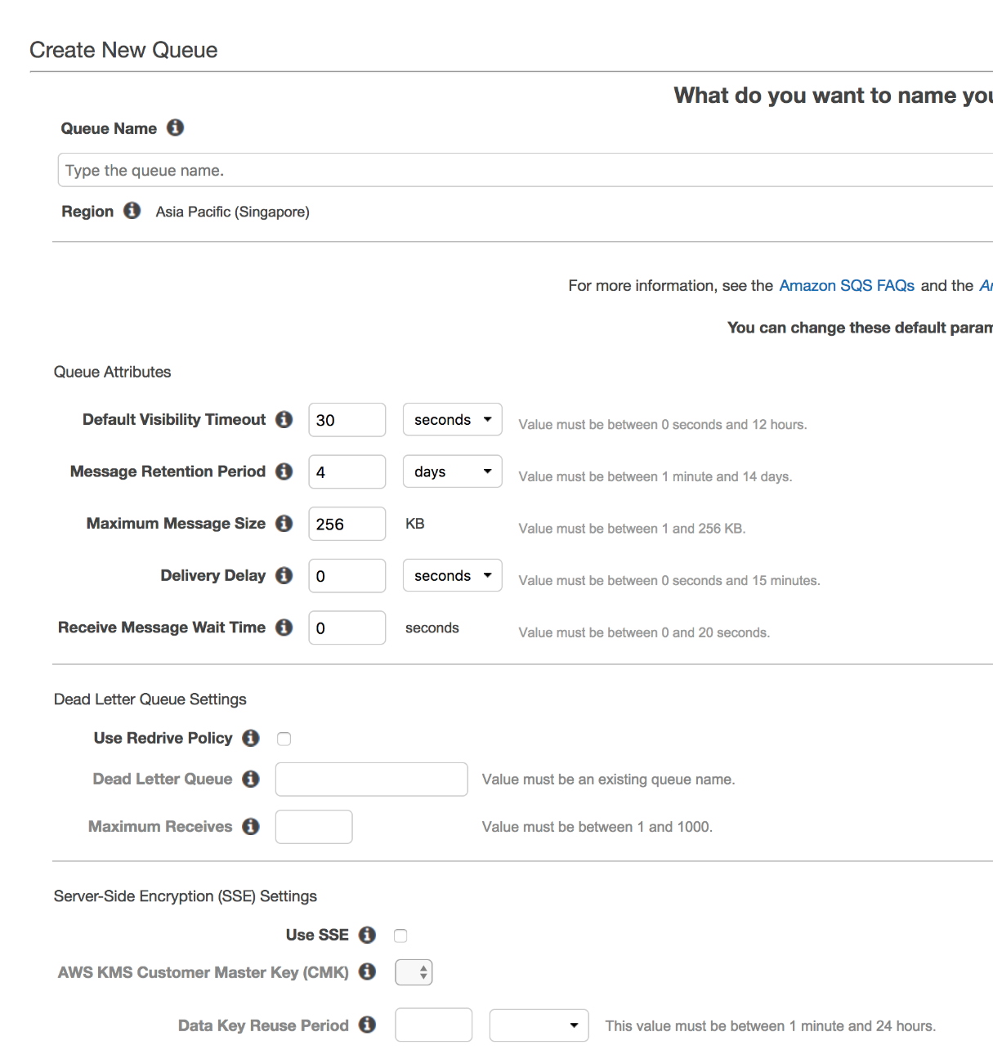
Using SQS
Create a queue in a region
Various settings can be set
Messages can be sent with attributes and a message body
Messages then read and deleted explicitly from the queue

Slide 28
Send a message boto3
import boto3
sqs = boto3.client('sqs', region_name='ap-southeast-1’)
queue_url = 'https://sqs.ap-southeast-1.amazonaws.com/032418238795/CITS5503Queue'
# Send message to SQS queue
response = sqs.send_message(QueueUrl=queue_url, DelaySeconds=10, MessageAttributes={
'Title': {'DataType': 'String', 'StringValue': 'The Whistler'},
'Author': {'DataType': 'String','StringValue': 'John Grisham'},
'WeeksOn': {'DataType': 'Number','StringValue': '6'
}},
MessageBody=(
'Information about current NY Times fiction bestseller for week of 12/11/2016.' )
)
print(response['MessageId'])

Slide 29
Read a message boto3
import boto3
sqs = boto3.client('sqs', region_name='ap-southeast-1’)
queue_url = 'https://sqs.ap-southeast-1.amazonaws.com/032418238795/CITS5503Queue'
# Receive message from SQS queue
response = sqs.receive_message(QueueUrl=queue_url,
AttributeNames=['SentTimestamp’], MaxNumberOfMessages=1, MessageAttributeNames=['All'],
VisibilityTimeout=0, WaitTimeSeconds=0)
message = response['Messages'][0]
receipt_handle = message['ReceiptHandle']
sqs.delete_message(QueueUrl=queue_url, ReceiptHandle=receipt_handle)
print('Received and deleted message: %s' % message)

Slide 30
Celery
Celery is a Pythonesque wrapper for message queues that maps queues to tasks in Python (a bit like AWS Lambda)
Maps a message from a queue to a method using the decorator @app.task
Will call the task on receipt of a message using Celery worker servers

