Slide 1

Human resources slide 1
GOVERNMENT
COLLEGE OF ENGINEERING
DEPARTMENT OF COMPUTER SCIENCE AND ENGINEERING
VIKRAM
THE GHOST
MINI PROJECT PRESENTATION

Slide 2
Human resources slide 1
GOVERNMENT
COLLEGE OF ENGINEERING
DEPARTMENT OF COMPUTER SCIENCE AND ENGINEERING
PROJECT GUIDE
Mrs. P. SUGAVANESWARI, M.E.
PROJECT TEAM
S ANBUMANI - 613519104004
S THIYANESWARAN - 613519104045
K VINO - 613519104048

Slide 3
Human resources slide 2
AGENDA
OBJECTIVES
SYSTEM DESIGN
MODULES
SCREENSHOTS
REFERENCES

Slide 4



Human resources slide 3
To develope an offline and a hard mode game which will be much difficult to play.
Player is to survive and stay alive.
Single player mode with Increasing difficulty on levels to make game much interesting.
To Study on AI
OBJECTIVES

Slide 5
Human resources slide 4
SYSTEM DESIGN
HARDWARE REQUIREMENTS
1) SYSTEM REQUIREMENTS
Hard disk : 100 MB or Above
RAM : 2GB or Above
SOFTWARE REQUIREMENTS
Operating System : Windows
Software : Python
Programming Language : Python

Slide 6
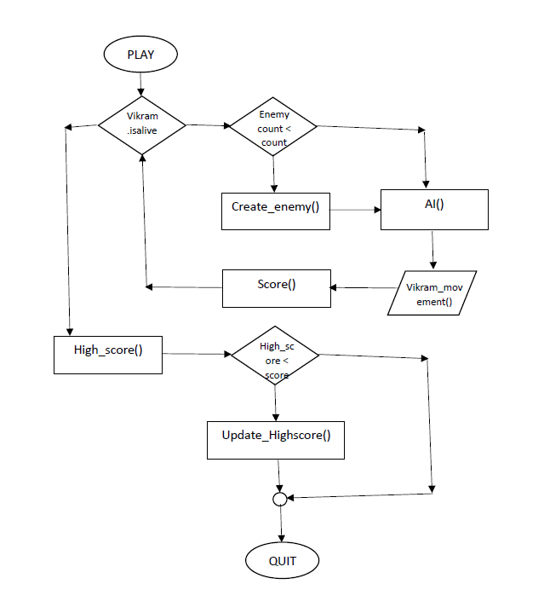
Human resources slide 4
SYSTEM DESIGN
2) FLOW CHART DIAGRAM

Slide 7
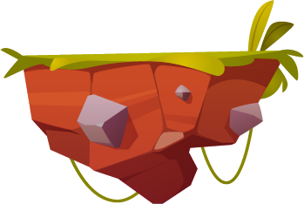

Human resources slide 4
SYSTEM DESIGN
i) Surface (Floating rock)
3) GRAPHICS
A) OBJECTS
ii) Health Heart

Slide 8
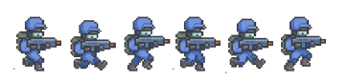
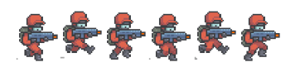
Human resources slide 4
SYSTEM DESIGN
i) Character Vikram - Run
3) GRAPHICS
B) CHARACTERS
ii) Character Enemy - Run

Slide 9
Human resources slide 5
IN – BUILD MODULES
Pygame
Open-source Python library that is utilized to create video games.
Random
Open-source Python library that is used to generate random numbers
MODULES
USER – DEFINED MODULES
Resource
Module created to implement the classes to the similar type of objects

Slide 10
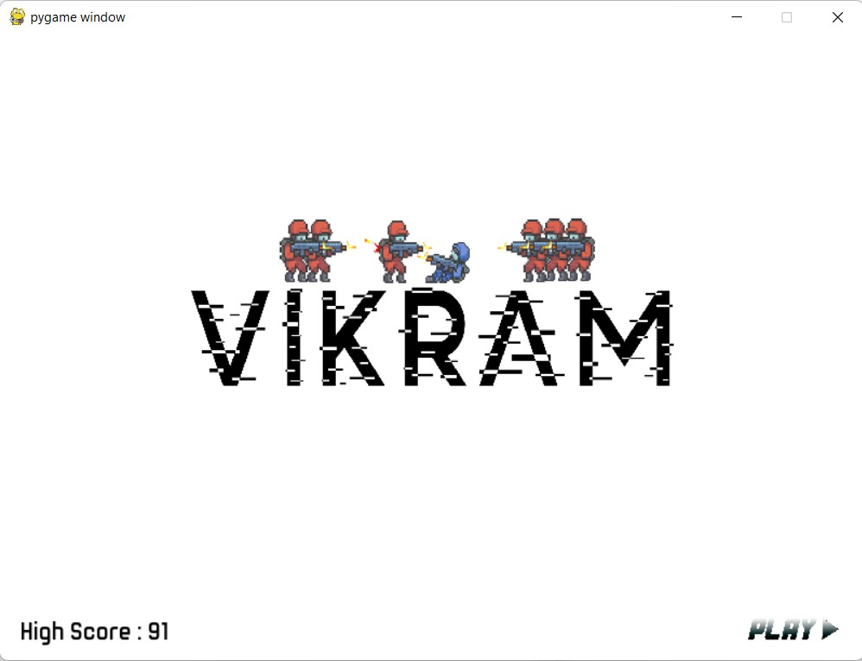
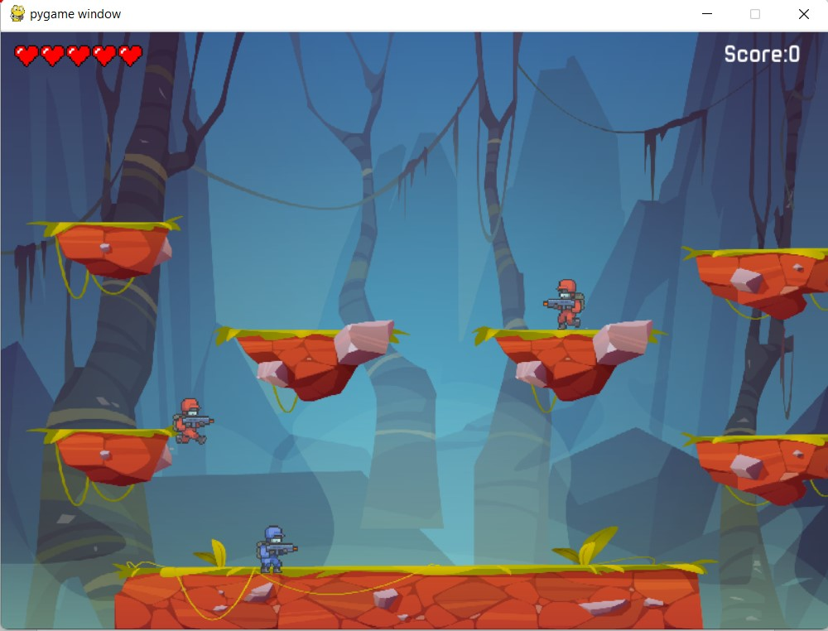
Human resources slide 6
SCREENSHOTS
Gameplay Screenshots of Project VIKRAM – THE GHOST Game
Mainmenu
Starting Game

Slide 11
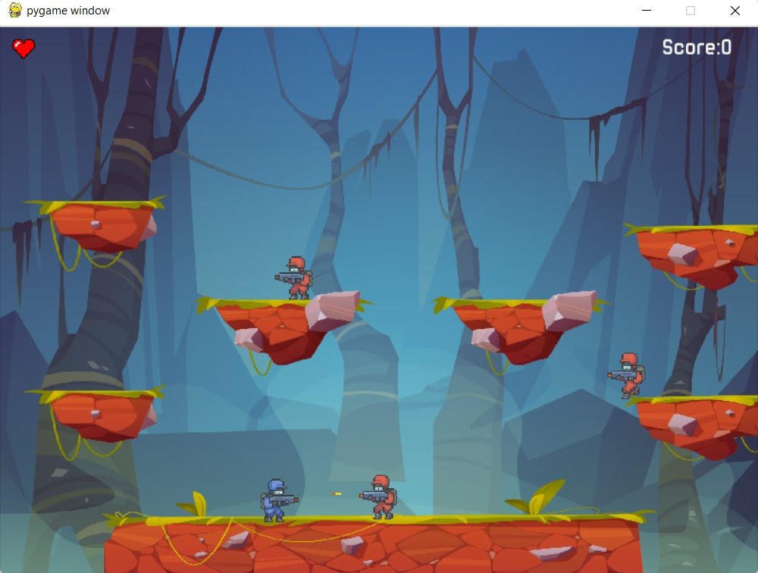
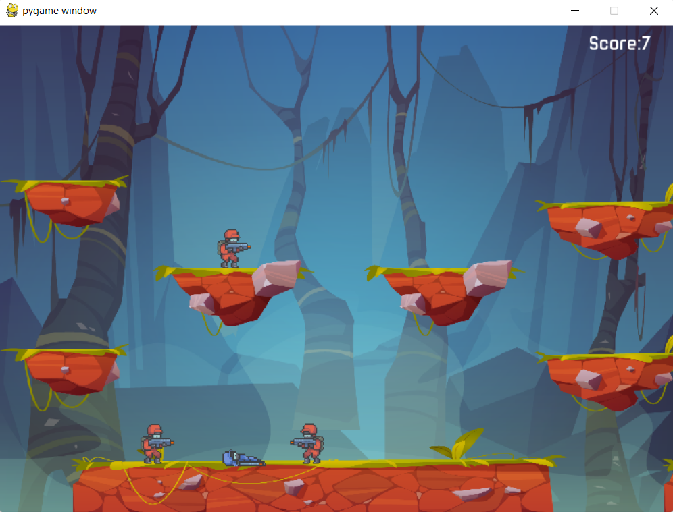
Human resources slide 6
SCREENSHOTS
Gameplay Screenshots of Project VIKRAM – THE GHOST Game
Shooting
Death of Vikram

Slide 12
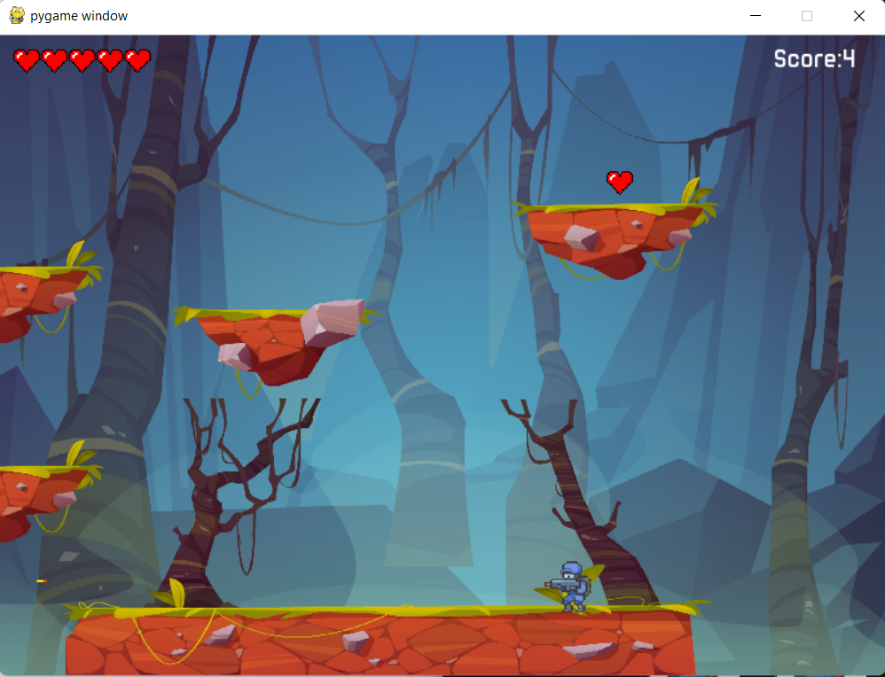
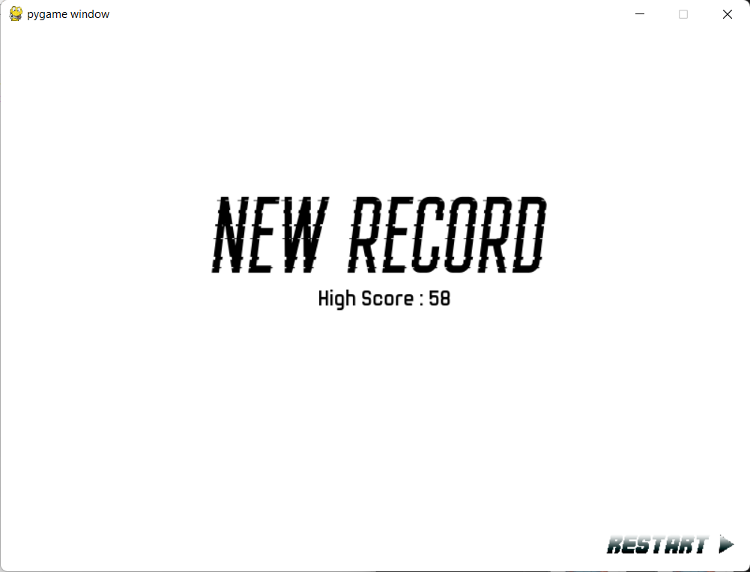
Human resources slide 6
SCREENSHOTS
Gameplay Screenshots of Project VIKRAM – THE GHOST Game
Extra Health
New Highscore Page

Slide 13

Human resources slide 8
REFERENCES
Background image and surface rock image. Available from: Free Vector | Game platform cartoon forest landscape, 2d design (freepik.com)
Vikram characters. Available from: https://secrethideout.itch.io/team-wars-platformer-battle
Enemy characters. Available from: https://secrethideout.itch.io/team-wars-platformer-battle
Pygame Documentation. Pygame Front Page — pygame v2.1.1 documentation
Python Documentation. 3.10.5 Documentation (python.org)
Real python. Python Tutorials – Real Python
Stack Overflow. Stack Overflow - Where Developers Learn, Share, & Build Careers

Slide 14
Human resources slide 10
Thank You

