Slide 1
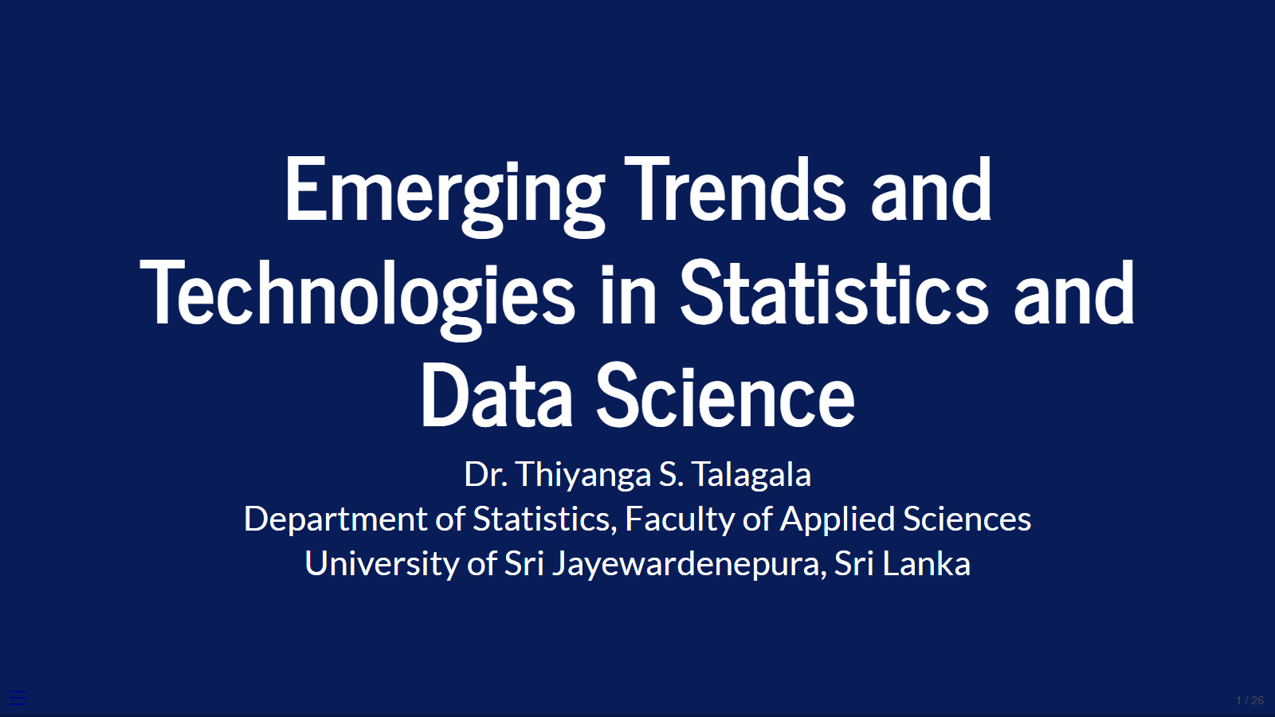
Must-know technologies and tools
XAI
YOLO
R, Python, Julia
Federated Learning

Slide 2
