Slide 2

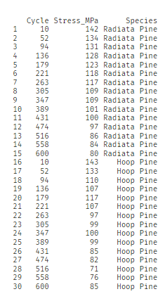

Population
Sample of trees

Slide 3
Population
Sample of trees
Descriptive Statistics: Summarizing and analyzing collected data.

Slide 4
Population
Sample of trees
Descriptive Statistics: Summarizing and analyzing collected data.
Inferential Statistics: Making inferences and predictions about a population based on sample data.

Slide 5
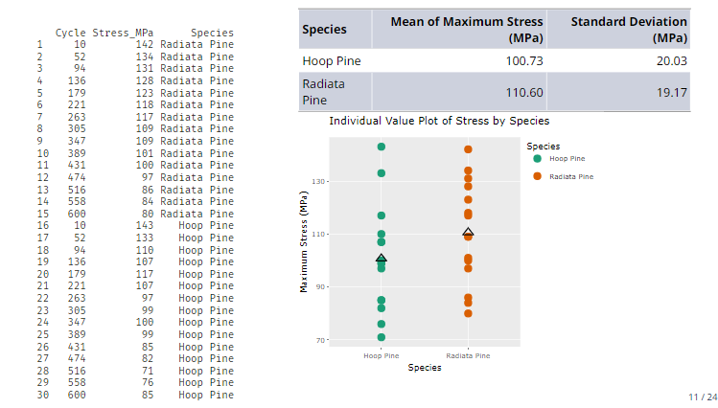
Population
µ - Population mean of maximum stress for Radiate pine
H0: µ ≤ 110.6
H1: µ > 100.6

Slide 6

Sample mean ($\overline{x}$)
Population
µ - Population mean of maximum stress for Radiate pine
H0: µ ≤ 110.6
H1: µ > 100.6

Slide 7
Sample mean ($\overline{x}$)
Population
µ - Population mean of maximum stress for Radiate pine
H0: µ ≤ 110.6
H1: µ > 100.6
Hypothesis testing
Statistical inference method that uses data from a sample to draw conclusions about a population parameters/ population distributions.
To which hypothesis does the data provide support?

