Slide 2
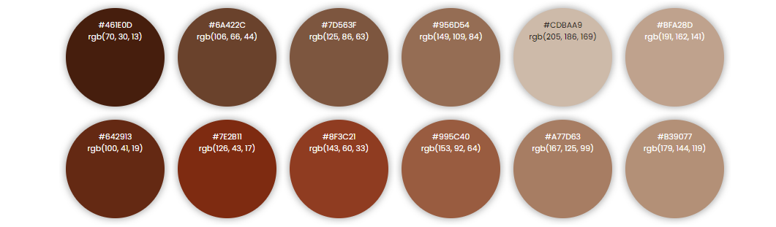
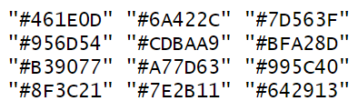
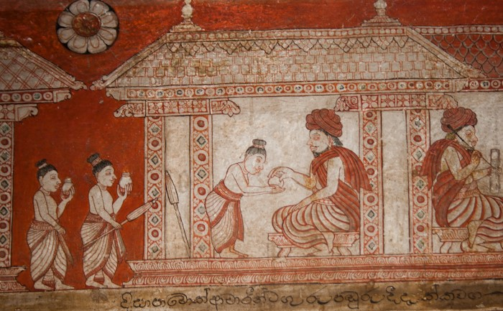
Exploring the Evolution of Color Palettes in Ancient Wall Paintings Across Different Kingdoms Using Machine Learning
Thiyanga S. Talagala, Department of Statistics, Faculty of Applied Science, University of Sri Jayewardenepura, Sri Lanka
Independent Variables: Hexadecimal Colour Values of the Image
Image Database
Supervised Machine Learning Algorithms
Predict the period of kingdom
Hexadecimal colour values of the example image
Apply machine learning explainability method to see what is happening inside the black-box model
Example image
Dependent Variable:
Period of the Kingdom
Period of the example image: Kandy Era Frescos

