Slide 1
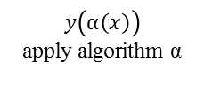

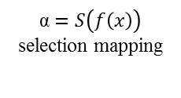



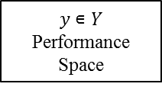
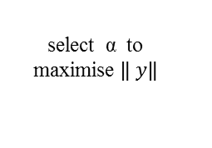
$$x∊P$$
Problem Space
$y$ $∊Y$
Performance Space
feature extraction $f$
select α to maximise $\left\| \left.y\right\|\right.$
$$y\left(α\left(x\right)\right)$$
apply algorithm α
$$f(x)∊F$$
Feature Space
α $∊A$
Algorithm Space
α $=S\left(f\left(x\right)\right)$
selection mapping

