Slide 2
reference set
training period
input - features
observed sample
population
fit models
train a classification algorithm
simulated time series
test period
identify “best” model
output - labels
label
random forest classifier
new time series
feature calculation
forecasting method

Slide 3
reference set
training period
input - features
observed sample
population
fit models
train a classification algorithm
simulated time series
test period
identify “best” model
output - labels
label
random forest classifier
new time series
input -features
forecasting method

Slide 4
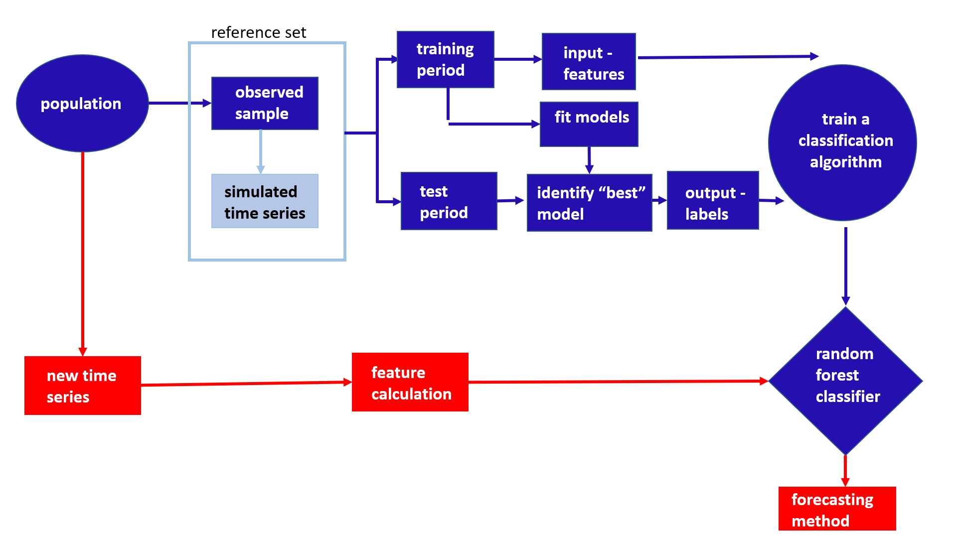
2-d visualization
using PCA
OOB sample
vote matrix
OOB predictions
machine learning interpretability tools
- feature importance
- partial dependence plots

