Slide 1
reference set
training set
input - features
observed sample
population
fit models
train a classification algorithm
simulated time series
identify “best” model
output - labels
test set
label
random forest classifier
new time series
feature calculation
forecasting method

Slide 2
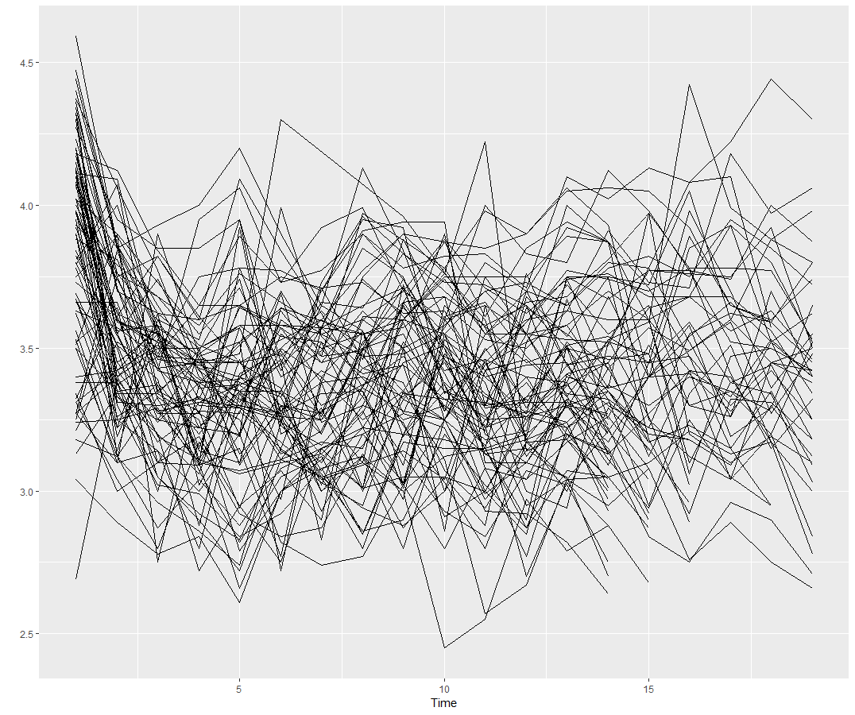
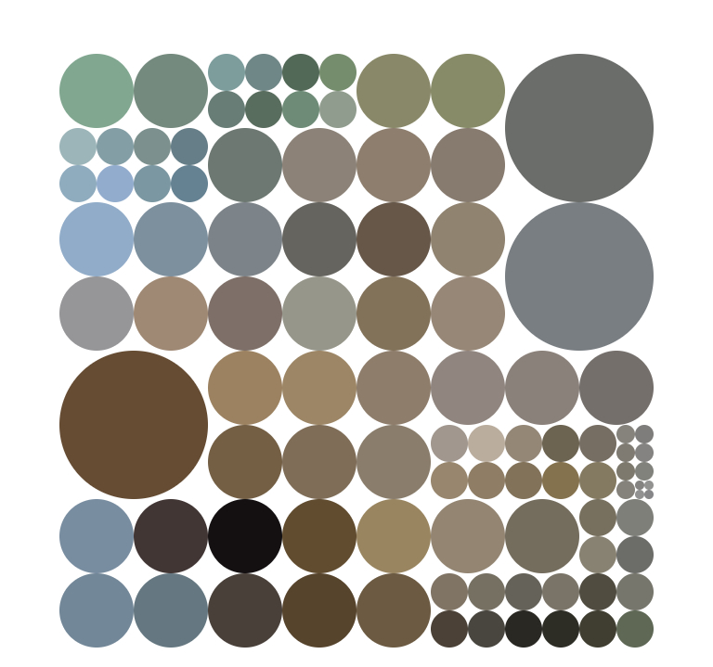
Problem space: Large collection of time series
Algorithm space

Slide 3
Problem space: Large collection of time series
Algorithm space

Slide 4
training set
input - features
observed sample
population
sample
fit models
train a
meta-learner
test set
id | arima | ets | nn | …
1 | 1.23 | 1.01 | 2.51
2 | 0.06 | 3.51 | 4.51
3 | 0.80 | 0.14 | 0.50
… | …. | …. | … | …
Algorithm performance space
new time series
feature calculation
meta-learner
forecasting method

Slide 5
training set
input - features
observed sample
population
sample
fit models
train a
meta-learner
test set
id | arima | ets | nn | …
1 | 1.23 | 1.01 | 2.51
2 | 0.06 | 3.51 | 4.51
3 | 0.80 | 0.14 | 0.50
… | …. | …. | … | …
Algorithm performance space
new time series
feature calculation
meta-learner

Slide 6
training set
input - features
observed sample
population
sample
fit models
train a
meta-learner
test set
id | arima | ets | nn | …
1 | 1.23 | 1.01 | 2.51
2 | 0.06 | 3.51 | 4.51
3 | 0.80 | 0.14 | 0.50
… | …. | …. | … | …
Algorithm performance space
new time series
feature calculation
meta-learner

Slide 7
training set
input - features
observed sample
population
sample
fit models
train a
meta-learner
test set
id | arima | ets | nn | …
1 | 1.23 | 1.01 | 2.51
2 | 0.06 | 3.51 | 4.51
3 | 0.80 | 0.14 | 0.50
… | …. | …. | … | …
Algorithm performance space
new time series
feature calculation
meta-learner

Slide 8
training set
input - features
observed sample
population
sample
fit models
train a
meta-learner
test set
id | arima | ets | nn | …
1 | 1.23 | 1.01 | 2.51
2 | 0.06 | 3.51 | 4.51
3 | 0.80 | 0.14 | 0.50
… | …. | …. | … | …
Algorithm performance space
new time series
feature calculation
meta-learner

Slide 9
training set
input - features
observed sample
population
sample
fit models
train a
meta-learner
test set
id | arima | ets | nn | …
1 | 1.23 | 1.01 | 2.51
2 | 0.06 | 3.51 | 4.51
3 | 0.80 | 0.14 | 0.50
… | …. | …. | … | …
Algorithm performance space
new time series
feature calculation

Slide 10
training set
input - features
observed sample
population
sample
fit models
train a
meta-learner
test set
id | arima | ets | nn | …
1 | 1.23 | 1.01 | 2.51
2 | 0.06 | 3.51 | 4.51
3 | 0.80 | 0.14 | 0.50
… | …. | …. | … | …
Algorithm performance space
new time series
feature calculation

Slide 11
training set
input - features
observed sample
population
sample
fit models
train a
meta-learner
test set
id | arima | ets | nn | …
1 | 1.23 | 1.01 | 2.51
2 | 0.06 | 3.51 | 4.51
3 | 0.80 | 0.14 | 0.50
… | …. | …. | … | …
Algorithm performance space
new time series
feature calculation

Slide 12
training set
input - features
observed sample
population
sample
fit models
train a
meta-learner
test set
new time series
feature calculation

Slide 13
training set
input - features
observed sample
population
sample
train a
meta-learner
test set
new time series
feature calculation

Slide 14
training set
observed sample
population
sample
train a
meta-learner
test set
new time series
feature calculation

Slide 15
observed sample
population
sample
train a
meta-learner
test set
new time series
feature calculation

Slide 16
observed sample
population
train a
meta-learner
test set
new time series
feature calculation

Slide 17
training set
input - features
observed sample
population
sample
fit models
train a
meta-learner
test set
id | arima | ets | nn | …
1 | 1.23 | 1.01 | 2.51
2 | 0.06 | 3.51 | 4.51
3 | 0.80 | 0.14 | 0.50
… | …. | …. | … | …
Algorithm performance space
new time series
feature calculation
Meta-learner
forecasting method

Slide 18
training set
input - features
observed sample
population
sample
fit models
train a
meta-learner
test set
id | arima | ets | nn | …
1 | 1.23 | 1.01 | 2.51
2 | 0.06 | 3.51 | 4.51
3 | 0.80 | 0.14 | 0.50
… | …. | …. | … | …
Algorithm performance space
new time series
feature calculation
Meta-learner
forecasting method

Slide 19
reference set
training set
input - features
observed sample
population
sample
fit models
train a
meta-learner
simulated time series
test set
id | arima | ets | nn | …
1 | 1.23 | 1.01 | 2.51
2 | 0.06 | 3.51 | 4.51
3 | 0.80 | 0.14 | 0.50
… | …. | …. | … | …
Algorithm performance space
new time series
feature calculation
Meta-learner
forecasting method

Slide 20
reference set
training set
input - features
observed sample
population
sample
fit models
train a classification algorithm
test set
identify “best” model
simulated time series
random forest classifier
new time series
feature calculation
forecasting method

Slide 21
training set
input - features
observed sample
population
sample
fit models
train a
meta-learner
test set
id | arima | ets | nn | …
1 | 1.23 | 1.01 | 2.51
2 | 0.06 | 3.51 | 4.51
3 | 0.80 | 0.14 | 0.50
… | …. | …. | … | …
Algorithm performance space
new time series
feature calculation
Meta-learner
forecasting method

Slide 22
reference set
training set
input - features
population
sample
fit models
train a classification algorithm
simulated time series
identify “best” model
output - labels
test set
label
random forest classifier
new time series
feature calculation
forecasting method

Slide 23
reference set
training set
input - features
observed sample
population
fit models
XGboost
Algorithm
simulated time series
test set
output vector- forecast error
label
Fitted
XGboost model
new time series
feature calculation
Weights for forecast combination

Slide 24
reference set
training set
input - features
observed sample
population
Bayesian Surface Regression
fit models
simulated time series
test set
output vector- forecast error
label
new time series
feature calculation
Fitted
model
Forecast error

Slide 25
reference set
training set
input vector - features
observed sample
population
Fit a Bayesian Multivariate Surface Regression
(BMSR)
fit models
simulated time series
output vector –
forecast error of each model
test set
Fitted BMSR model
new time series
feature calculation
forecast errors of each forecast-model

Slide 26
reference set
training set
input vector - features
observed sample
population
Fit a Bayesian Multivariate Surface Regression
(BMSR)
fit models
simulated time series
output vector –
forecast error of each model
test set
Fitted BMSR model
new time series
feature calculation
forecast errors of each forecast-model

Slide 27
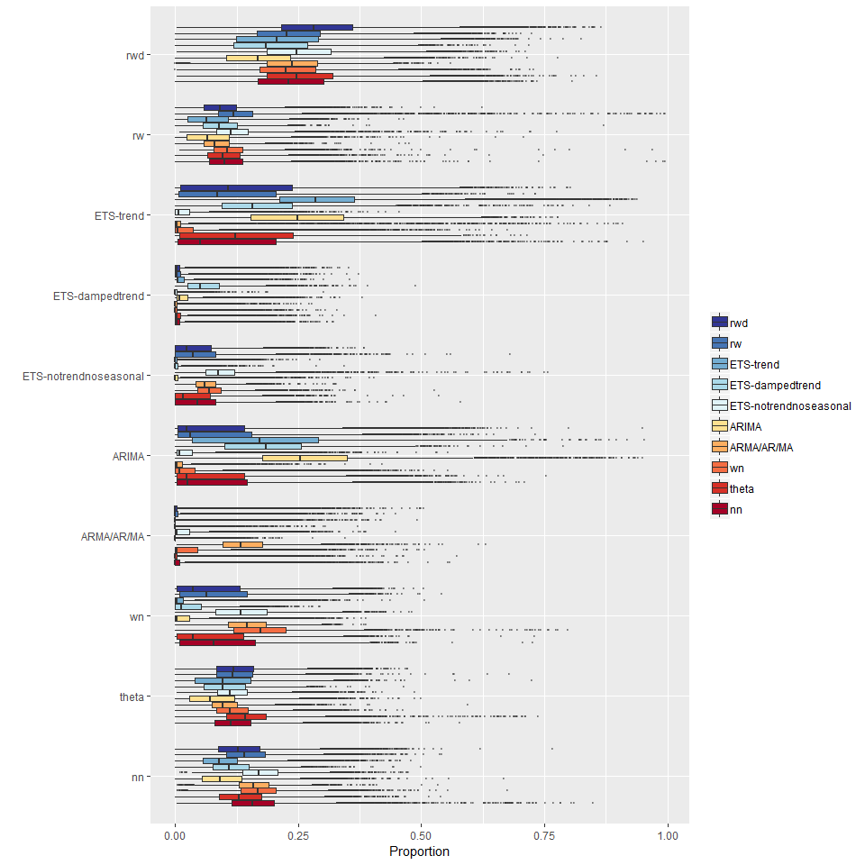
rwd
rw
ETS-trend
ETS-damped trend
ETS-no trend no seasonal
ARIMA
ARMA/AR/MA
wn
theta
nn

